Slide 1
Capsule Net
wu

Slide 2
Papers about Capsule net
Transforming Auto-encoders (ICANN 2011)
Dynamic Routing Between Capsules (NIPS 2017)
MATRIX CAPSULES WITH EM ROUTING (ICLR 2018, under review)

Slide 3
Transforming Auto-encoder
G. E. Hinton, ICANN 2011

Slide 4
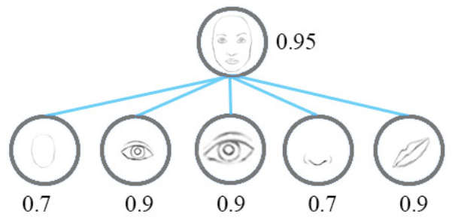
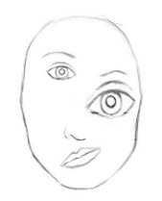
Introduction
This paper argues that convolutional neural networks are misguided in what they are trying to achieve.
“Neurons” just use a single scalar output to summarize the activities of a local pool of replicated feature detectors

Slide 5
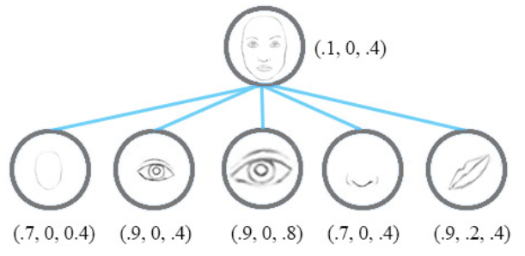
Introduction
Artificial neural networks should use local “capsules” that perform some quite complicated internal computations on their inputs and then encapsulate the results of these computations into a small vector of highly informative outputs (pose, likelihood).

Slide 6
Introduction
Routing on agreements (But no specific implementation in this paper)
Learning the First Level of Capsules: the “capsules” that implement the lowest-level parts in the hierarchy need to extract explicit pose parameters from pixel intensities. (This paper addressed this question)

Slide 7
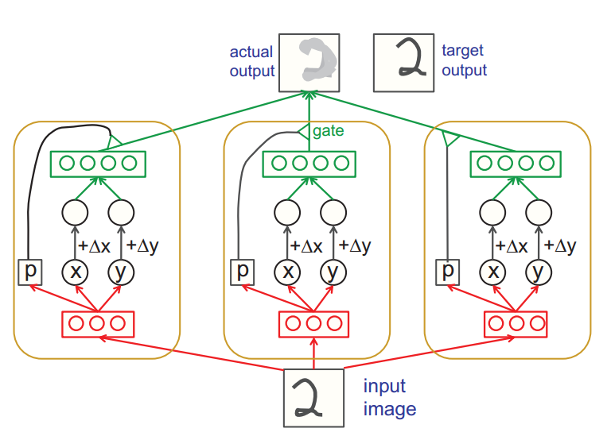
Model
Inputs:
input image,
∆x ,
∆y
Output:
a shifted image

Slide 8
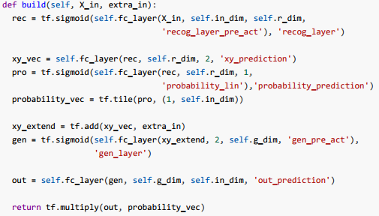
Model

Slide 9
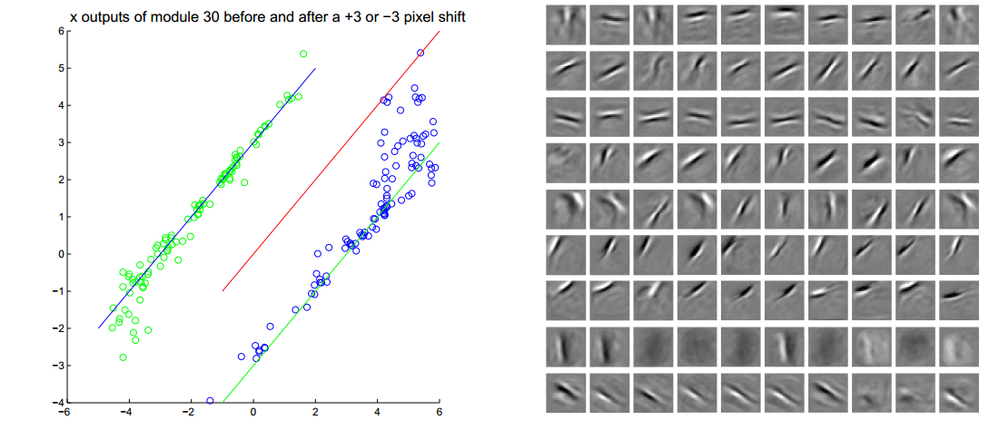
Experiments

Slide 10
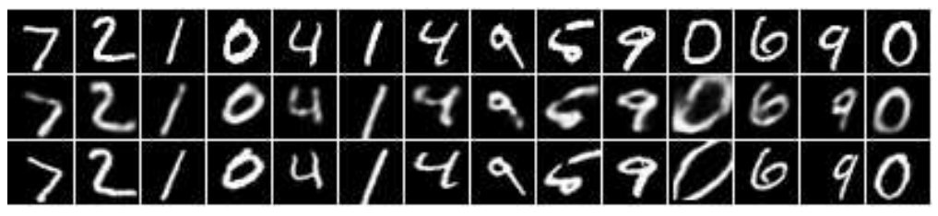
Experiments
The top row shows input images; the middle row shows output images and the bottom row shows the correctly transformed output images.

Slide 11
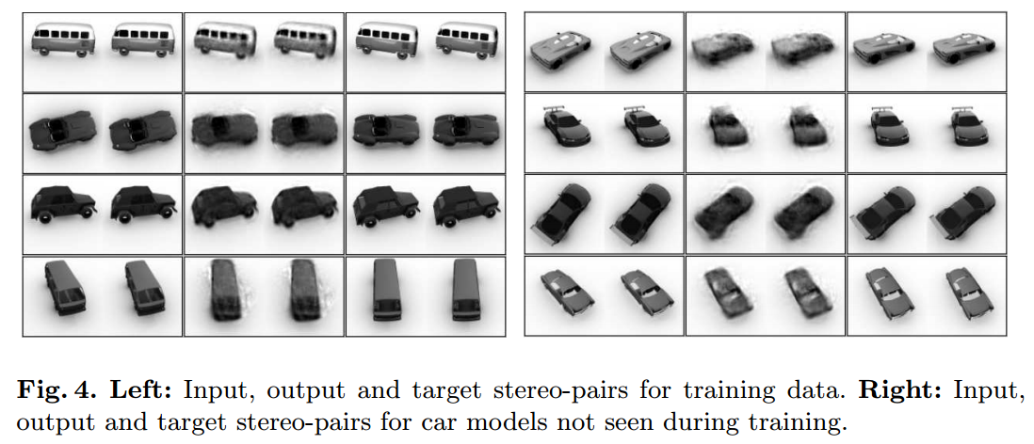
Experiments

Slide 12
Work to do
Specific routing algorithm
New initialization method of the first capsule method

Slide 13
Dynamic Routing Between Capsules
Sara Sabour, Nicholas Frosst, Geoffrey E. Hinton. NIPS 2017

Slide 14
Introduction
This paper give a implementation of a multilayer capsule network that does image classification task.
Give a specific routing algorithm: dynamic routing mechanism.
This type of “routing-by-agreement” should be far more effective than the very primitive form of routing implemented by max-pooling which allows neurons in one layer to ignore all but the most active feature detector in a local pool in the layer below.
Notes:
This type of “routing-by-agreement” should be far more effective than the very primitive form of routing implemented by max-pooling which allows neurons in one layer to ignore all but the most active feature detector in a local pool in the layer below.

Slide 15
Introduction
Instead of using common full connection layer to initialize the first level capsules, it use CNN to do this work.
Convolutional neural networks (CNNs) use translated replicas of learned feature detectors and this allows them to translate knowledge about good weight values acquired at one position in an image to other positions. This has proven extremely helpful in image interpretation.

Slide 16
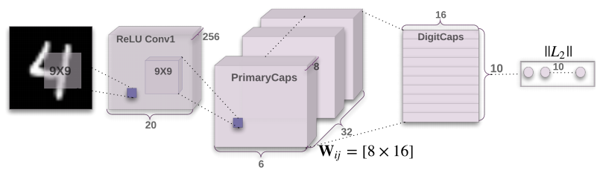
Model

Slide 17

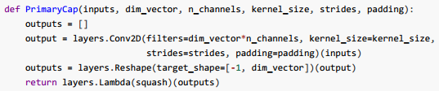
Model: Primary Capsules Layer
One can see it as a Convolutional layer with a non-linear function

Slide 18
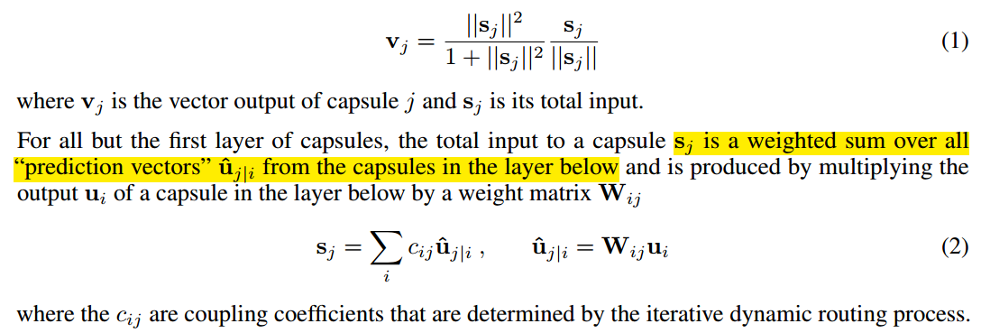

Model: Digit Capsule Layer
Between Primary Layer and this Digit Layer, the author uses the routing algorithm.

Slide 19
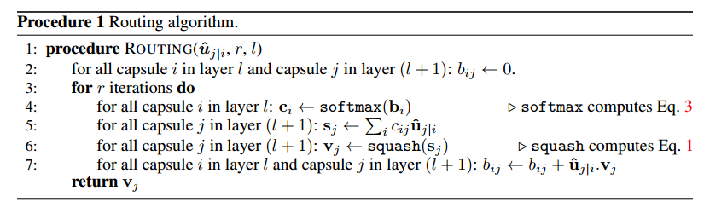
Model: Digit Capsule Layer
Routing algorithm.

Slide 20
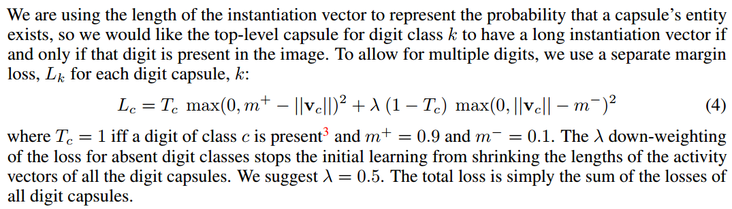
Model: Margin loss

Slide 21
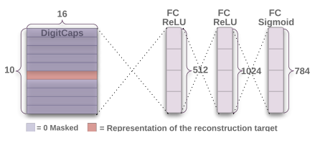
Model: Reconstruction as a regularization method

Slide 22
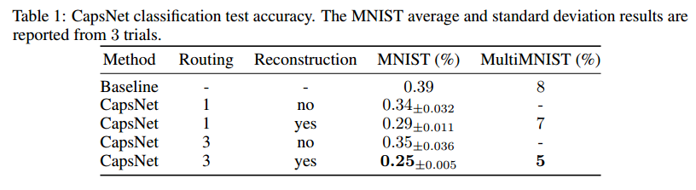
Experiments
Error rate on MNIST

Slide 23
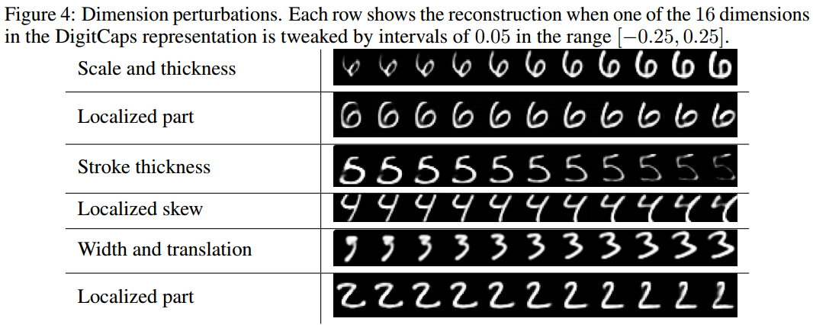
Experiments
What the individual dimensions of a capsule represent

Slide 24
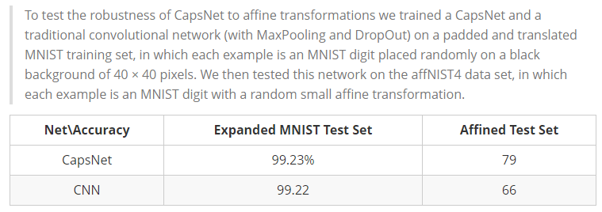
Experiments
Robustness to Affine Transformations

Slide 25
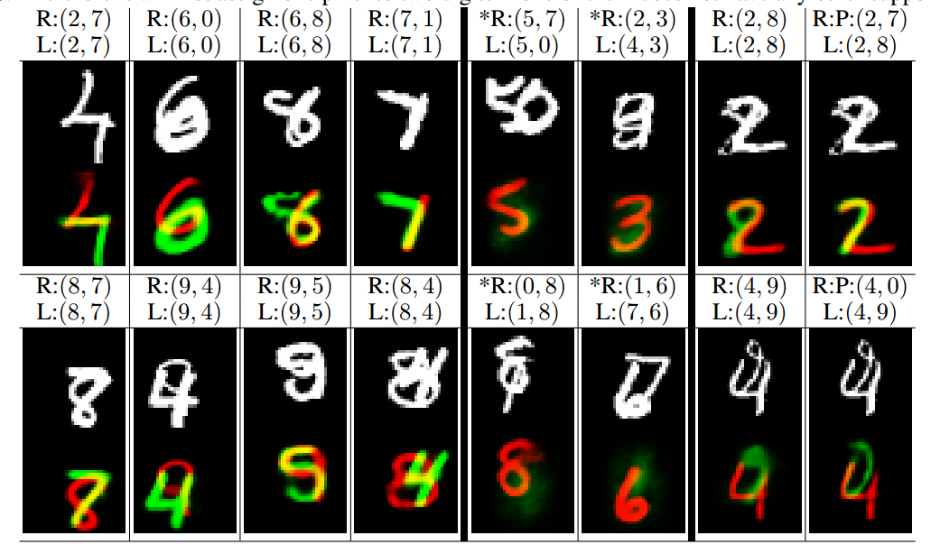
Experiments
Segmenting highly overlapping digits

Slide 26
MATRIX CAPSULES WITH EM ROUTING
ICLR2018, under review

Slide 27
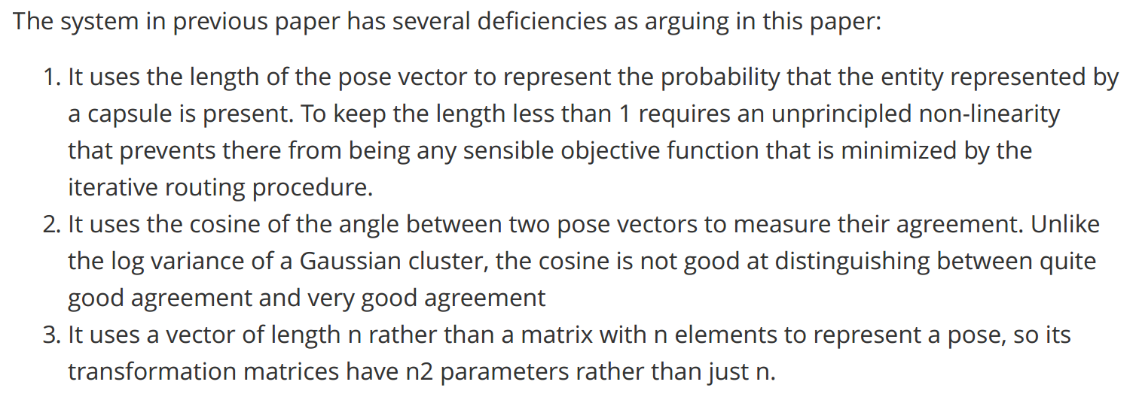
Introduction

Slide 28
Gaussian mixture

Slide 29
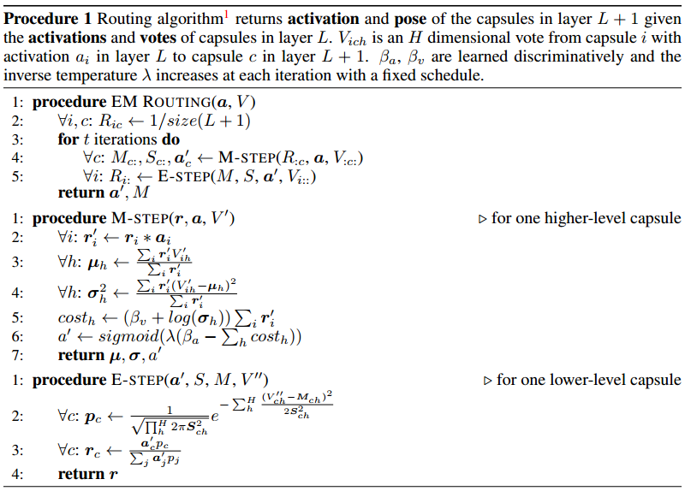
EM Routing

Slide 30
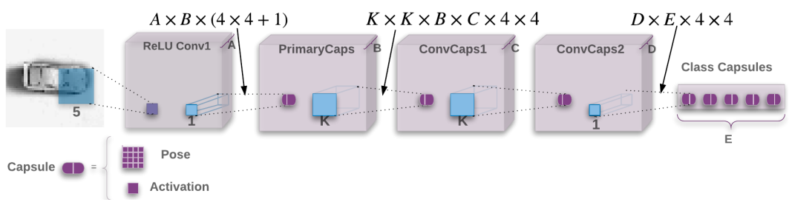
Model

Slide 31
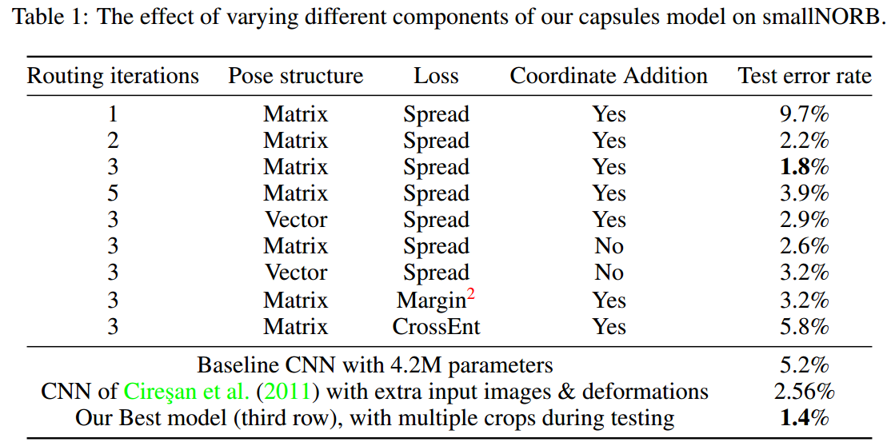
Experiments

Slide 32
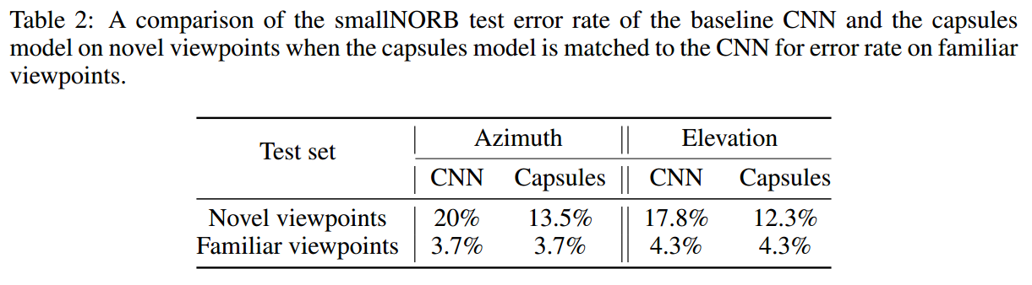
Experiments

Slide 33
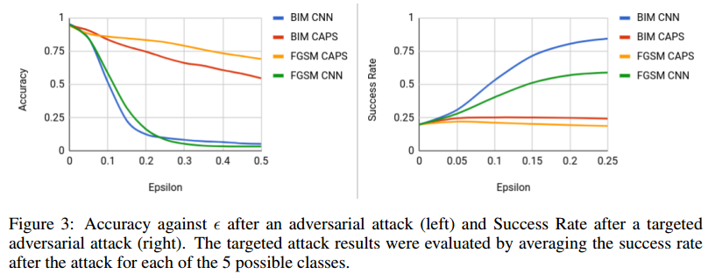
Experiments

Slide 34
Conclusions

Slide 35
What’s Capsule
A capsule is a group of neurons that not only capture the likelihood but also the parameters of the specific feature.
A capsule performs some quite complicated internal computations on their inputs and then encapsulate the results of these computations into a small vector of highly informative outputs
When a capsule is working properly, the probability of the visual entity being present is locally invariant

Slide 36
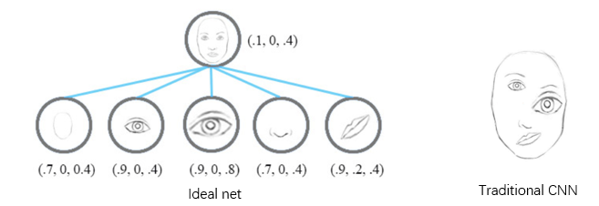
How to route between capsules
Routing on agreements
Problem: how to formulate the agreements

Slide 37
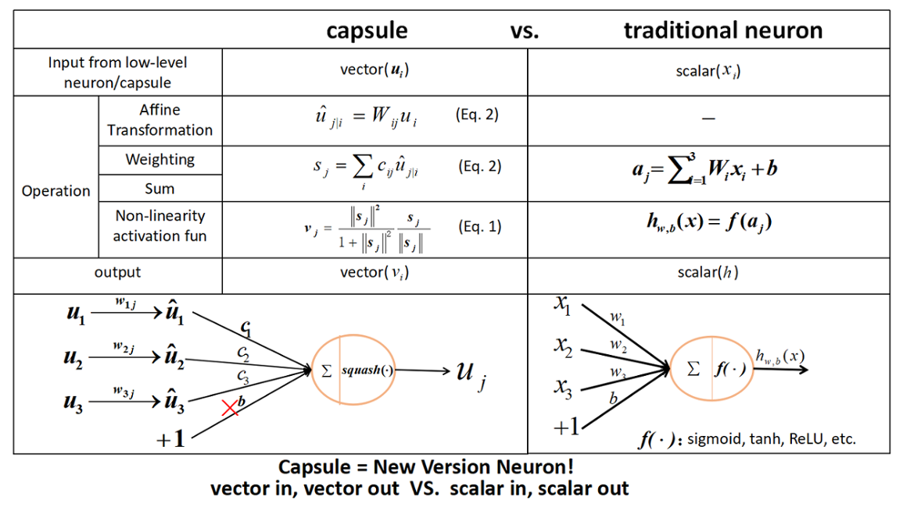
Capsule vs Neuron

