Slide 1
VBPR: Visual Bayesian Personalized Ranking from Implicit Feedback
AAAI’16

Slide 2
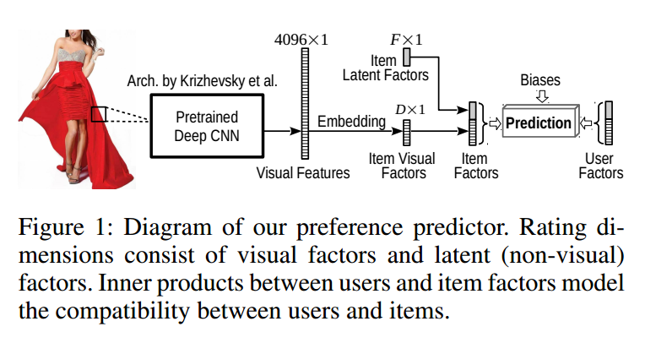
Structure of VBPR

Slide 3
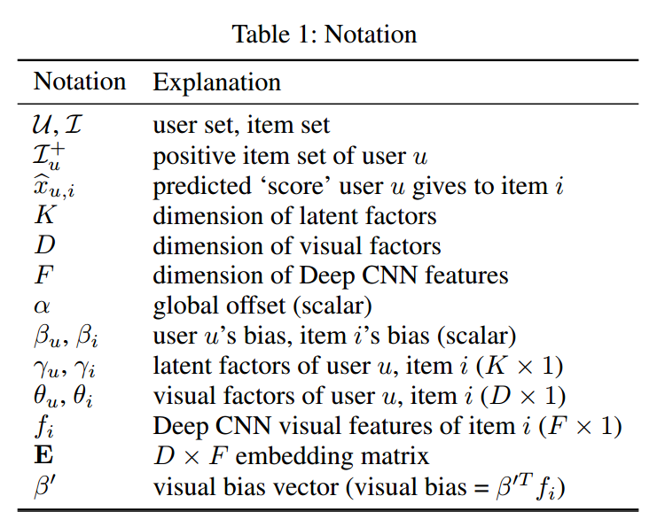

Formulation

Slide 4
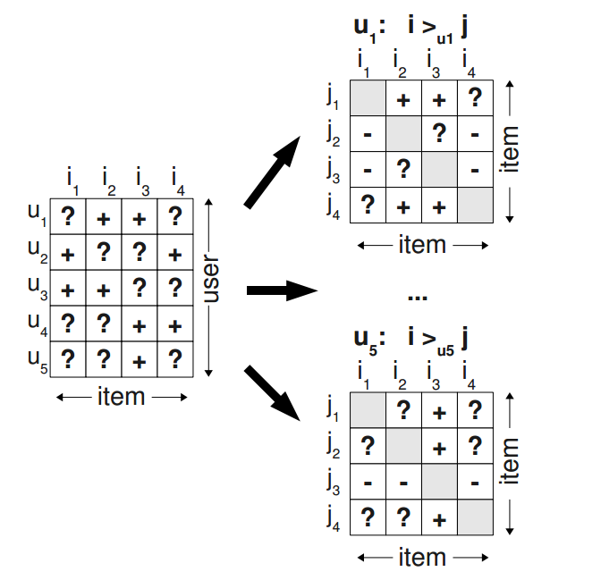
BPR
1. Change dataset:

Slide 5
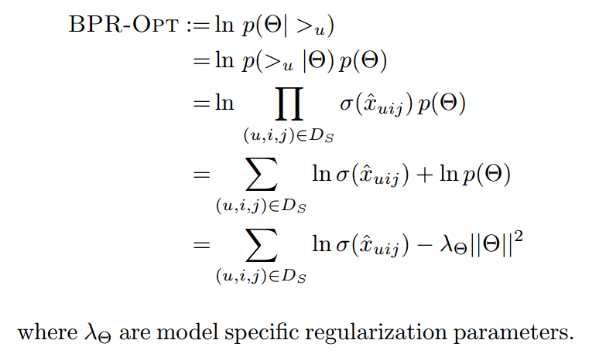
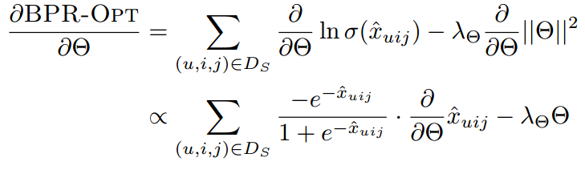

BPR
Notes:
BPR优化目标

Slide 6
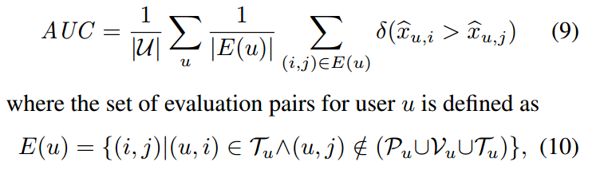
Experiments
Evaluation Methodology

Slide 7
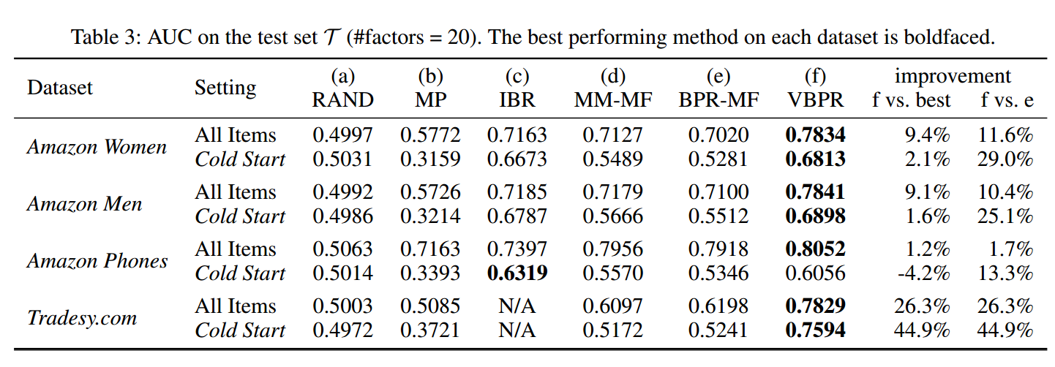
Results

Slide 8
A Hybrid Collaborative Filtering Model with Deep Structure for Recommender Systems
AAAI’17

Slide 9
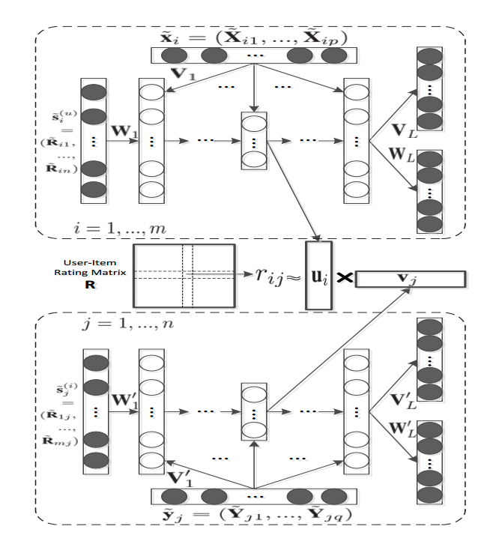
Structure

Slide 10
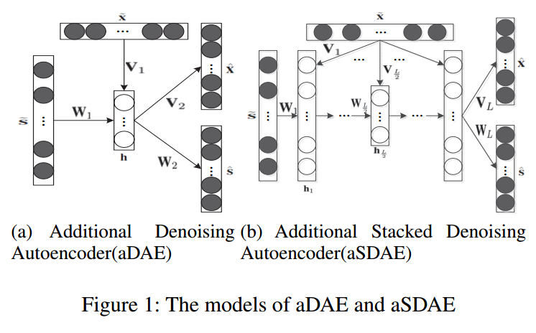
aDAE and aSDAE

Slide 11
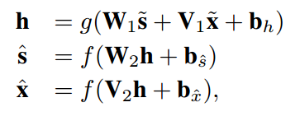
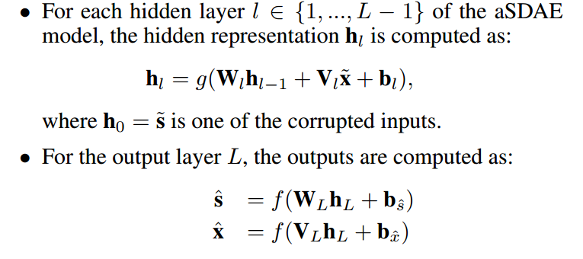
aDAE and aSDAE
aDAE
aSADE

Slide 12


User features

Slide 13
Item features
Notes:
1. the item side information contains the item’s title, release data and 18 categories of movie genre are encoded into a binary valued vector of length 1822

Slide 14
Structure

Slide 15
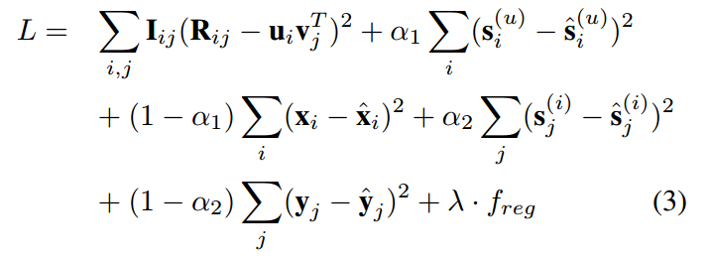
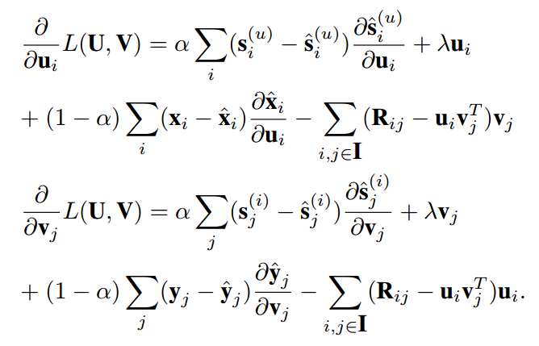
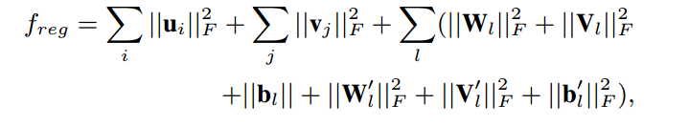
Optimization
Loss function:
Gradient:
Notes:
优点： 利用PMF来解释正则化项，解释了正则化项是一种先验，基于我们已有的知识对要学习的映射的结构进行一定限制。但是PMF的之时选用了非常宽泛的高斯先验，针对于基于评分推荐这一具体应用场景，其信息含量就少了许多。
BPMF在初始化User的向量的时候，使用了评分的评分的信息，使其信息更丰富。
本文的一大优点就是使用auto encoder的方法再利用了评分的信息。
缺点：利用神经网络训练出来的特征向量和U,V隐藏因子的集合没说清楚。
下面介绍两种结合方式。

Slide 16
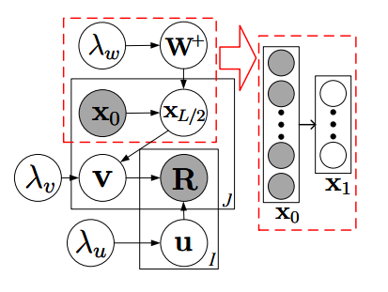
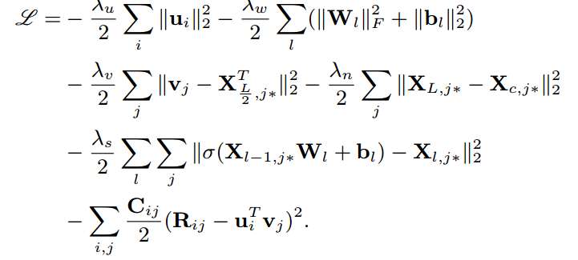

CDL
Loss Function:
Notes:
cdl

Slide 17
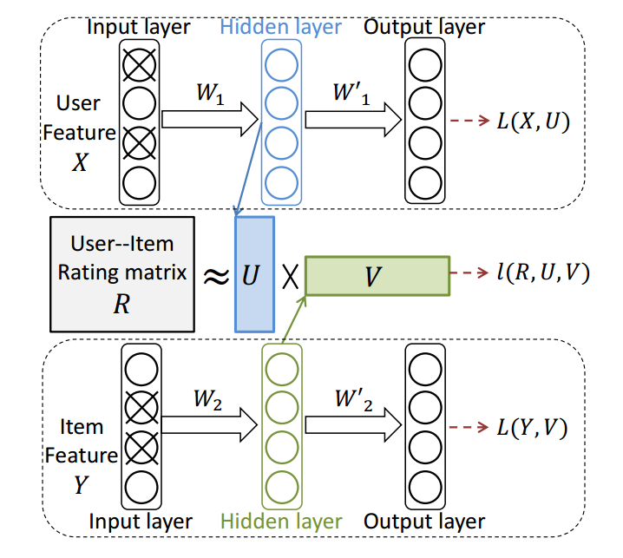
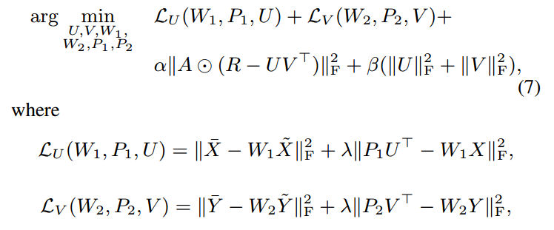
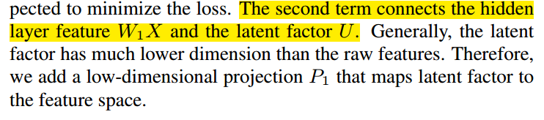
DCF
Notes:
dcf

Slide 18
Experiments
Movielen Datasets: binarize explicit data by keeping the ratings of four or higher and interpret them as implicit feedback
Book-Crossing: binarize explicit data by keeping the ratings of six or higher and interpret them as implicit feedback

Slide 19
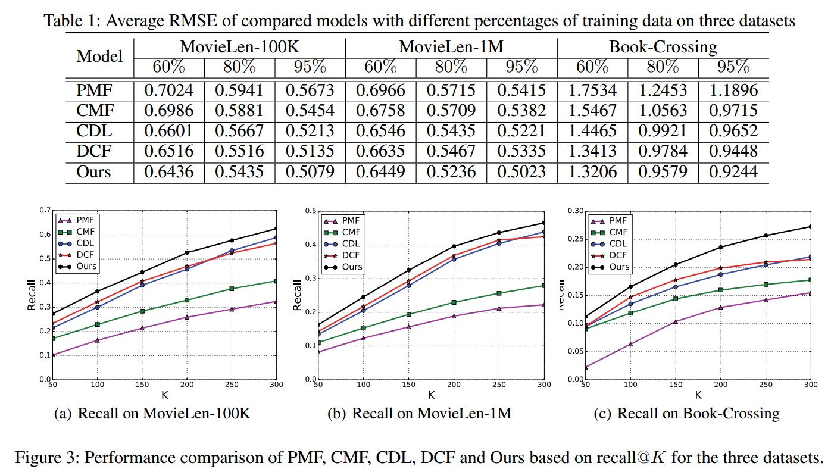
Results

