Slide 1
ICML18 Papers about GAN Theory
Wu, 2018/09/25

Slide 2
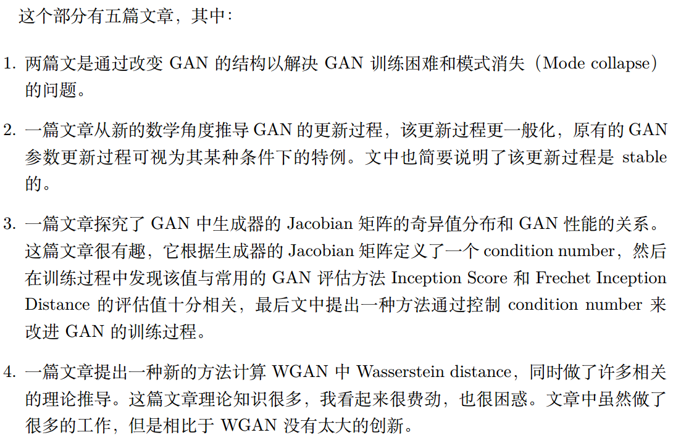
Introduction

Slide 3
Today’s topics
Wasserstein distance
The way to compute Wasserstein distance in WGAN
A two step way to compute exact Wasserstein distance
Jacobian Matrix
Is Generator Conditioning Causally Related to GAN Performance?
Two architecture variations of GAN
Tempered adversarial network
Improve training of GAN using representative features

Slide 4
Wasserstein Distance
Wasserstein Distance is a measure of the distance between two probability distributions.
Informally, Wasserstein distance can be interpreted as moving piles of dirt that follow one probability distribution at a minimum cost to follow the other distribution. So it’s also called Earth Mover’s Distance(EMD)
Today, we will use only basic linear algebra and probability theory to give a brief explanation.

Slide 5


Wasserstein distance example
In order to change $P$ to be same as $Q$，we:
First move 2 shovelfuls from $P_{1}$ to $P_{2}.$
The move 2 shovelfuls from $P_{2}$ to $P_{3}$.
Finally move 1 shovelfuls from $P_{4}$ to $P_{3}.$
So, EMD = 2 + 2 + 1 = 5

Slide 6
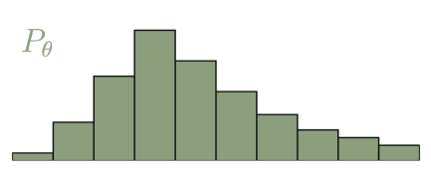
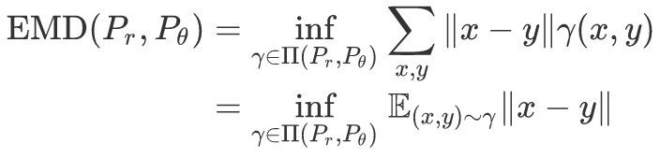
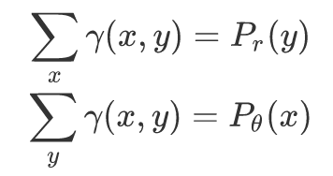
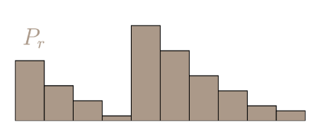
Wasserstein distance
And,

Slide 7
Wasserstein distance example
1 | 2 | 0 | 0
0 | 2 | 2 | 0
0 | 0 | 1 | 0
0 | 0 | 1 | 3
1.
Optimal plan:
2.
EMD can be calculated using Linear programming.

Slide 8




From GAN to WGAN
GAN:
WGAN:

Slide 9
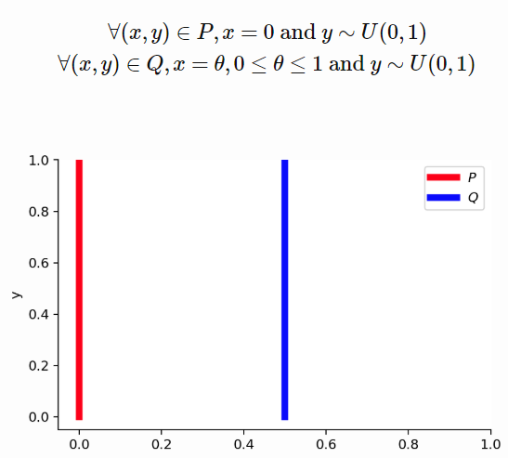
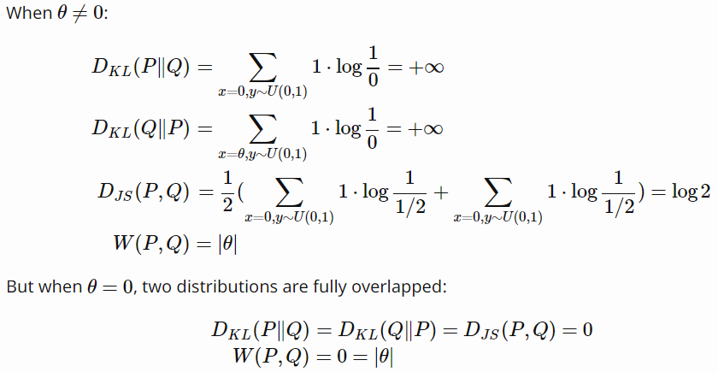
Example: Wasserstein distance is better.
Notes:
D_KL gives us ifinity when two distributions are disjoint. The value of D_JS has sudden jump, not differentiable at θ=0. Only Wasserstein metric provides a smooth measure, which is super helpful for a stable learning process using gradient descents.

Slide 10
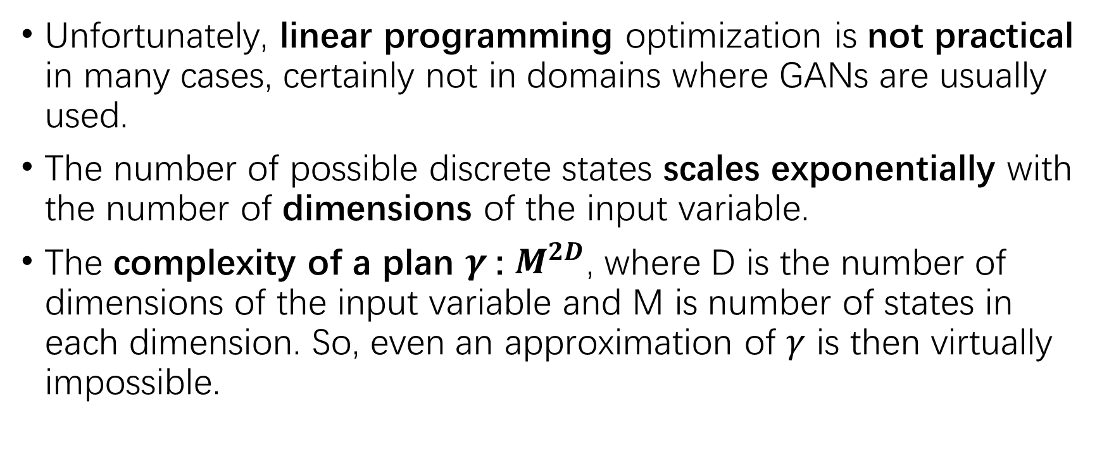
Dual Form of Wasserstein distance
Unfortunately, linear programming optimization is not practical in many cases, certainly not in domains where GANs are usually used.
The number of possible discrete states scales exponentially with the number of dimensions of the input variable.
The complexity of a plan $γ$: $M^{2D}$, where D is the number of dimensions of the input variable and M is number of states in each dimension. So, even an approximation of $γ$ is then virtually impossible.

Slide 11
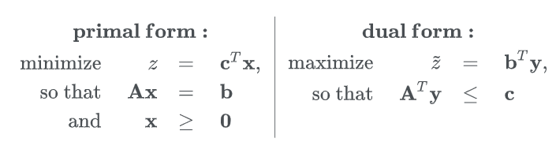

Dual Form of Wasserstein distance
Weak Duality theorem:
Notes:
This what we know. And when z^~ is maximized, it’s equal to z.

Slide 12

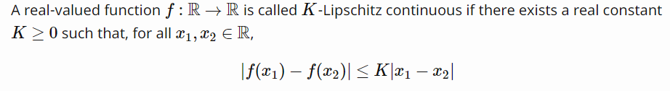
Dual Form of Wasserstein distance
Kantorovich-Rubinstein duality:
Notes:
K-Lipschitz continuous. And explain function f comparing to discriminator

Slide 13
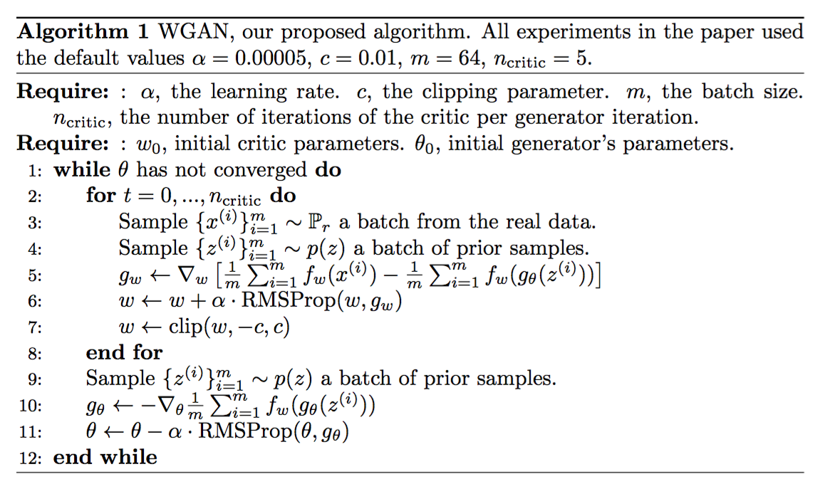
WGAN algorithm

Slide 14
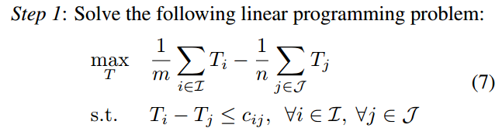
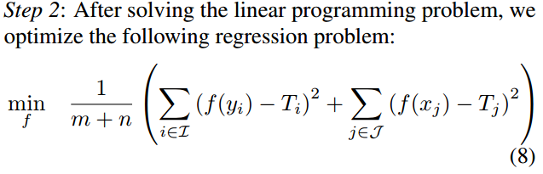
A two step way to compute exact EMD
Notes:
Explain c_ij

Slide 15
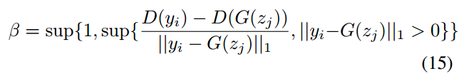

No hyper-parameter weight scaling

Slide 16
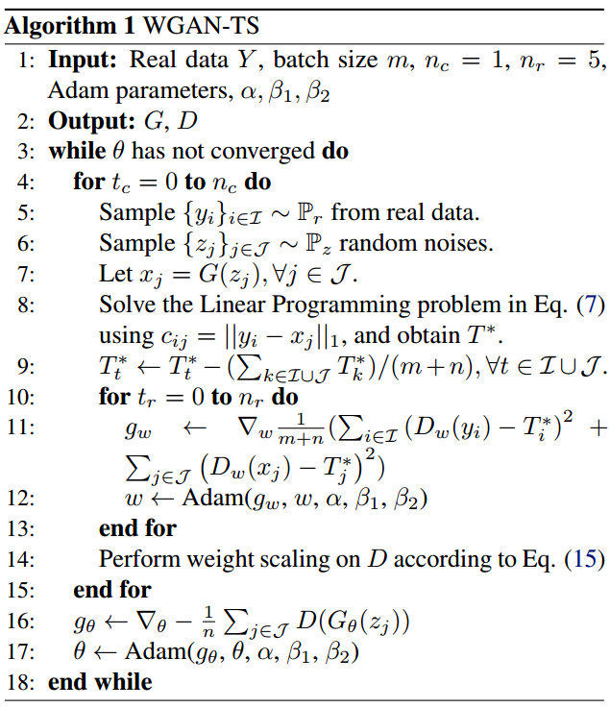
WGAN-TS algorithm
Notes:
Explain 8, c_ij, 9 减去均值。
10-13：DNN optimization

Slide 17
Does WGAN-TS make sense?
WGAN produces comparable images.
WGAN-TS compute more accurate Wasserstein distance.
WGAN-TS is more efficient.

Slide 18
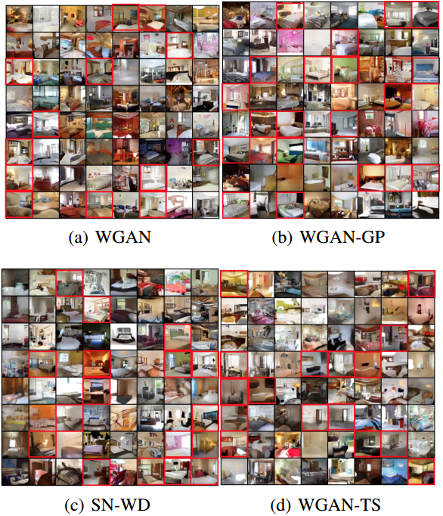
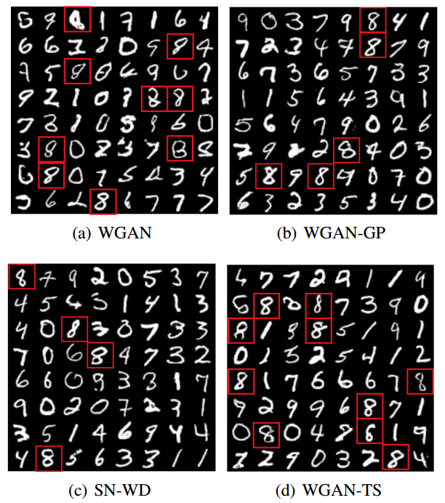
Comparable images

Slide 19
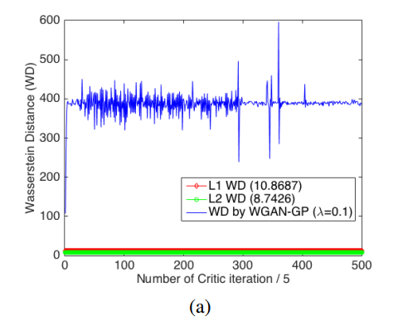
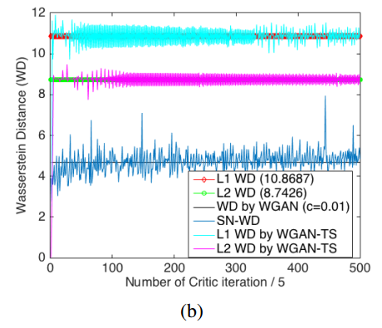
More accurate Wasserstein distance

Slide 20
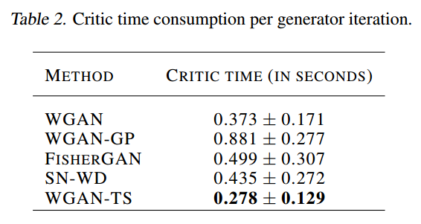
More efficient？

Slide 21

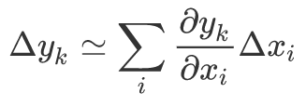
Jacobian Matrix
For a function y = f(x), the Jacobian matrix is defined as:
Jacobian matrix provides measure of the local sensitivity of the outputs to changes in each of the input variables(PRML cp5.3.4)
Jacobian matrix can be evaluated efficiently using backpropagation

Slide 22
Generator Conditioning
Recent work (Pennington et al., 2017) suggests that controlling the entire distribution of Jacobian singular values is an important design consideration in deep learning.
So, why not to study the distribution of singular values of the Jacobian of the generator in Generative Adversarial Networks (GANs).

Slide 23
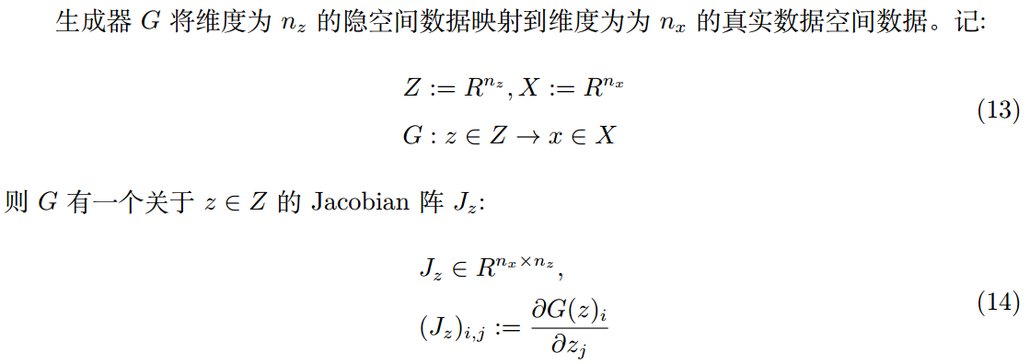
Jacobian matrix of Generator

Slide 24
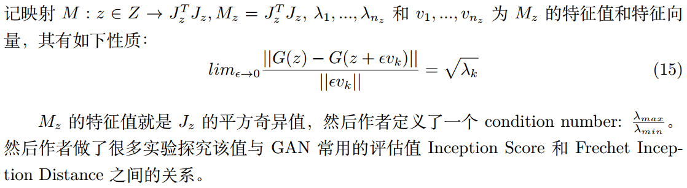
Condition number

Slide 25
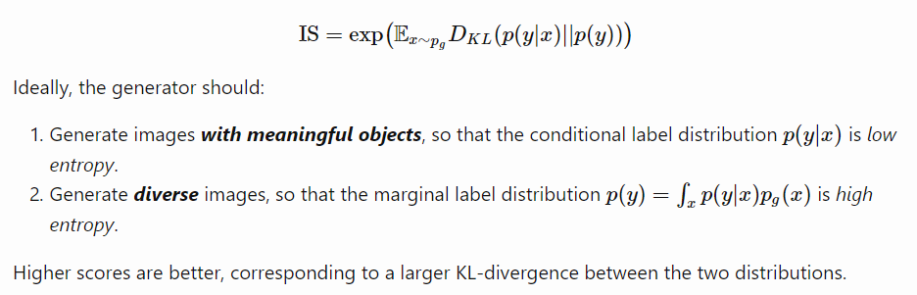
Inception score
Applying an Inception-v3 network pre-trained on ImageNet to generated samples and then comparing the conditional label distribution with the marginal label distribution

Slide 26
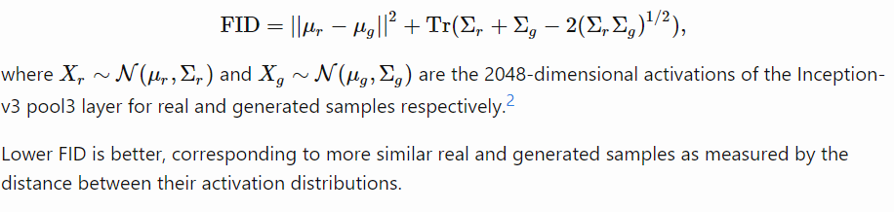
Fréchet Inception Distance
The FID is supposed to improve on the IS by actually comparing the statistics of generated samples to real samples
Notes:
Why not to use image directly , instead of using activations of Incepton-3

Slide 27
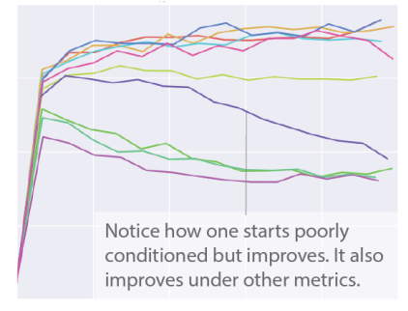
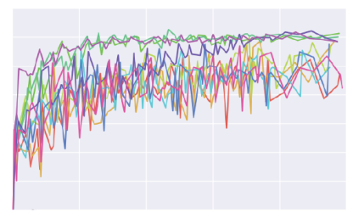
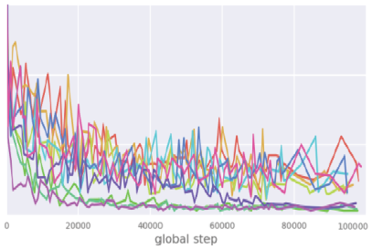
Experiments
Condition number
Inception score
FID

Slide 28
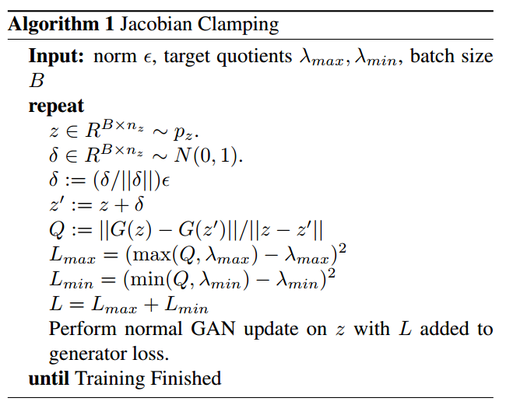
Jacobian Clamping

Slide 29
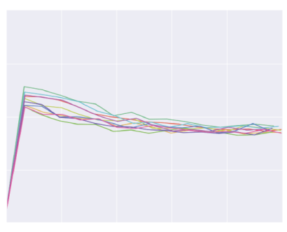
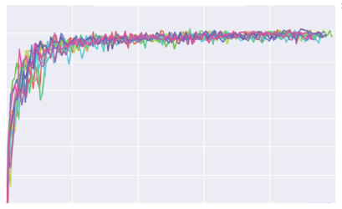
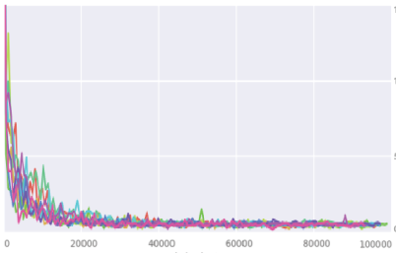
Experiments with Jacobian Clamping
Condition number
Inception score
FID

Slide 30
Other works
Tempered adversarial network
Improve training of GAN using representative features
A theory for generative adversarial methods that does not rely on the traditional minimax formulation.

Slide 31
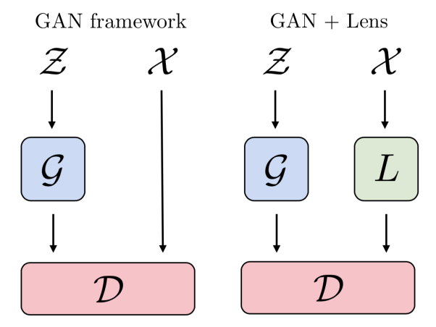



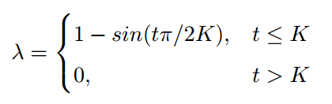
Tempered adversarial network

Slide 32
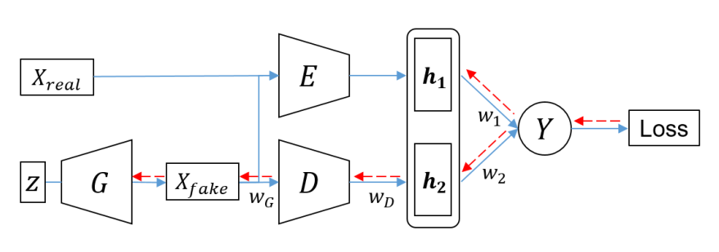
Improve training of GAN using representative features

Slide 33
Conclusion
Wasserstein distance
Concept and how to calculate
Advantages
Dual form and WGAN
WGAN-TS: well writing
Jacobian matrix
Concept and how to calculate
Generator conditioning and Jacobian Clamping: interesting
GAN Metrics
Inception Score
Fréchet Inception Distance
Two architecture variations of GAN

