Slide 1
Location Based Social Network
Wu

Slide 2
Concept
Social network: friends, groups.
Social structure can share location-embedded information
New social structure made up of individuals connected by the interdependency derived from their locations in the physical
Location-tagged media content, such as photos, video, and text.

Slide 3
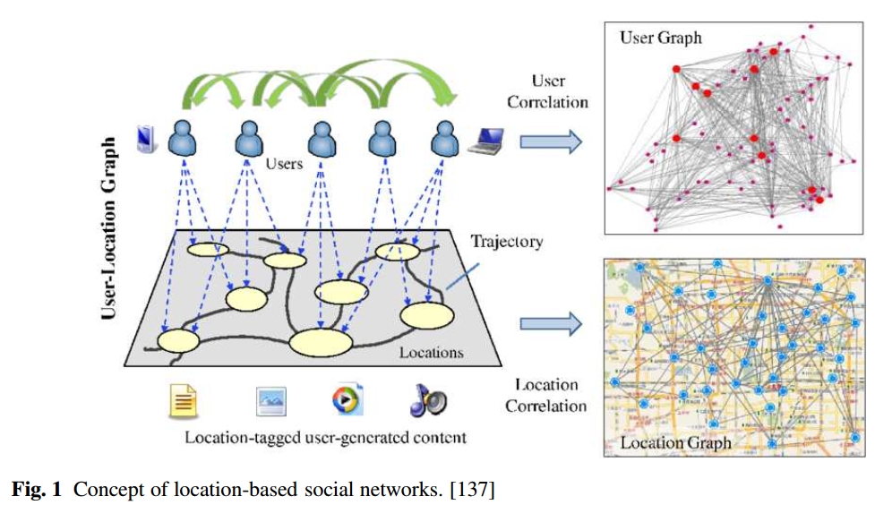
Concept

