Slide 1
Word2vec
Notes:
Popular in Natural Language Processing

Slide 2
Development
NNLM:
A Neural Probabilistic Language Model.2003
RNNLM:
Recurrent neural network based language model.2010
CBOW Model, Skip gram model:
Efficient Estimation of Word Representations in Vector Space.2013

Slide 3
Application
Linguistic Regularities in Continuous Space Word Representations.2013
Exploiting Similarities among Languages for Machine Translation.2013
Distributed Representations of Sentences and Documents.2014
Target-Dependent Twitter Sentiment Classification with Rich Automatic Features.2015

Slide 4
NNLM

Slide 5
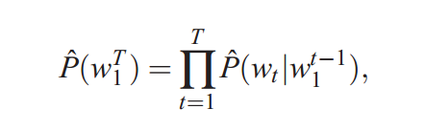
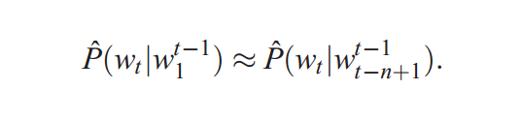
statistical language model:
N-gram model:
Notes:
Curse of Dimensionality

Slide 6
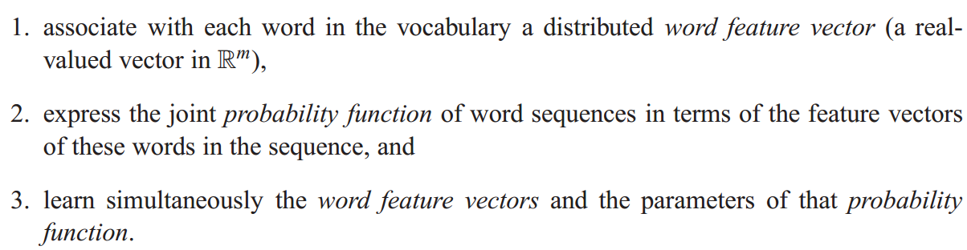
NNLM

Slide 7
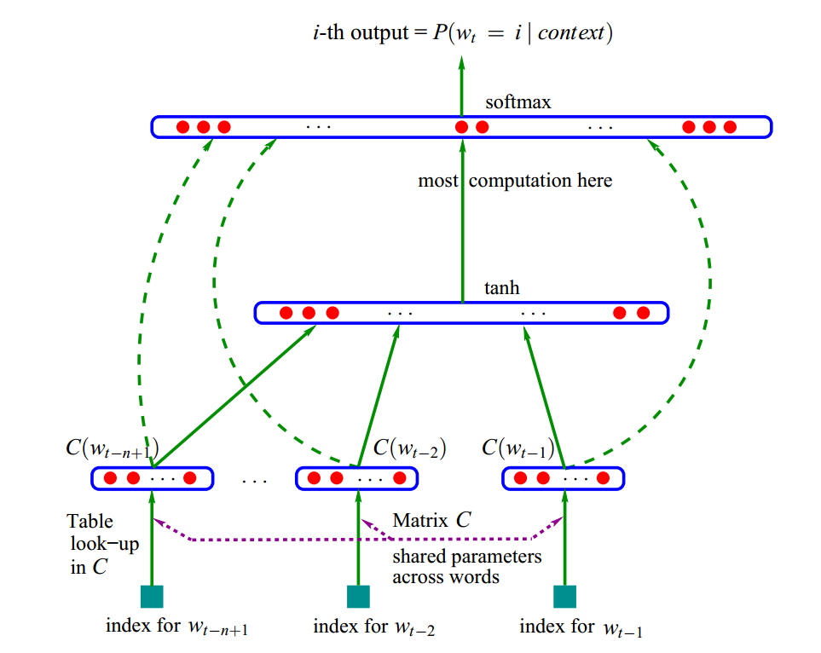


NNLM
U,b
W
H,d
x

Slide 8
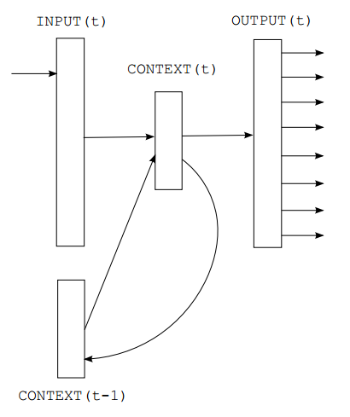
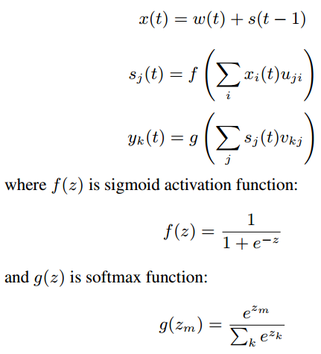
RNN:

Slide 9
CBOW Model Skip Gram Model

Slide 10
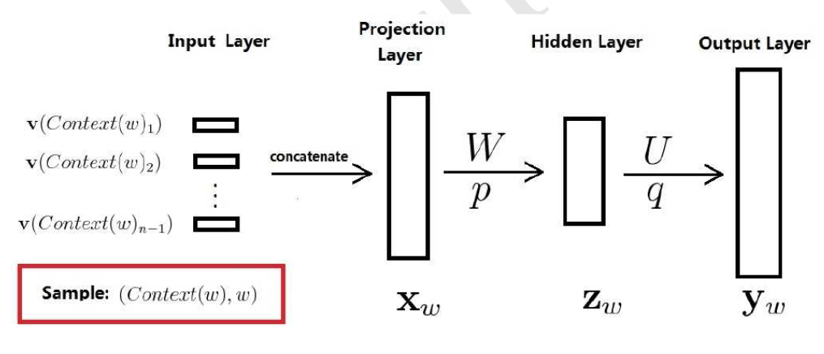
NNLM

Slide 11
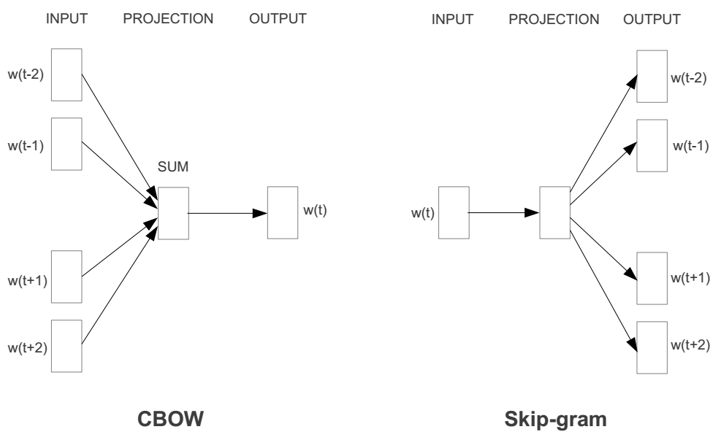

Slide 12
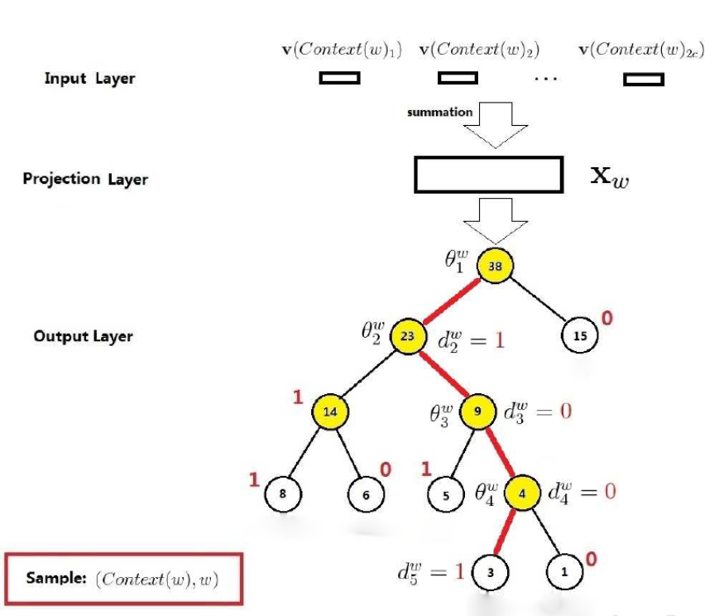
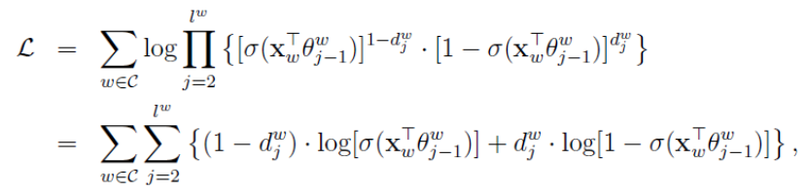
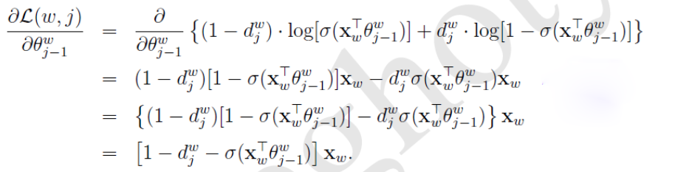

CBOW Based on Hierarchical Softmax
Output Layer

Slide 13
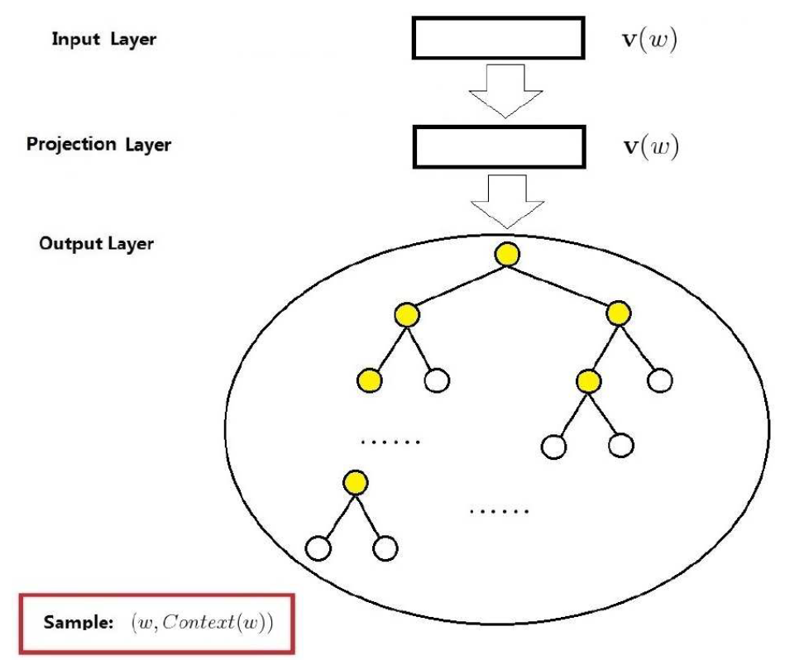
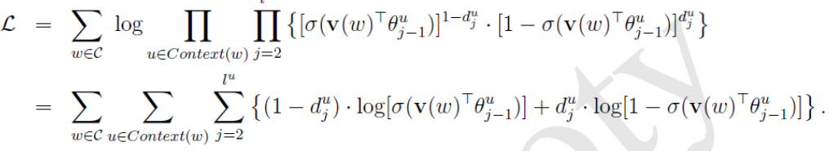
Skip Gram Model

Slide 14



CBOW based on Negative Sampling

Slide 15

Skip gram model

Slide 16




Complexity
N: context size
D: distributed vector size
H: hidden layer size
V: output layer size
NNLM:
RNNLM:
CBOW Model
Skip Gram Model:

Slide 17
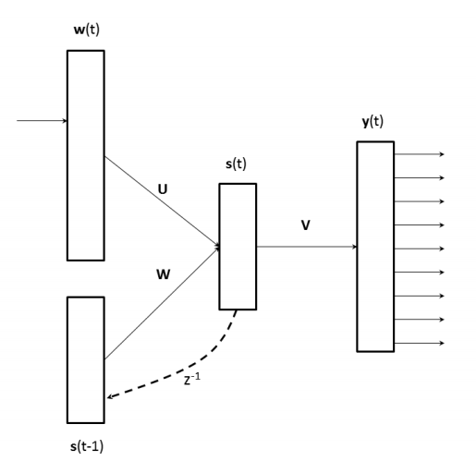
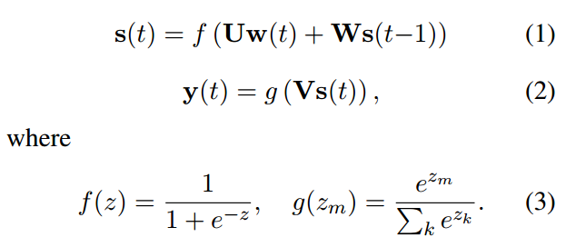
Linguistic Regularities in Continuous Space Word Representations.2013

Slide 18
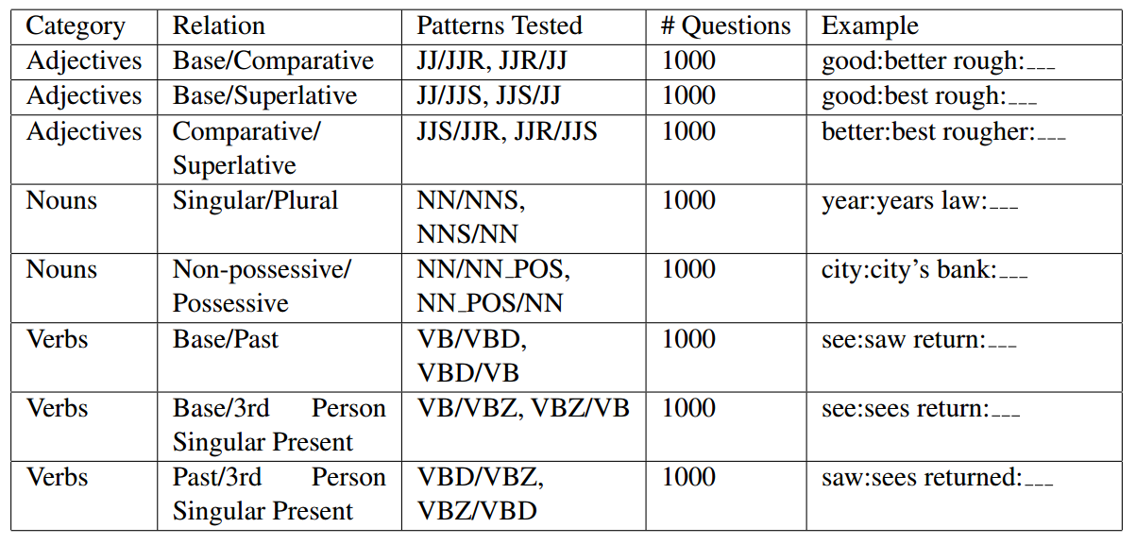
Test cases

Slide 19
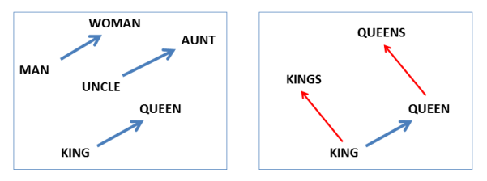
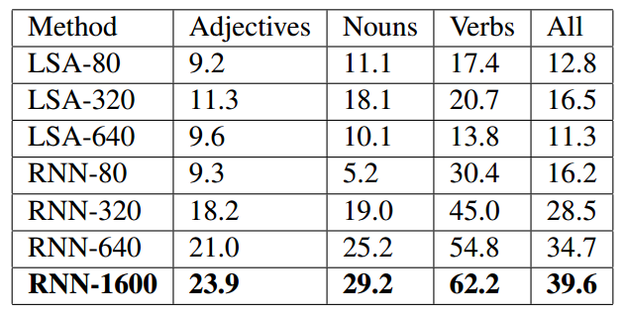

Test result

Slide 20
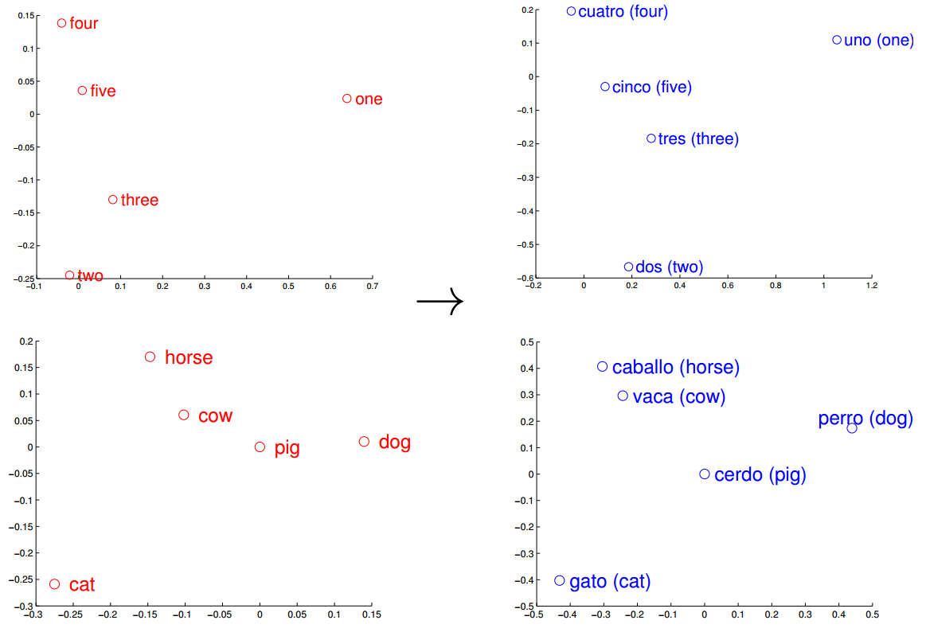
Exploiting Similarities among Languages for Machine Translation.2013

Slide 21
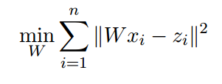
Translation Matrix

Slide 22
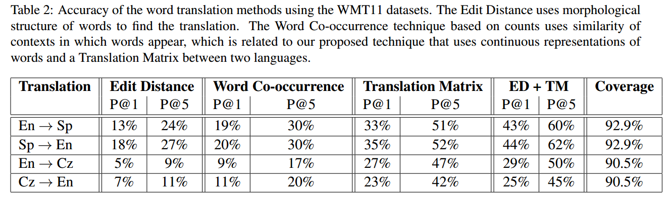
Test

Slide 23
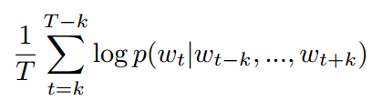
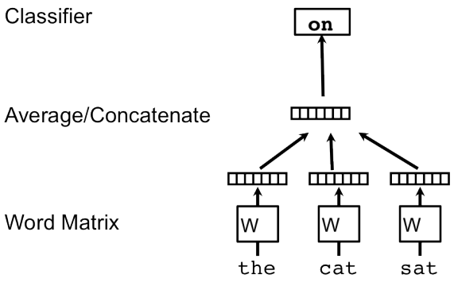


Distributed Representations of Sentences and Documents.2014
- Learning Vector Representation of Words

Slide 24
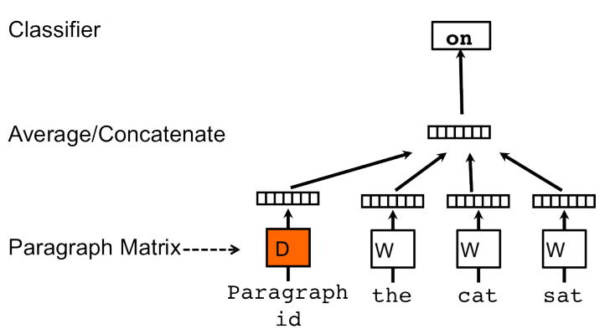
Distributed Memory Model of Paragraph Vectors (PV-DM)

Slide 25
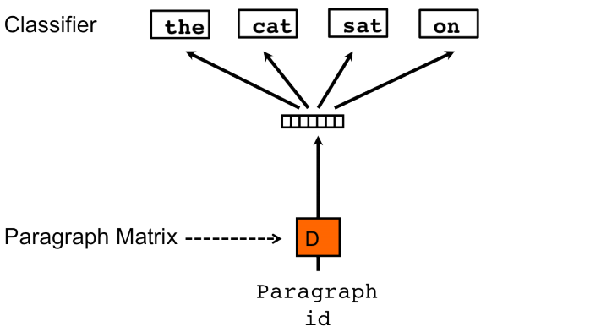
Distributed Bag of Words version of Paragraph Vector (PV-DBOW)

Slide 26
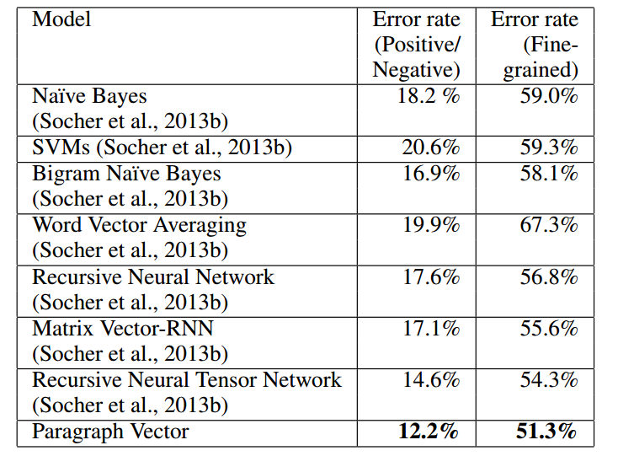
Sentiment Analysis with the Stanford Sentiment Treebank Dataset

Slide 27
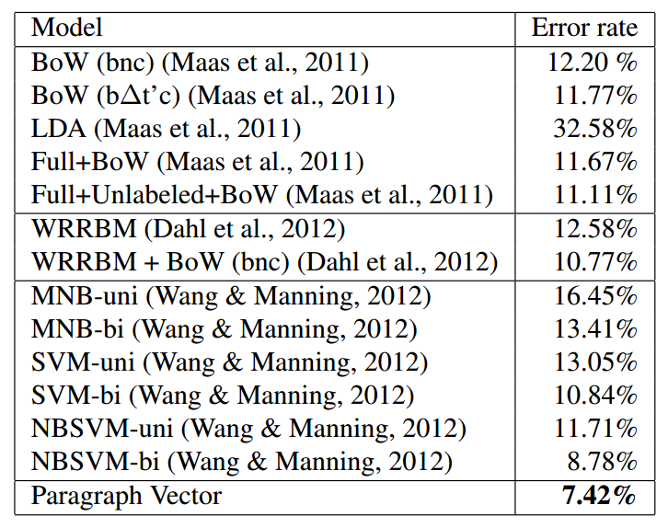
Sentiment Analysis with IMDB dataset

Slide 28
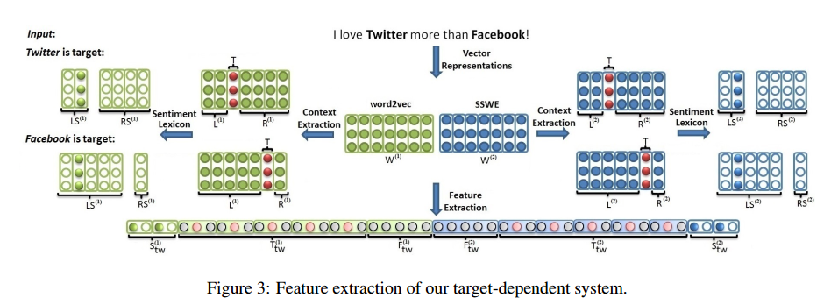
Target-Dependent Twitter Sentiment Classification with Rich Automatic Features .2015

