Slide 1
Bandit Approaches for Recommendation
Wu, 2018/04/23

Slide 2
Overview
Multi-armed bandit problem
Contextual-bandit for recommendation
Transferable contextual-bandit for cross-domain recommendation

Slide 3
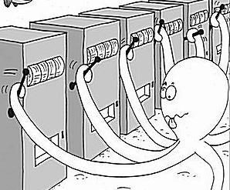
Multi-armed bandit problem
Suppose each machine has an unknown distribution of reward
A gambler(player) should decide in which order to play the machines and how many times to play each machine to maximize the total rewards
Notes:
Originally considered by Allied scientists in World War II, the problem proved so intractable that, according to Peter Whittle, the problem was proposed to be dropped over Germany so that German scientists could also waste their time on it

Slide 4
Exploitation/Exploration Dilemma
Exploitation: to play the machine that has the highest reward till now
Exploration: to choose a new machine to get more information about other machines

Slide 5


Metric: Regret
Let be the real distributions of rewards of K machines and be the mean values of these distributions
Then regret after T rounds is:

Slide 6
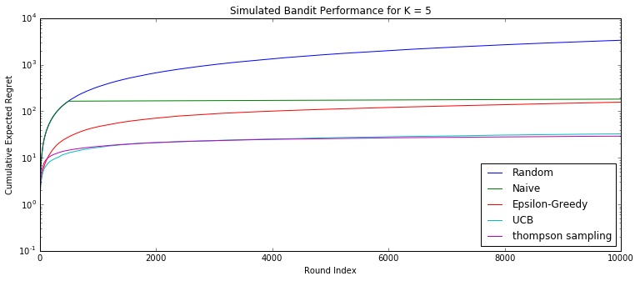
Some algorithms

Slide 7

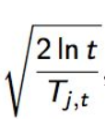
UCB: Upper Confidence Bound
In trial t, the algorithm estimate both the mean reward u of each arm a and a corresponding confidence interval c ,so that:
Then select the arm that achieves the highest UCB:
For example: =
Notes:
Regret has a upper bound function with variable t

Slide 8
Contextual-bandit for recommendation
Recommendation difficulties
Dynamically changing. So the traditional CF methods is not applicable
Cold start
The scale of most web services of practical interest calls for solutions that are both fast in learning and computation

Slide 9
Multi-armed bandit algorithms

Slide 10
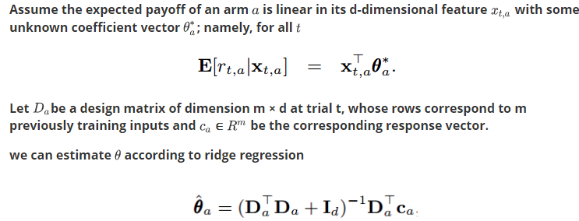
LinUCB: Add contextual information to UCB

Slide 11
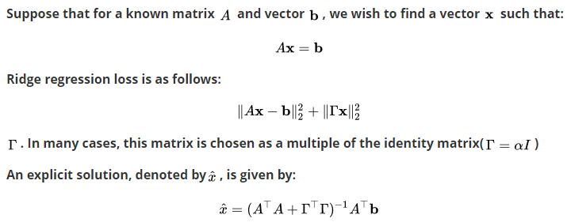
Ridge regression

Slide 12
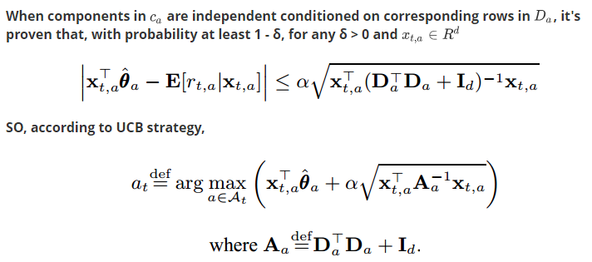
LinUCB: to fit UCB

Slide 13
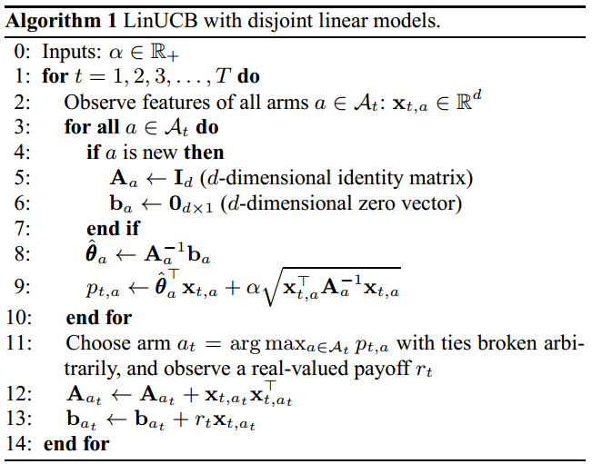
Algorithm 1

Slide 14

LinUCB with Hybrid Linear Models
In many applications including ours, it is helpful to use features that are shared by all arms, in addition to the arm-specific ones.
For hybrid models, we can no longer use Algorithm 1 as the confidence intervals of various arms are not independent due to the shared features.

Slide 15
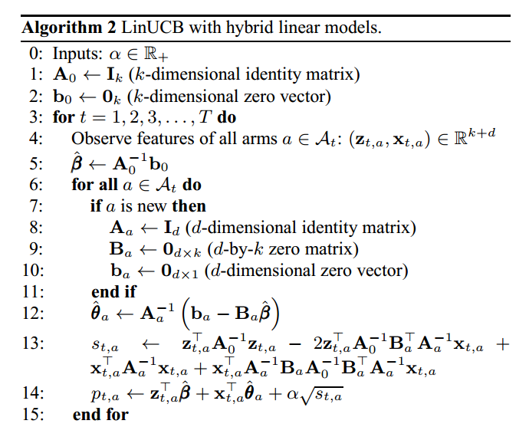
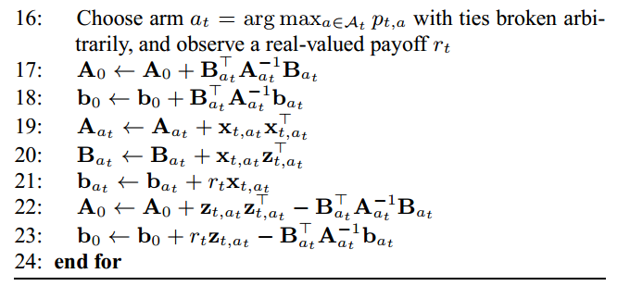
Algorithm 2

Slide 16
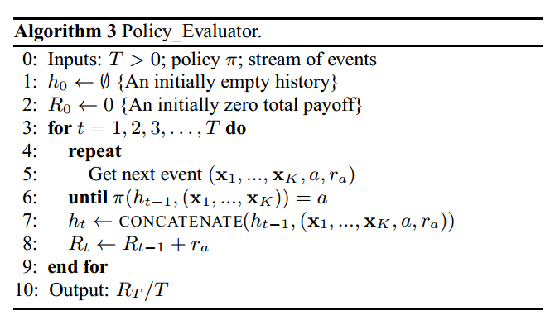
Evaluation Method

Slide 17
Experiments
Dataset: collected from Yahoo! Today Module
Feature Construction:
User: 1000 categorical components, which include: (i) demographic information: gender (2 classes) and age discretized into 10 segments; (ii) geographic features: about 200 metropolitan locations worldwide and U.S. states; and (iii) behavioral categories
Article: 100 categorical. include: (i) URL categories: tens of classes inferred from the URL of the article resource; and (ii) editor categories: tens of topics tagged by human editors to summarize the article content

Slide 18
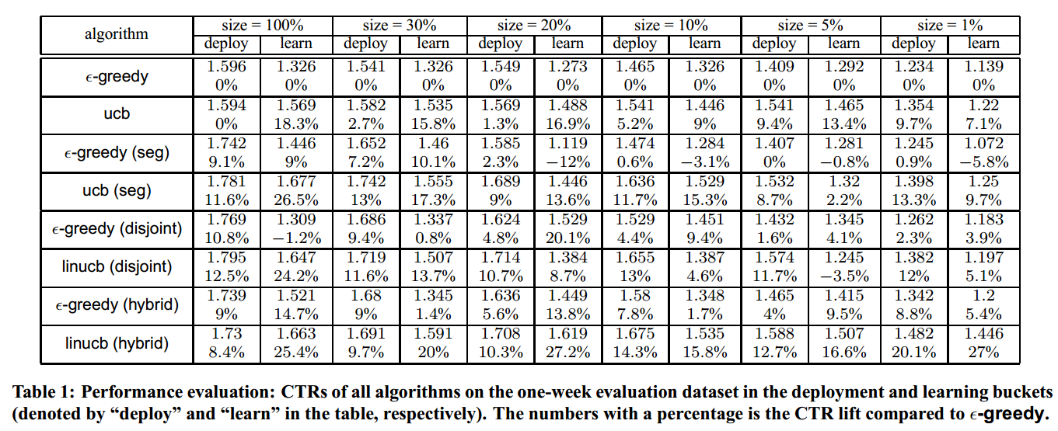
Experiments
Notes:
Dataset: Yahoo! Today Module

Slide 19
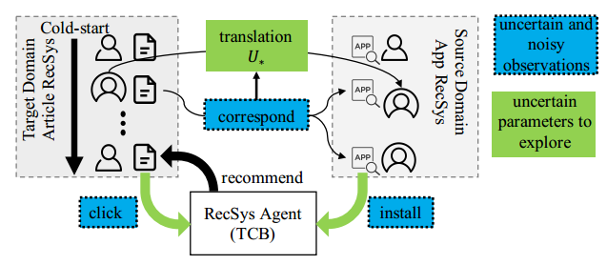

Transferable contextual-bandit for cross-domain recommendation

Slide 20
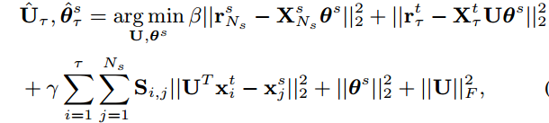
Optimization
With optimal U_*
To estimate U

Slide 21
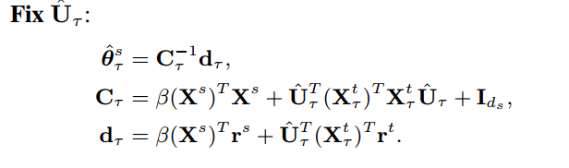
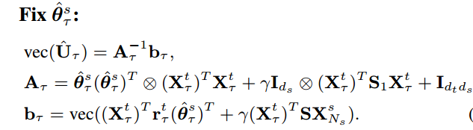
Alternative optimization

Slide 22

A pure exploitation policy

Slide 23
UCB: Upper Confidence Bound
In trial t, the algorithm estimate both the mean reward u of each arm a and a corresponding confidence interval c ,so that:
Then select the arm that achieves the highest UCB:
For example: =
Notes:
Regret has a upper bound function with variable t

Slide 24
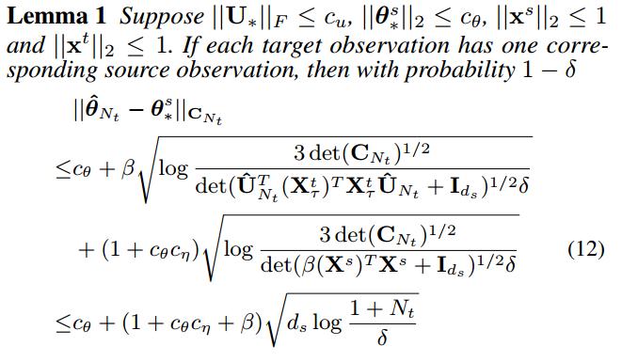
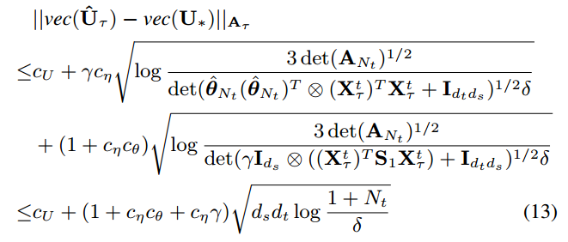

Fit to UCB

Slide 25
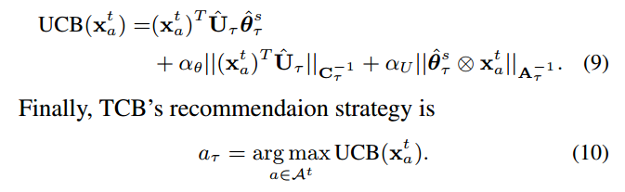
Fit to UCB

Slide 26
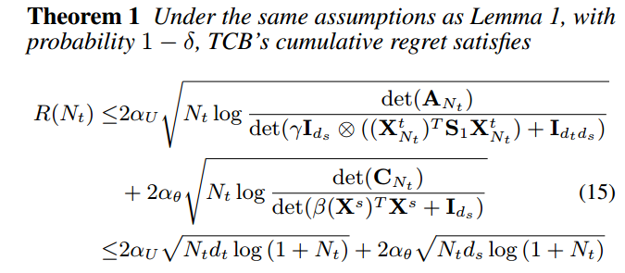
Regret Bound

Slide 27
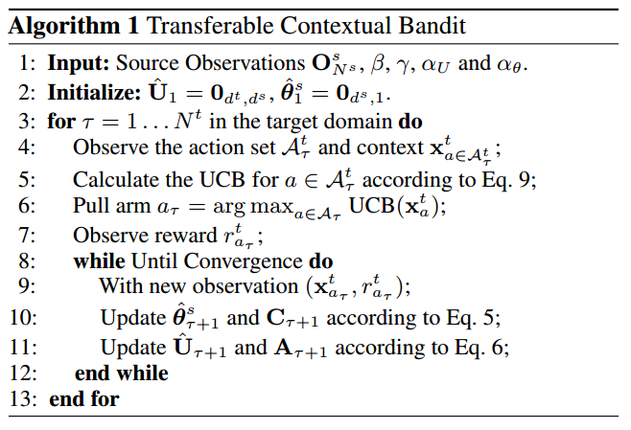
Algorithm

Slide 28
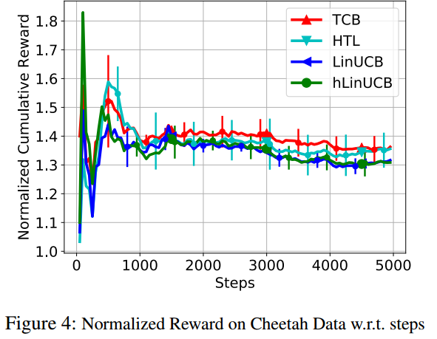
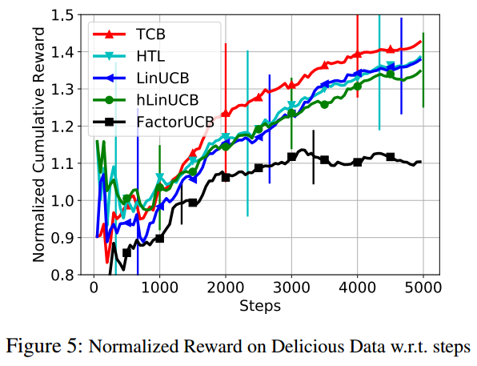
Experiment

