Slide 1
Language-Independent Multi-Document Text Summarization

Slide 2
Introduction
Using document-specific word associations as a model of the document。
The method is based on a simple model: a document is a set of sentences, and each sentence is a set of words.
The method outperforms existing methods when tested in multi-document summarization tasks in nine different languages

Slide 3
Why use word associations
associations (i.e. pairs of words) are more informative than individual words
Example：A hypothetical document talking about an accident to President Obama is characterized by the combination of these two common words, and our goal is to be able to recognize such unexpected combinations. In contrast, a purely keyword-based method fails to discover the connection, and may actually miss both words if they are sufficiently common in news in general.

Slide 4
Formulation of the Problem
Notations:
U: universe of all sentences
D: set of documents to be summarized
d: each document
c: total words in D
d ˆ: summary document
k: upper bound of number of words in d

Slide 5
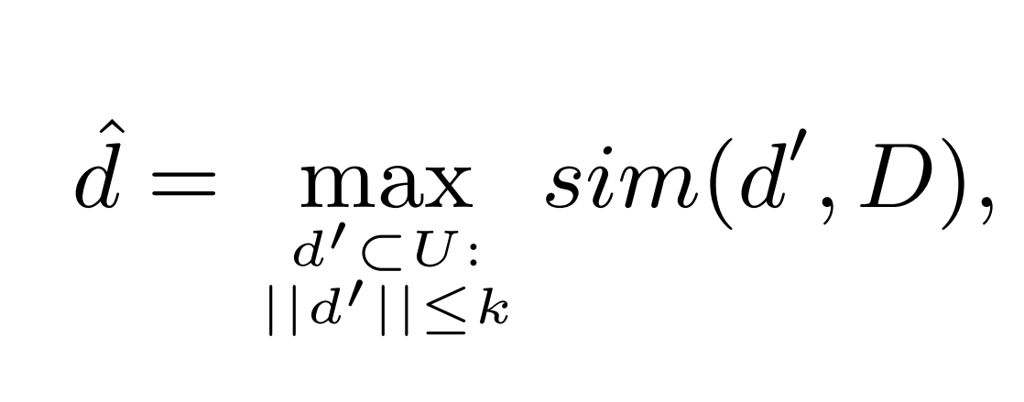
Formulation of the Problem
Formula
Notes:
So, the problem is to specify the function sim().

Slide 6
Defining Document-Specific Word Associations
Notations:
T: the set of all words
s: sentence: {t1, · · · , tk} of words ti ∈ T
d_{s}: the document to be summarized
n_{i}: the frequency of word t_{i} in d_{s}
n_{ij}: the the frequency of their co-occurrence in the same sentence in d_{s}
n: the total number of sentences in d_{s}
B : background corpus
m,m_{i},m_{ij} : the same to n but measure in B.
Notes:
The goal is to identify word associations that are more common in the document than expected.

Slide 7
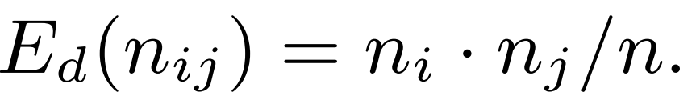
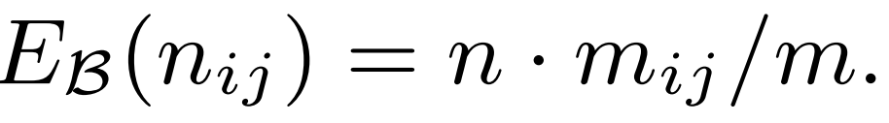
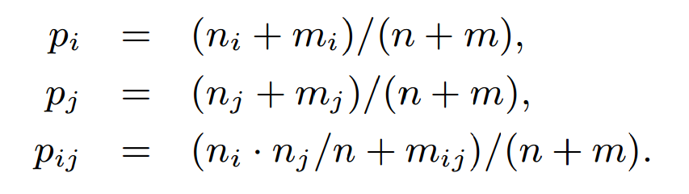
Word associations that are “expected”.
1.
2
Mixture model

Slide 8
Weighting Word Associations
log-likelihood ratio(llr) test
Null model are as above
Alternative model

Slide 9
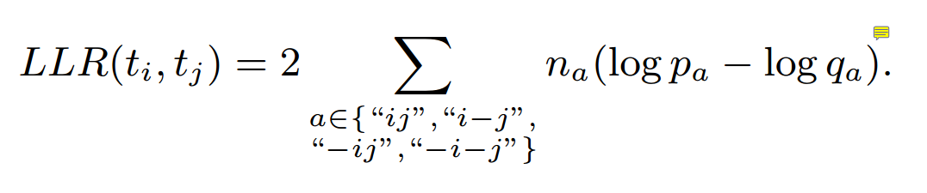
Weighting Word Associations
Formula
Document-specific associations are now obtained by selecting those word pairs for which LLR(ti, tj) > 0 and which co-occur at least twice in the document d_{s}
Notes:
we get the word associations. Then we should choose sentences according to the word associations.

Slide 10
Weighting Word Associations
log-likelihood ratio(llr) test
Notations:
Pij: cooccurrence of ti and tj
pi−j: occurrence of ti without tj
p−ij: occurrence of tj without ti
p-i-j: absence of both
pi−j = pi − pij; p−ij = pj − pij; p−i−j = 1 − pij − pi−j − p−ij.

Slide 11
Sentence Selection
pick sentences that cover as many of the associations as possible
pick sentences that cover the most central nodes in the term-association graph
combine the two strategies above.

Slide 12

Sentence Selection
Notations
G = (V, E, W )
s is the set of nodes (all words in the document ds)
W (ti, tj) = LLR(ti, tj)

Slide 13
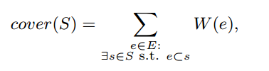
Covering Associations.
Formula:
S is the set of sentences that we choose randomly

Slide 14

Covering Central Words
Formula:
d(u, v) is the length of the shortest path between nodes u and v
the length of a path is 1/W (e).

Slide 15
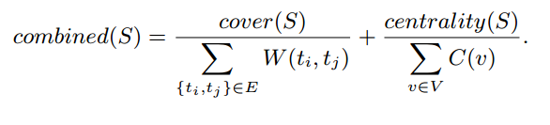
Covering Associations and Central Words
Formula:
Notes:
So we have implement the sim() function

Slide 16
NP-Hard Complexity
Under some reasonable assumptions the problem then reduces to a (weighted) set cover problem [14]: we have to choose a set d ˆ ⊂ U of sentences such that d ˆ maximally covers the information in D.
Greedy Optimization Strategy.
Genetic Algorithm.

Slide 17
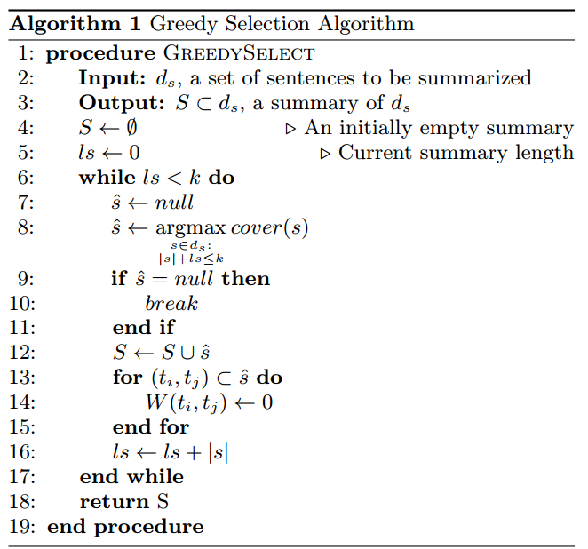
Greedy Optimization Strategy.

Slide 18
Genetic Algorithm
Genome: a set of sentences (technically, sentence identifiers)
Crossover: defined between two individuals a and b (sets of sentences) and produces two individuals a0 and b0 to the offspring
Mutation: takes an individual a as input and generates a new modified individual a0, by randomly adding or removing a random sentence in a0.
Scoring: either cover(S), centrality(S) or combined(S). if the individual contains more than k words then the score is 0.

Slide 19
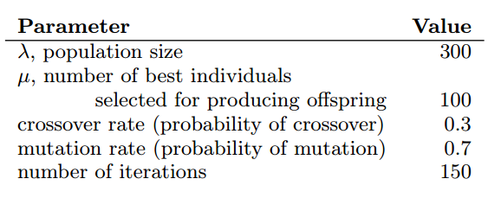
Genetic Algorithm
Parameters:
The parameter values were obtained by rough experimental analysis of the convergence speeds on the English language

Slide 20
Evaluation
Evaluation Method
ROUGE
Dataset
MultiLing-2013 dataset：9 language，15 topics，each topic has 10 document
Notation
G: graph cover measure
C: word centrality measure
G+C: combined
GR: greedy method
GA: genetic algorithm

Slide 21
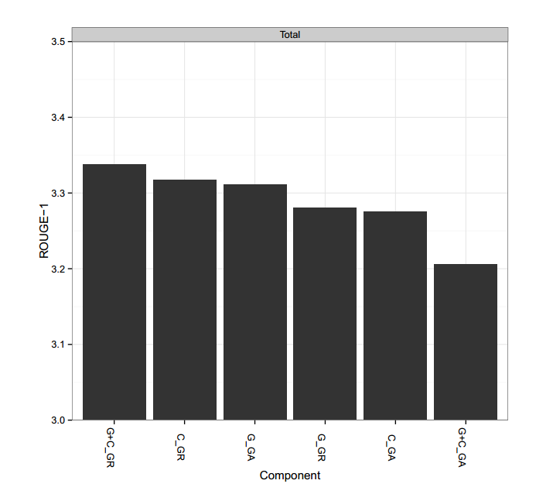
Evaluation

Slide 22
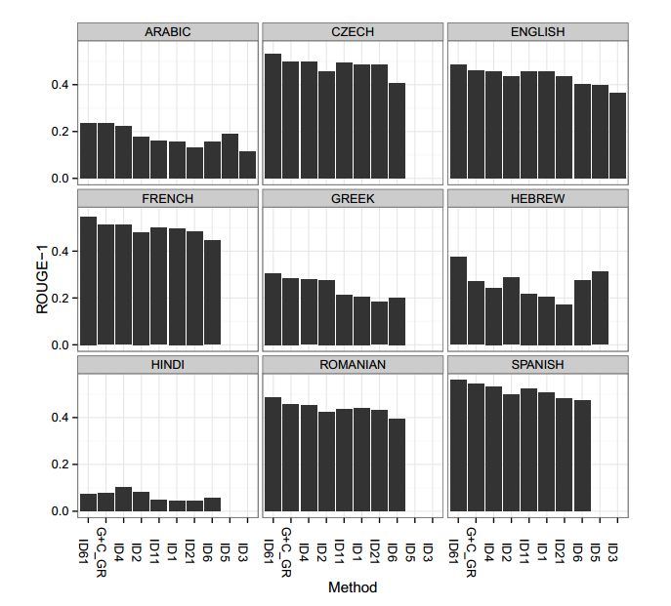
Evaluation
Notes:
The global baseline system ID6 is a simple vector space model based approach. It finds the centroid C in the vector space and tries to generate text which is most similar to the centroid, according to the cosine measure. The global topline method ID61 is not a real summarization method, it is an approximation of the upper limit of performance in extraction-based summarization. It works similarly to ID6, but “cheats” by using human-written summaries to generate the vector space, and then chooses sentences from the original documents to create text which is most similar to the centroid. Among the summarization methods of MultiLing 2013, ID4 denotes the best performing method, UWB [22].

