Slide 1
VBPR: Visual Bayesian Personalized Ranking from Implicit Feedback
AAAI’16

Slide 2
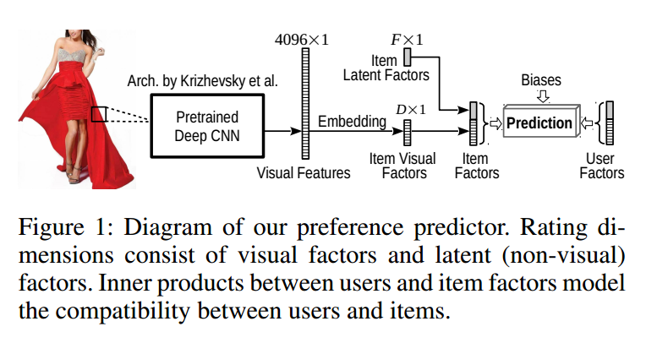
Structure of VBPR

Slide 3
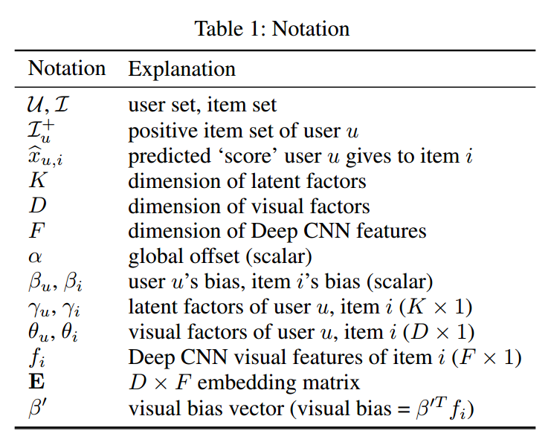

Formulation

Slide 4
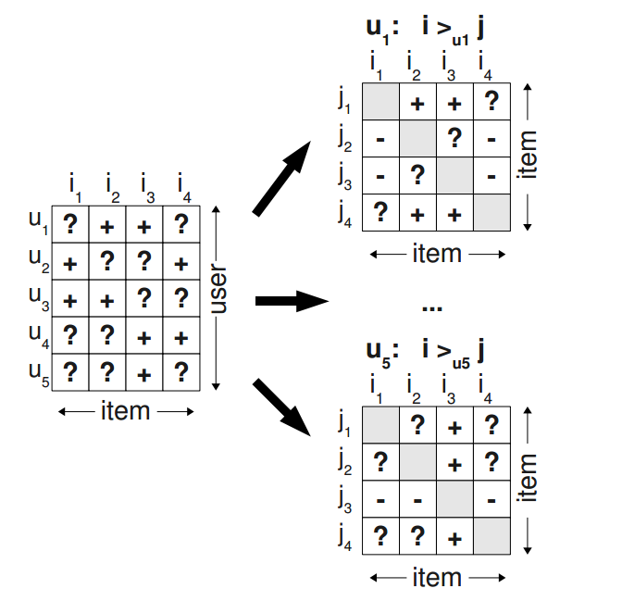
BPR
1. Change dataset:

Slide 5
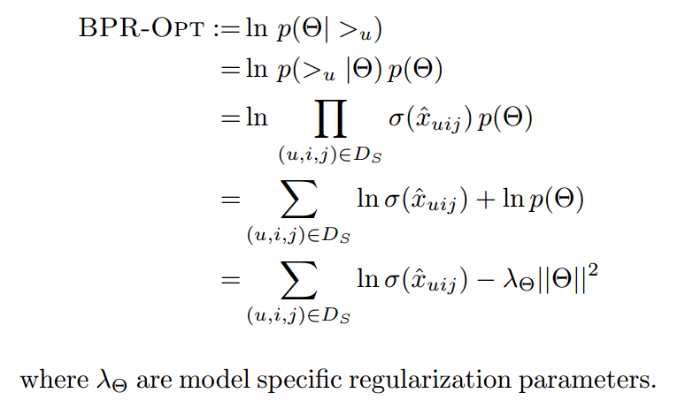
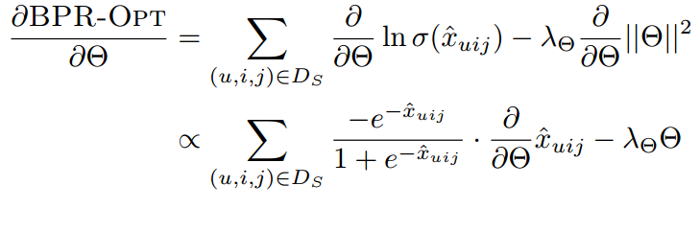

BPR
Notes:
BPR优化目标

Slide 6
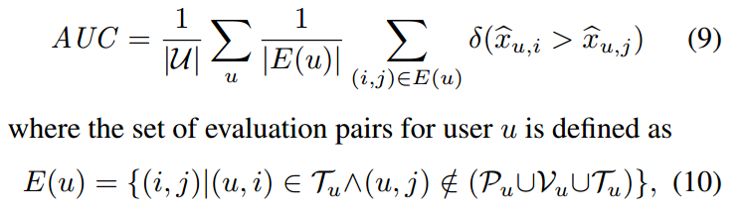
Experiments
Evaluation Methodology

Slide 7
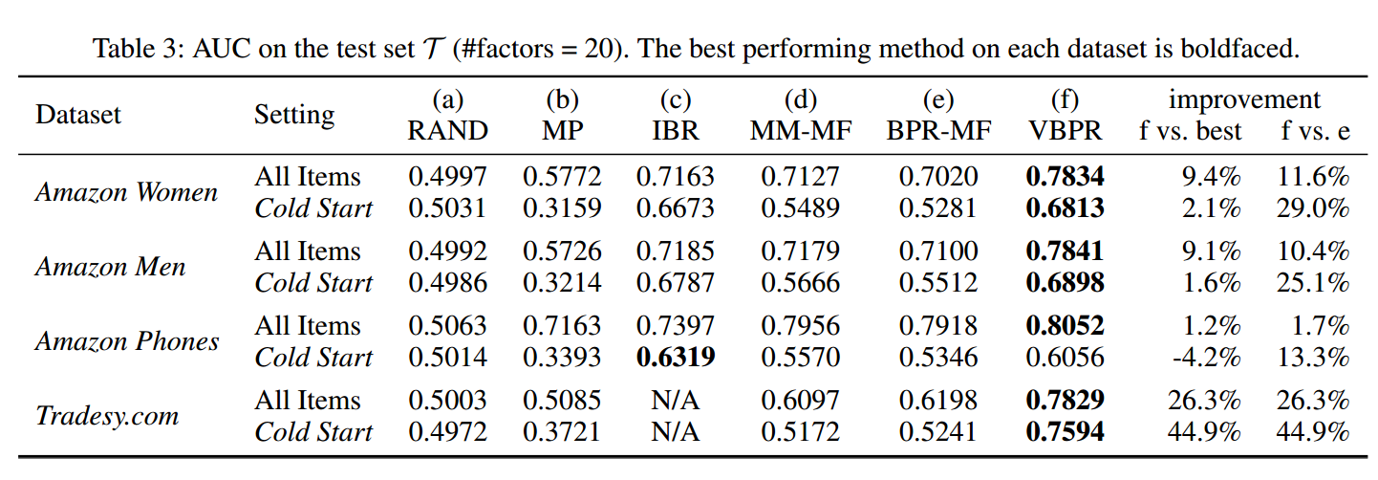
Experiments

Slide 8
A Hybrid Collaborative Filtering Model with Deep Structure for Recommender Systems
AAAI’17

Slide 9
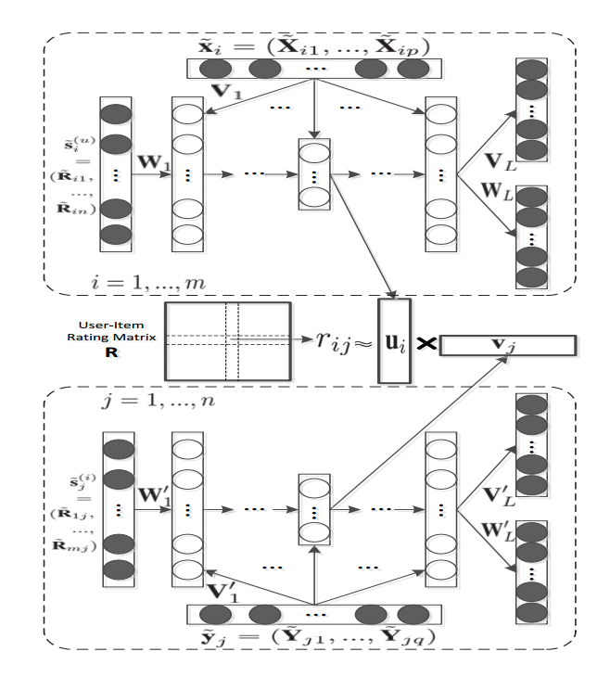
Structure

Slide 10
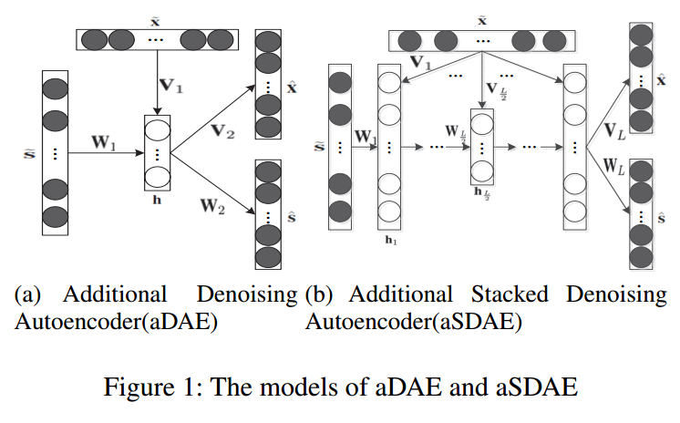
aDAE and aSDAE

Slide 11


User features

Slide 12
Item features
Notes:
1. the item side information contains the item’s title, release data and 18 categories of movie genre are encoded into a binary valued vector of length 1822

Slide 13
Structure

Slide 14
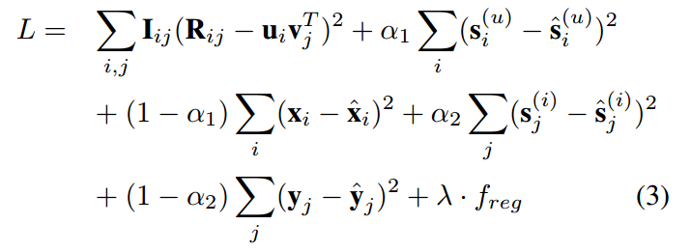
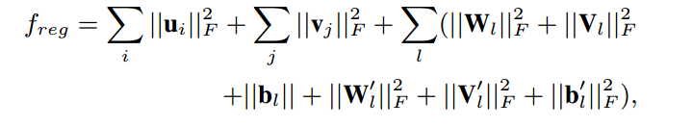
Loss function

Slide 15
Experiments
Movielen Datasets: binarize explicit data by keeping the ratings of four or higher and interpret them as implicit feedback
Book-Crossing: binarize explicit data by keeping the ratings of six or higher and interpret them as implicit feedback

Slide 16
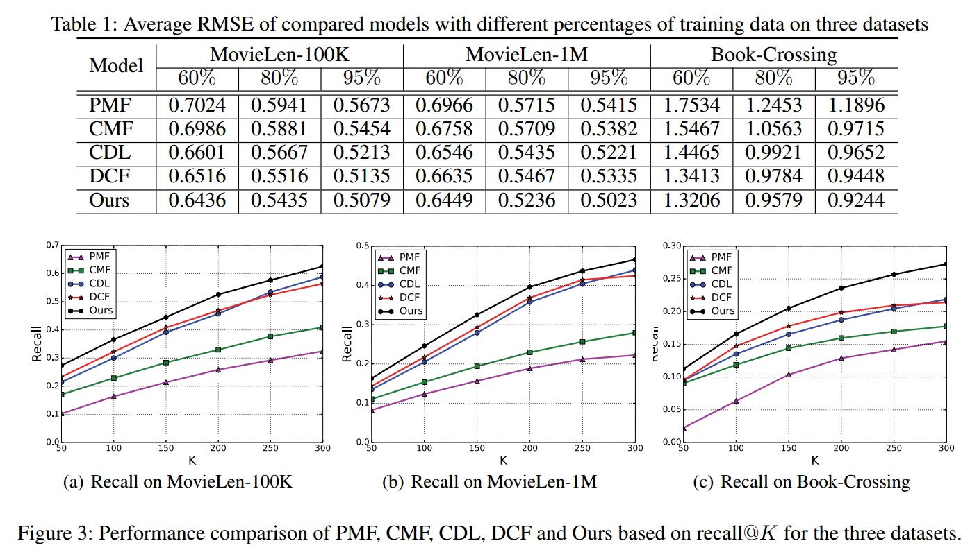
Results

