Slide 1
Workshop UML Activity Diagram
ICT & Software Engineering - S2

Slide 2
Content
UML Activity diagram
What is it?
Guided examples
Notes:
Besides LO2 you are also

Slide 3
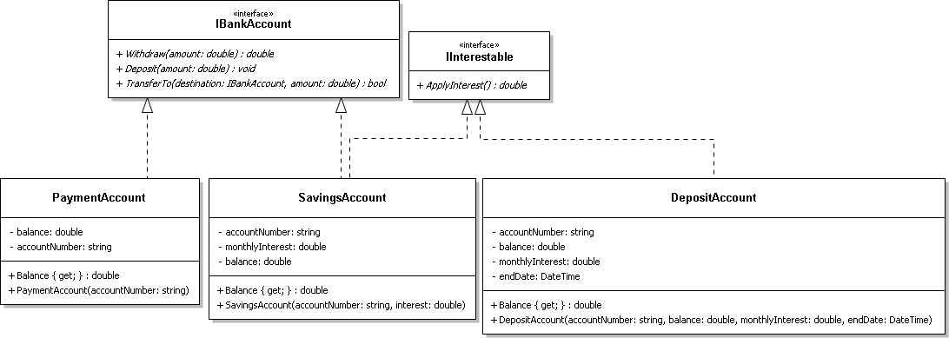
UML diagrams: Structural vs behavioural
?
Notes:
By now you all know what a class diagram is and that it is part of UML Diagrams. What does a class diagram depict (example class diagram is taken from OOD – Week 10)? It shows the structure of a system and is fixed; this is the reason why it falls in to the structural diagram category.
Today we’re going to have a look at activity diagrams (for example, see bottom diagram) which are behavioural UML diagram. Any idea what it fits in to that category? Hint: how do the two diagram relate to each other?

Slide 4
WHY UML Activity Diagrams
Pre-defined way to:
visualize process/flow of activities in a system
Intermediate step before actually implementing things
How does it compare to a Use Case?
Notes:
An activity diagram follows the UML specifications, which means we have a pre-defined way of depicting a process flow of a software system. It is aimed to be used as a tool for developers to visualize how their software system is going to behave in different scenarios.
The activity diagram, just like a class diagram, can be used as a way to brainstorm with fellow developers about how want to implement functionalities and how they are connected to each other. It is also usable to present/discuss it with stakeholders in you project.
When we compare this to a UC, an activity diagram can be used to describe the flow between functionalities and the logic/business rules connected to them; basically give a different type of view/perspective of how a system handles the activities. A use case describes the steps of a functionalities and is usually more detailed. Note that you could use an activity diagram to depict exactly what is in one use case, but whether it would have added value depends on preference.

Slide 5
Example: Processing an Order
Start node
Decision node
Merge node
End node
Activity nodes
Directed edges
Guards
Notes:
[Note that this slide contains animations]
The diagram shown here is an UML Activity diagram with some basic activity diagram components in it. The activity flow in this example shows how and when the back-office of a (web)shop start processing an order in the software system and ‘contains’ multiple UC.
A process goes through this diagram from node to edge and from start till end (a so called path through the activity diagram). The components used in the example are the official/generally accepted ones:
Start node: The start of the process
End node: The end of the process
Activity node: The activity to do in the process.
Directed edges: How from one node, for example activity, proceeds to the next.
Decision node: Indicates a branching path/decision in the process to the next node; this is combined with a label, called a guard, in an edge
Guards: A label on the directed edge from originating from a discussion node. When the specified condition (the guard) is true the edge to the next node will be followed
Merge node: Indicates the point where all branching paths come together to proceed to the same connected node
With DDO you did something comparable (the process flow diagram at week 1) and an activity diagram looks a lot like that/a flow chart. The difference is that the UML Activity Diagram also contains components for relevant for developers (see next slide). For example, support for parallel processes; a flow chart does not support that.

Slide 6
Example: Processing an Order - Sequential
Let us assume that for these two activities it does not really matter which is done first
Notes:
In a UML activity diagram sequential and parallel steps to perform the activities depicted in the example is sequential, which mean that first one activity must be finished before another (order is indicated by the edges).
When considering the example, there are activities that can be done in parallel. Which activities do you think could be done at the same time without messing up the activity flow?
With an activity diagram we have a special way of depicting this called Fork- and Join-nodes (see next slide)

Slide 7
Example: Processing an Order - Parallel
Fork node
Join node
Notes:
The solid black lines (fork node and join node) with activities in it means that the activities in it can be done in parallel (the order does not matter), but when it is done the process proceed to one of the next payment received nodes.

Slide 8

Questions?

Slide 9
Demo/Practice
Webshop activity diagram
Checkout of shopping cart to place an order; an order exists out of:
At least one item
Shipping address
A payment type (iDeal or Creditcard)
Send confirmation email when order is successfully placed/created
Extra: When a user is logged in the shipping address is loaded from account information
Notes:
Let us together draw the activity diagram; we first start with 1 & 2 and after that we will ask you to think about how to include 3 in the process.
The easiest way is to use a tool for this. For example, Microsoft Visio, https://online.visual-paradigm.com/ or https://creately.com
See next hidden slide for a possible activity diagram for the first two points.

Slide 10
Demo/Practice
Possible activity diagram for:
Checkout of shopping cart to place an order; an order exists out of:
At least one item
Shipping address
A payment type (iDeal or Creditcard)
Send confirmation email when order is successfully placed/created
What about?: When a user is logged in the shipping address is loaded from account information
Notes:
This is an possible activity diagram for the first two points. How and where would the third point fit in?

Slide 11
More programming related usage
Notes:
The diagrams up until this point are seen from a ‘high level of abstraction’ when considering the actual implementation of a system/application.
We can also use activity diagrams to depict more ‘low level’ parts of the system.
What kind of programming concept/construct does the left activity diagram remind you of? What about the right one?

Slide 12
Practice – Algorithm
Algorithm to show the top 5 best selling items:
Sales information must be retrieved from closed orders
An order contains the product and quantity sold
Hint: the activity diagram should be on pseudo-code level (e.g. it should not contain each line of code as an activity); also see previous slide for examples
Notes:
Try to draw the diagram for this by yourself. Your teacher will pick arbitrary diagrams from students to show and discuss via, for example, screen sharing in MS Teams

Slide 13
Questions?

Slide 14
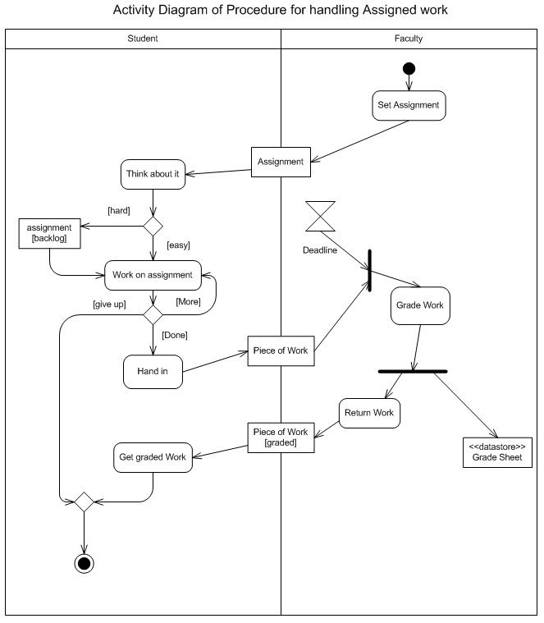

More advanced components
Other useful components:
Sub-diagrams ( -icon): declutter your diagram
Swim lanes: include the actors
Time event node ( ): Include time in your process
Object node ( ): Object/thing involved in the process
Etc.
Notes:
Image taken from http://homepage.eircom.net/~iandowney/activity.htm at 8 May 2020
This workshop only covered the part we think you will find useful to apply now, but there is more. The shown activity diagram contains more components then we covered (note that the actual content is not relevant) so depict finer details of a process within a system.
Some other useful component:
Sub diagrams (pitch fork icon): when the process is getting complex you will end-up with a big activity diagram. You can split it up in smaller ones by showing a rake icon in the activity node.
Swim lanes: this allows you to include which actors are supposed to do which activities
Time event node: Include time in your process by using this node to indicate time passes before the continue to the next node
Object node: Object/thing involved in the process such as a form
You can find more online; possible resources are:
https://www.guru99.com/uml-activity-diagram.html
https://www.tutorialspoint.com/uml/uml_activity_diagram.htm
https://www.geeksforgeeks.org/unified-modeling-language-uml-activity-diagrams/

Slide 15
usages in S2?
Drowning in details? Visualize it!
PRJ: Discussion with tutor about automated scheduling, statistics, etc.
OOD/WAD: Brainstorm about complex ‘activity flows’ of algorithms without coding first
Split up complex problems
or
Determine first what you want as output

