Slide 1

Custom USB Device for PTT Control
Dylon Mutz, KK6OTK
dylon.mutz@gmail.com

Slide 2


Introduction
What was the goal?
Wanted to try out APRS (Automatic Packet Reporting System)
  Developed by Bob Bruninga, WB4APR
  Packets sent on the VHF and HF bands
  Used to transmit position reports, weather reports, and other kinds of data
  Every-day positional reports, Public Service, and Emergency communications
Experiment with digital modes
Also wanted to use with other computer-related software and control
  GNUradio
  Xastir
  Direwolf

Slide 3
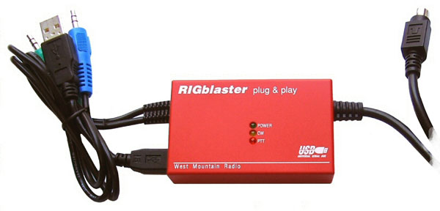
Background
What were the options?
TNC (terminal node controller)
USB PC linker Adapter (~$73)
SignalLink USB ($130)
Mini-DIN 6-pin Packet cable ($50-$60)
  Some of these cables do not provide PTT functionality
Rigblaster Plug & Play ($120)
What option was chosen?
All of the above were good options
Personally liked the Rigblaster Plug & Play for being small and simple
But after doing some research, I felt like I could make this myself
Also more fun to learn and build something

Slide 4
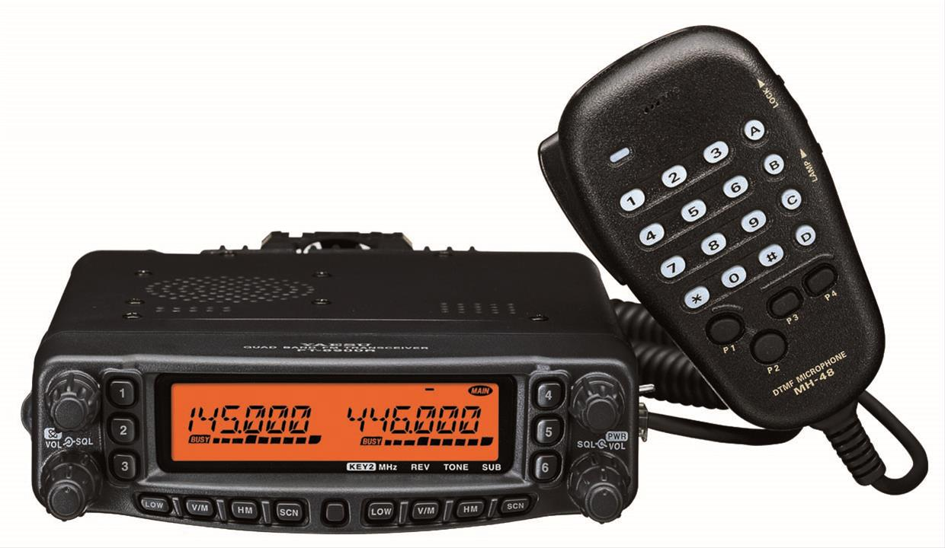
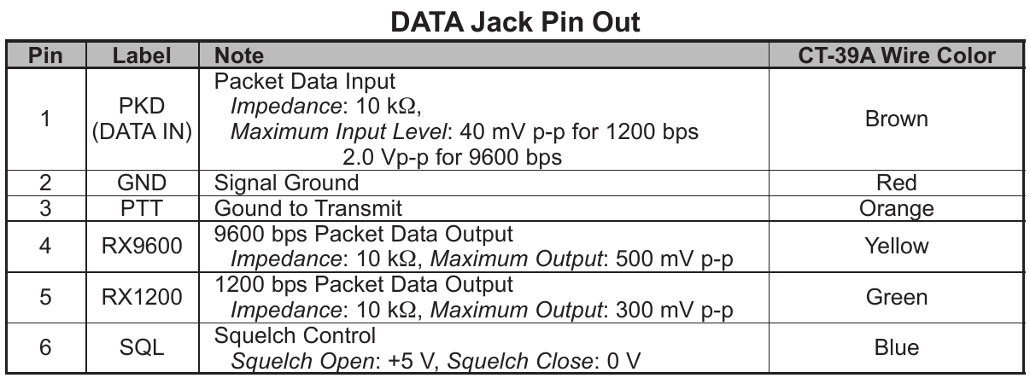
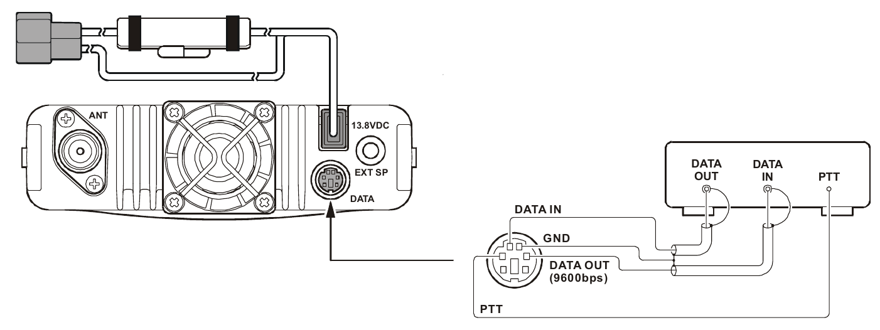
Operation
Yaesu FT-8900R
Data I/O pins can be connected to computer's sound card through audio jacks
Activating the PTT requires pulling the pin to ground

Slide 5
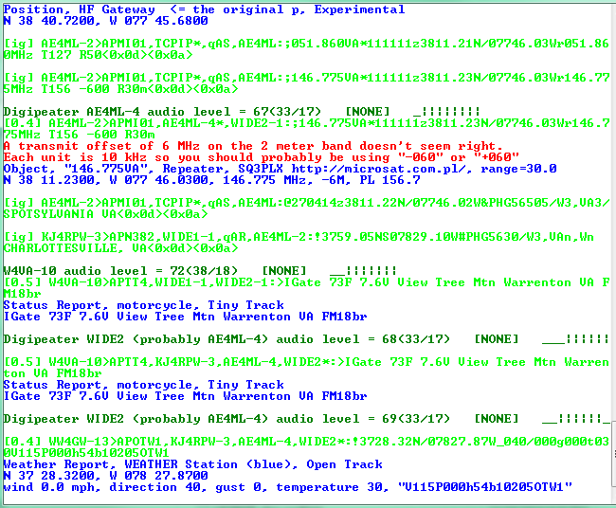
Operation
Direwolf
First of two main programs I want to use for APRS
Direwolf acts as a software TNC using soundcard and serial port
Sends/receives packets through mic and speaker ports
Activates transmitter through serial port (or USB to RS232 adapter)

Slide 6

Operation
Xastir
Second of two main programs I want to use for APRS
Xastir provides object mapping and interfaces with Direwolf to send/receive messages

Slide 7


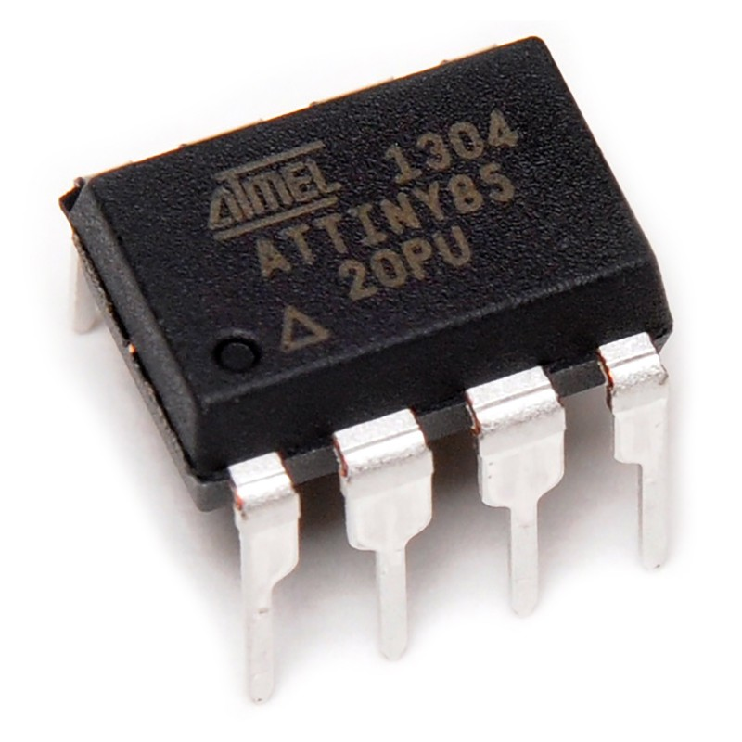
USB Interface
USB interface
Problem: Need an IC that can send/receive USB packets and has a controllable output pin
Solution: AVR ATtiny85 + V-USB library
  ATtiny85 is an 8-pin programmable microcontroller (μC) with 6 I/O pins
  V-USB is a software library that allows AVR chips to be used as a USB device
ATtiny85
+

Slide 8
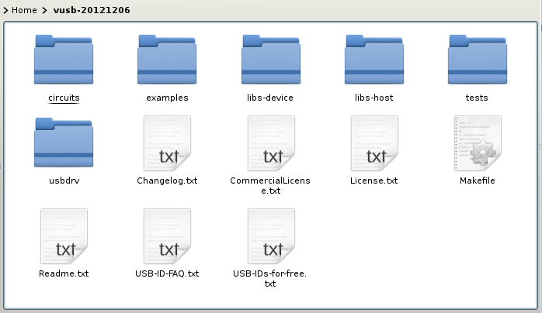
USB Interface
V-USB Setup
The latest V-USB package can be downloaded from https://www.obdev.at/vusb/
Contents include very useful documentation
Main folder is “usbdrv” which contains the V-USB firmware

Slide 9
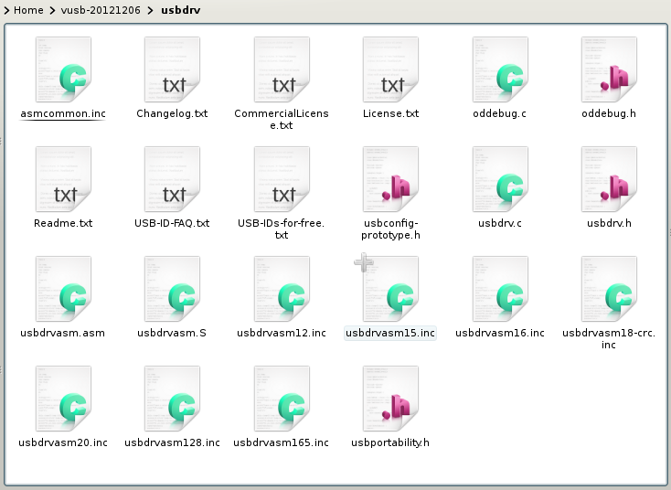
USB Interface
V-USB Setup
The “usbconfig-prototype.h” contains settings for USB configuration
  Only a few need to be set to get up and running

Slide 10
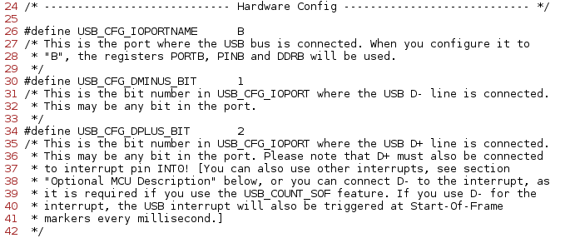
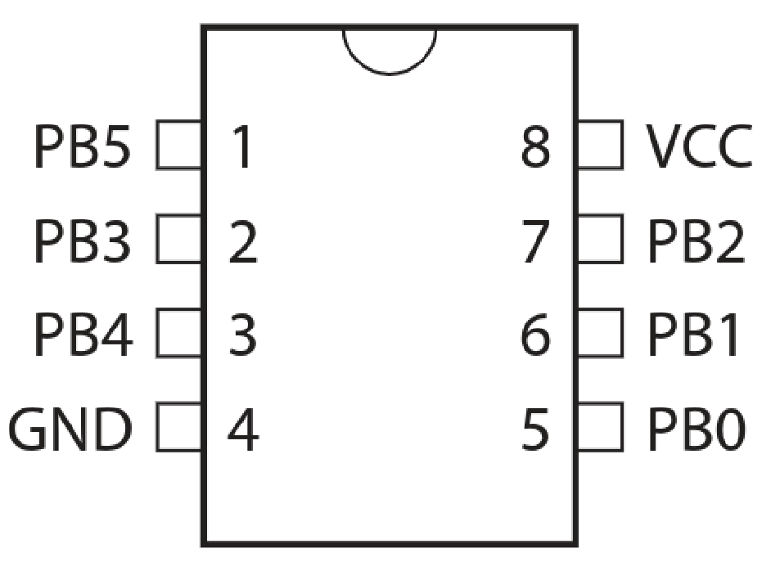
USB Interface
V-USB Setup
ATtiny85 pinout shows all I/O pins are labeled 'PBx'
  'B' is the port name
  'x' is the number of the pin
usbconf.h
Pinout ATtiny85

Slide 11
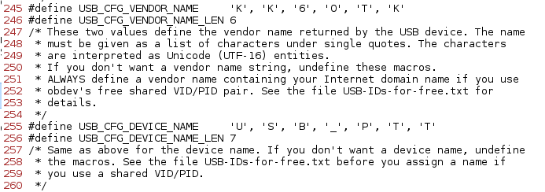
USB Interface
V-USB Setup
Vendor name and device name can be set
Many other options can also be configured in this file for more advanced devices
usbconf.h

Slide 12
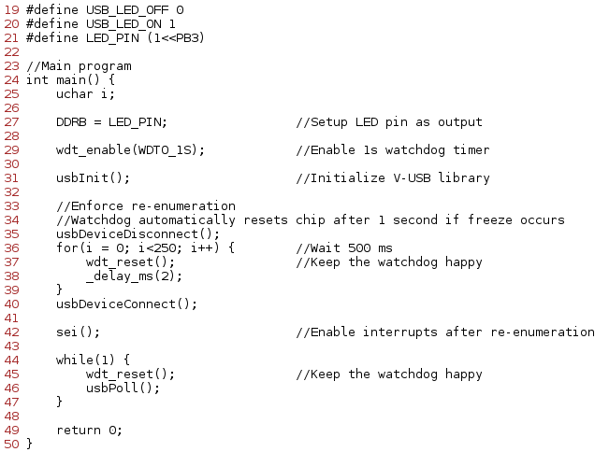
USB Interface
V-USB Setup
Main program also has to be written in main.c
Section includes any initial setup and executes USB operation
Lines 19 & 20 define commands that will be received via USB
Line 21 defines an output pin, PB3, that is connected to an LED
main.c

Slide 13
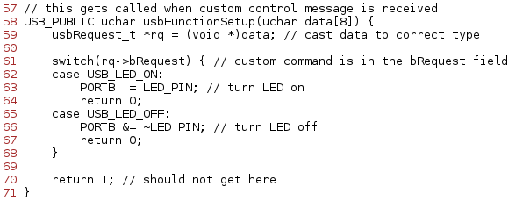
USB Interface
V-USB Setup
This function is automatically called whenever the μC receives a USB command
The command is passed as data into the function, and a case statement can be used to execute the proper function
main.c

Slide 14
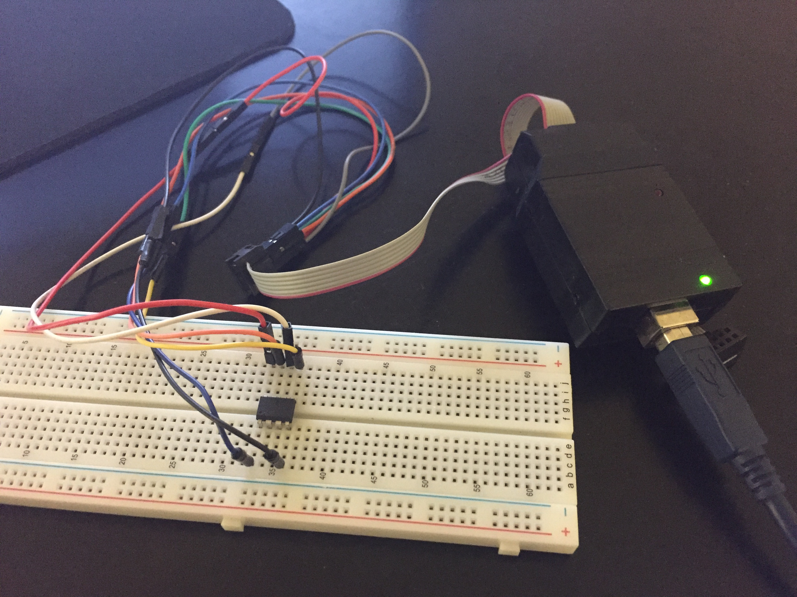
USB Interface
Programming the μC
With main.c and usbconfig.h set up, the μC can be programmed
USBtinyISP, an AVR programmer, was needed to program the chip
After programming, the rest of the circuit can be designed around it

Slide 15
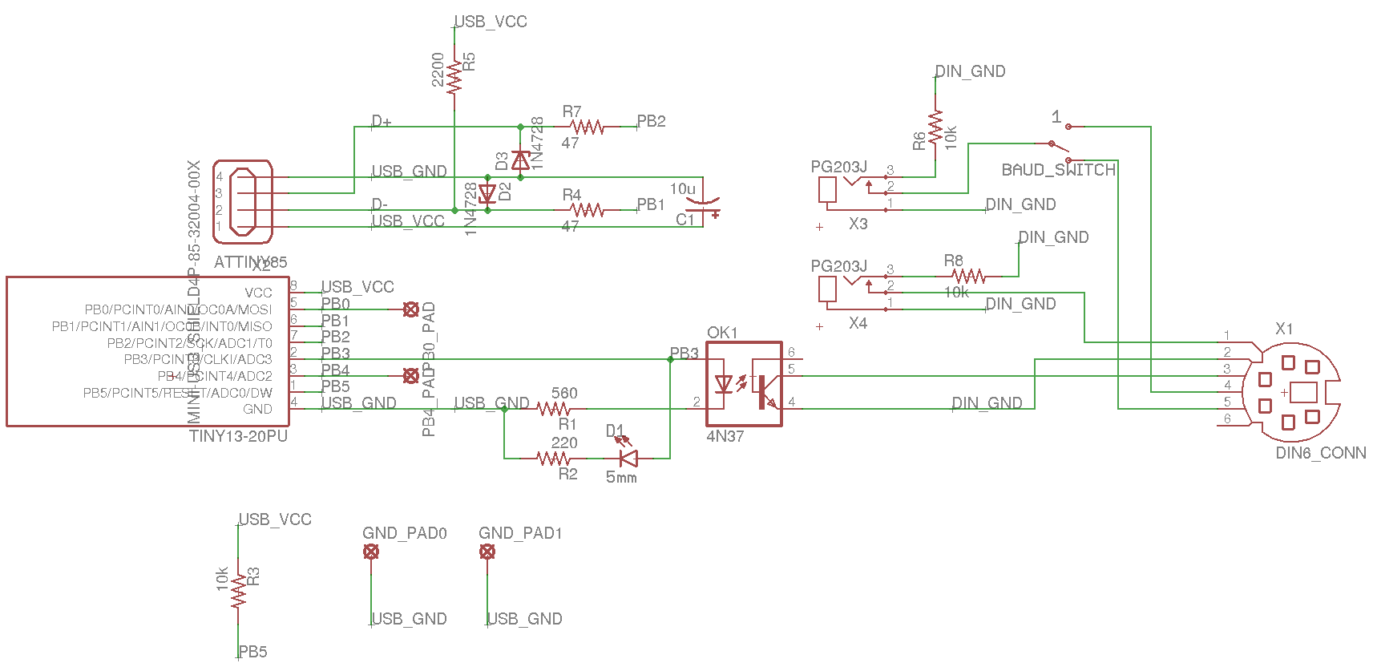
Circuit Design
USB Connector
Standard USB supports 5V power and ground and 3.3V data lines
Flyback voltage may develop when unplugging USB cables
  Min 1uF to max 10uF capacitor across Vbus/GND to prevent damage

Slide 16
Circuit Design
ATtiny85 Microcontroller (μC)
Communicates with computer through USB
Interprets commands and controls output pins
Powered by 5V USB Vbus
3.6V zener diodes to regulate μC 5V I/O pins for data line use

Slide 17
Circuit Design
Visual LED
μC turns the LED on via an output pin
Just a way to let operator know when the radio is transmitting
Same output pin also connected to optoisolator (next slide)

Slide 18
Circuit Design
Optoisolator
Used to isolate computer USB from radio
Transfers signal optically through LED and phototransistor
μC turns the device on/off via the same output pin as the visual LED
Two separate grounds (USB_GND & DIN_GND)

Slide 19
Circuit Design
Signal I/O
Audio jacks used for Tx/Rx signals
Slide switch on Rx signal selects 1200 or 9600bps
Connected to ground through 10kΩ resistor when unplugged

Slide 20
Circuit Design
Mini-DIN 6-pin Connector
Connects everything between the circuit and the radio
  PTT pin
  Ground
  Tx line
  1200/9600bps Rx lines

Slide 21
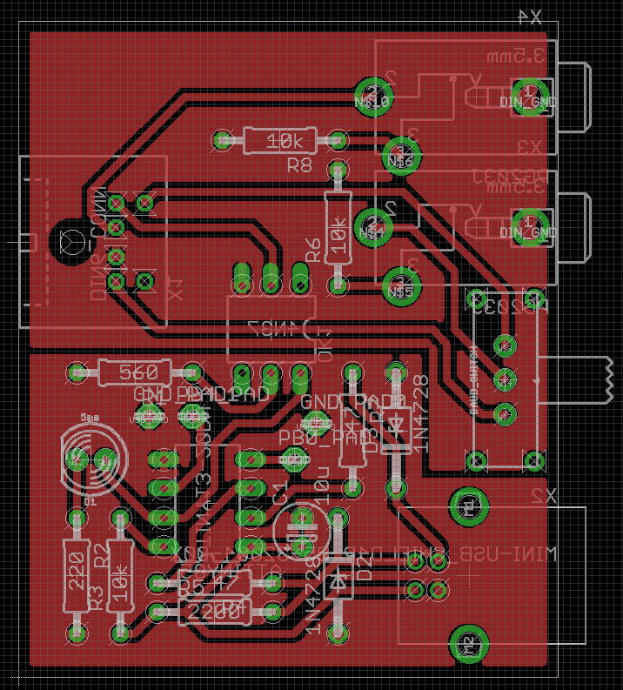
Circuit Design
Layout
Layout (and schematic) done in EAGLE PCB Software
Single-layer PCB
Two ground planes for isolation
Component Location
  1 – Mini-DIN 6-pin Connector
  2 – Audio Input
  3 – Audio Output
  4 – 9600/12000 Baud Slide Switch
  5 – USB Connector
  6 – ATtiny85 μC
  7 – Optoisolator
  8 – Visual LED
2
1
3
7
4
8
6
5

Slide 22
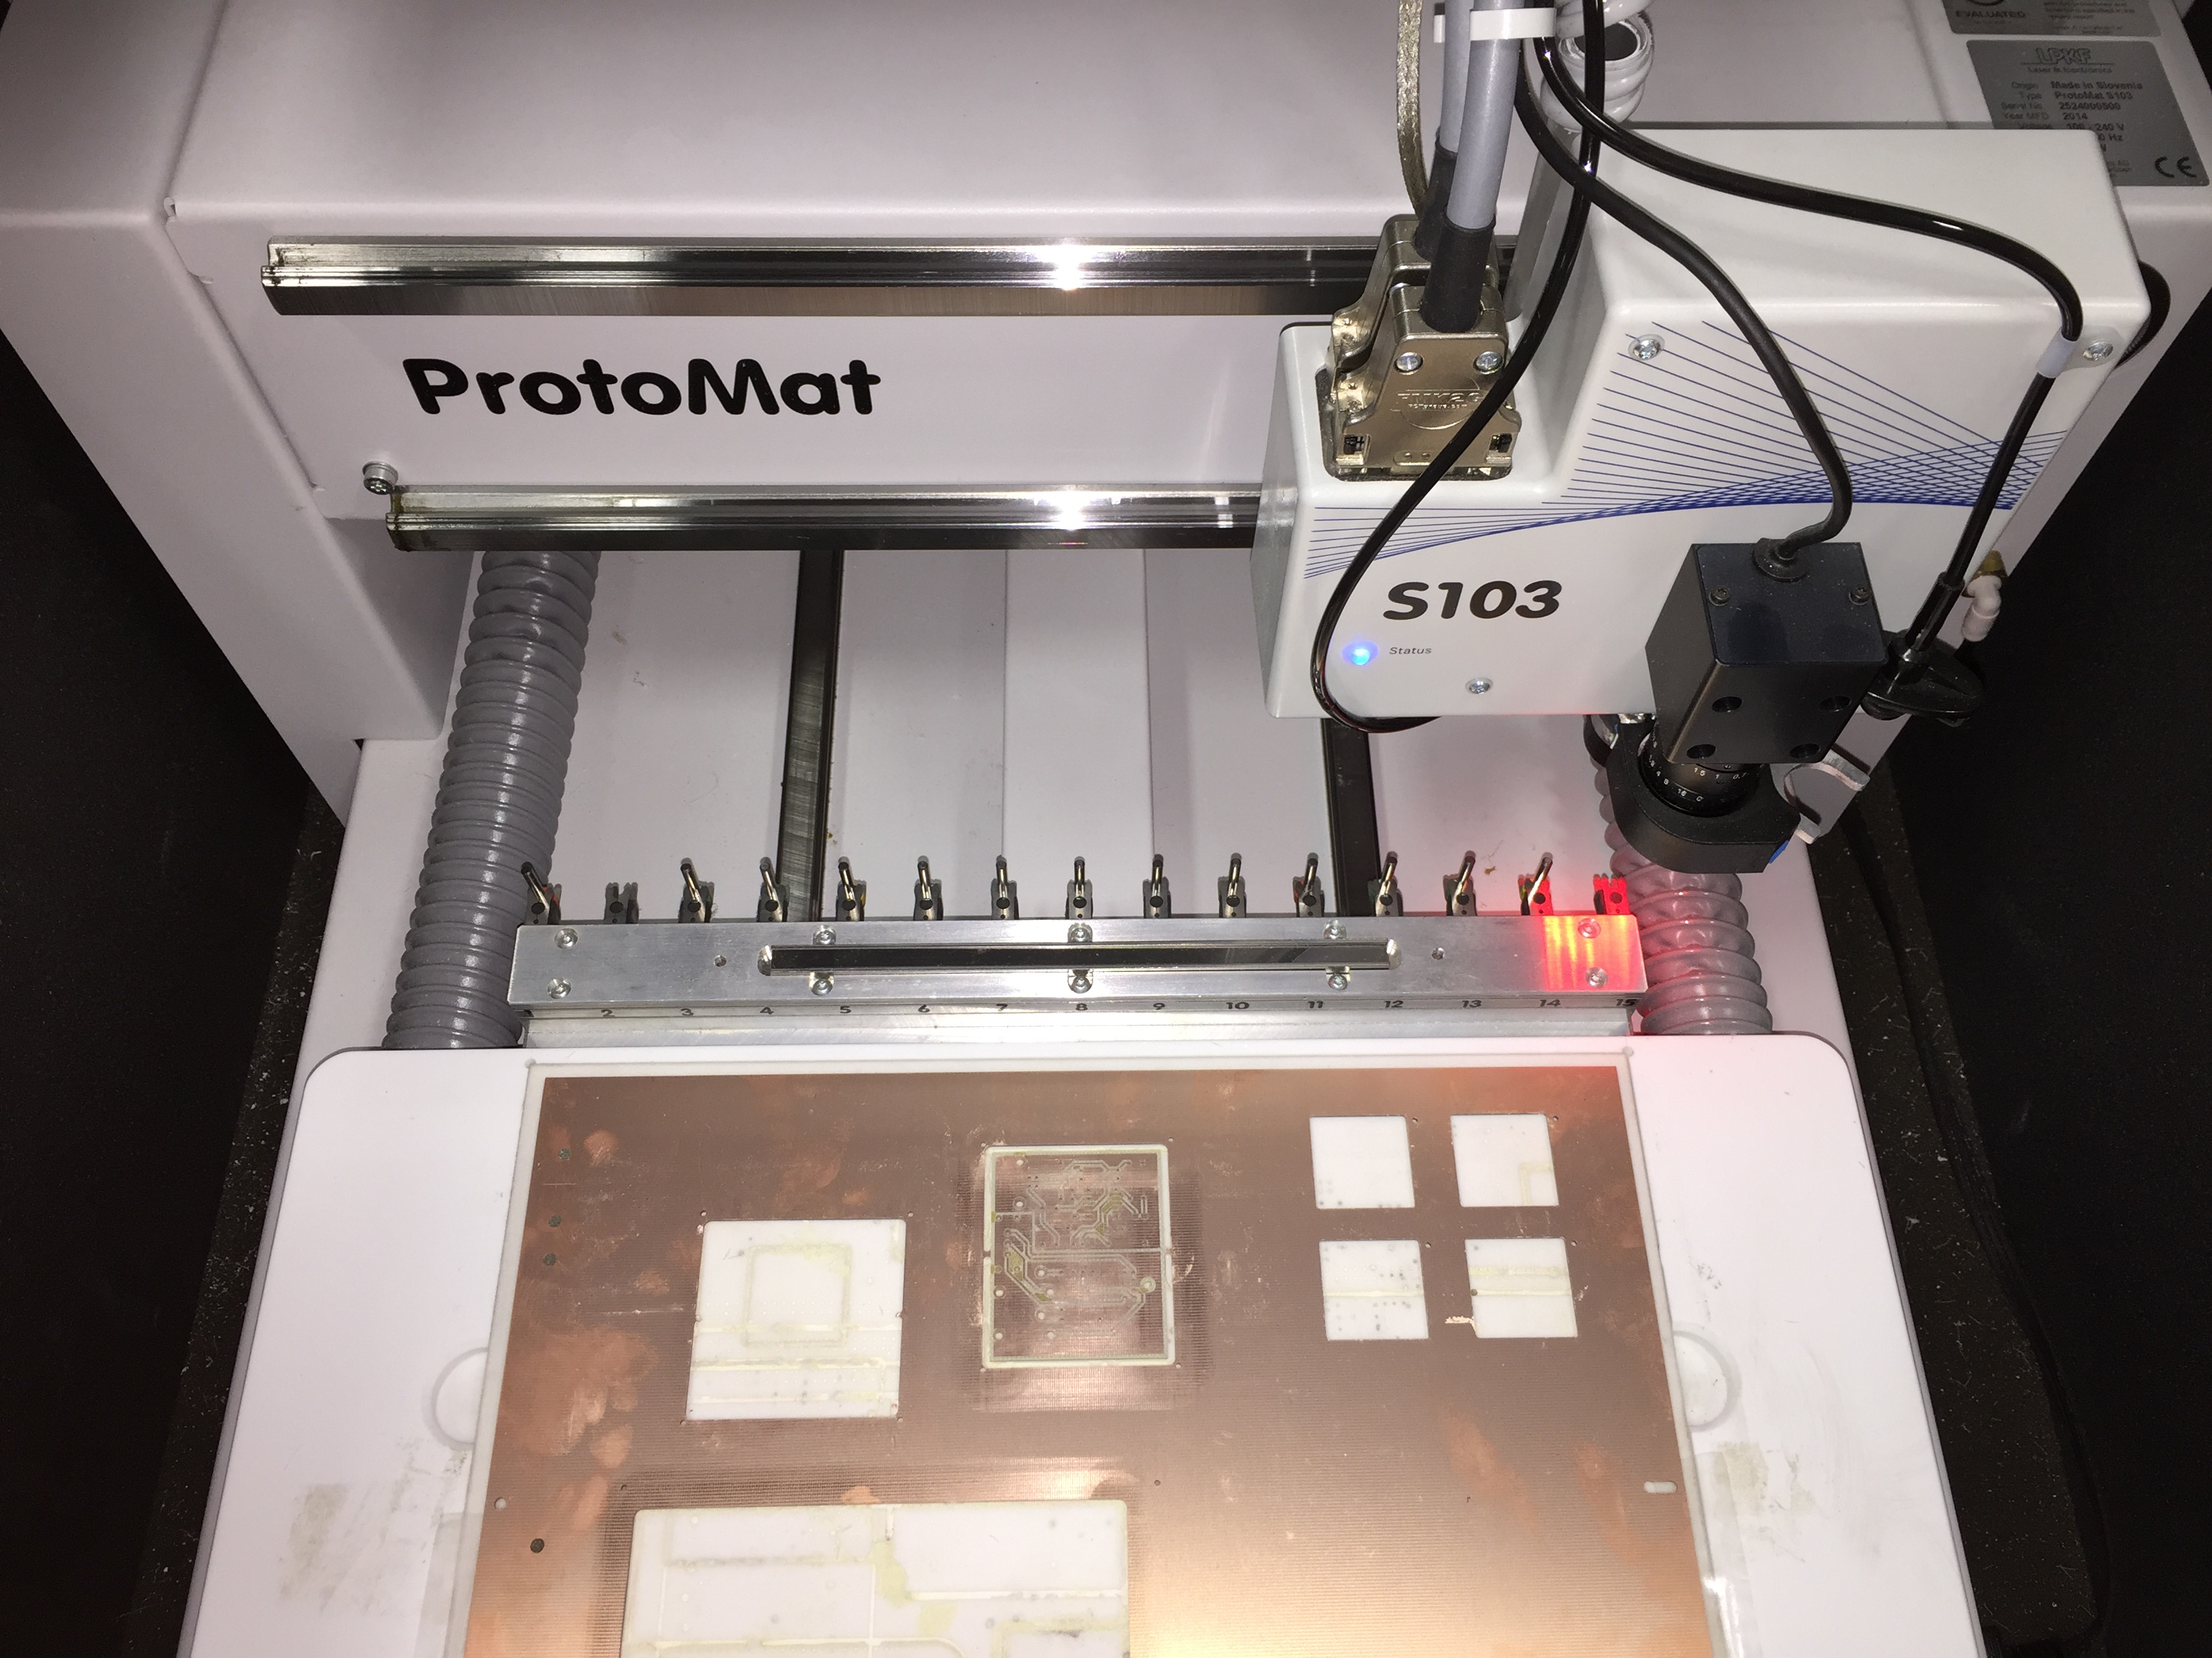
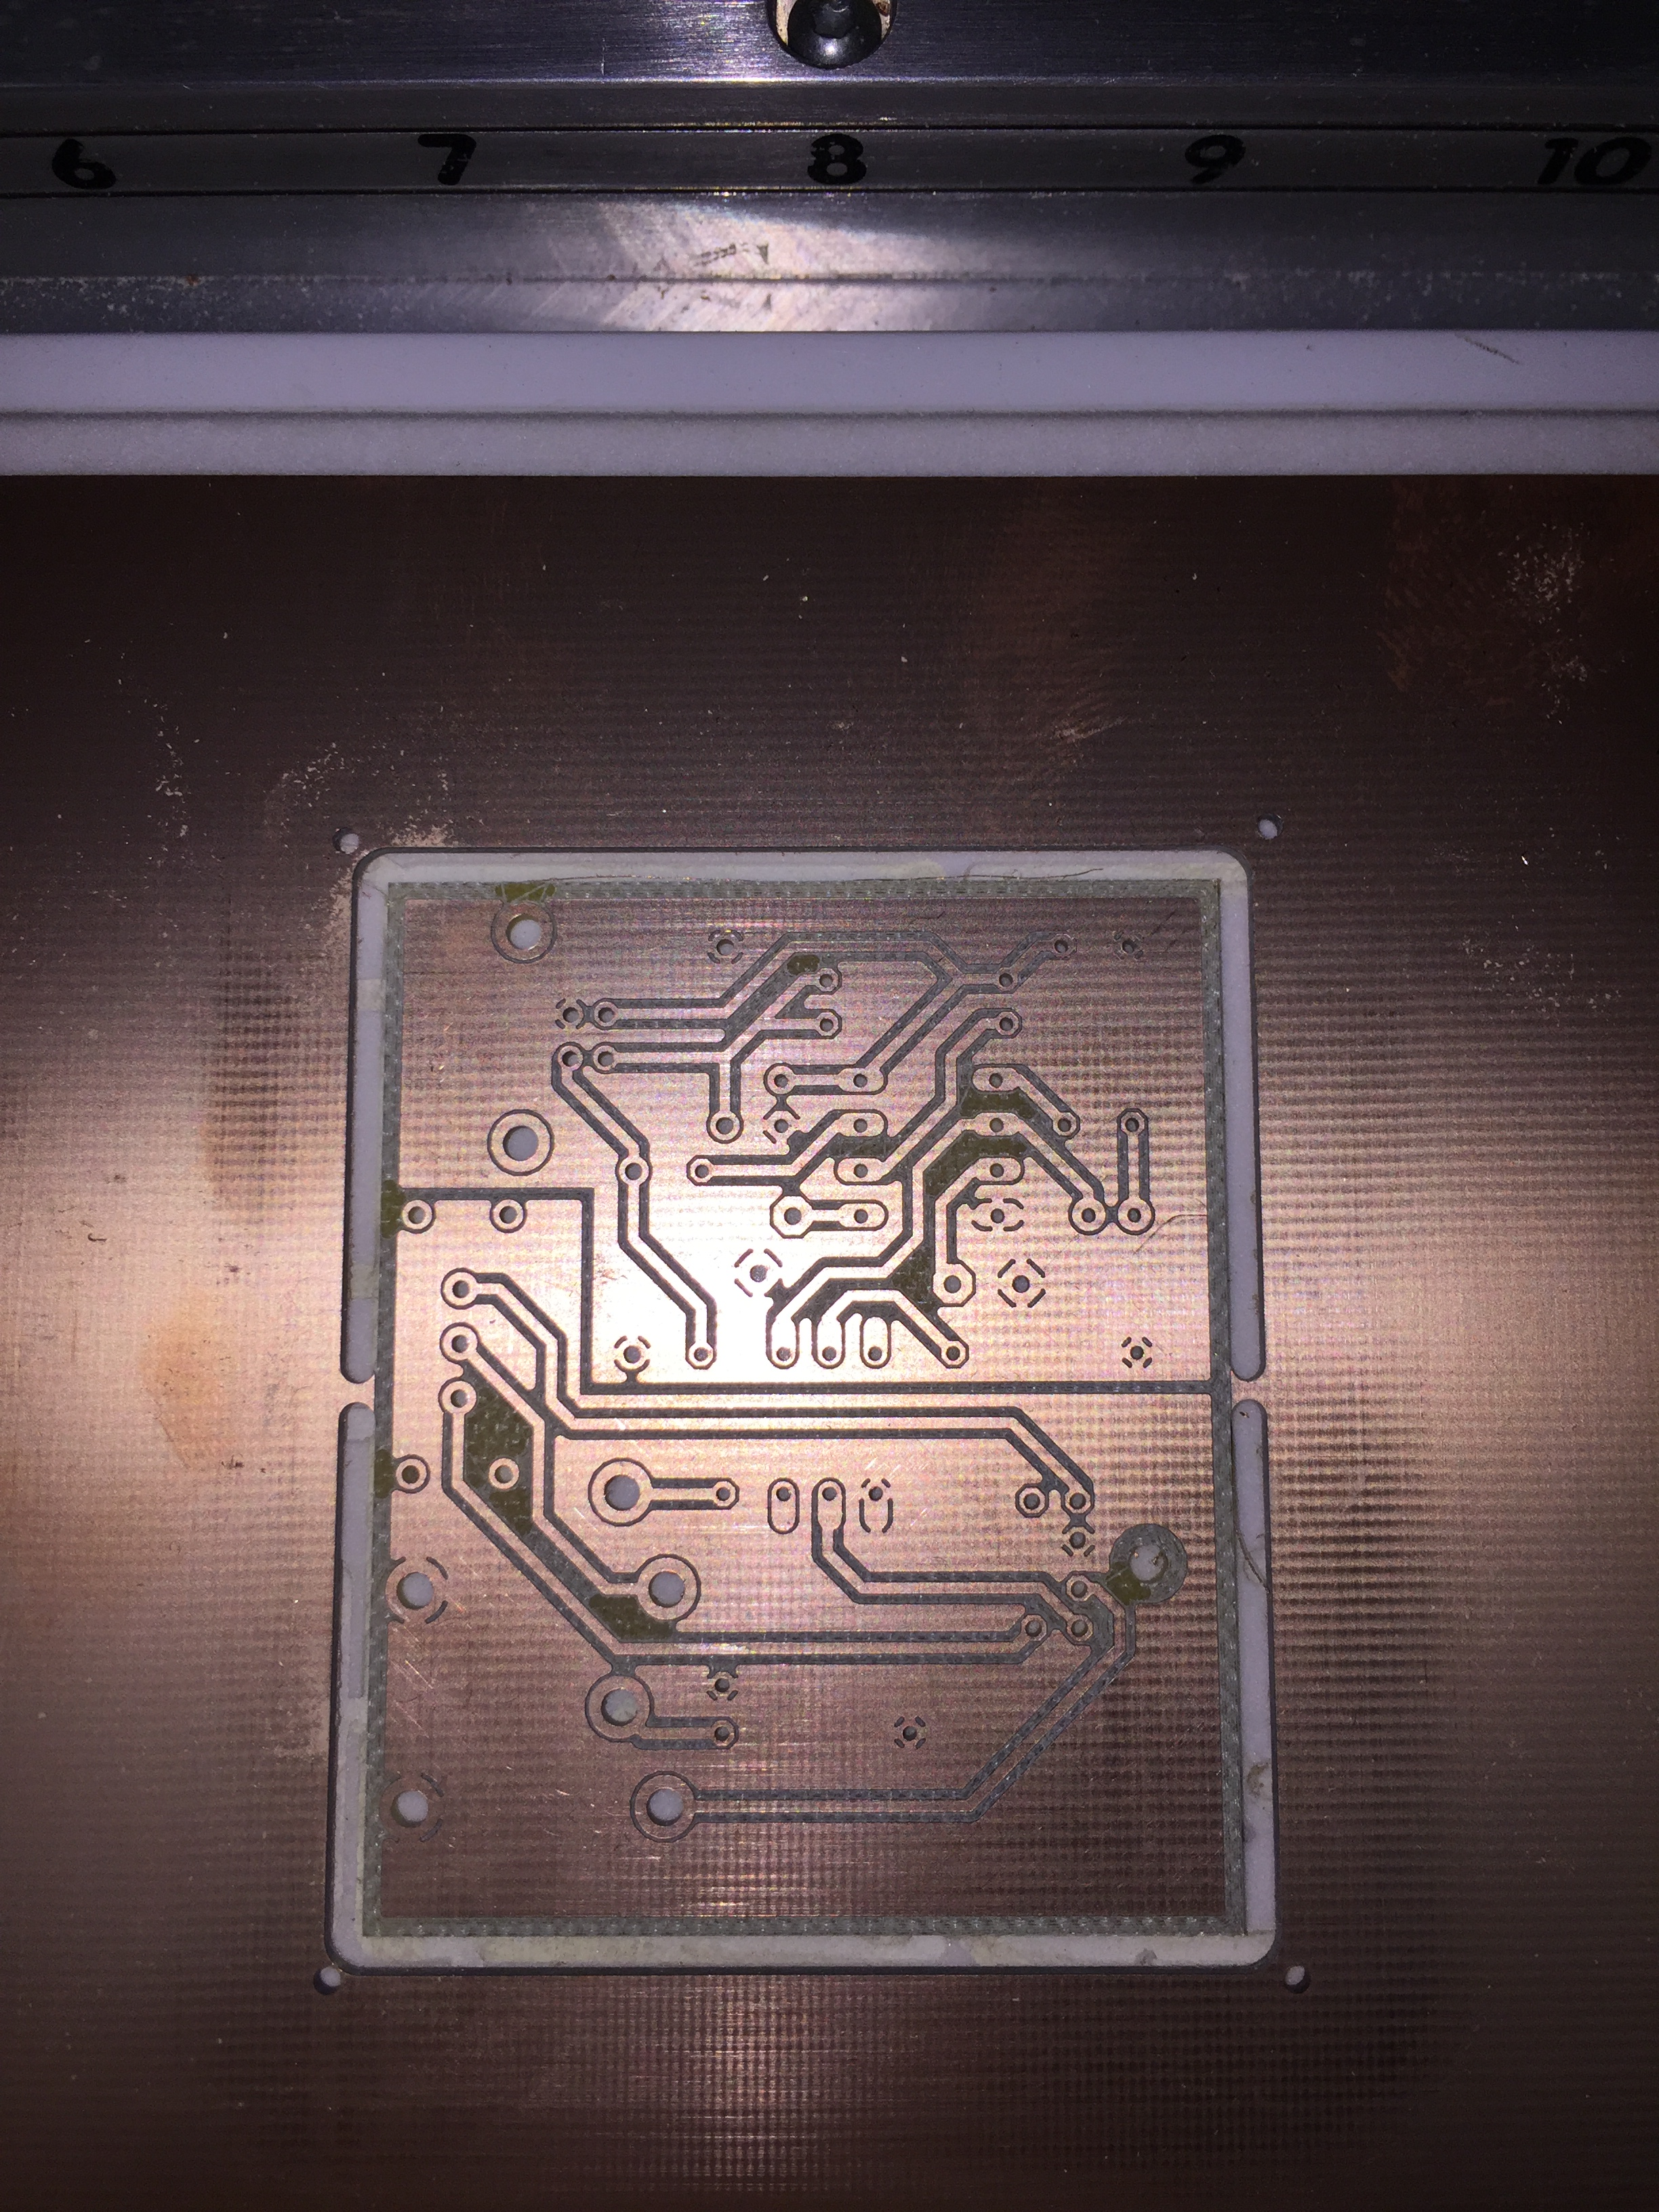
Fabrication
PCB Fabrication
LPKF PCB milling machine in Fablab
Approx 45 minutes fabrication time

Slide 23
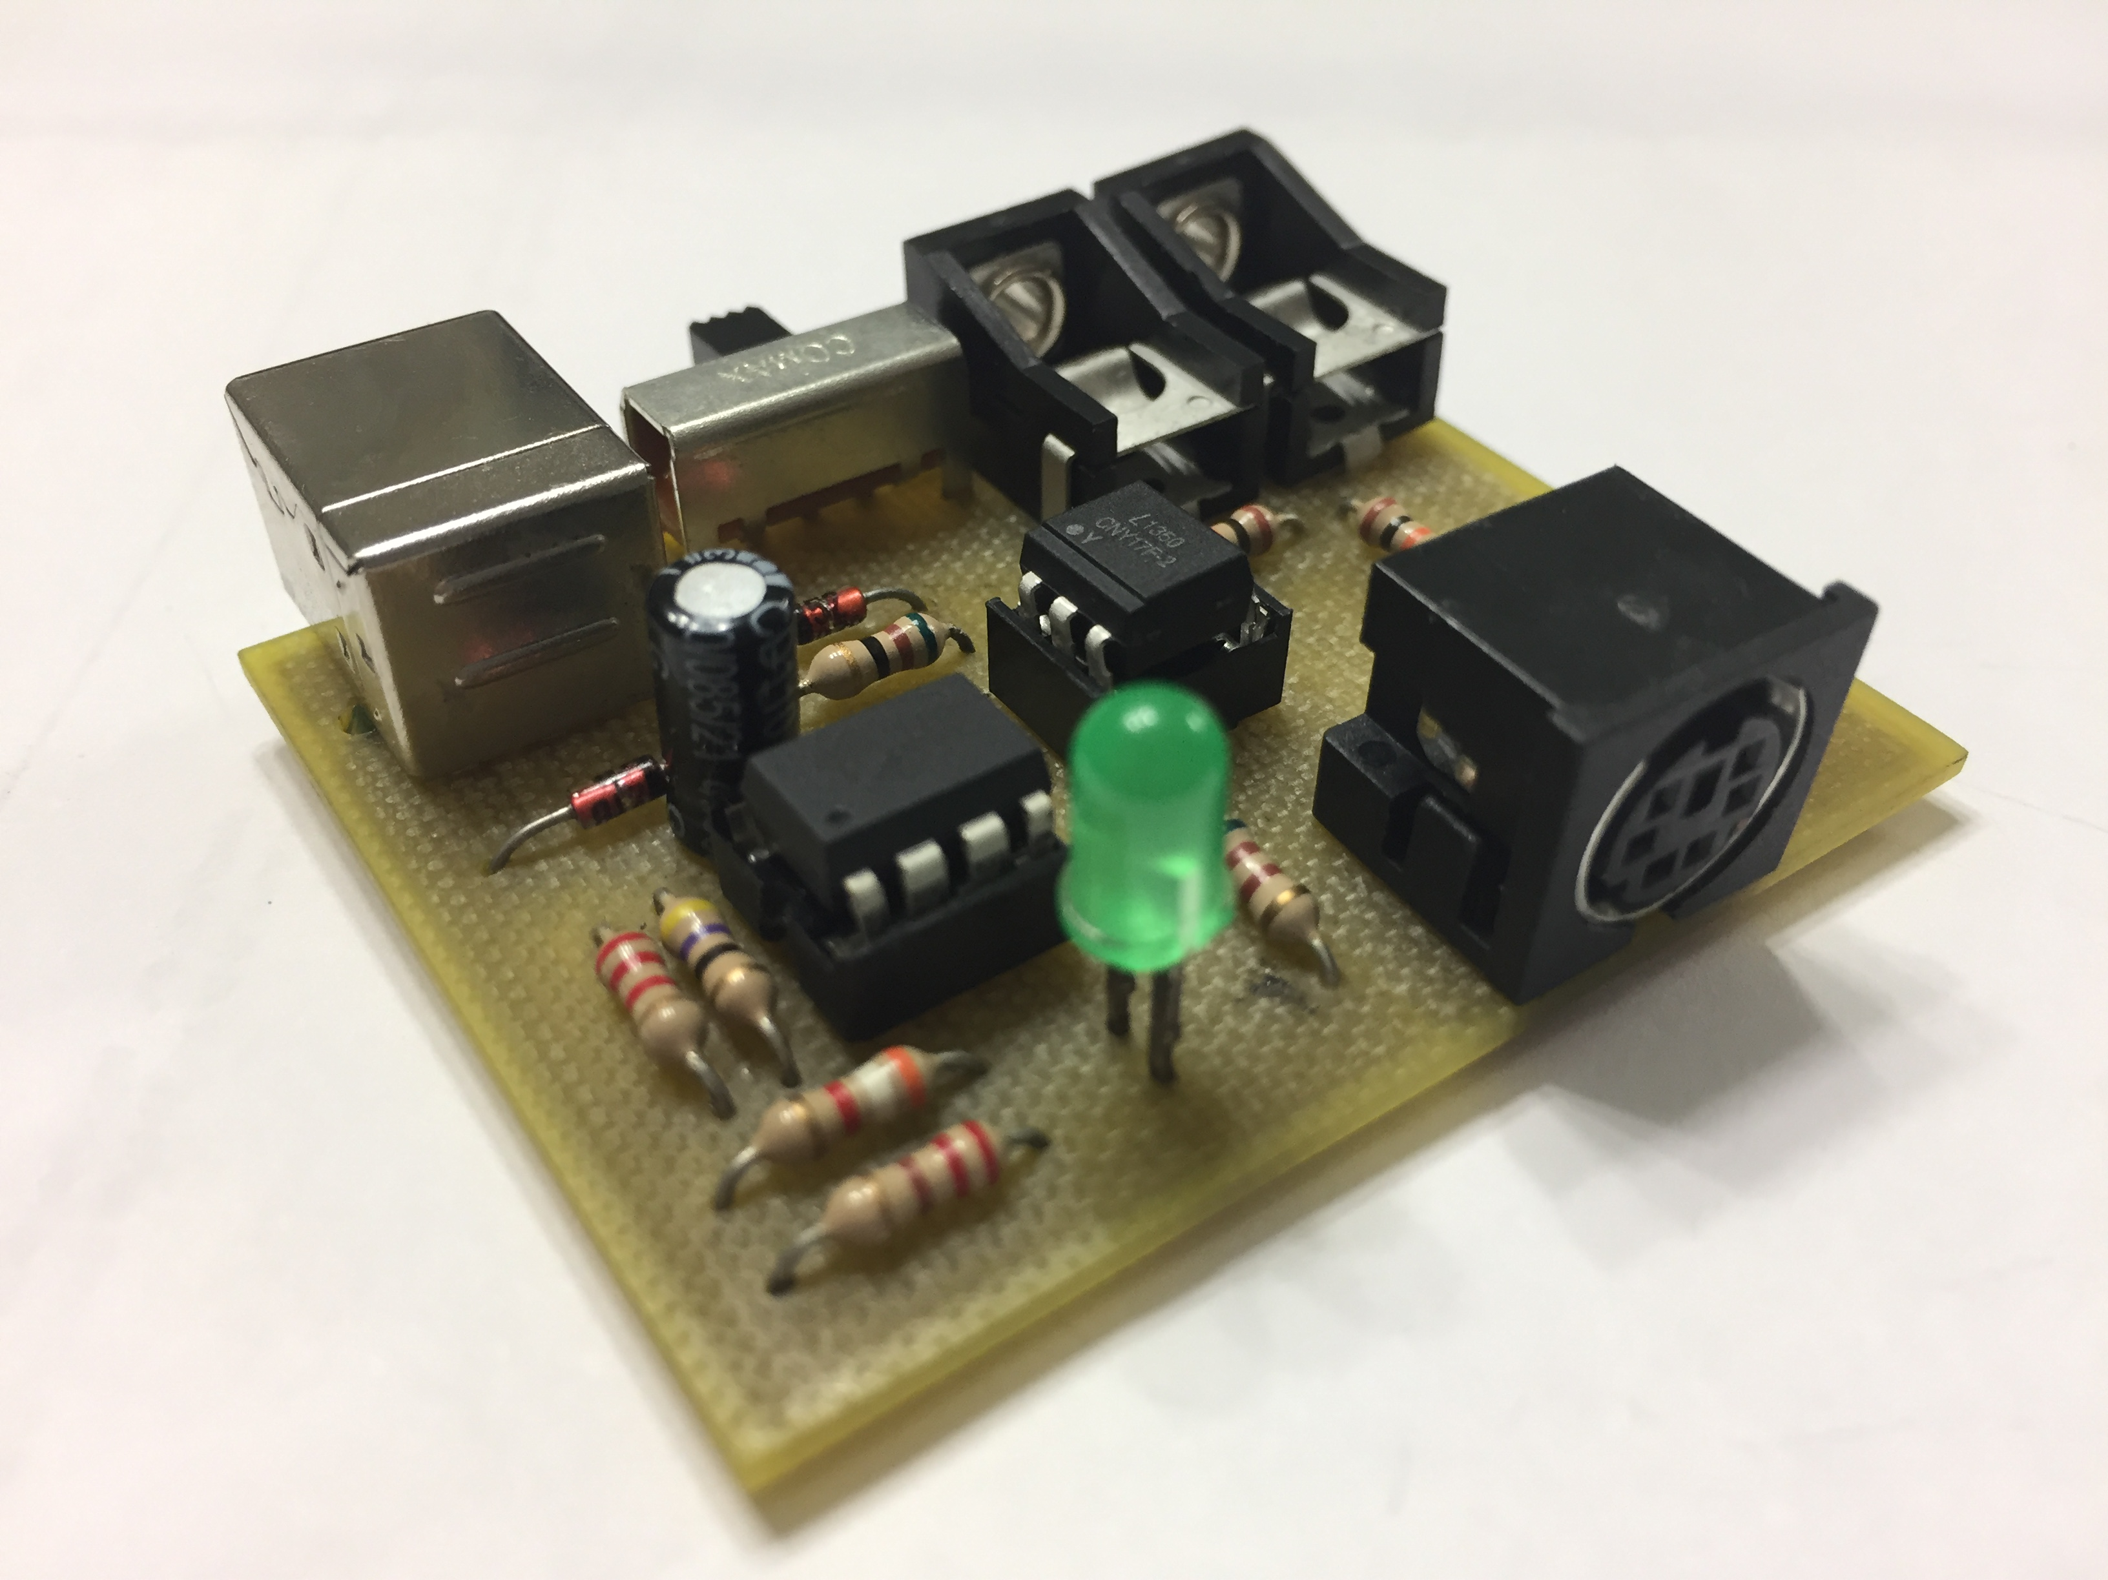
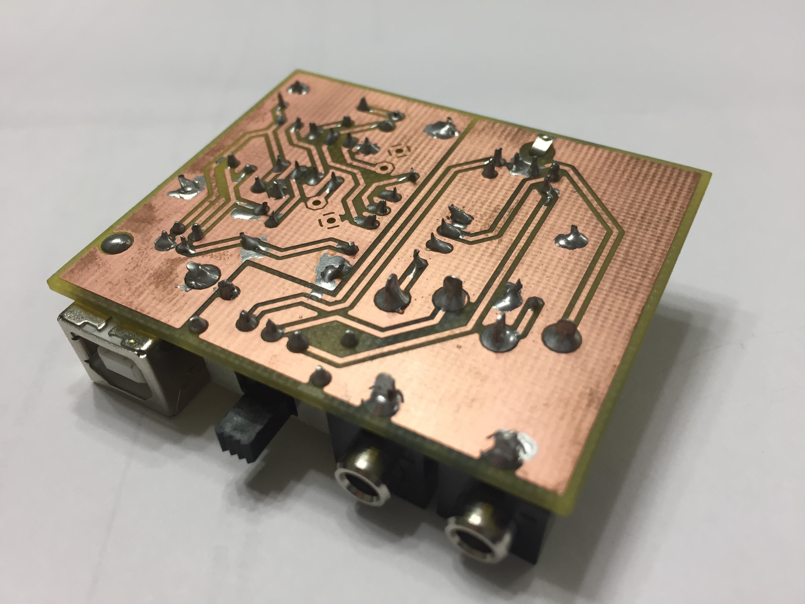
Fabrication
Board Assembly
Board with soldered components

Slide 24
Driver Software
Software Hierarchy
*The following applies to Linux systems
Direwolf (user space program) needs to control the USB device
Device driver (kernel space program) needed to allow user space program to interact with the actual hardware device
User Application
User
Space
Library Function
System Call
Kernel
Space
Device Driver
Hardware

Slide 25
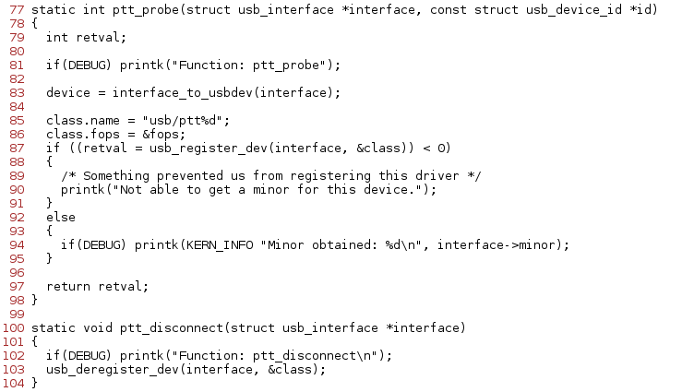

Driver Software
ptt_driver.c
ptt_driver.c is created as the device driver
One important structure and several important functions are defined here
  ptt_table is a list of all devices that will work with this driver
      Device is identified by the same unique number that was programmed into the microcontroller
  ptt_probe registers the device with the kernel when it plugged in
    The “class” parameter being passed in contains the name for the device file, “ptt%d”
  ptt_disconnect will de-register the device when it is unplugged

Slide 26
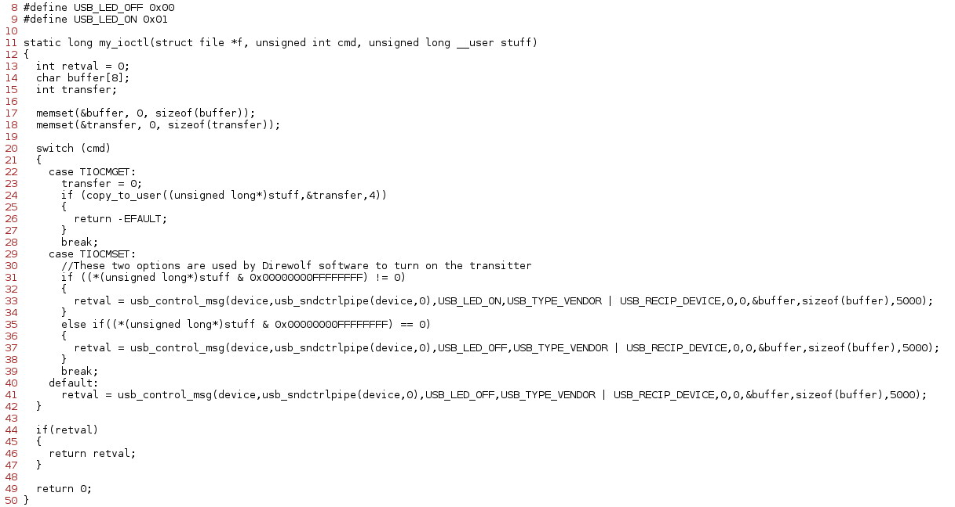
Driver Software
ptt_driver.c
When Direwolf sends a command to the device, it uses a system call function, called “ioctl”, or I/O Control
One of the parameters of ioctl specifies the device file that the command is for (“ptt%d”)
This command is then caught by the driver and interpreted
The driver then uses a special function called “usb_control_msg” to send the proper command to the actual hardware device

Slide 27
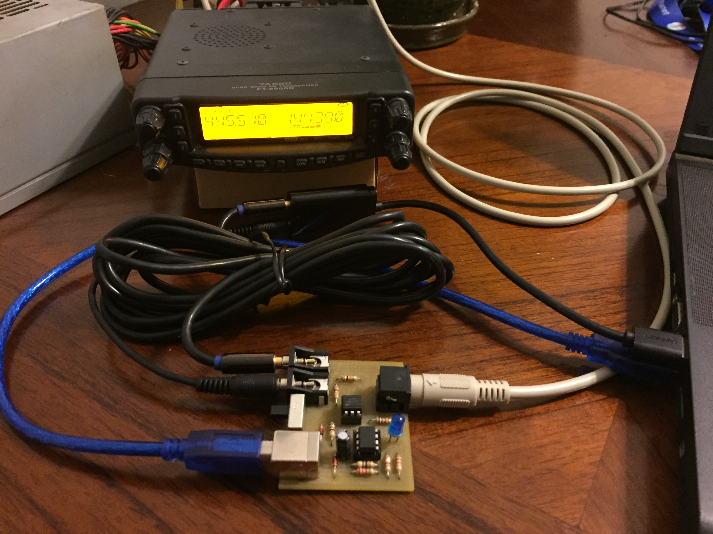
Driver Software
ptt_driver.ko
ptt_driver.c can then be compiled into an executable file and loaded into the Linux kernel
The driver file has the “.ko” extension at the end, as do all Linux driver files
Finally, the hardware device can be plugged into the computer and radio

Slide 28
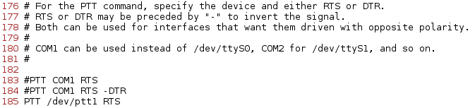
Integration
Direwolf
Now, Direwolf can be configured to use the new device
  “direwolf.conf” is created automatically by the software in the user's home directory
  Changed the desired channel PTT property to “PTT /dev/ptt0 RTS”

Slide 29
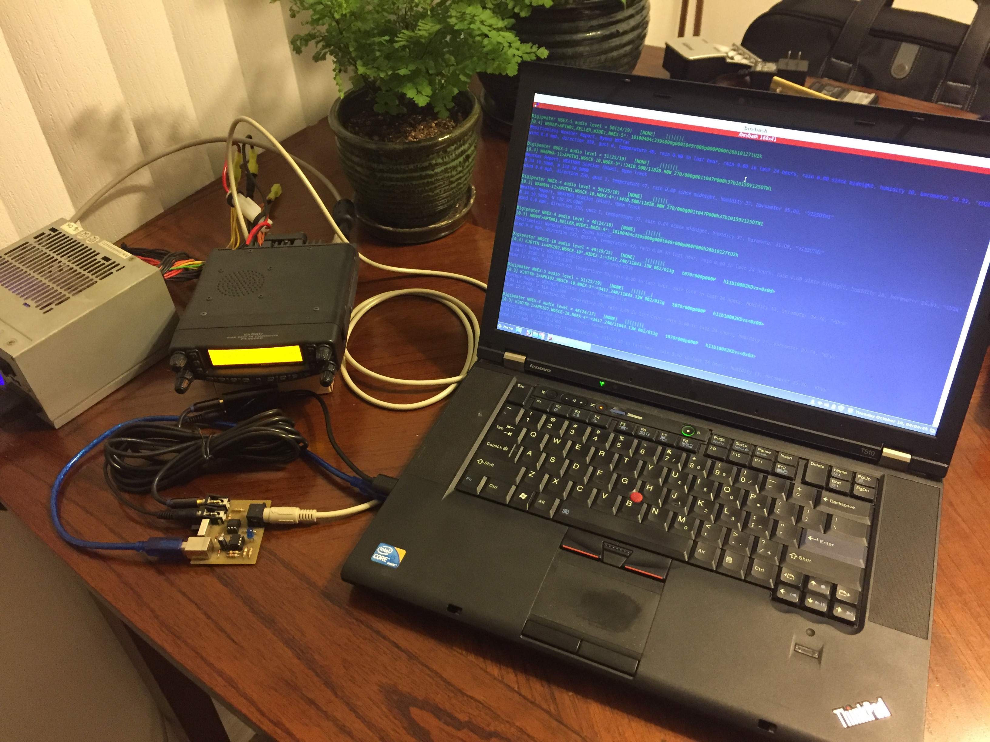
Integration
Direwolf
Open Direwolf and see all the incoming messages

Slide 30
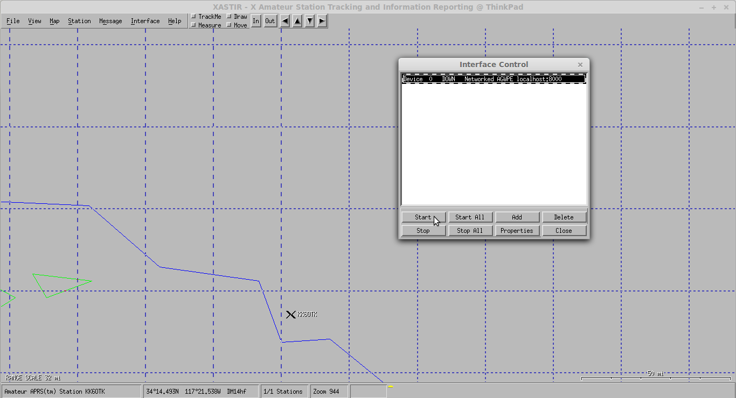
Integration
Xastir
Open Xastir and connect to Direwolf

Slide 31
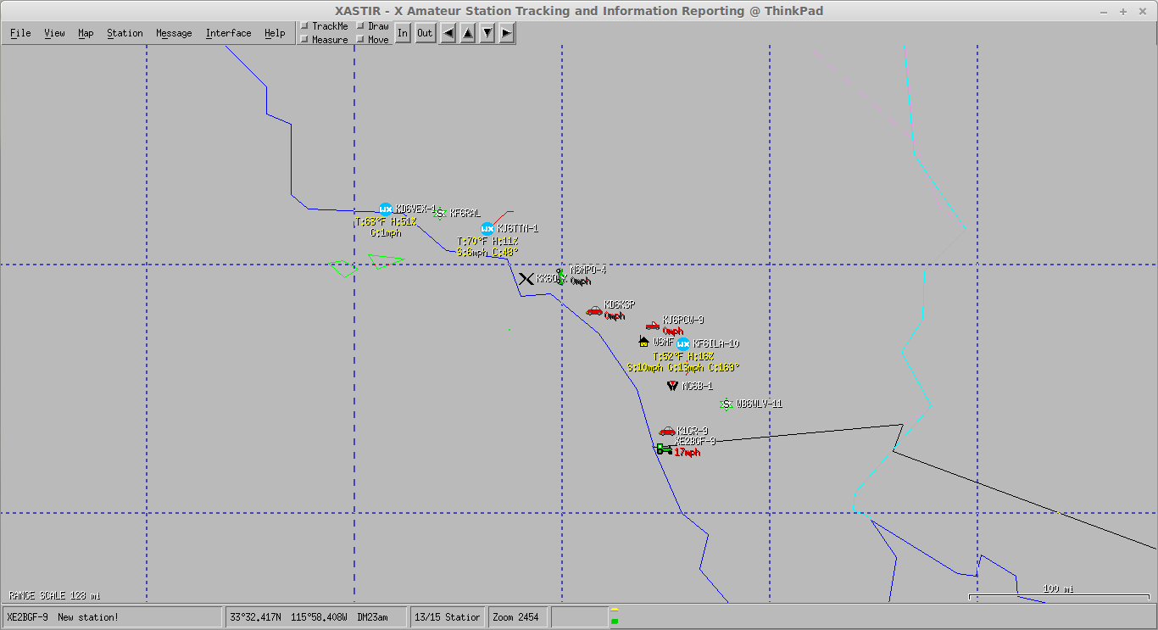
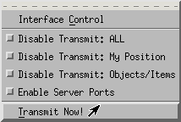
Integration
Xastir
See object start popping up on the map
Transmit callsign and location

Slide 32
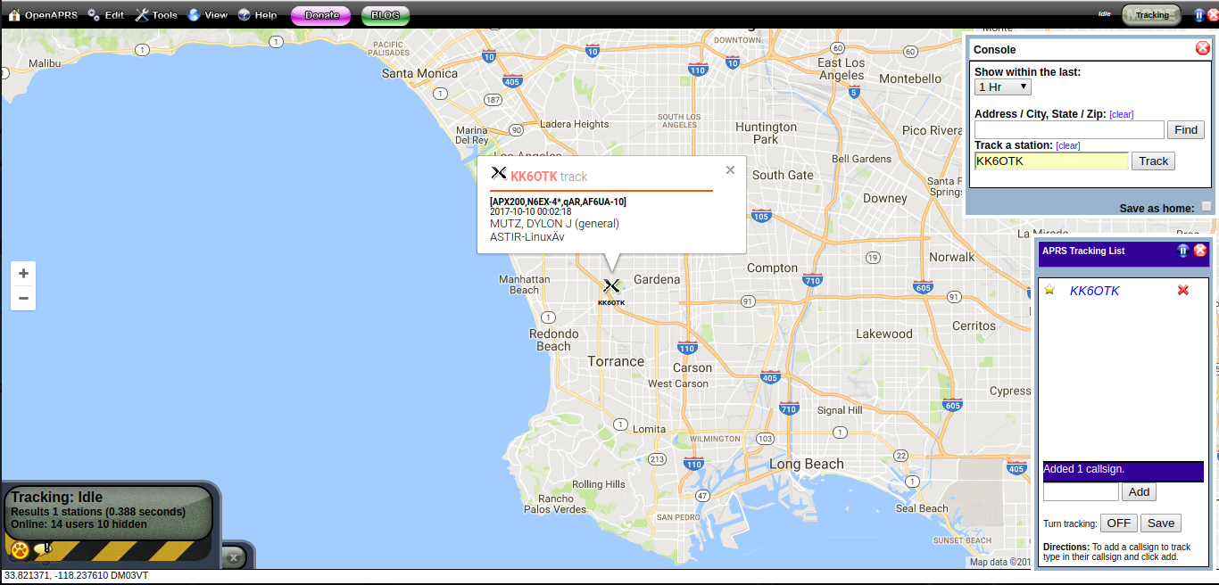
Integration
OpenAPRS
Check www.openaprs.net to verify message was heard

Slide 33

Demo

Slide 34
Other Comments
Other Comments
Developed in Linux, but could be applied to Windows and Mac
AVR chips + V-USB
  Can be applied to much more complicated devices/machines
    Interfaces & adapters
    Data acquisition
    Display and LEDs
    Motor control
  DIY software as well to control custom hardware
Slides and all software code, schematic, layout, etc is on my GitHub profile
  https://github.com/KK6OTK/USB_PTT
Radio connector and layout could be modified for other radios

Slide 35
Future Improvements
Future Improvements
Support for HT connections
Audio isolation between radio and soundcard
Support for squelch
Support more software options
Resistor on optoisolator bias pin
  Prevent stray RF from being picked up on open wire
Housing for the PCB
Installation script for driver
Microsoft Windows driver

Slide 36
Bill of Materials
Part | Digikey Part # | Quantity | Total Cost
USB Connector | ED2982-ND | 1 | $0.55
8-pin IC Socket | AE9986-ND | 1 | $0.18
6-pin IC Socket | A1203467-ND | 1 | $0.20
ATtiny85 | ATTINY85-20PU-ND | 1 | $1.26
Optoisolator | 160-1318-5-ND | 1 | $0.37
3.6V Zener Diode | 1N5226B-TPCT-ND | 2 | $0.24
6-pin mini-DIN Connector | MD-60S | 1 | $1.15
SPDT Slide Switch | CKN10393-ND | 1 | $0.50
3.5mm Mono Jack | CP-3536N-ND | 2 | $1.32
5mm LED | Spare parts | 1 | ~$0.10
Resistors and capacitors | Spare parts | 9 | ~$0.90
USB, Audio, & DIN Cable | Spare parts | 4 | ~$10.00
PCB | Made in Fablab | 1 | $0.00
Total |  |  | ~$16.77

Slide 37
References
References
[1] APRS: Automatic Packet Reporting System. Available: http://www.aprs.org/
[2] Sound Card Packet TNC Computer to Radio Interface. Available: http://kb3kai.com/sound-card-tnc
[3] Ham Radio Software on Centos Linux. Available: http://www.trinityos.com/HAM/CentosDigitalModes/hampacketizing-centos.html#6.softtnc
[4] Direwolf Soundcard Packet on Linux, with AX25 and LinPac. Available: https://www.kevinhooke.com/2015/09/12/direwolf-soundcard-packet-on-linux-with-ax25-and-linpac/
[5] Packet Radio: Introduction to Packet Radio. Available: https://www.tapr.org/pr_intro.html
[6] GitHub: wb20sz/direwolf. Available: https://github.com/wb2osz/direwolf
[7] XastirWiki. Available: https://xastir.org/index.php/Main_Page
[8] V-USB with ATtiny45/ATtiny85 without a crystal. Available: http://codeandlife.com/2012/02/22/v-usb-with-attiny45-attiny85-without-a-crystal/
[9] USB in a Nutshell. Available: http://www.beyondlogic.org/usbnutshell/usb2.shtml
[10] An Introduction to Device Drivers in the Linux Kernel. Available: http://opensourceforu.com/2014/10/an-introduction-to-device-drivers-in-the-linux-kernel/
[11] OpenAPRS. Available: http://www.openaprs.net/
[12] Google Maps APRS. Available: https://aprs.fi/

