Slide 1
An Outlook on AI Jobs
Members:
Nathan Anecone
Kalvin Anglin
Peta-Gaye Mckenzie
Odele Pax
Funda Subasi

Slide 2
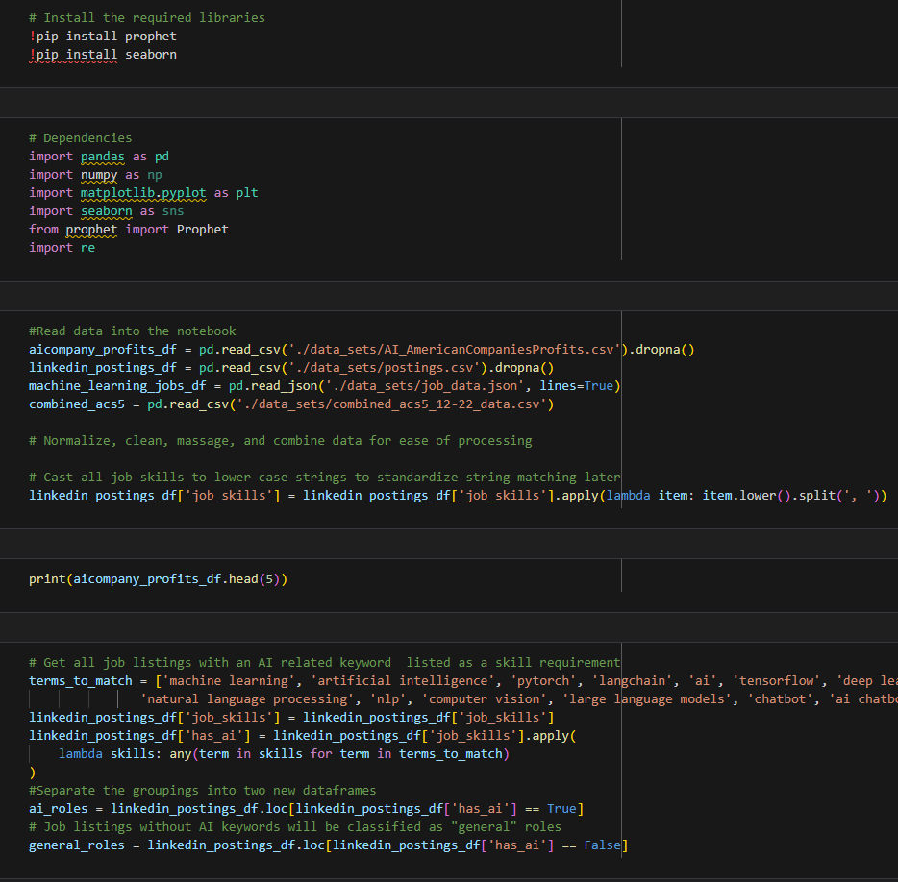
Project Overview
Trends of AI Jobs
As we see continued growth in tech sectors, we will see education adapt
to evolving skillset needs, along with organizations within the sector offering broader workplace flexibility.

Slide 3
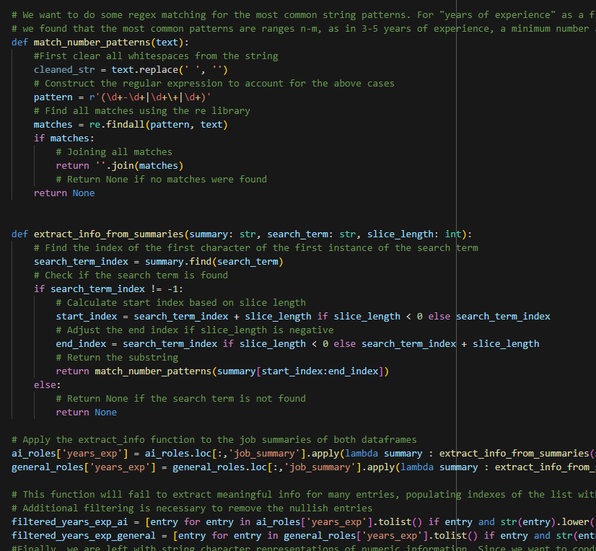
Project Overview
Questions Proposed
What industries are benefitting
the most from AI?
Where is the largest demand for jobs?
How has education adapted
to technical job needs?
What skillsets are the most desirable
for AI jobs?

Slide 4
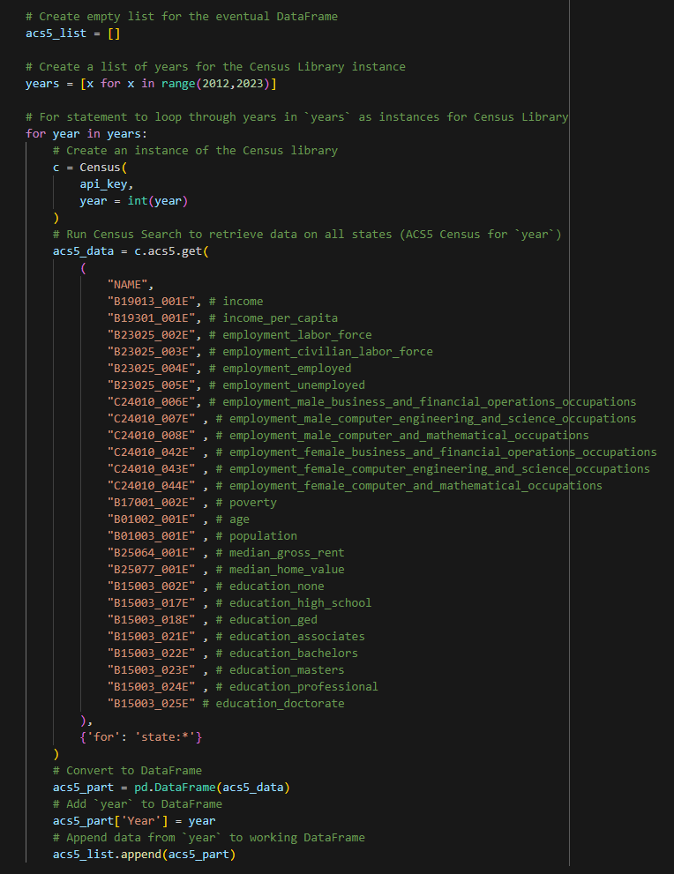
Project Overview
Steps Taken
Version Control
Sourcing Data
Finalizing Selections
Exploratory Data Analysis
Generating Visualizations
Summarizing Findings

Slide 5
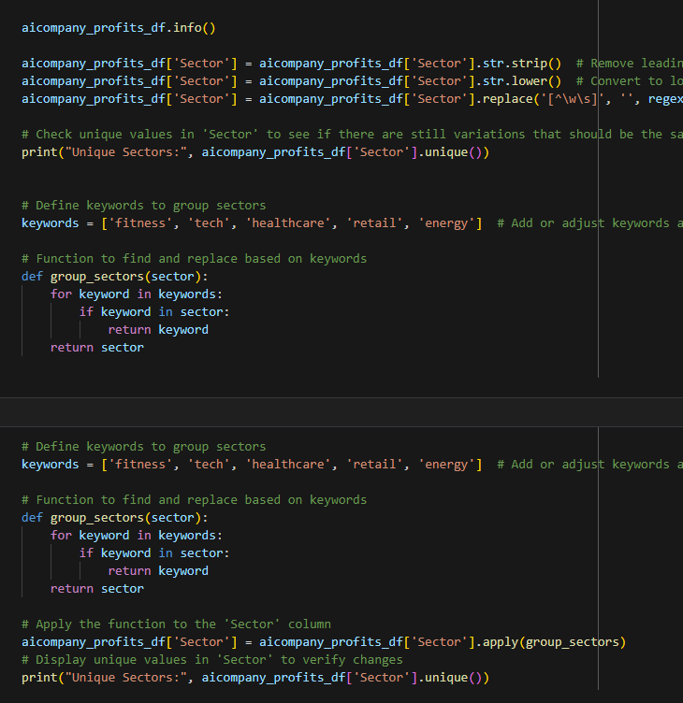
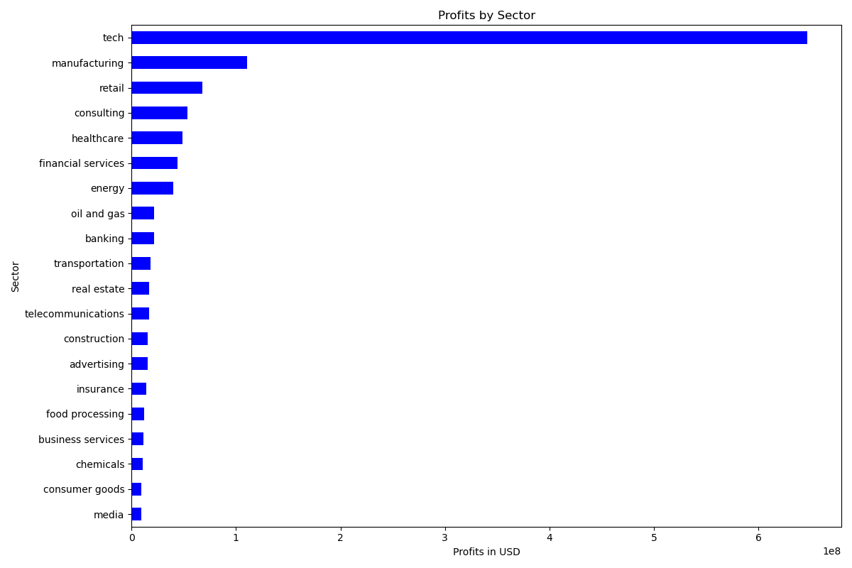
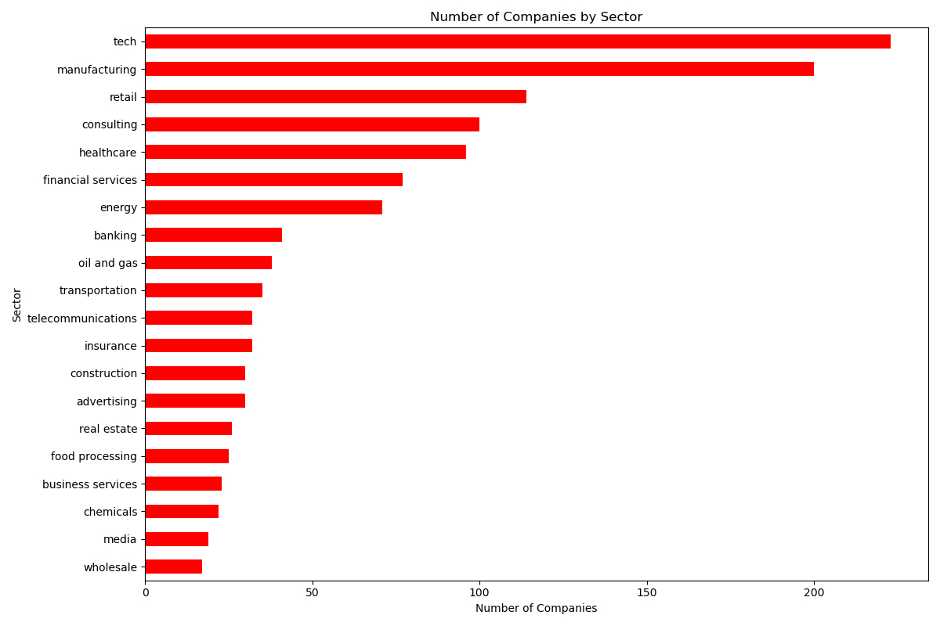
Question 1
What industries are benefitting
the most from AI?
Top 3 Sectors by total Companies:
Tech
Manufacturing
Retail
Top 3 Most Profitable Sectors:
Tech
Manufacturing
Retail

Slide 6
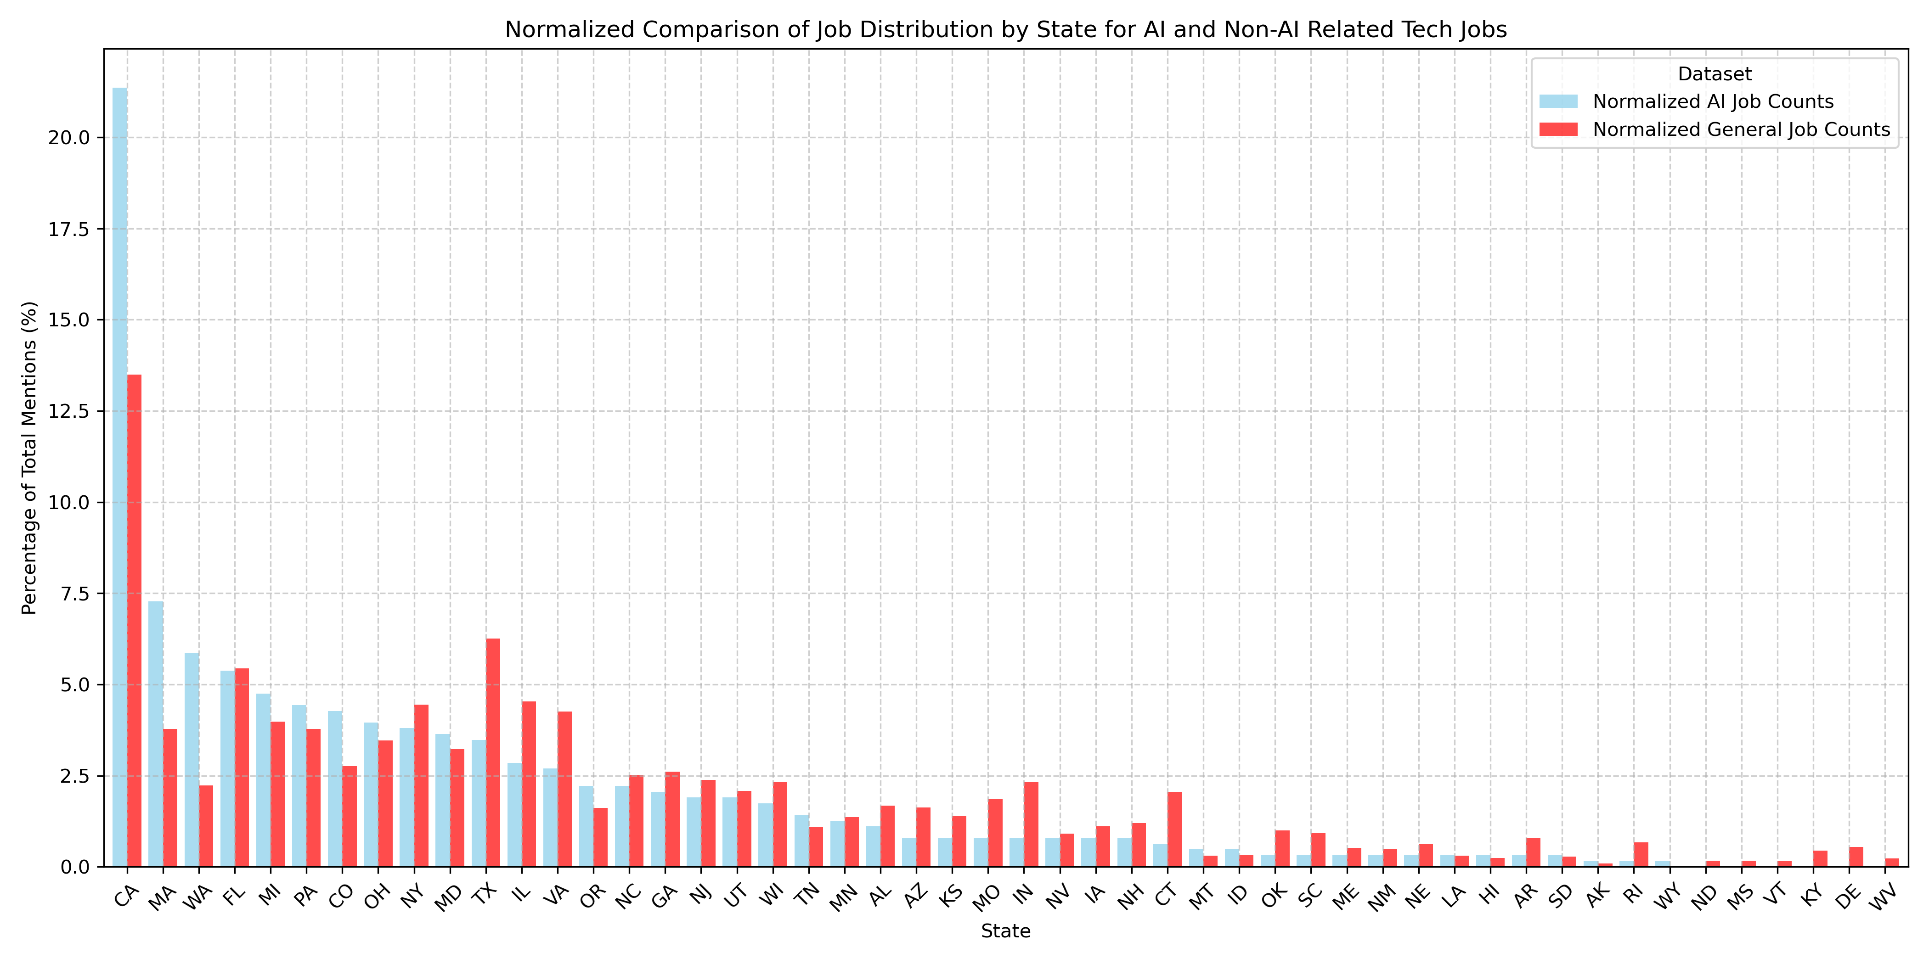
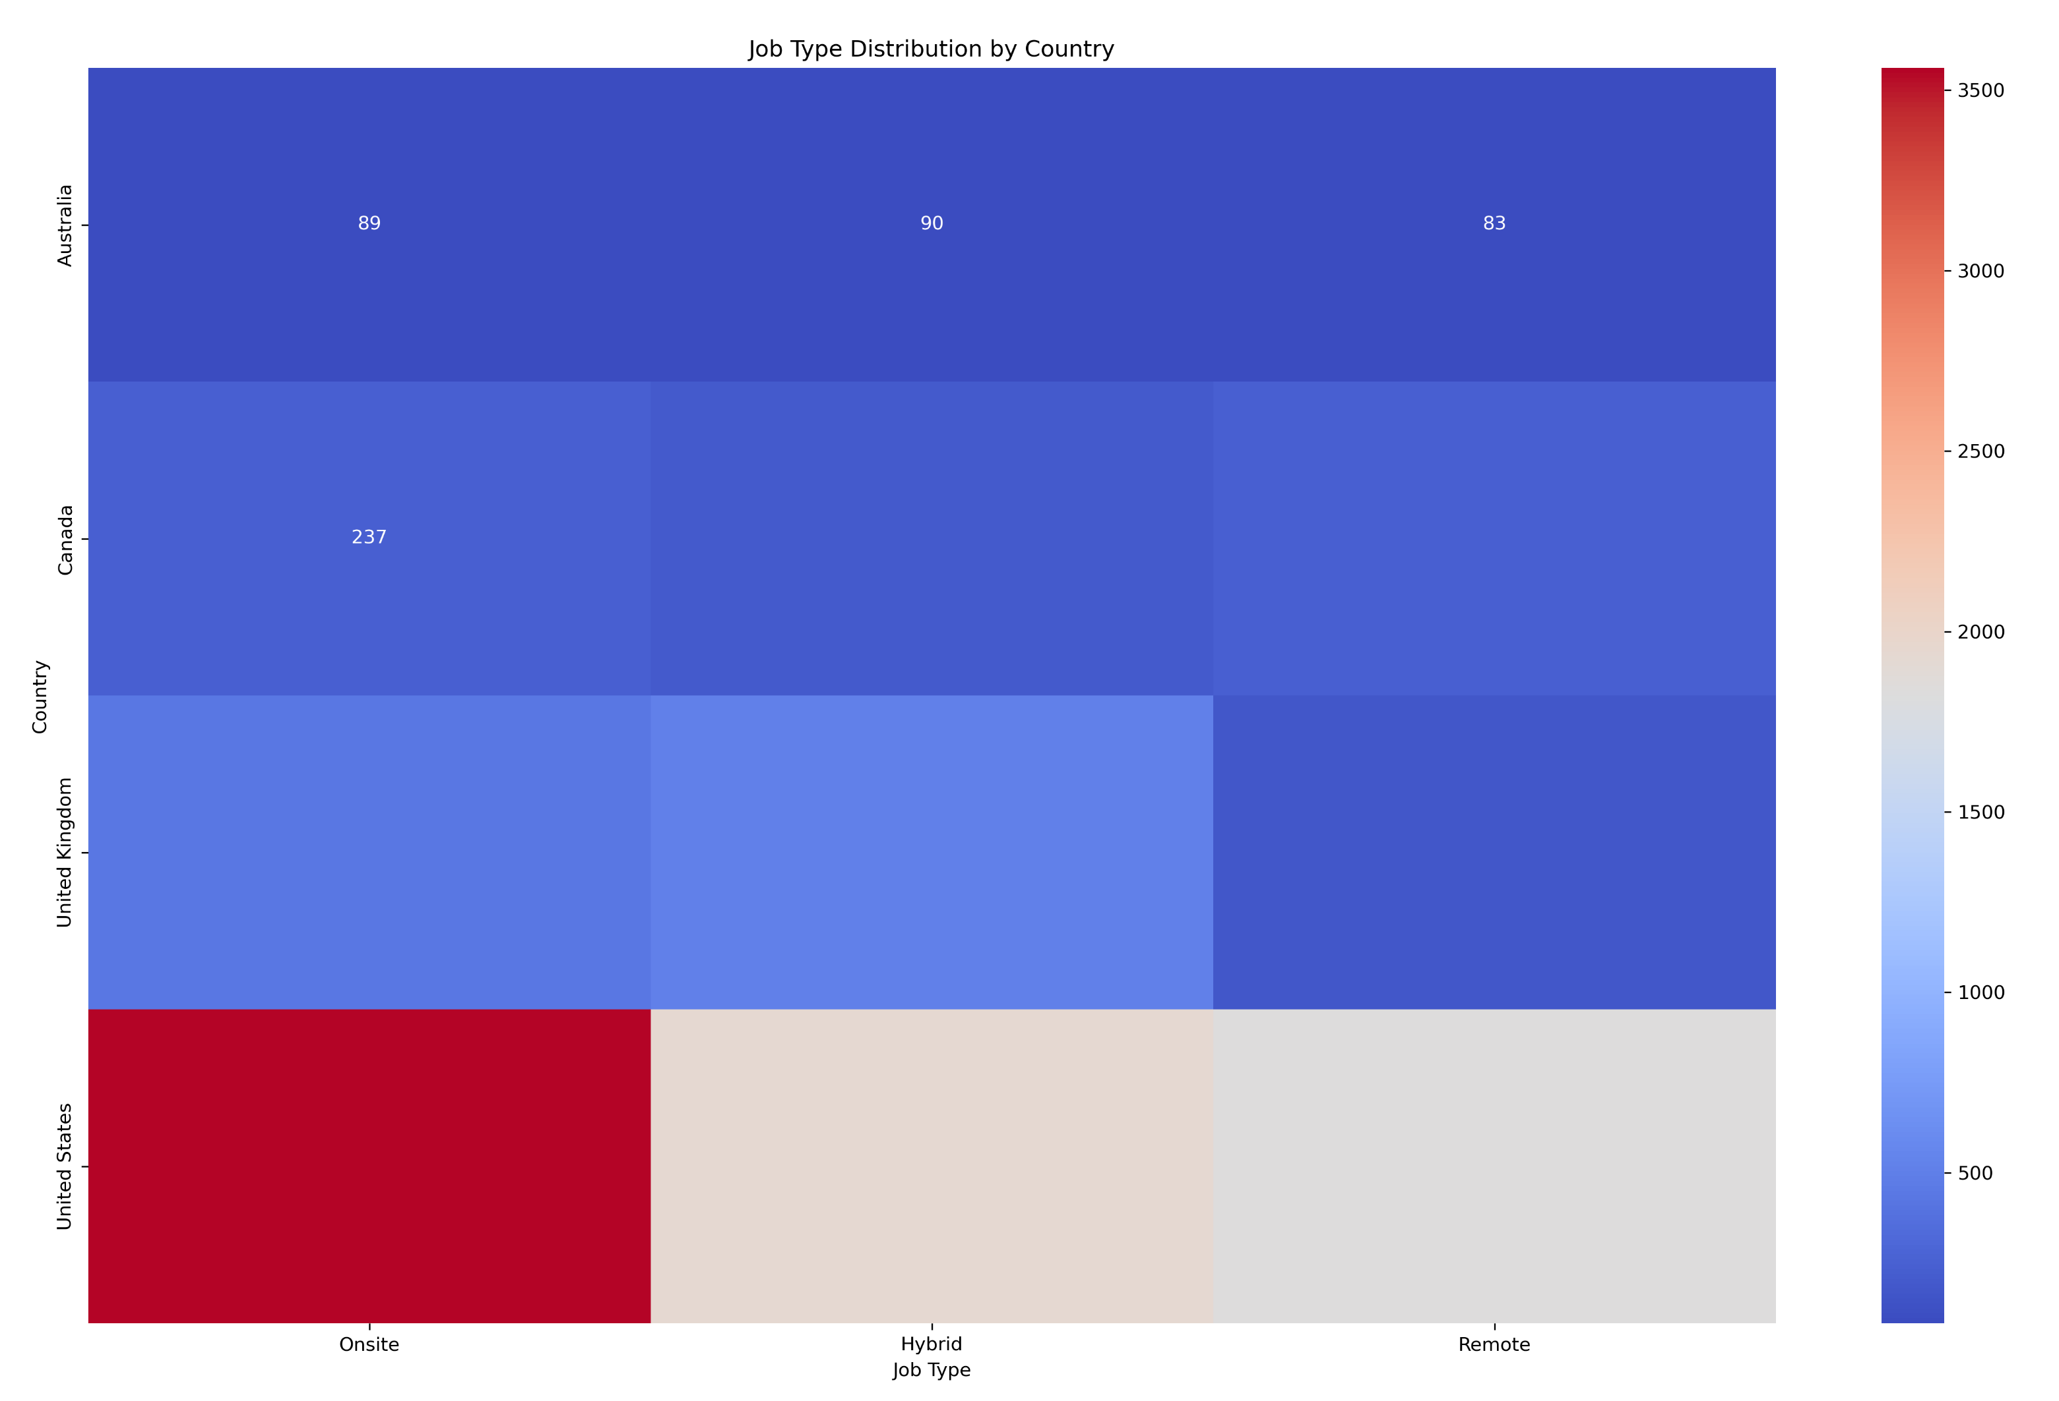
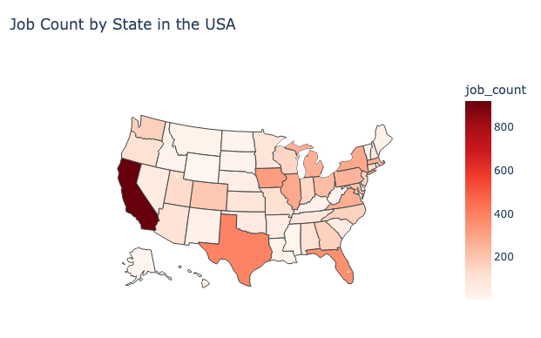
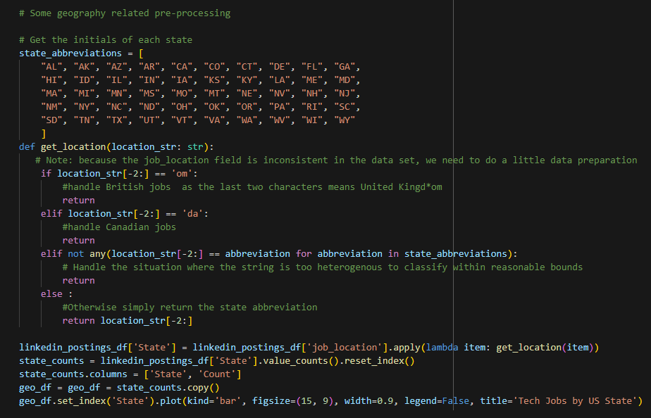
Question 2
Where is the largest demand
for jobs?
Top 3 States for AI Jobs:
CA
MA
WA
Insight into workspace flexibility
US prefers onsite
Canada likes remote
(for jobs offered to US employees)

Slide 7
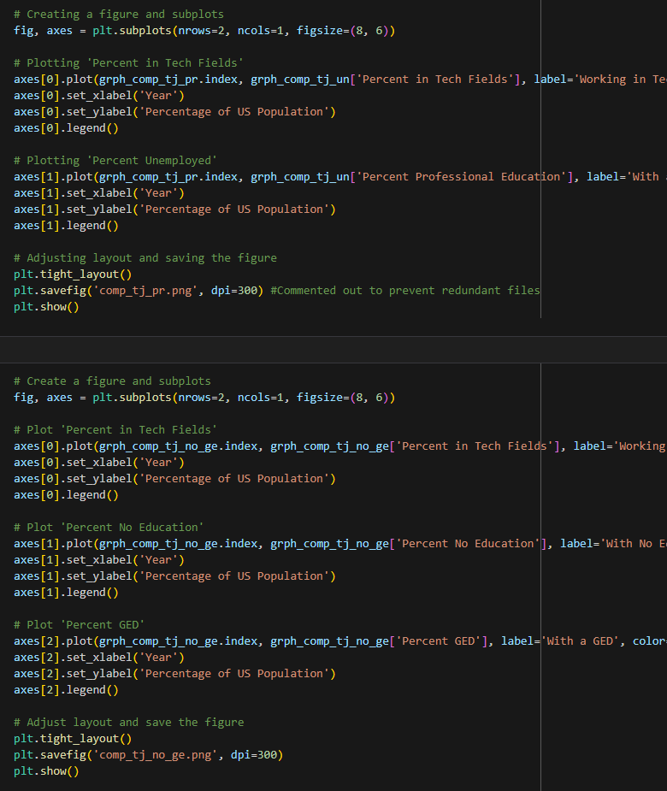
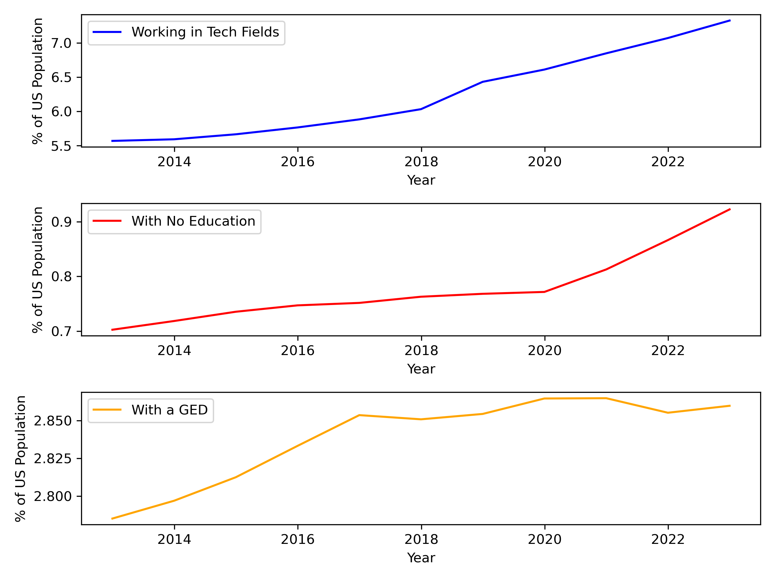
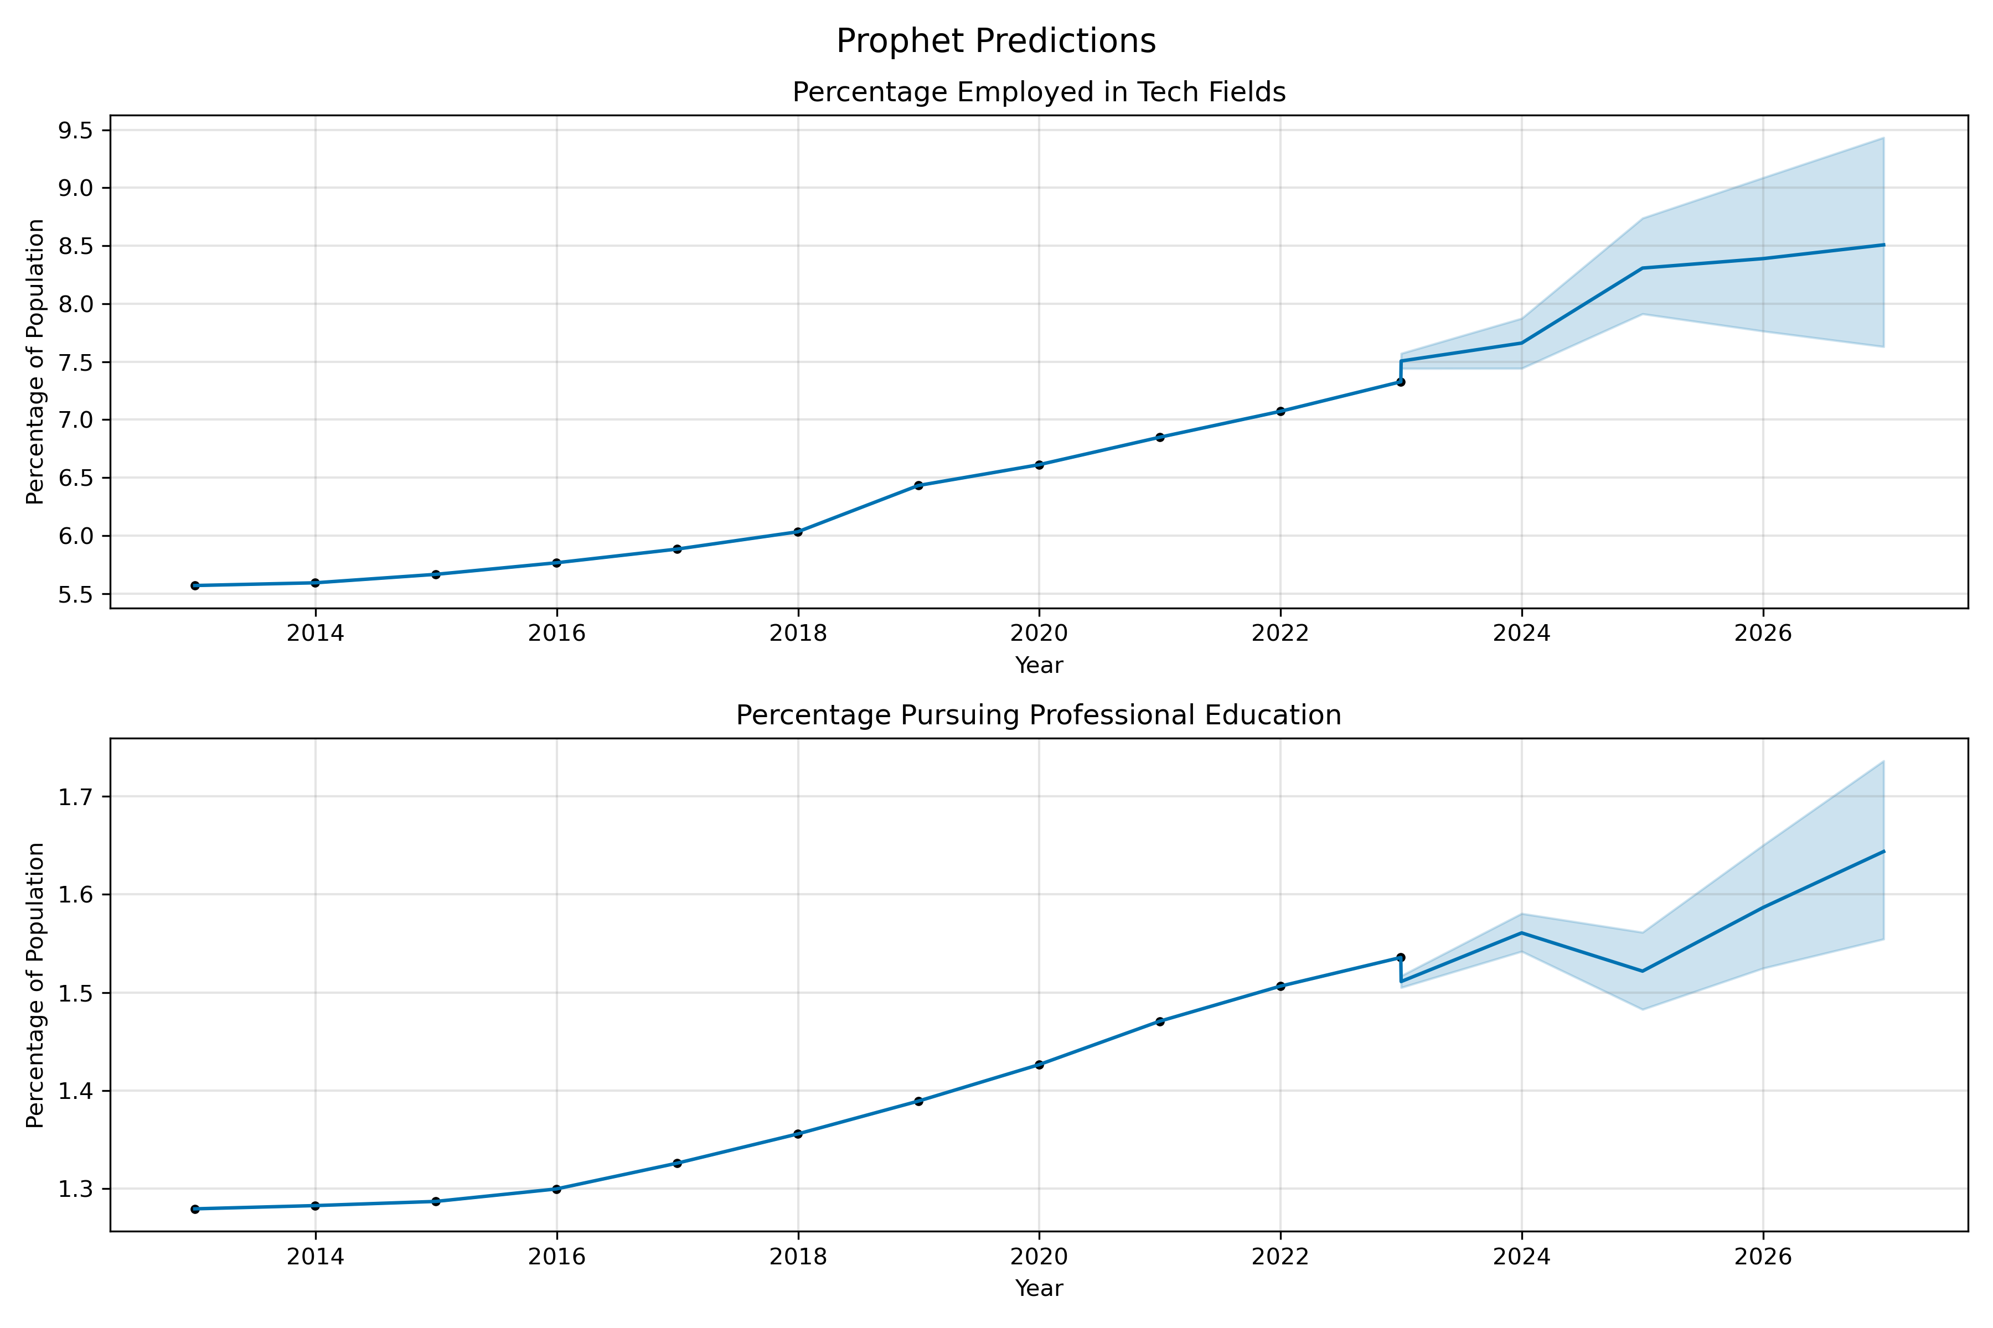
Question 3
How has education adapted to technical job needs?
Continued growth in
alternative forms of education
Nearly 1:1 correlation with rises
in tech-related jobs and
professional education
(like this boot camp)

Slide 8
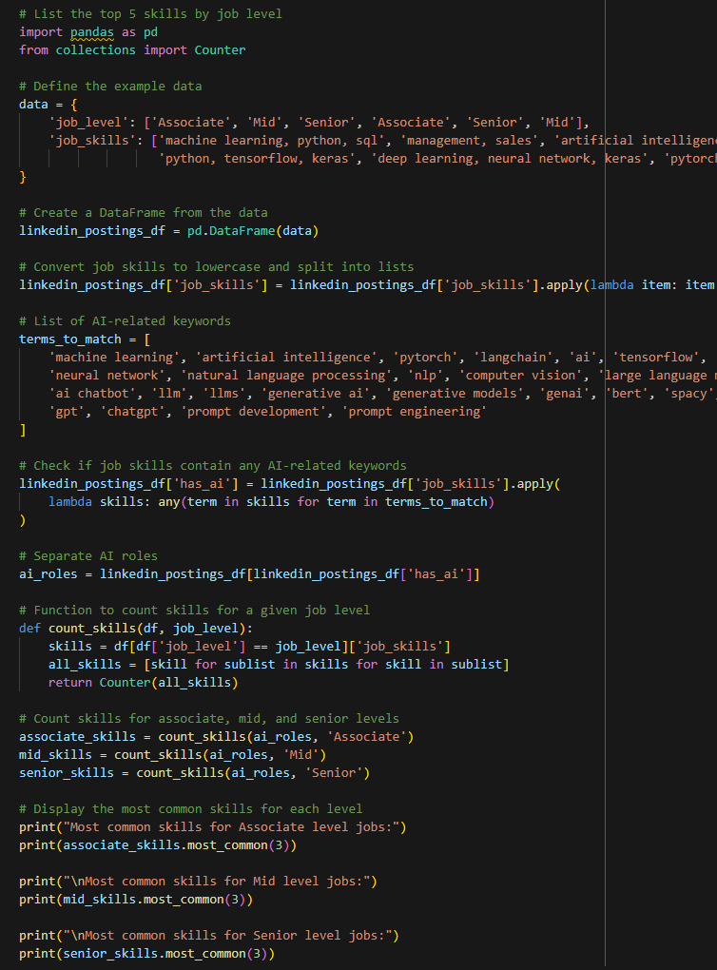
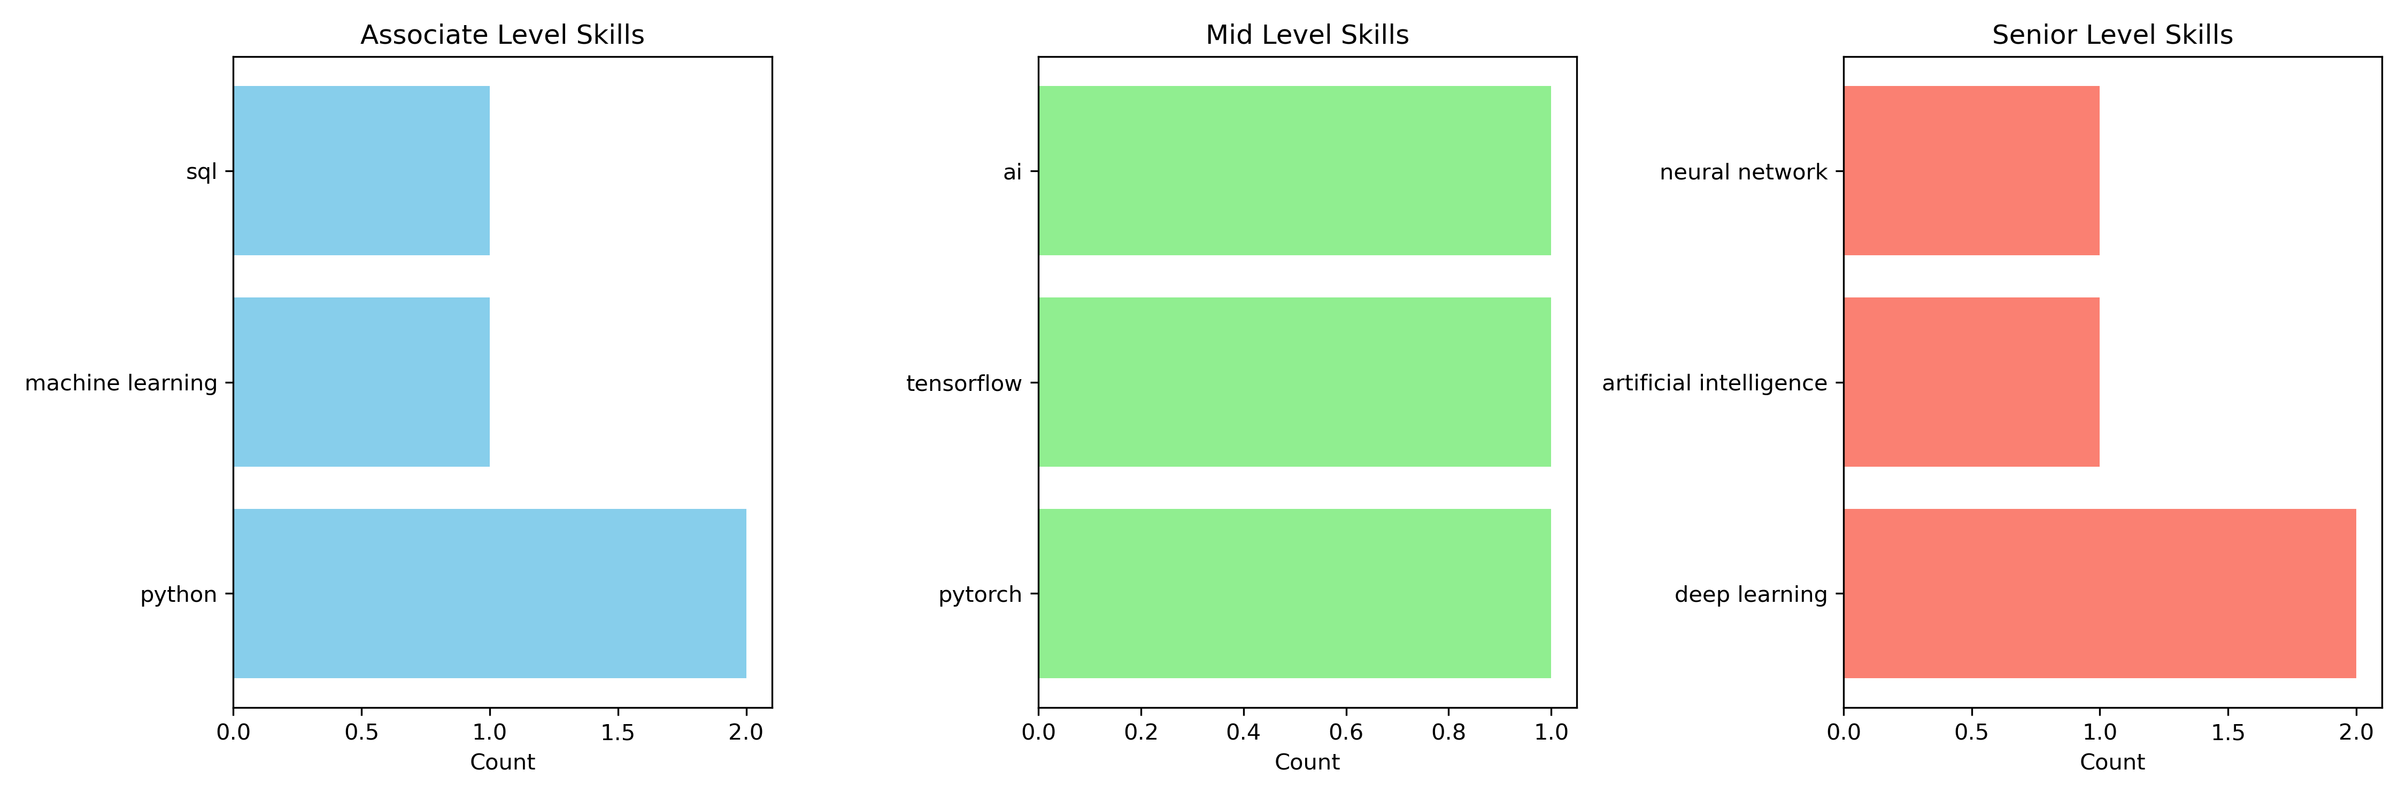
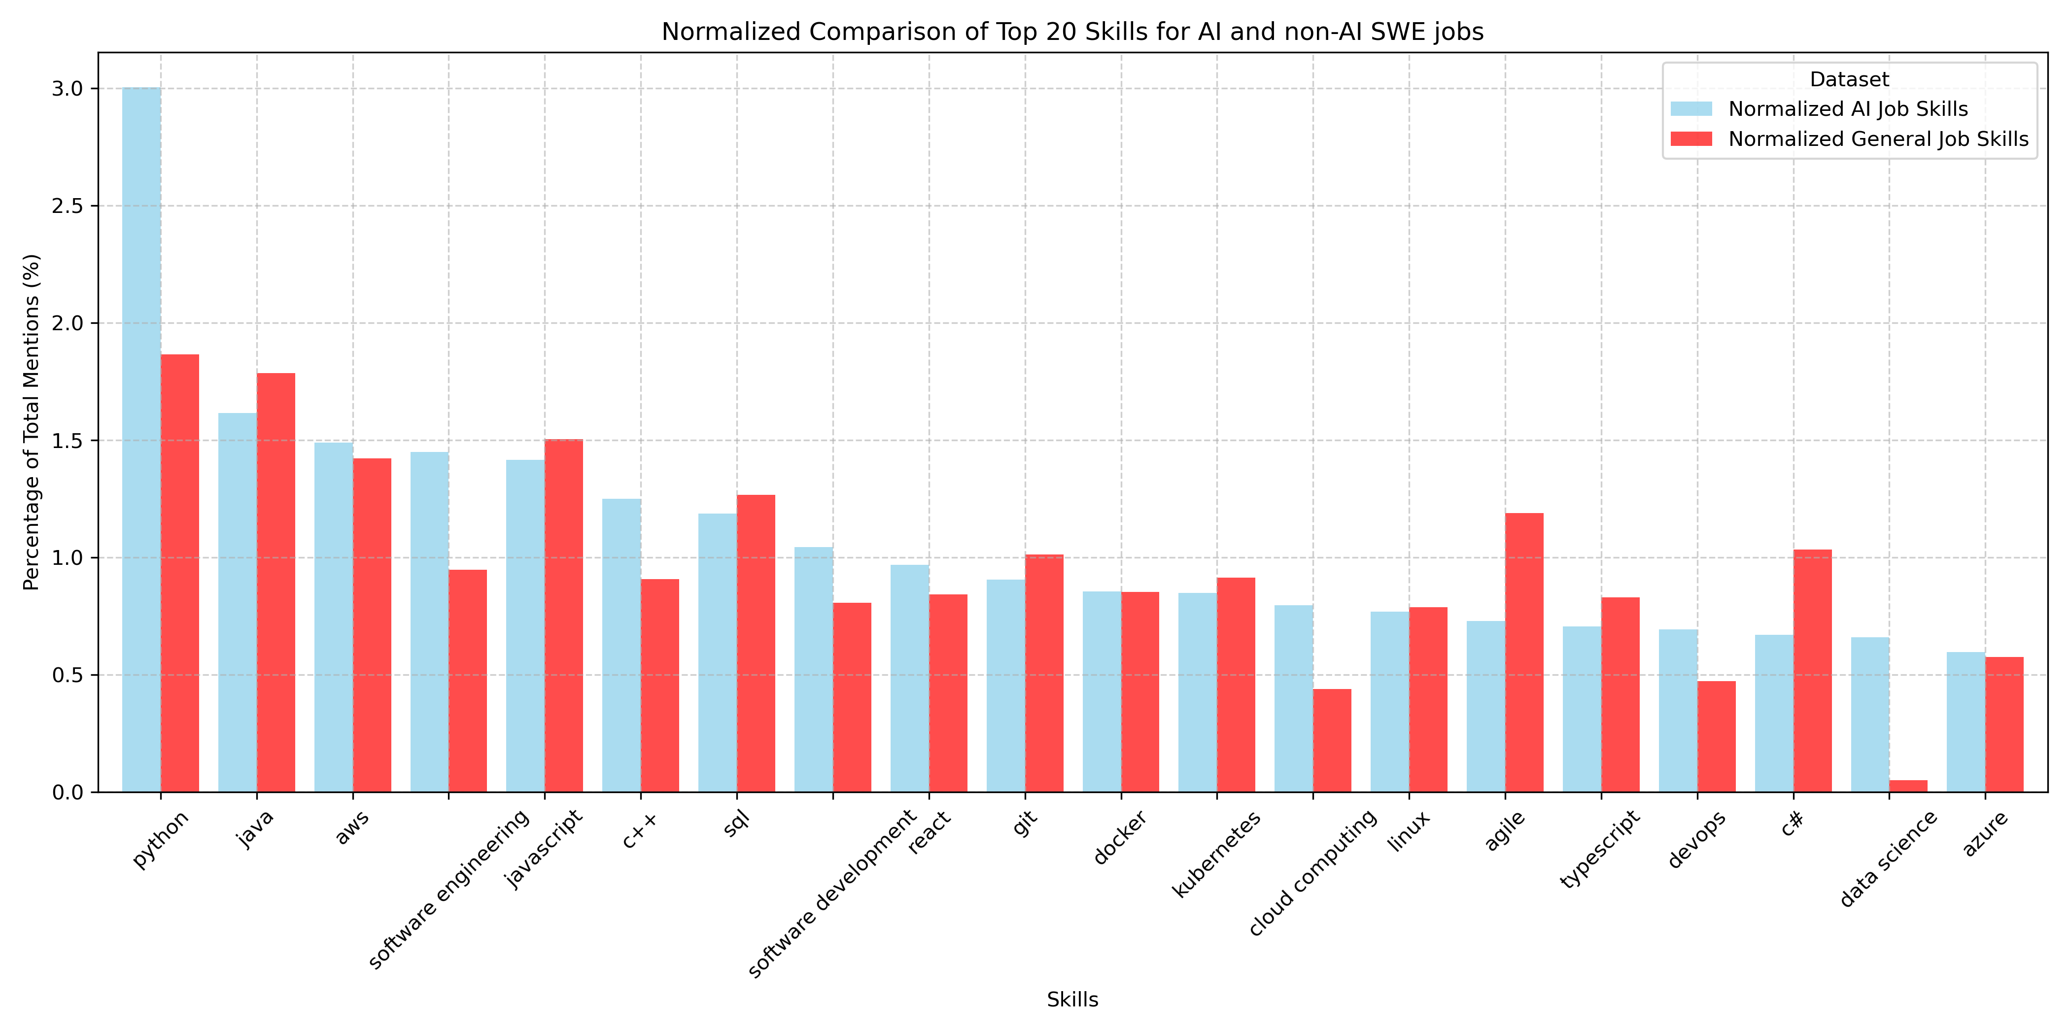
Question 4
What skillsets are the
most desirable for AI jobs?
Top 3 Skills for AI Jobs:
Python
Java
AWS
Top Skills by Job Level:
Associate – Python
Mid Level – Just… Yes
Senior – Deep Learning

Slide 9
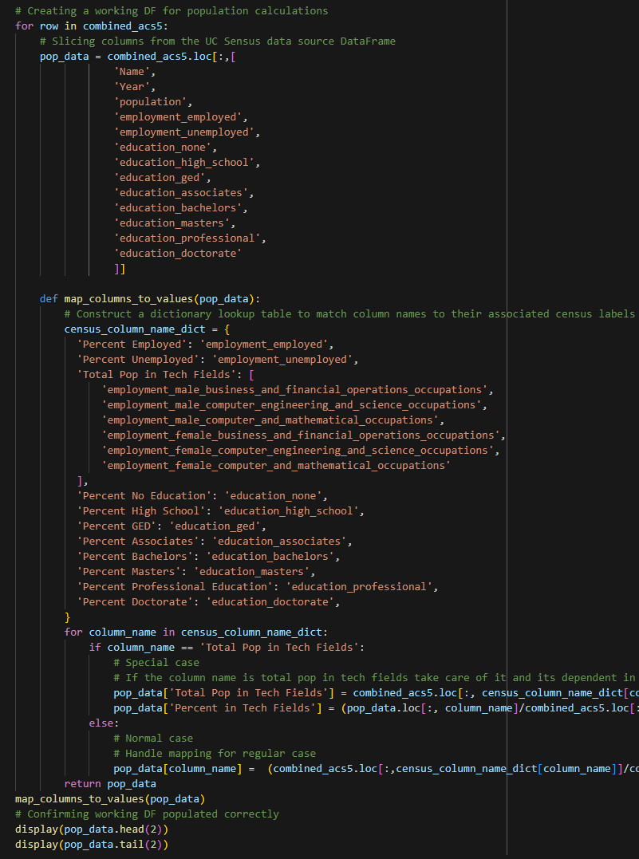
Summary
Sectors
Tech sectors continue to show the most profitability from AI,
but manufacturing is likely the next breakout market
Demand
Mid level positions hold the largest demand, and largely for onsite
or hybrid workspaces
Education
A clear relationship exists between the trends in tech-related jobs and
a growing reliance on professional education
Skills
Python, Java, and AWS seem to be the most in-demand skills for AI jobs, with a more advanced focus on ML being the key to senior roles

Slide 10
Problems Encountered
Extraction
LinkedIn data lacked explicit “years of experience”
Inconsistent summaries may have affected extracted data
Interpretation
US Census lacked clear “tech-related” classification
Closest possible subset selected for calculations
Limitations
Access to applicable job data locked behind paywalls
Incomplete data relating
to probable aspects of connected trends
(eg; unemployment and AI jobs)

Slide 11
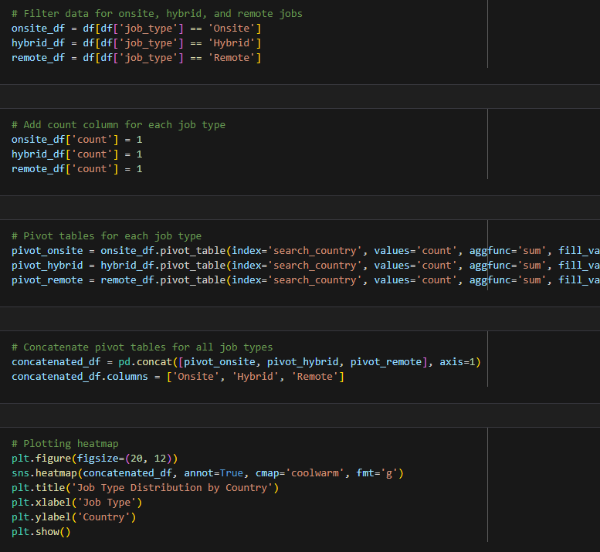
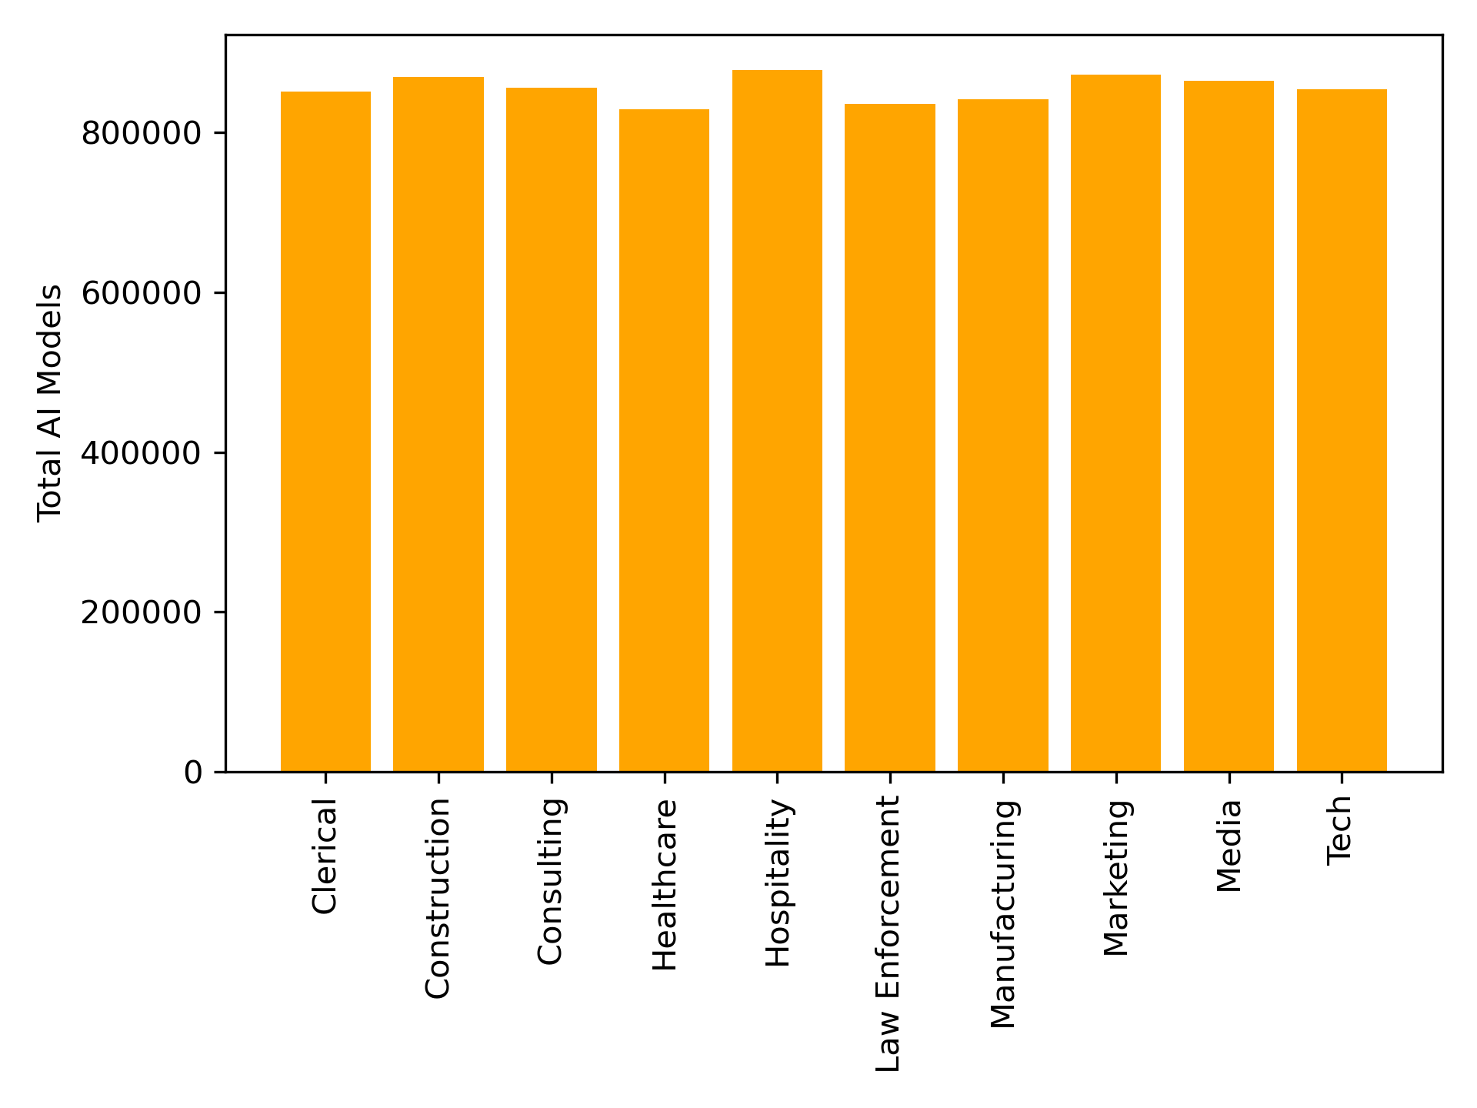
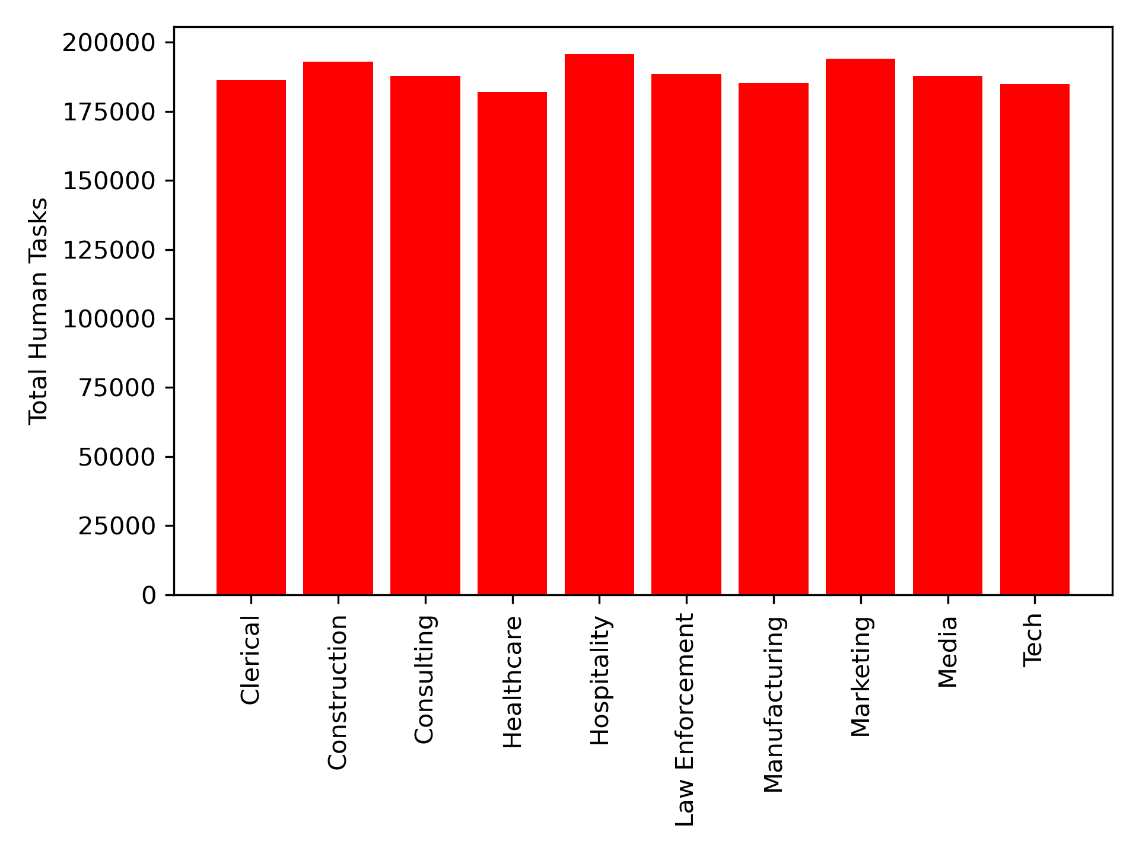
Future Considerations
AI and Human Tasks
With multiple models filling in each human task, will the trend move towards displacement or replacement of human jobs?
Additional Sectors
Are there similar trends for AI in sectors,
such as manufacturing?
Beyond Python
What common threads are there among
ML jobs that do not require Python?
Data for AI and Layoffs
What is the direct correlation between the rise of
AI jobs and the amounts of layoffs in similar sectors?

Slide 12
Questions?
Catchy Signoff Phrase™
References Used;
Combined data from US Census API for 2012 - 2022: https://www.census.gov/data/developers/guidance.html
LinkedIn Job Postings for 2023: https://www.kaggle.com/datasets/joebeachcapital/linkedin-jobs
AI Companies and Profit by Sector for 2022: https://www.kaggle.com/datasets/hansrobertson/american-companies-profits-and-benefits-from-ai
AI Models Index: https://www.kaggle.com/datasets/manavgupta92/from-data-entry-to-ceo-the-ai-job-threat-index

