Slide 1
AA228 Final Project Hit or Stand?
Naixiang Gao, Jack Ren, Jiaqi Shao
Created: December 2024

Slide 2
Agenda
Project Overview
Our Approach
Data Generation/Simulation
Q Learning
Success Validation
Future work

Slide 3
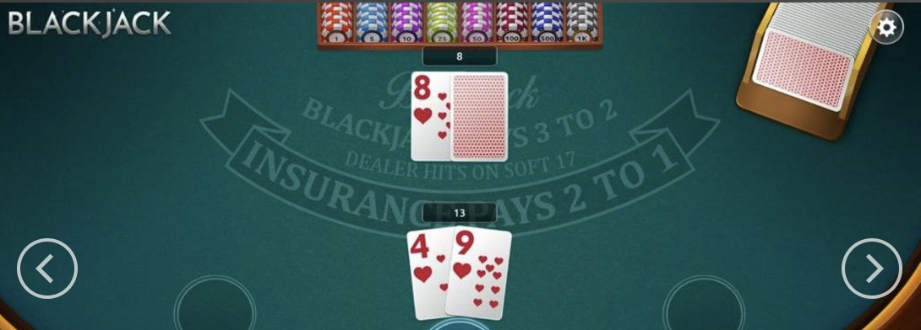
Project Overview - Blackjack
Our Setting:
There's only one Agent and one Dealer, we are on Agent side.
Agent Wins When:
(1) Agent's hand value higher than Dealer's hand value without busting
(2) Dealer busts

Slide 4
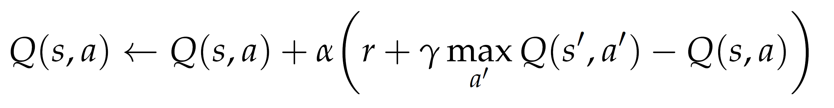
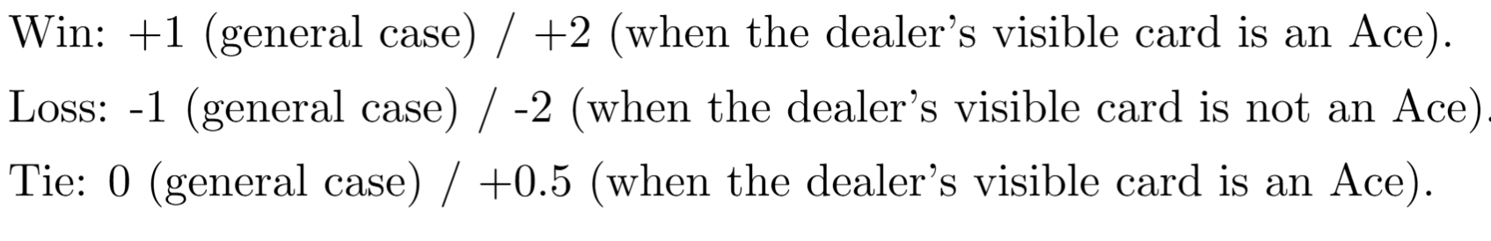
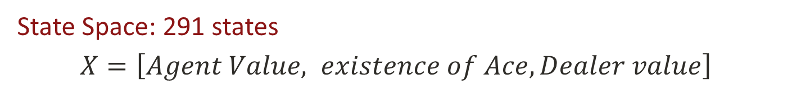
Q-Learning
State Space: 291 states
$X=\left[Agent Value, existence of Ace,Dealer value\right]$
Range: [4, 21] True/False [2, 11]
Action: 2
Hit(1) or Stand(2)
Reward: 6 conditions
Learning rate: 0.1
Discount Factor: 0.9
Notes:
Model-free method to estimate the action value function incrementally.
0.1 ->risk averse

Slide 5
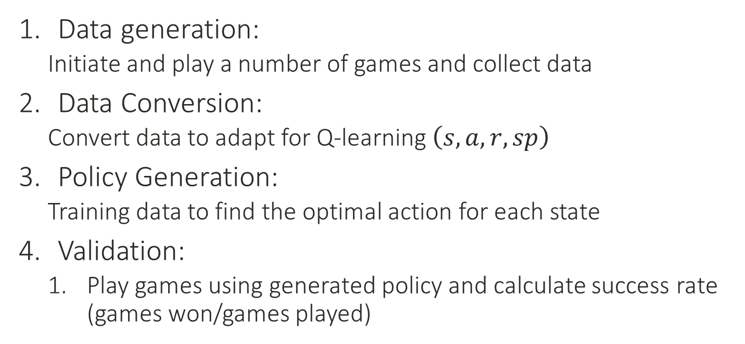
Training Procedure
Data generation:
Initiate and play a number of games and collect data
Data Conversion:
Convert data to adapt for Q-learning $\left(s, a, r, sp\right)$
Policy Generation:
Training data to find the optimal action for each state
Validation:
Play games using generated policy and calculate success rate (games won/games played)

Slide 6
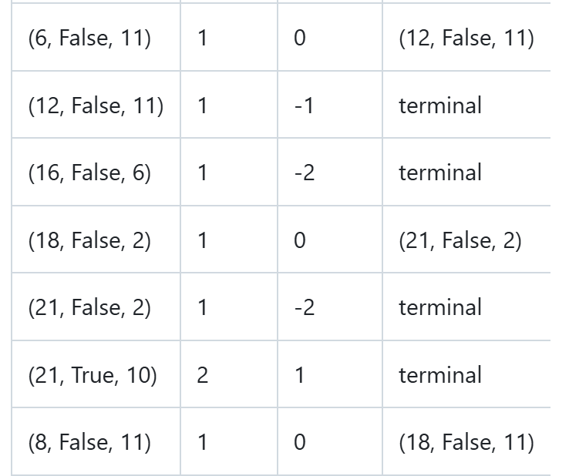
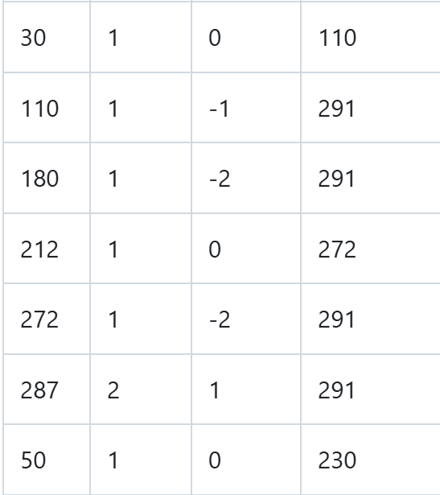
Example
$$Each row:\left(state,action, reawrd, next sate\right)$$

Slide 7
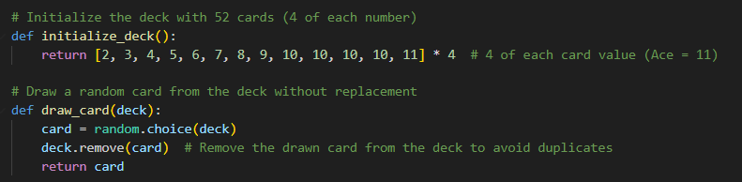
Game Simulation – Initialization
10, J, Q, K --> 10 points.
Initialize Ace to be 11.
Each card is unique. (Don't care about suit of the cards)

Slide 8
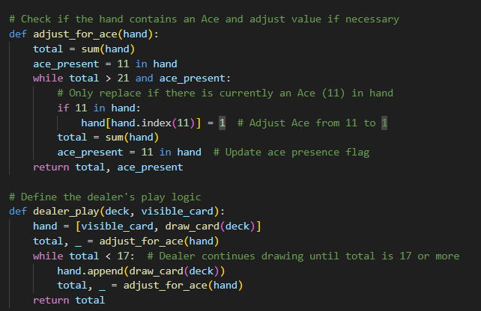
Game Simulation – Ace Adjustment & Dealer's Action
Total Points > 21, Ace will change from 11 to 1 and recalculate the points in hand.
Dealer's action should follow Hard 17 Rule.

Slide 9
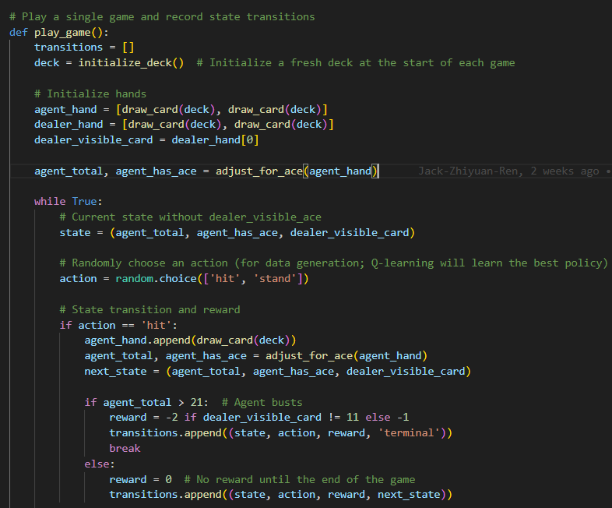
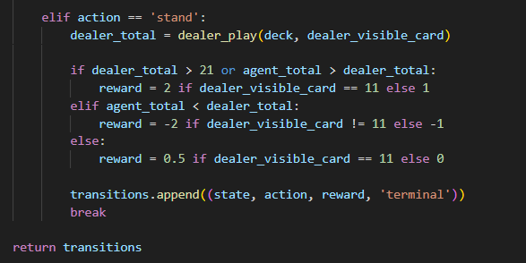
Game Simulation – Whole Game
Default used in Data Generation -> random action
Record the data in form :(state, action, reward, next_state)

Slide 10
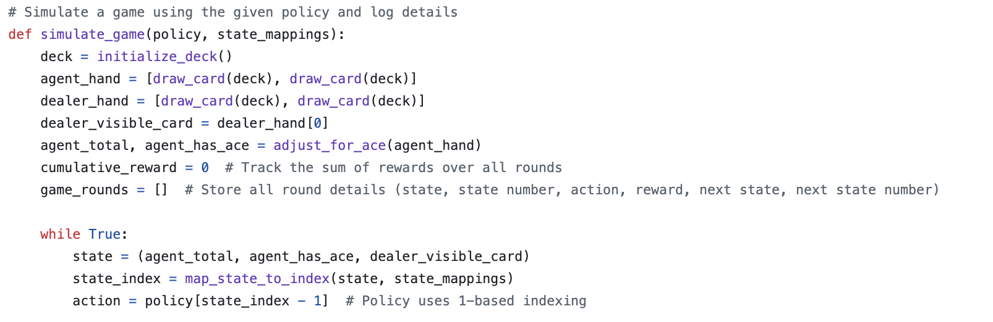
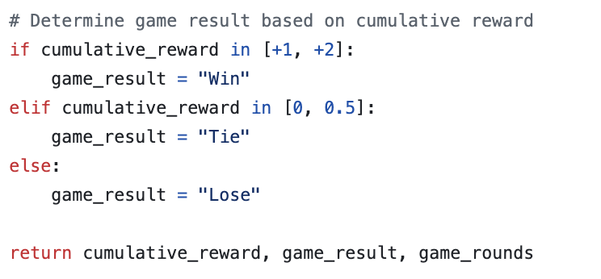
Success Validation
Testing Procedure:
Simulate the game with action chosen from policy
Distributed each game into three categories (Win/Tie/Lose) according to cumulative reward

Slide 11
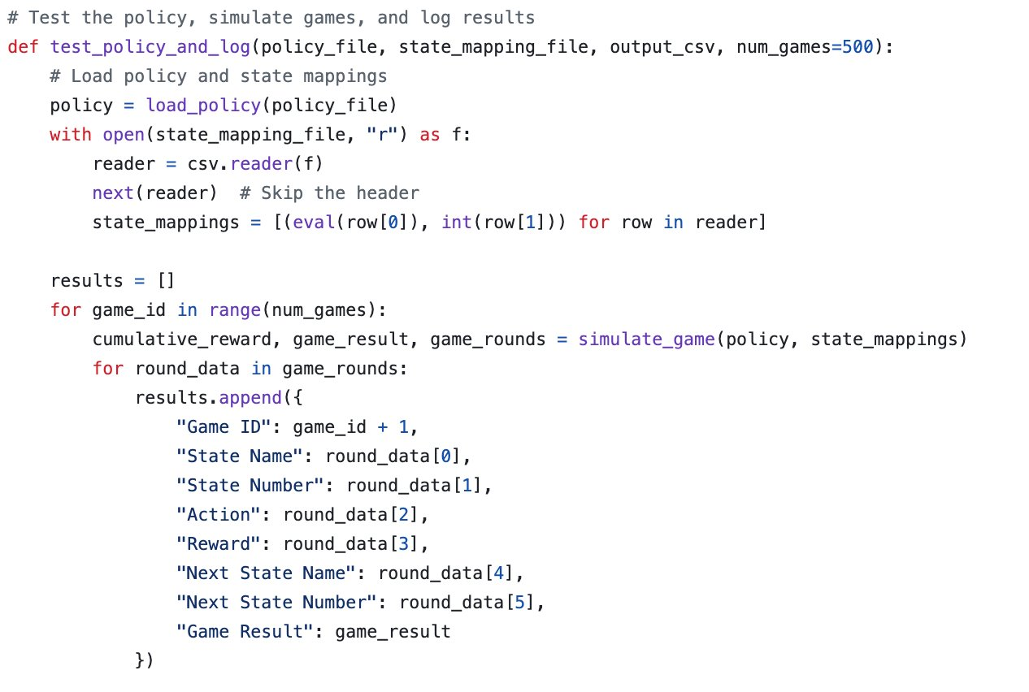
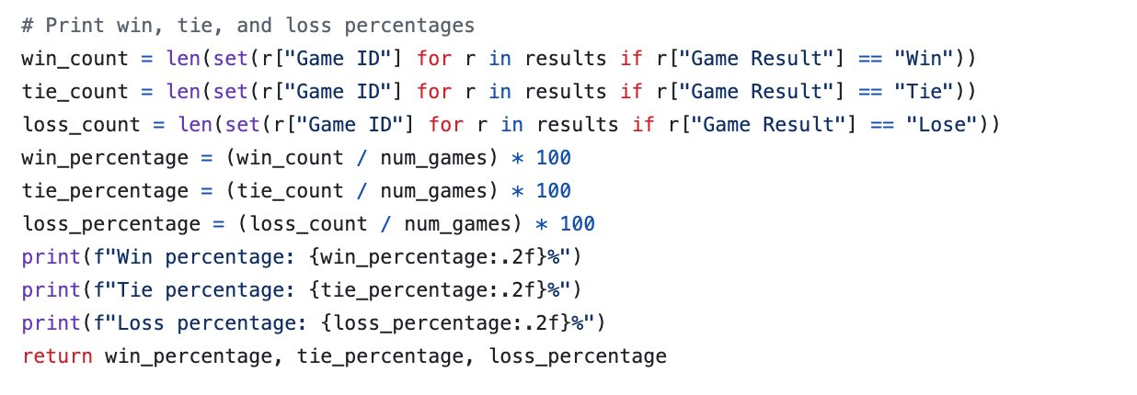
Success Validation
Testing Procedure:
Test the policy with enough amount of game
Calculate the winning percentage

Slide 12
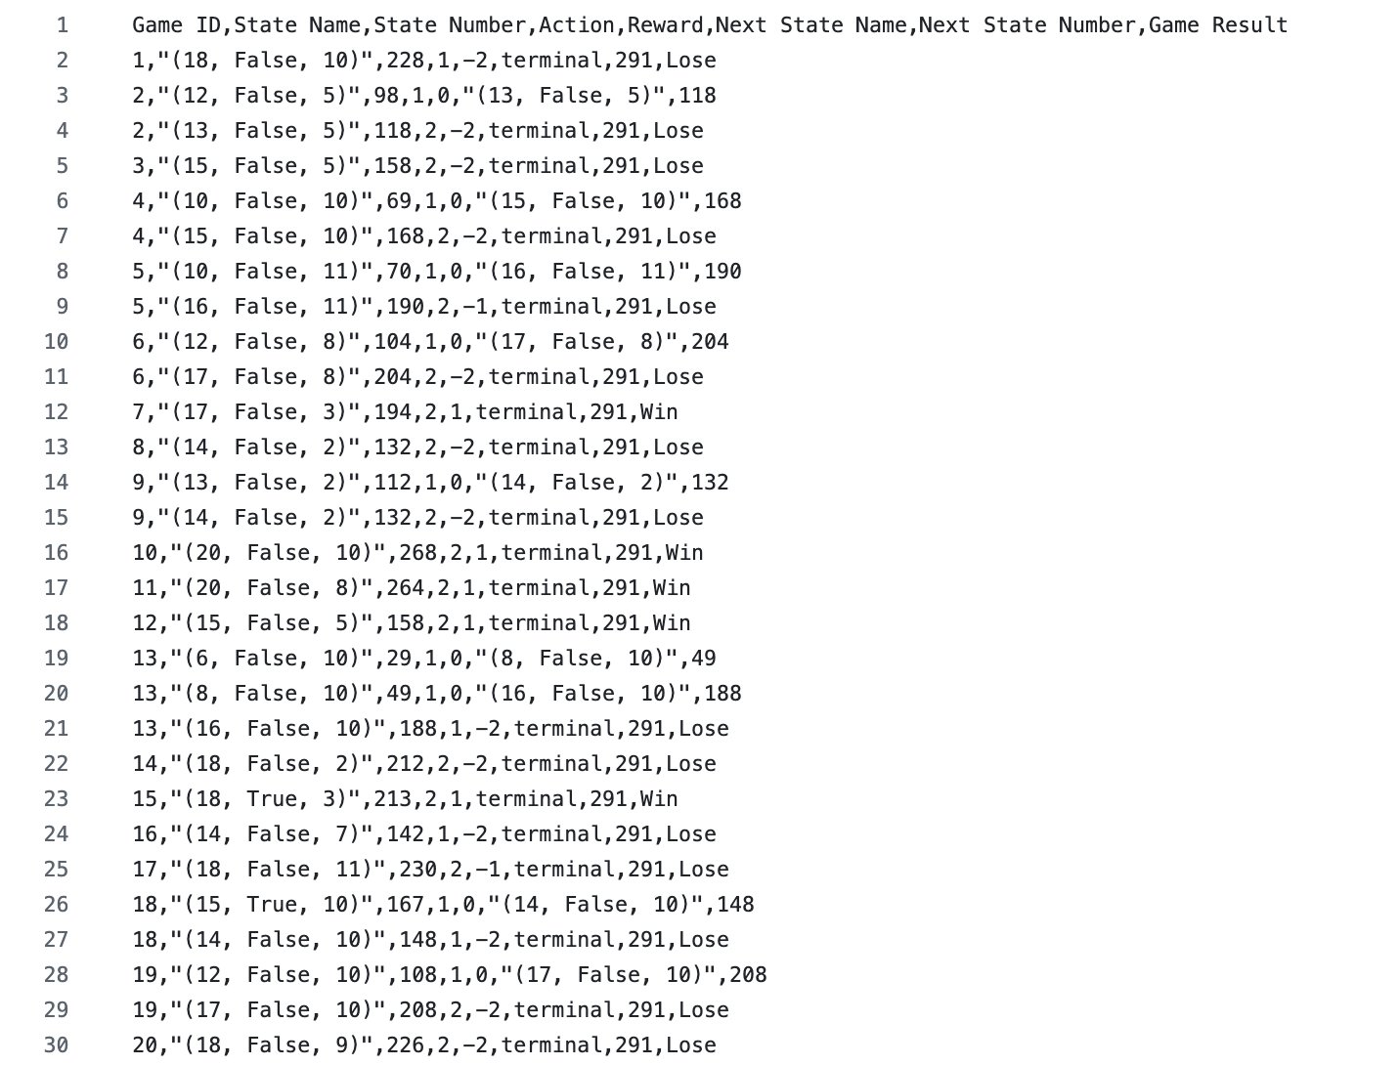

Success Validation

Slide 13
Future Work
Try to use other learning methods like SARSA, MCTS
Increase the number of agent
Add Blackjack rule to the game
Add Dealer Policy

Slide 14
Reference
Mykel J. Kochenderfer, K. H. W., Tim A. Wheeler, Algorithms for Decision Making, The MIT Press, 2022.
Grosvenor. Blackjack strategy: Hit or stand?, 2021. URL https://blog.grosvenorcasinos.com/blackjack-strategy-hit-or-stand#:~:text=When%20playing%20blackjack%20there%20are,total%20and%20end%20your%20turn.
Johannes Hewig. Decision-making in blackjack: An electrophysiological analysis. CerebralCortex, 17(4):865–77, 2007.

Slide 15
Group Contribution
Naixiang Gao: Establish game simulation and generate training data.
Jack Ren: Convert data to adapt for Q-learning and Q-learning structure
Jiqai Shao: Success validation and state names to state index conversion
All members contributed equally to proposal report, project status update report, and final video report.

Slide 16
Thank you!

