Slide 1

Modeling Forest Fires Using Bayesian Regression
Amanda West, Nikki Aaron, & Bev Dobrenz
Notes:
https://support.sas.com/resources/papers/proceedings16/9361-2016.pdf
http://www3.dsi.uminho.pt/pcortez/fires.pdf
https://docs.google.com/document/d/1KQsGcqkScUg5hW0pnA7mkd63041vuotN1i8p1QOjUWE/edit?pli=1

Slide 2
Outline
Problem Description
Mathematical Linkage
Bayesian Method(s) Used
Results and Conclusions
<number>
Notes:
First we will go into the background and goals
next
insight into the math behind our model
And the
different bayesian methods used
Finally we will leave you with our results and feedback for next steps.

Slide 3
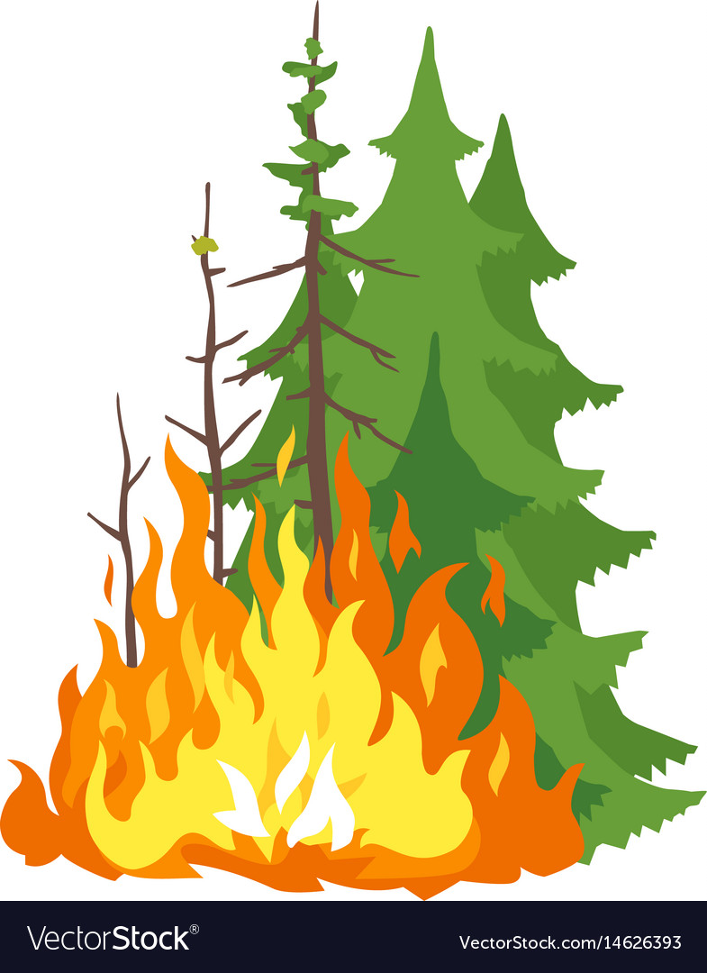


Background
Source:VectorStock
Source: SaukValley.com
Source:Gallery Yopriceville
On average, forest fires in the US burn 7 million acres per year and cost taxpayers upwards of $2.4 billion in prevention and maintenance.
<number>
Notes:
Our project is centered around forest fires. Forest fires have been and will continue to pose a problem for the US park service, and park services around the world.
These problems are only growing, so modeling forest fires can inform the best allocation of fire management resources for stakeholders.
https://www.fs.usda.gov/science-technology/fire/forecasting

Slide 4
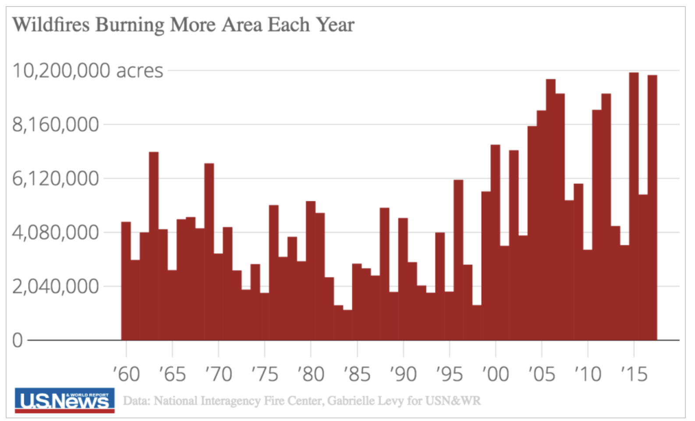
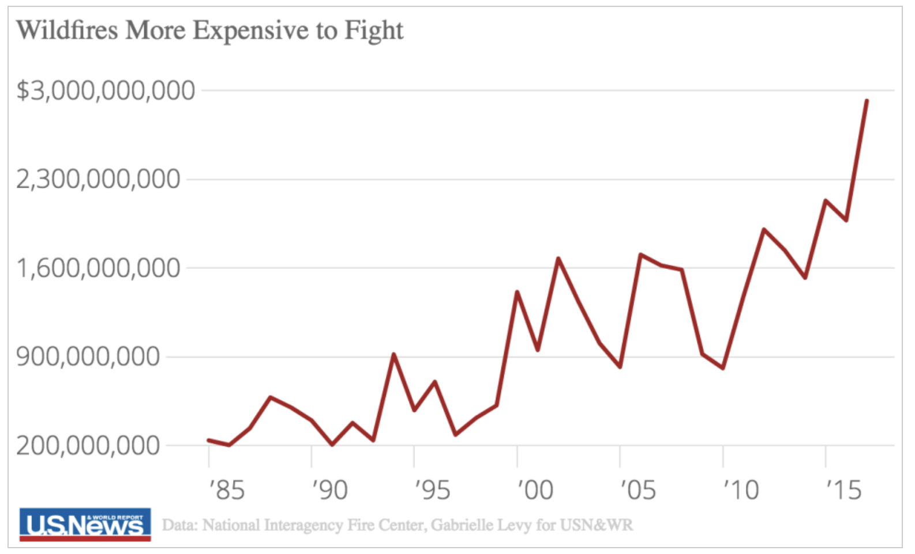
Additional Information About Forest Fires
<number>
Notes:
https://www.usnews.com/news/data-mine/articles/2018-08-01/wildfires-are-getting-worse-and-more-costly-every-year

Slide 5


Goal
Analyze various weather, climate, fuels, and fire activity factors to model the probability of the occurrence and the burn area of a forest fire.
Results can inform pre-positioning of firefighting assets and fire management strategies
Source:NetClipart
Source:VectorStock
<number>
Notes:
specifically, our goal was to model the probability of both the occurrence and burn area of forest fires.
We used information about weather, climate, fuels (wind), and fire activity to inform this analysis.
Success for the project the production of results that can inform the prepositioning of firefighting assets and different fire management strategies.

Slide 6
Where Our Data Is From
<number>

Slide 7
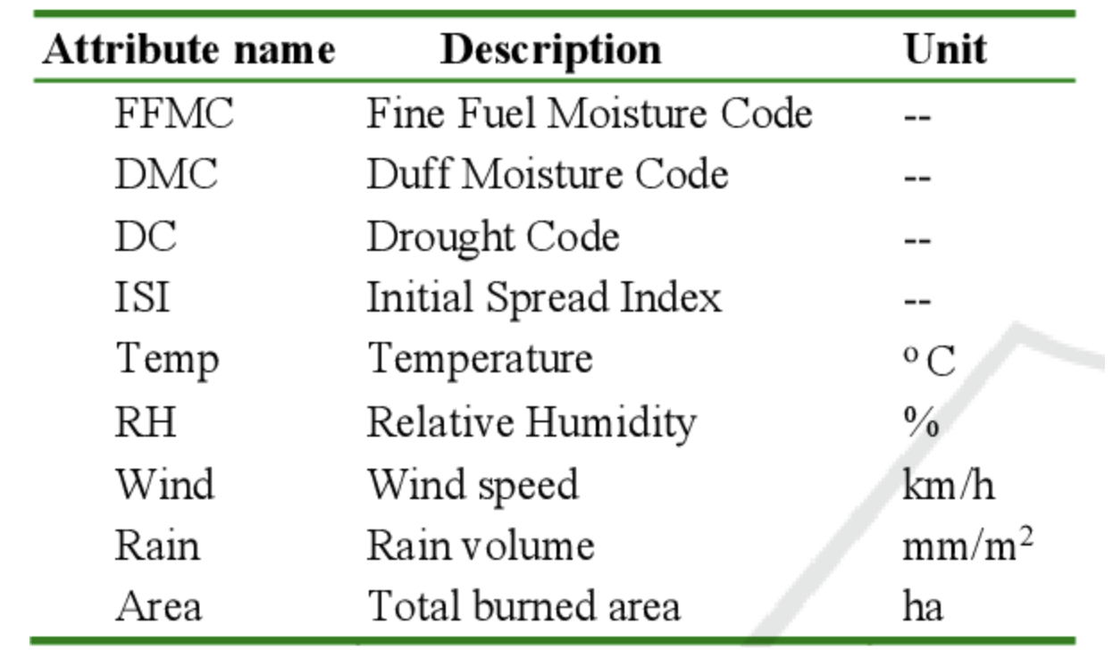
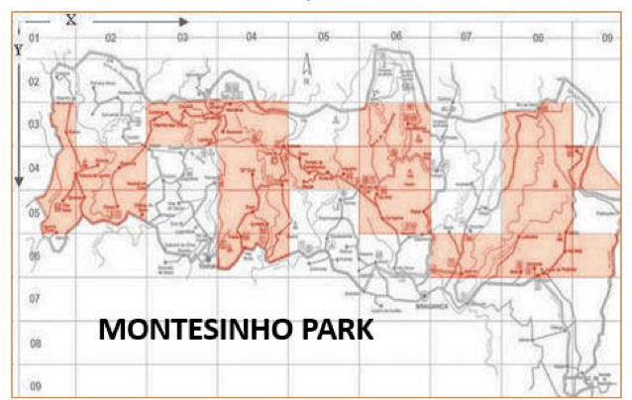
Data
Response: Burn area of forests in Montesinho National Park (NE Portugal) from January 2000 - December 2003
Predictors: Fire Weather Index, Canadian system for quantifying fire danger
Source: supportsas
<number>
Notes:
Our data comes from Montesinho National Park in NE Portugal. At random dates from the year 2000 to 2003, predictor data was recorded including the month, weekday, long with weather information like rain, humidity, temperature, and wind speed. Four indices from the Fire Weather Index (FWI) were also recorded. The Fire Weather Index is a Canadian system for rating fire risk, but is commonly used all around the world. The first three indices are fuel moisture codes which rate the average moisture content of fuel materials in different layers of the forest floor. The fourth is an Initial Spread Index which rates the risk of fire spreading to larger areas. Many of these predictors are correlated so multicollinearity is an issue with our models.
https://cwfis.cfs.nrcan.gc.ca/background/summary/ffws
https://www.nwcg.gov/publications/pms437/cffdrs/fire-weather-index-system

Slide 8
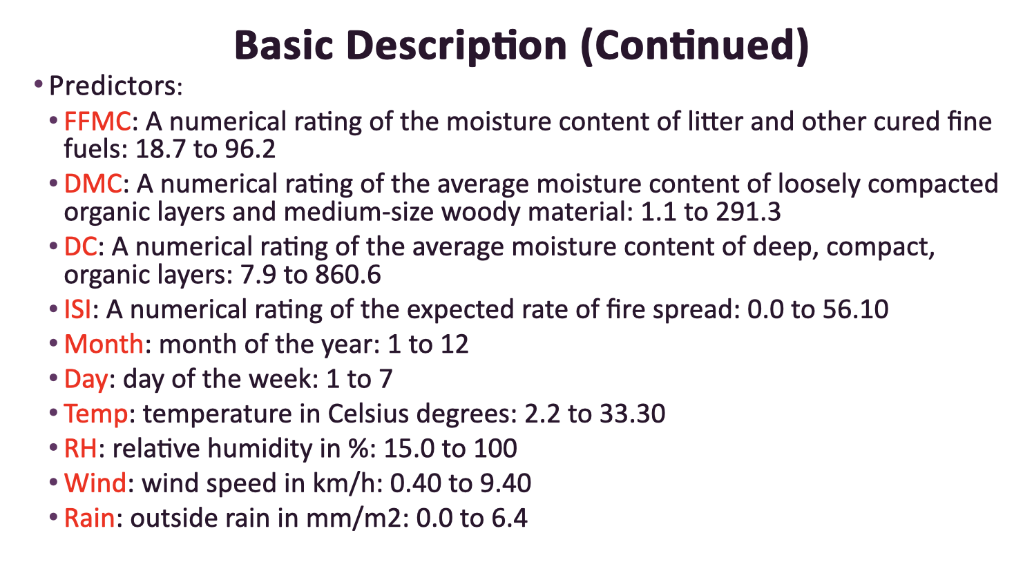
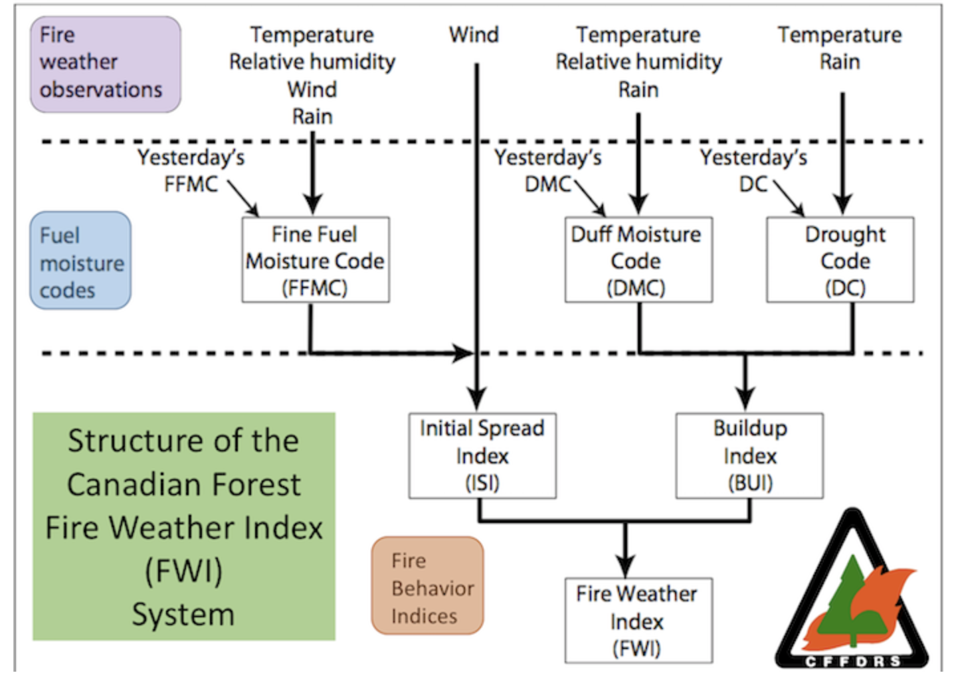
Fire Weather Index
Source: nwcg.gos
<number>

Slide 9
Bayesian Methods Used
Quantify uncertainty in response given the predictor data and prior
Bayesian Logistic Regression:
Did a forest fire occur or not
Bayesian Linear Regression:
Total burn area of forest fire
<number>
Notes:
Bayesian methods will allow us to model response variables from the given data and also take into account prior information that is known or suspected about the response. The first response of interest is whether a forest fire occurs or not. This binary response can be modeled with Bayesian logistic regression. In Bayesian logistic regression, we have transformed Bayes’ theorem from probabilities to log odds then to an inverse logit so that our final model is a linear relationship between the log odds of our posterior distribution and our data. For this relationship to hold, we need to center our predictor data distributions at 0. We will also standardize the data so that each column has a variance of 1. The prior chosen for the intercept and the slope are both Gaussian distributions with mean of 0 and standard deviation of 1.
The result of the logistic regression will be a set of two beta values per predictor, one being a slope and one an intercept. These betas describe a set of S-shaped logistic curves, one for each predictor. Each curve will have a predictor value on the x-axis and the probability of a fire occurring on the y-axis, allowing us to visualize the uncertainty in the response given the predictor data and prior. The slope beta defines how steep the S-shaped curve changes from 0 to 1. The intercept beta moves the curve from left to right.
The second response of interest is on the subset of data where fires occurred, and quantifies the total burn area of the fire on a continuous scale. This response can be modeled using Bayesian linear regression. Like in logistic regression, the result will be a set of two betas for each predictor variable. The distribution produced by linear regression, however, depends on the distribution chosen for the prior.

Slide 10
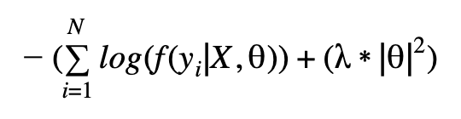

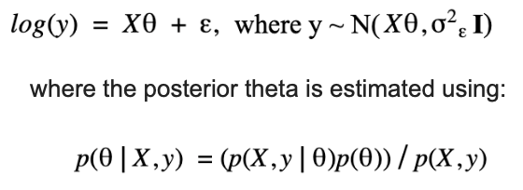
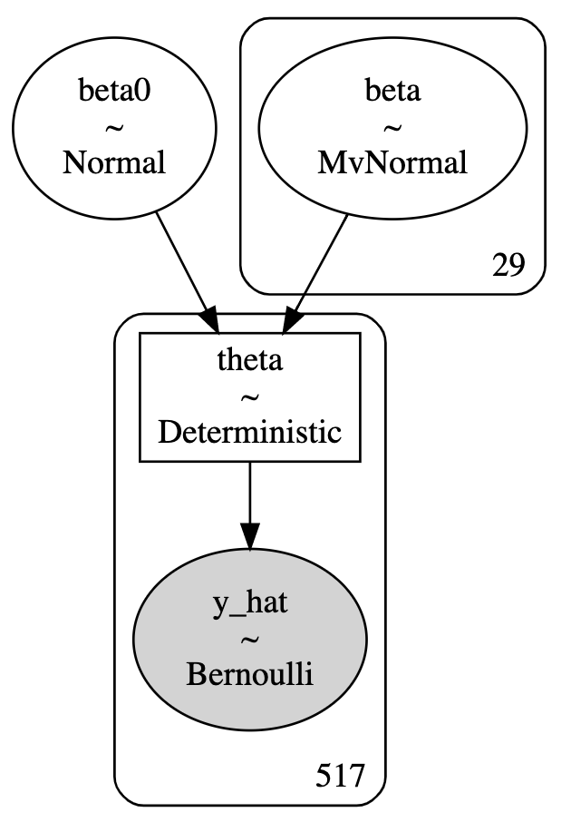
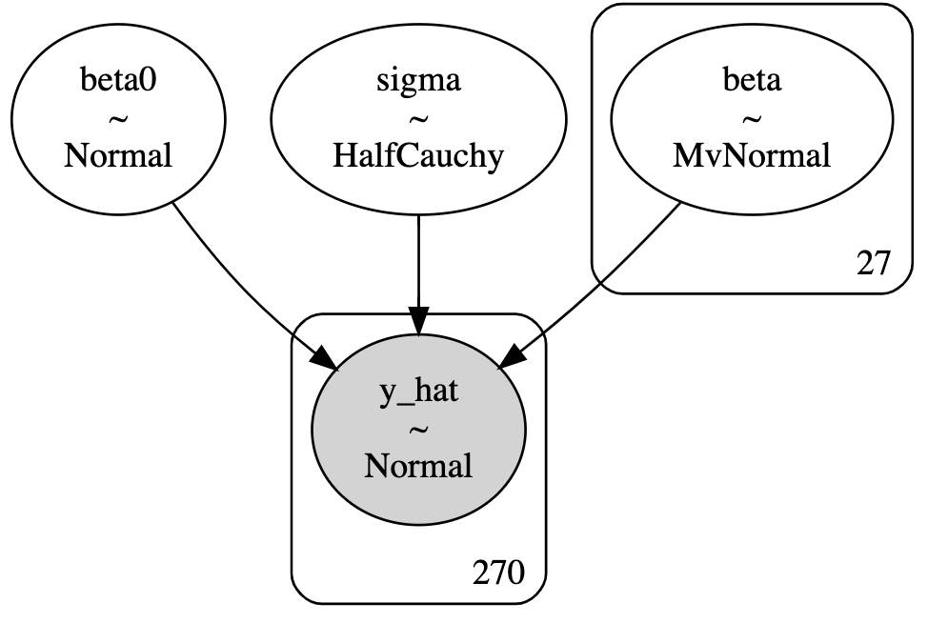
Mathematical Linkage Bayesian Regression
Loss Function (Ridge)
Logistic
Linear
<number>
Notes:
We tested both Ridge regression and Lasso, and chose Ridge for our final model. Since we don’t have a few predictors with higher significance than the others, they all have fairly similar significance levels, Lasso was shrinking all our coefficients to 0. Another benefit to Ridge is that it performs well on data with multicollinearity. Ridge obtains solutions using a squared error loss function and this solution is Bayes optimal if you assume there is no correlation among observations, that there is a single, constant variance on the error term.
Our first model uses a Bernoulli distribution to model the boolean fire occurrence response, and assumes Gaussian priors on each coefficient and the intercept term. To obtain the equation for this Bayesian logistic model, an inverse logit is used to transform Bayes Theorem so that we have an linear relationship between the log odds posterior distribution and our standardized predictors.
Our second model uses the continuous burn area as the response variable, which we have log transformed so we could model it with a Gaussian posterior distribution. This is linearly related to the predictors each with Gaussian priors on their mean. The variance cannot be negative, so the single, shared variance for this model was assumed to follow a HalfCauchy distribution..

Slide 11
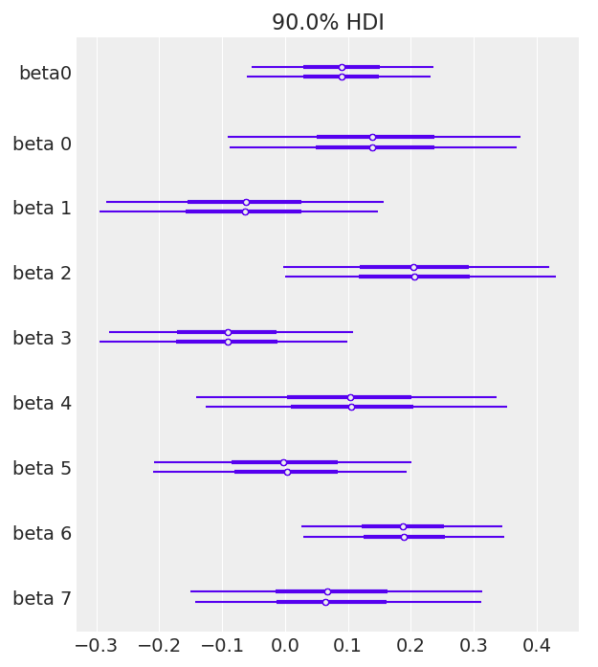



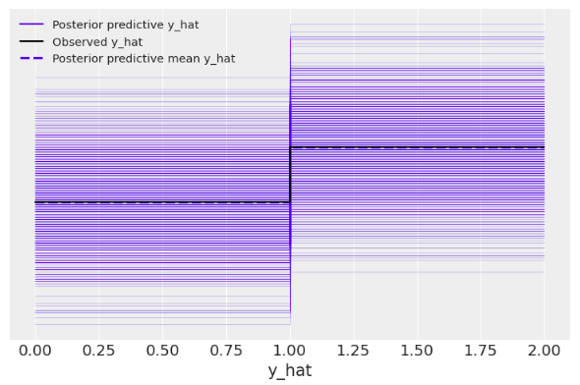
Results: Logistic Model
Source: ClipartKey
Source: PMGkey
Source: Vectorified.com
Intercept
+
+
[ DC ]
Rain
Wind
Temp
Rain
Fire y/n
=
DC
<number>
Notes:
Both models are significantly affected by wind, temperature, and rain at 90% HDI. Additionally, the linear model is significantly affected by humidity. These results support common intuition about factors that influence forest fires. Additionally, research shows that the lower the humidity level the more vigorously a fire is able to spread. We believe this is why humidity is therefore significant in the linear model, which measures total burn area as opposed to just if or if not a fire occurred.
Furthermore, because we are trying to predict forest fires, we believe it’s better to be more risk averse. As a result even though our logistic model findings have more uncertainty, we still believe it could be useful for employees at the park. Furthermore, our linear model has seemingly less uncertainty and therefore may be a better model for the park service to use.

Slide 12

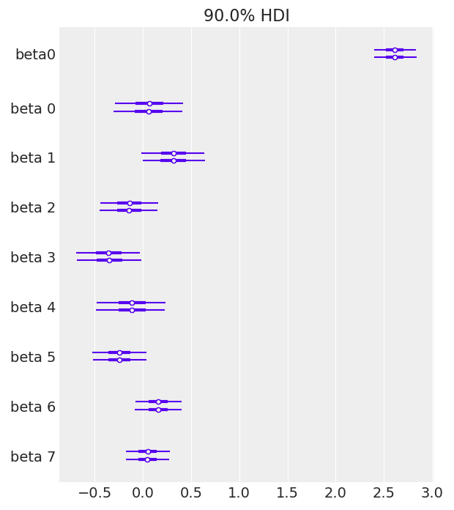
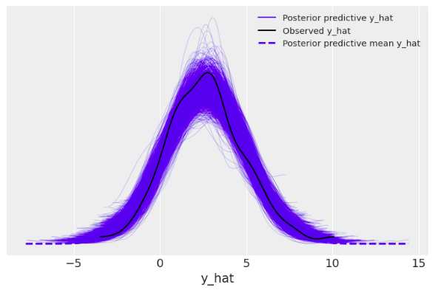
Results: Linear Model
Source: ClipartKey
Source: PMGkey
Source: Vectorified.com
Source: Vecteezy
Intercept
+
+
+
DMC
Wind
[ DMC, ]
Temp
Rain
RH: Humidity
[ ISI ]
Fire Burn Area
ISI
=
RH
<number>
Notes:
Both models are significantly affected by wind, temperature, and rain at 90% HDI. Additionally, the linear model is significantly affected by humidity. These results support common intuition about factors that influence forest fires. Additionally, research shows that the lower the humidity level the more vigorously a fire is able to spread. We believe this is why humidity is therefore significant in the linear model, which measures total burn area as opposed to just if or if not a fire occurred.
Furthermore, because we are trying to predict forest fires, we believe it’s better to be more risk averse. As a result even though our logistic model findings have more uncertainty, we still believe it could be useful for employees at the park. Furthermore, our linear model has seemingly less uncertainty and therefore may be a better model for the park service to use.

Slide 13
Conclusion
It is possible to model the probability of burn area and general occurrence of forest fires using Fire Weather Index Factors
Next steps:
Collect data about first responder resources to inform burn area analysis
Hierarchical model to accommodate diverse landscapes in regions of the park
<number>
Notes:
With current scientific literature affirming our results, we believe that forest fire stakeholders can use our probabilistic model to inform decision making about fire prevention and maintenance strategies. Our next steps would be to decrease uncertainty via…….^^^

Slide 14
Questions?
<number>
Notes:
We believe the reason why the linear regression, which uses the total area burned as the response variable, is not significant is because the amount of first responders present is not a variable included in the data. When the environment reflects ideal conditions for a wildfire (summer months, low humidity, windy, etc.), it is likely that the quantity of first responders on hand would also fluctuate as well. Since the data did not provide insight into available first responders, we were unable to account for this in our model. However, since the logistic regression model only examines if a forest fire occurred, the response was not affected by the quantity of first responders present. This explains why the logistic regression model provided significant information about important factors that can inform fire prevention and maintenance strategies.

