Slide 1

Portuguese Vinho Verde Red and White Wines
Nikki Aaron, Colleen Callahan,
Michael Pajewski, Pantea Ferdosian

Slide 2
About the Data Set
Released by Paulo Cortez of the University of Minho, Guimarães, Portugal
Quality and composition of Portuguese Vinho Verde wines
Vinho Verde is slightly fizzy, high acidity fruit flavored
Most often of the white variety
Reds sometimes available in limited supply

Slide 3
Data Set Variables
Variables | Description
Fixed Acidity | Most acids contained in wine are fixed or nonvolatile
Volatile acidity | Acids that readily evaporate, high levels lead to an unpleasant vinegar taste
Citric acid | Citric acid can add ‘freshness’ and flavor to wines
Residual sugar | Sugar remaining after fermentation between 1 gram/liter and 45 grams/liter
Chlorides | Amount of salt in the wine
Free sulfur dioxide | Prevents microbial growth and the oxidation of wine
Total sulfur dioxide | In low concentrations is undetectable, but over 50 ppm becomes evident in the nose and taste of the wine
Density | Depends on the percent content of water, alcohol, and sugar
PH | ph is on a scale from 0 (acidic) to 14 (basic) most wines are between 3-4 on the pH scale. Related to acidity, but does not vary nearly as much.
Sulphates | antimicrobial and antioxidant
Alcohol (% volume) | Percent alcohol content of the wine
Quality | Qualitative score between 0-10

Slide 4
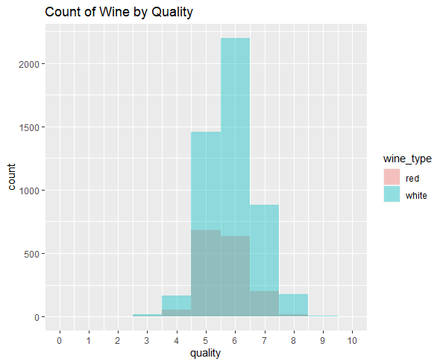
About the Data
~5000 white, 1600 red
Measures of acidity, alcohol, sugar, antioxidants, and salt
Possible outliers in residual sugar, total sulfur dioxide, sulphates, and chlorides
Quality scores 5-7 on average, none higher than 9 or below 3
Goal of our analysis

Slide 5
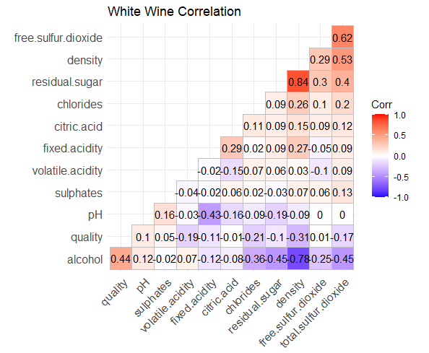
Correlation for White Wine
The following variables are highly correlated.
Quality and alcohol
Residual sugar and density
Alcohol and density
Free sulfur dioxide and total sulfur dioxide

Slide 6
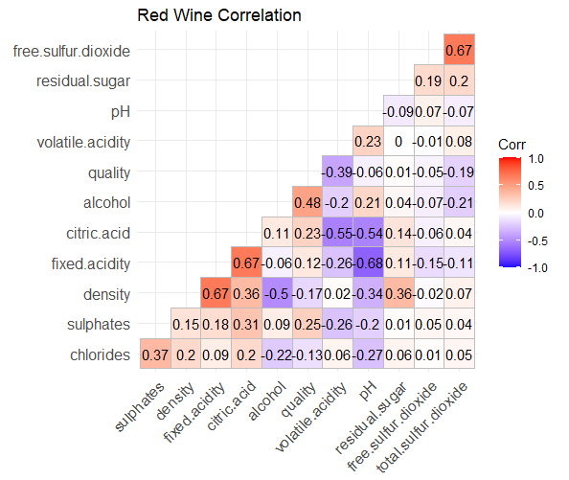
Correlation for Red Wine
The following variables are highly correlated.
Quality and alcohol
Density and fixed acidity
Fixed acidity and citric acid
Volatile acidity and citric acid
Fixed acidity and ph
Free sulfur dioxide and total sulfur dioxide.

Slide 7
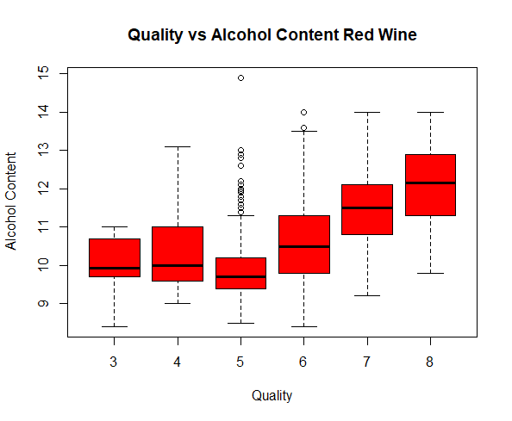
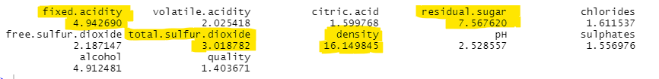
Observations
Multicollinearity in measures of acidity, composition by volume, and sulfur dioxide
Alcohol content is most notable predictor of quality, more is better
High volatile acids more often low quality
Notes:
During data exploration, we noticed a couple of patterns and interesting points.
We could tell from VIF values and correlations that measures of acidity, composition by volume, and sulfur dioxide predictors had collinearity with one another because they are physically related quantities.
We also noticed that the most notable trend in quality data was for alcohol content. Good red and white wines have a higher average alcohol content.
Wines that had high volatile acids, the acids that evaporate easily, were rated more poorly on average. We assume this is because it has an unpleasant smell and taste.
For white wines, those with higher sugar were rated more poorly on average.

Slide 8
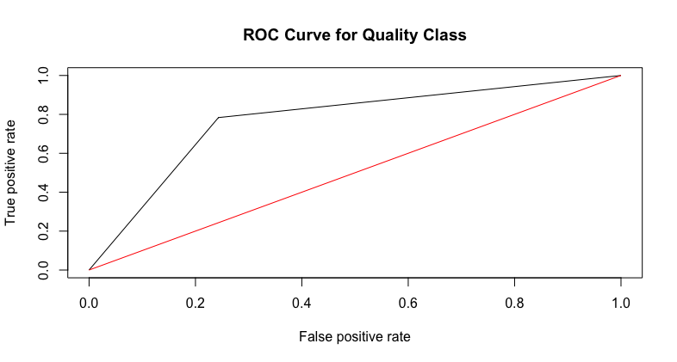
Wine Quality Logistic Regression (Red)
Quality score
“Bad”: 1-5
“Good”: 6-10
Quality class regressed on
Alcohol
Free Sulfur Dioxide
Sulphates
Volatile Acidity
Total Sulfur Dioxide
Chlorides
ΔG²: 864
P-value: 0
log(π/1-π) = -7.38 +0.82*alcohol - 3.13*volatile acidity -4.28*chlorides
- 0.02*total sulfur dioxide + 0.02* free sulfur dioxide + 2.42*sulphate

Slide 9
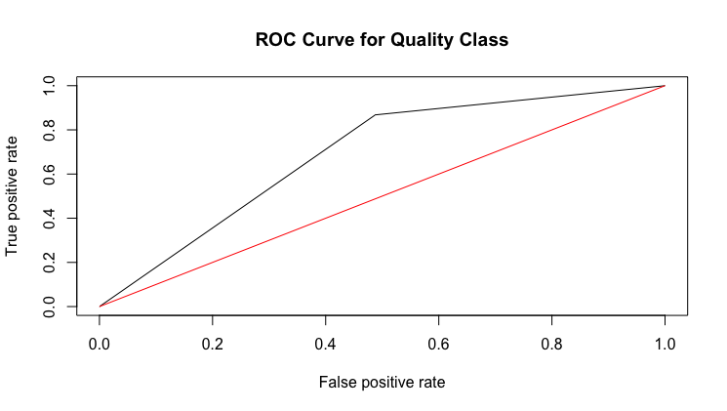
Wine Quality Logistic Regression (White)
Quality score
“Bad”: 1-5
“Good”: 6-10
Quality class regressed on
Alcohol
Free Sulfur Dioxide
Sulphates
Volatile Acidity
Density
Residual Sugar
pH
ΔG²: 922
P-value: 0
log(π/1-π) = 201.6 -6.59*volatile acidity + 0.14*residual sugar + 0.02* free sulfur dioxide - 213.6*density + 0.97*pH + 0.34*sulphates + 0.80*alcohol

Slide 10
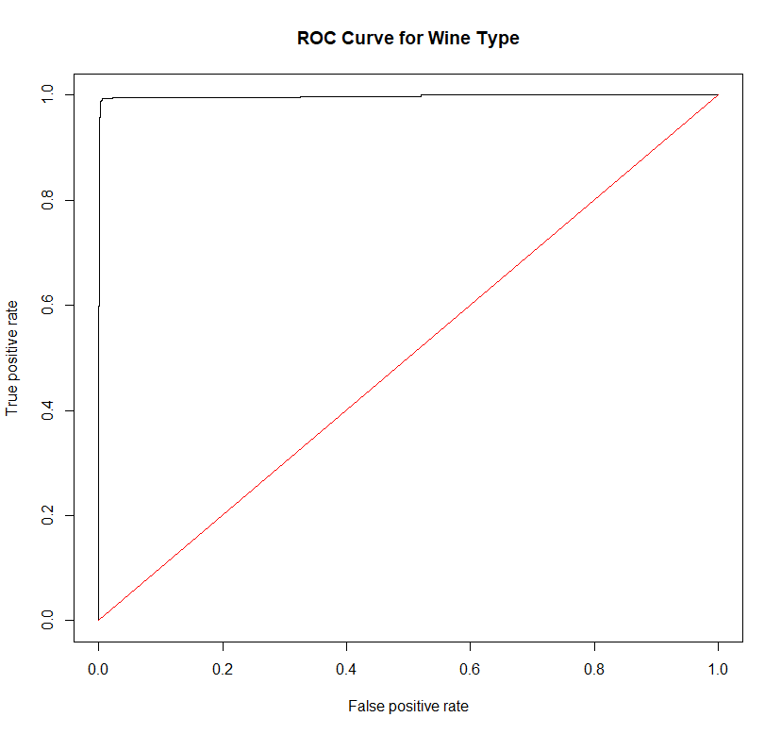
Wine Type Logistic Regression
Type class regressed on
Density
Residual sugar
Total sulfur dioxide
Volatile acidity
Chlorides
Sulphates
Alcohol
Free sulfur dioxide
ΔG²: 4742
P-value: 0
log(π/1-π) = -1456 +1447*density - 0.89*residual sugar -0.06 * total sulfur dioxide + 7.46 * volatile acidity + 22.02*chlorides + 3.55*sulphates + 1.49*alcohol + 0.071*free sulfur dioxide
Notes:
We got a more useful model for predicting Wine Type than we did for Wine Quality. We used all the predictors except quality (which was not significant), pH and citric acid (which were related to the other acidity predictors).
This gave us a great ROC Curve, a Delta G-squared of 4742, and a p-value of 0 so we know it is useful.

Slide 11
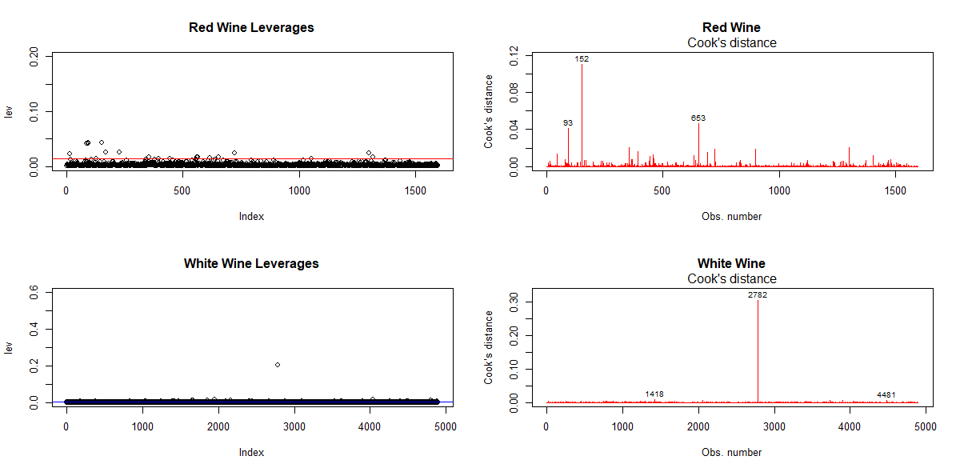
Leverage and Cooks - Quality

Slide 12
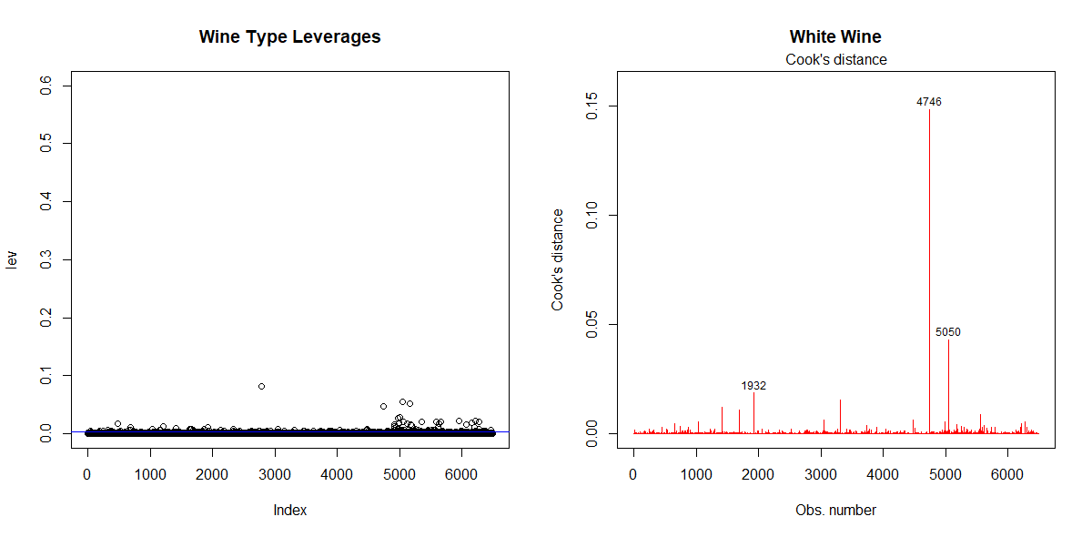
Leverage and Cooks - Wine Type

Slide 13
Confusion Matrices
Wine Type
Accuracy: 99% | Precision: 99% | False Positive Rate: 0.3%
False Negative Rate: 3.2% | Recall: 99%
Red Quality
Accuracy: 77% | Precision: 79% | False Positive Rate: 30%
False Negative Rate: 28% | Recall: 78%
White Quality
Accuracy: 75% | Precision: 89% | False Positive Rate: 47%
False Negative Rate: 30% | Recall: 77%
A model from this data set performs very well at predicting wine type with 99% accuracy and few errors.
However, accuracy for predicting quality is much worse -- only 76-77%. The predictors in this data set are not excellent predictors of quality, but predict correctly more often than not.
Notes:
Accuracy: How many correct guesses out of the total
Precision: Out of those predicted positive, how many are truly positive?
Recall: Out of those actually positive, how many were predicted posit
ive?

Slide 14
Log Odds Predictions
 | Red Wine Quality | White Wine Quality | Wine Type
Delta G-squared p-value | 0 | 0 | 0
Sample 1 Prediction (Actual: Good Quality Red) | 95% Probability Good | -- | 99.6% Probability Red
Sample 2 Prediction (Actual: Good Quality White) | -- | 95% Probability Good | 1.5% Probability Red
All models are useful for prediction according to the 0 p-values computed from delta G-squared.
We can see from two sample points that odds prediction is correctly identifying actual values with high probabilities.
Notes:
We used our models and predictor values from two sample points from the data to calculate log odds for the wine type and quality responses. A Good Red wine had a 95% probability of being Good, and a 99.6% probability of being Red. A Good White wine had a 95% probability of being Good and only a 1.5% probability of being Red.

