Slide 1


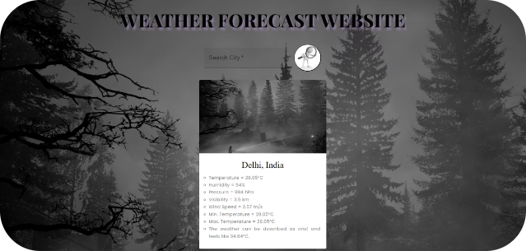

Weather Forecast Website using ReactJS
Presented by -
Neha Andola, University Roll No. 2018888
Under the mentorship of -
Ms. Tanusha Mittal, Assistant Professor

Slide 2
Introduction
Weather prediction is essential for effective daily planning, allowing people and organizations to prepare for various weather conditions.
Reliable forecasts are vital for transportation, agriculture, construction, outdoor events, and emergency response.
Weather updates are easily accessible on mobile phones and computers.
These enables individuals and organizations to stay prepared for any weather-related challenges.

Slide 3

Objectives
The primary aim of this project is to create an intuitive and user-friendly weather website using React JS. The website will dynamically fetch and display current weather information for a specified city, leveraging data from a reliable weather API.
1
Search Functionality
2
Real-time Weather Display
3
Responsive Design
Implementing a user-friendly search bar where users can input city names to fetch real-time weather information.
Ensuring immediate presentation of current weather conditions, including temperature, weather descriptions, and other pertinent data.
Optimizing the website for accessibility and visual appeal across a variety of devices, such as desktops, tablets, and smartphones, through responsive design principles.

Slide 4
Leveraging React JS
Component Reusability
Efficient Rendering
Smooth User Experience
Component-based architecture enables developers to create reusable components like weather widgets, forecast cards, and interactive maps, speeding up development and ensuring site-wide consistency.
React's virtual DOM ensures efficient updates by minimizing direct DOM manipulations, leading to faster rendering and improved performance.
React enables the creation of Single-Page Applications (SPAs), which dynamically load content without refreshing the entire page.

Slide 5

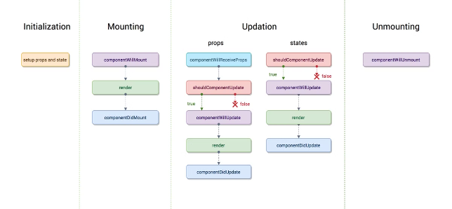
Development Methodology
1
Environment Setup
Establishing the React environment, including installing Node.js, npm, and creating a new project with Vite.
2
Component Design
Creating modular, reusable components like SearchBox, InfoBox, and WeatherApp to promote code maintainability.
3
API Integration
Selecting a weather data provider, implementing data retrieval based on user queries, and handling responses.

Slide 6

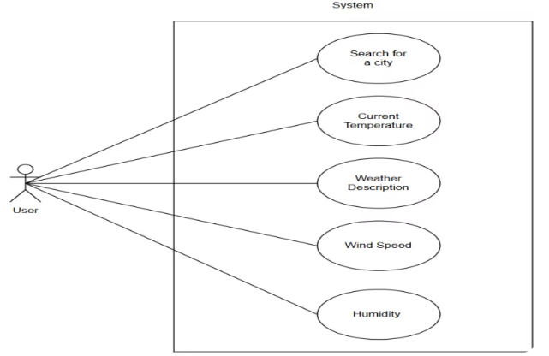
Use Case Diagram
The use case diagram illustrates the primary interactions between the user and the system, including searching a city name, fetching weather data, and displaying current weather conditions.

Slide 7



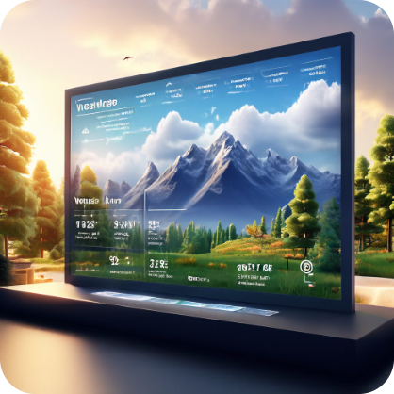



Result
Key Features
Search
Error Handling
Users can easily find weather data of a city by searching by city name.
If a user enters an invalid city name, the site shows a clear error message.
Visual Presentation
Current Conditions
Weather data is shown in an easy-to-read, visually engaging format.
The website displays up-to-date weather information.
Temperature Range
Users can view the expected high and low temperatures for the day.

Slide 8
Discussion
Outcome and Analysis
1
Core Feature
2
Design Choices
Search Functionality, current weather condition display, visual representation of data, error handling and temperature range display.
Use of React for component-based development, modular components, and vite for development efficiency.
3
Challenges
4
Performance Metrics
Faced and overcame challenges in API integration and handling asynchronous data fetching.
Page load speed, device adaptability, data retrieval efficiency, and user interface design.

Slide 9
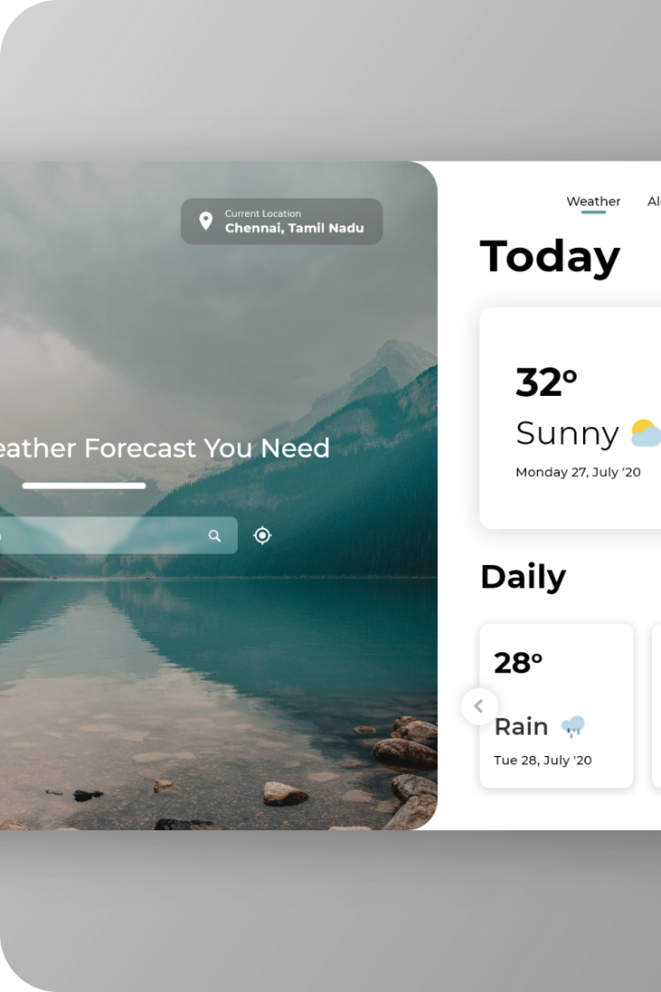
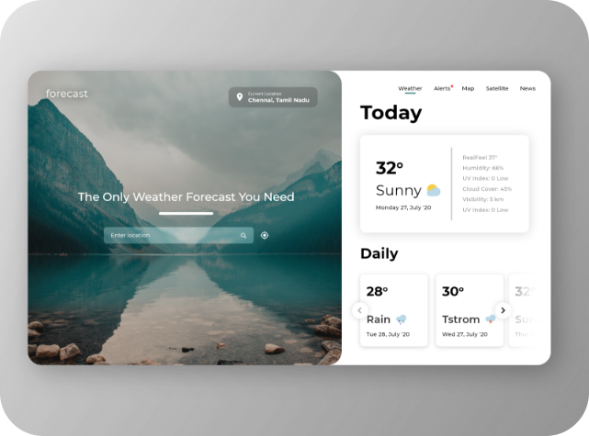
Future Improvements
Weather History
Extended Forecasts
Offering access to past weather data for pattern recognition.
Providing more detailed predictions over longer periods.
Severe Weather Notifications
Ongoing Performance Enhancements
Developing a system to alert users about extreme conditions.
Continuously refining load speeds and data handling.

Slide 10
Thank You

