Slide 1

INTRO TO DATABASE Smart Attendance System
Rami Abdullah alalli 2141114
Mohammad mobark aljahdali 2143307
saad mohammed alqarni 2140793
nawaf abdullah al-otaibi 2140887

Slide 2
01
Analysis
A brief history of attendance systems

Slide 3
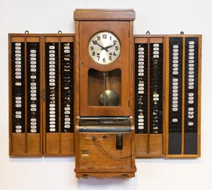
Back in the early 1900s, workplaces used to take attendance of its employees by checking their punch card, they would have to arrive and use a mechanical device that would record data on the paper punch cards which were stamped or punched by the clock in the machine, problem with that is that some employees would punch their cards along with a co-worker’s card. This, without a doubt, caused problems for companies
Mechanical punch card device

Slide 4
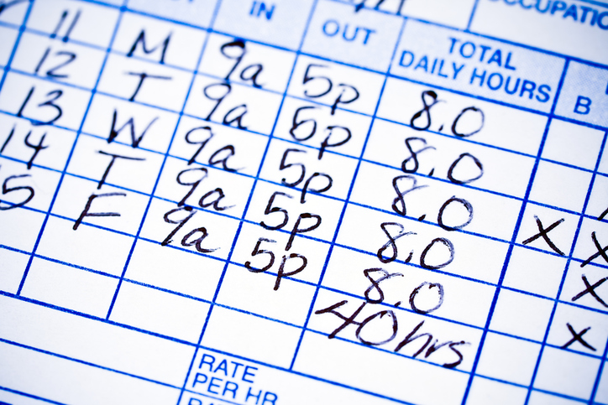
As time passed by, companies moved on from mechanical machines due to its cost for repair. Paper Timesheets were introduced, this method was inefficient because an employee would have to manually write their working hours, this has a possibility of dishonesty depending on the employee.
Timesheet used by each employee

Slide 5
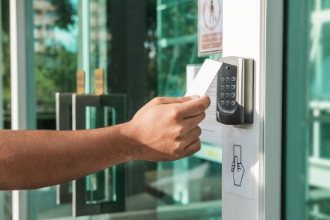
The era of Magnetic Cards appeared in the early 2010s, that used magnetic labels to transmit information when the card is swiped through a magnetic stripe card reader, the magnetic card would have an employee’s information in it and was recorded into the system when swiped, this solved crowding problems as it took a simple swipe to track attendance, but now the problem with paper punch cards raised again, any employee can swipe with cards that weren’t theirs
Card scanner that registers when an employee entered

Slide 6
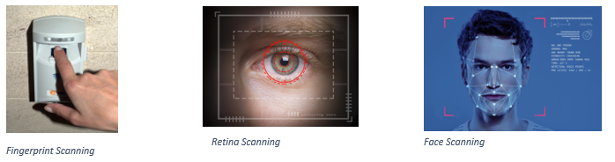
Now that we have moved onto the era of advanced technology, there are countless of ways to avoid dishonesty of attendance reports and by being time efficient at the same time using methods which verify that the employee is the only person who can take their own attendance, Fingerprints, Retina, Facial recognition, all these scans are unique to each person, meaning, there are no identical scans from one and another. These scans take less than a minute to complete and by providing many possible locations for the scanning devices, this should efficiently reduce the crowding caused by prior machines.

Slide 7

How the system works
A brief introduction into how our attendance system will work

Slide 8
This database is a demo program that takes place for 10 days with 5 employees.
It is set from January 10 until January 20.
All employees should arrive before 10:00:00 AM, they have 5 minutes to upload their scan at whichever device is available, the scanner inputs all the employees’ scan (Fingerprint, Retina, Face) to the system at 10:00:00 AM every day of the week, If they failed to input a scan before 10:05:00 AM then they will be marked as late until they arrive and the time will be counted.
If the employee fails to provide a scanning matter 30 minutes after the initial scan, they will be marked as absent.

Slide 9
Late Employees Report
1- Khalid was late to work in 2021 January 11, Scanned by device 15, Scanned at 10:08:35, Scan Type was with fingerprint.
2- Nayef was late to work in 2021 January 11, Scanned by device 7, Scanned at 10:27:45, Scan Type was with retina.
3- Ahmed was late to work in 2021 January 13, Scanned by device 12, Scanned at 10:25:05, Scan Type was with retina.
4- Nayef was late to work in 2021 January 17, Scanned by device 7, Scanned at 10:22:05, Scan Type was with facial recognition.
5- Faisal was late to work in 2021 January 19, Scanned by device 5, Scanned at 10:25:13, Scan Type was with fingerprint.

Slide 10
Absent Employees Report
1- Khalid was absent in 2021 January 10, Scanned by device 7, Scanned at 10:30:00, Scan type was with null.
2- Faisal was absent in 2021 January 12, Scanned by device 5, Scanned at 10:30:00, Scan type was with null.
3- Faisal was absent in 2021 January 13, Scanned by device 15, Scanned at 10:30:00, Scan type was with null.
4- Faisal was absent in 2021 January 18, Scanned by device 15, Scanned at 10:30:00, Scan type was with null.
5- Ahmed was absent in 2021 January 19, Scanned by device 12, Scanned at 10:30:00, Scan type was with null.

Slide 11
02
(ER Diagram)
Entity-Relationship Model

Slide 12
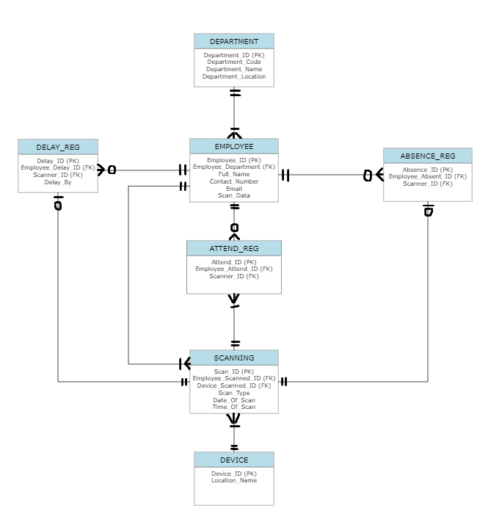
Phase 1 (ERD)

Slide 13
03
(Normalization and Relation)
Normalization And Relation

Slide 14
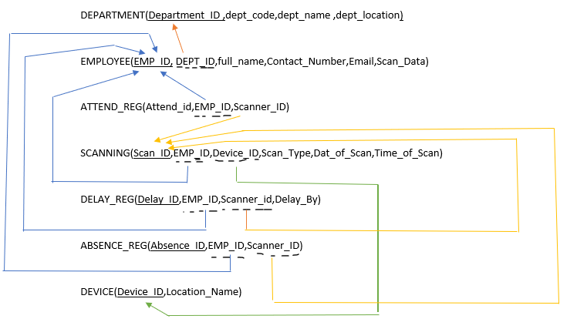
Phase 2 (Relation)

Slide 15
Phase 2 (Normalization)
Already in 1NF because
- there are no repeating groups.
- a unique key has been identified for each relation.
- all attributes are functionally dependent on all or part of the key.
2NF:
Already in 2NF because
-all non-key attributes are fully functionally dependent on the entire key (partial dependency has been removed).
3NF & BCNF:
Already in 3NF BCNF and because
- all transitive dependencies have been removed.
-any remaining anomalies that result from functional dependencies have been removed

Slide 16
04
(Implementing The DBMS)
Making the database

Slide 17
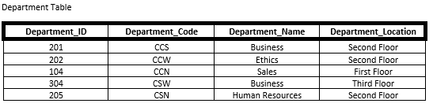
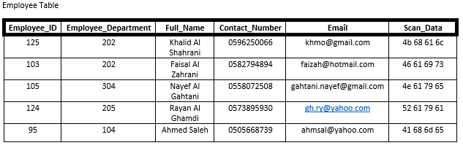
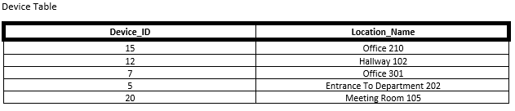
Tables:

Slide 18
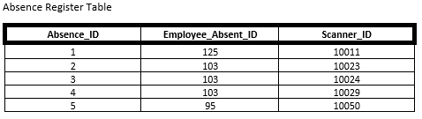
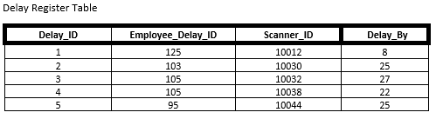
Tables:

Slide 19
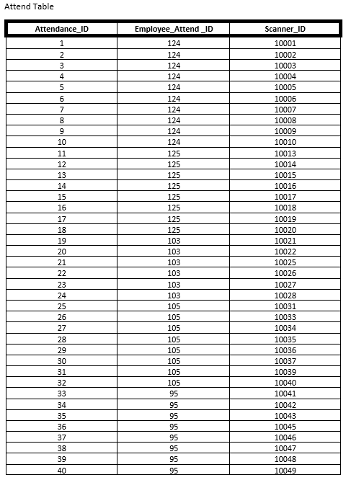
Tables:

Slide 20
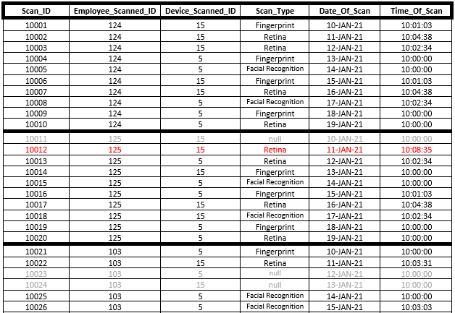
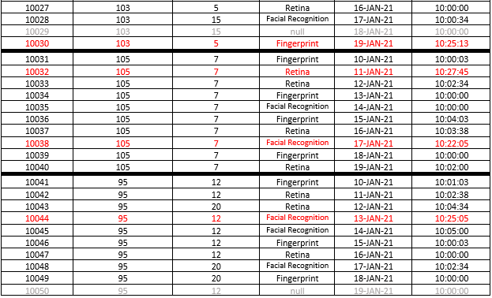
Tables:

Slide 21
05
(Queries)
Finding information in our database

Slide 22

Q1: In department 202, make a query that displays the employee’s details that work there and the name of their department.
Instructions:
Query:

Slide 23

Q2: Make a query to count how many times Khalid used fingerprint to get in
Instructions:
Query:

Slide 24

Q3: Make a query where you find out who was absent on the 10th of January
Instructions:
Query:

Slide 25

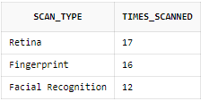
Q4: Sort the scanning types by most used to least
Instructions:
Query:

Slide 26


THANKS FOR LISTENING
Please keep this slide for attribution

