Slide 1

Natural language processing
BY ,
N.RIYAZ.AHMED
CSE

Slide 2
INDEX
NATURAL LANGUAGE AND NLP.
STEPS IN NLP.
TASKS IN NLP.
NLTK
APPLICATION’S.

Slide 3

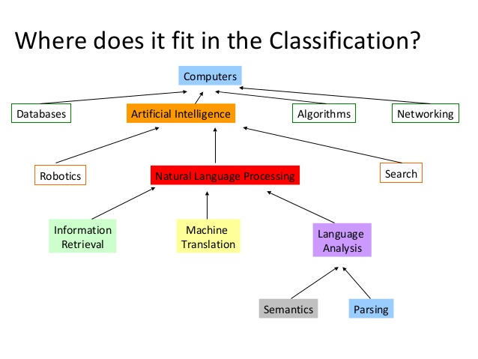
NATURAL LANGUAGE?
WHAT IS NLP?
WHY NLP?
PRACTICAL NLP.

Slide 4
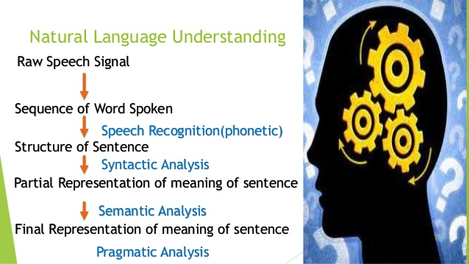
STEPS IN NLP:
MORPHOLOGICAL ANALYSIS
eg : carried= carry + ed
SYNTACTIC ANALYSIS
eg : “go to mroads’
SEMANTIC ANALYSIS
eg : “colorless green ideas”
DISCOURSE ANALYSIS
eg : john wanted it
PRAGMATIC ANALYSIS
eg : what's the time now?

Slide 5
TASKS IN NLP
SEGMENTATION
STEMMING
POS TAGGING
SENTIMENT ANALYSIS
DISAMBIGUATION…

Slide 6


Slide 7
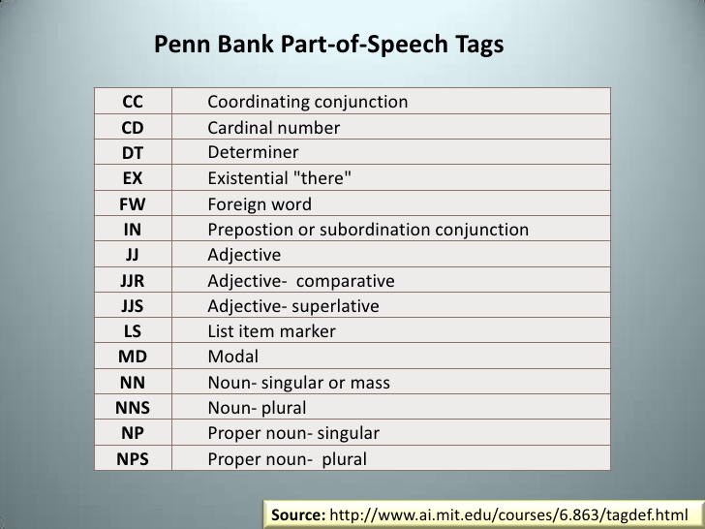

Slide 8
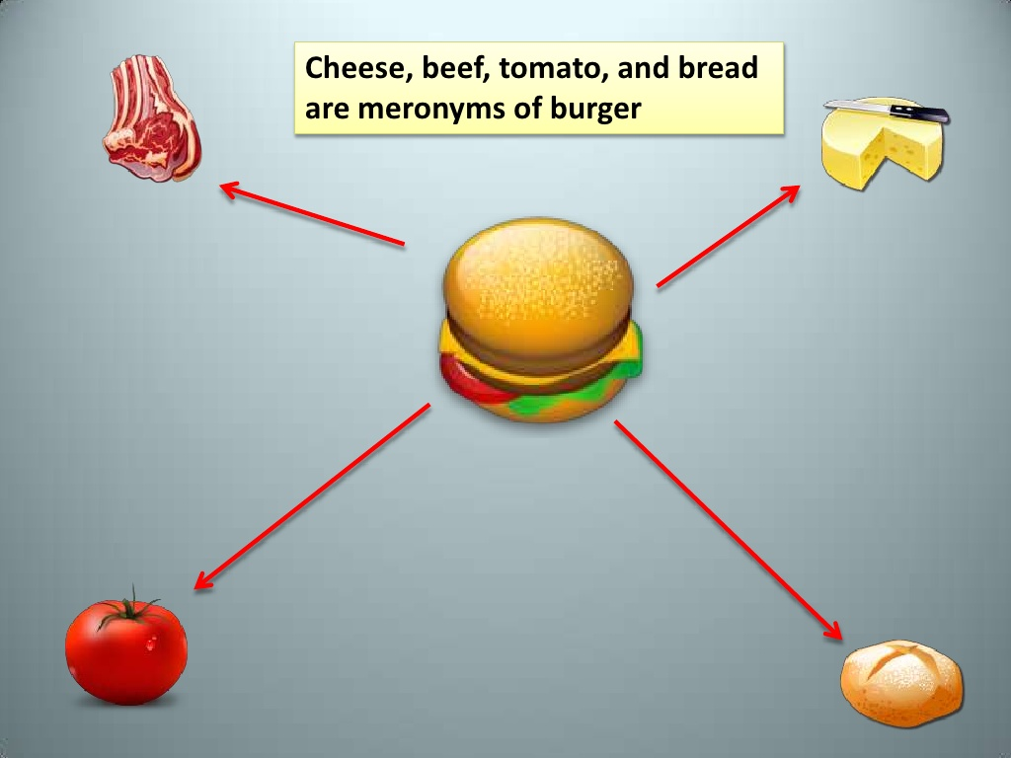
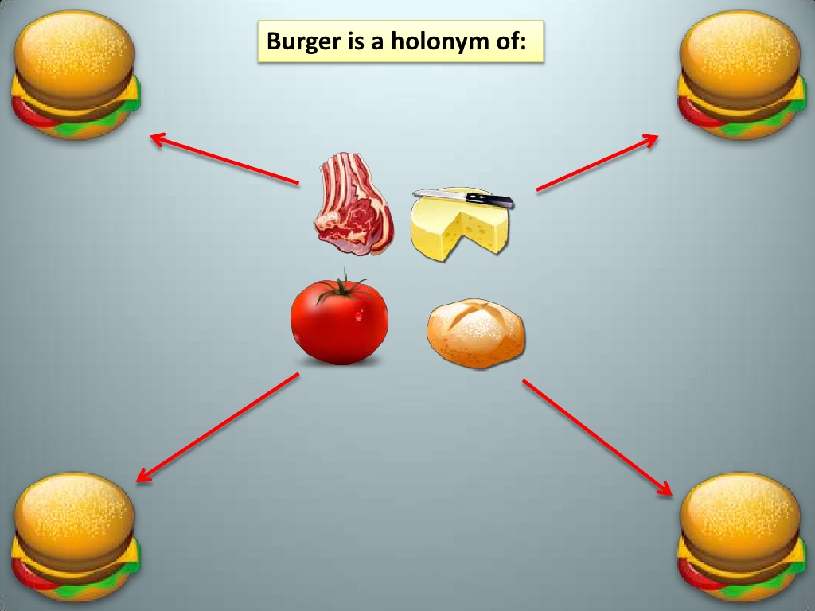
Meronyms and holonyms

Slide 9
other LIBRARIES IN NLP:
TextBlob
SpaCY
Pattern
MITIE
gensim
BeautifulSoup…...

Slide 10
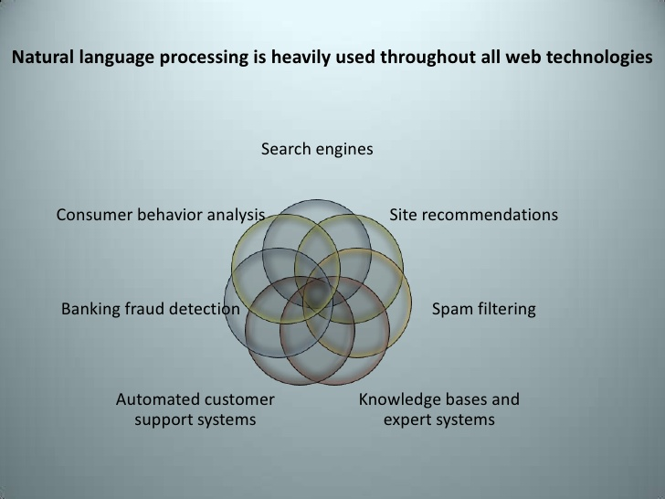
APPLICATION:
MACHINE TRANSLAITON
SPEECH RECOGNITION
TEXT PROCESSING
SEARCH ENGINE
ADVANCED TEXT EDITORS…….

Slide 11


