Slide 1
Numerical Methods Assignment
Runge-Kutta, Newton-Raphson and Secant methods | FOR and WHILE loops, pseudocode, flowcharts
GROUP TEN
NABUKALU ANGEL | BU/UP/2025/2127
NABUKENYA LATIFAH MATOVU | BU/UP/2025/3271
ODONG HARON | BU/UP/2025/3885
MUSASIZI DAN | BU/UP/2025/1549
OLWENY EMMANUEL | BU/UP/2025/4656

Slide 2
Q1: Runge-Kutta (order 4)
Problem: y'' - 2xy' + 8y = 0, y(0) = 12, y'(0) = 0, h = 0.1, 0 <= x <= 1
Set z = y': y' = z, z' = 2xz - 8y
k1 = f(x, y, z); k2 = f(x + h/2, y + h k1/2); k3 = f(x + h/2, y + h k2/2); k4 = f(x + h, y + h k3)
y(n+1) = y(n) + h/6 (k1 + 2k2 + 2k3 + k4), applied to both y and z
Exact solution is y = 16x^4 - 48x^2 + 12, so y(1) = -20 (used as a check).
Group Ten | Numerical Methods Assignment

Slide 3
Q1: Pseudocode
FOR loop
WHILE loop
START
INPUT f(x,y,z), x0, y0, z0 (z = y'), h, n
x <- x0 ; y <- y0 ; z <- z0
FOR i = 1 TO n DO
k1 <- f(x, y, z)
k2 <- f(x+h/2, y+h/2*k1y, z+h/2*k1z)
k3 <- f(x+h/2, y+h/2*k2y, z+h/2*k2z)
k4 <- f(x+h, y+h*k3y, z+h*k3z)
y <- y + h/6*(k1y + 2k2y + 2k3y + k4y)
z <- z + h/6*(k1z + 2k2z + 2k3z + k4z)
x <- x0 + i*h
PRINT i, x, y, z
END FOR
OUTPUT y(1)
STOP
START
INPUT f(x,y,z), x0, y0, z0, h, x_end
x <- x0 ; y <- y0 ; z <- z0
WHILE x < x_end DO
k1 <- f(x, y, z)
k2, k3, k4 as in the FOR version
y <- y + h/6*(k1y + 2k2y + 2k3y + k4y)
z <- z + h/6*(k1z + 2k2z + 2k3z + k4z)
x <- x + h
PRINT x, y, z
END WHILE
OUTPUT y(1)
STOP
Group Ten | Numerical Methods Assignment

Slide 4
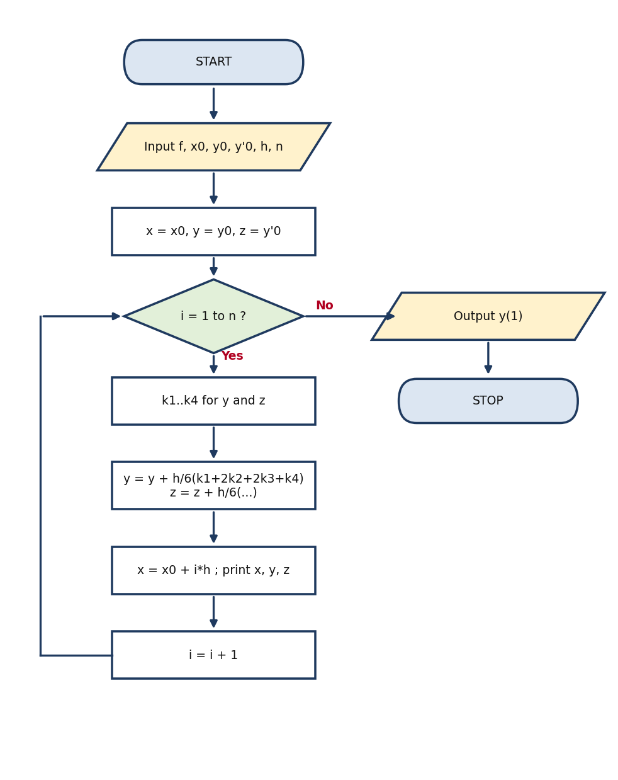
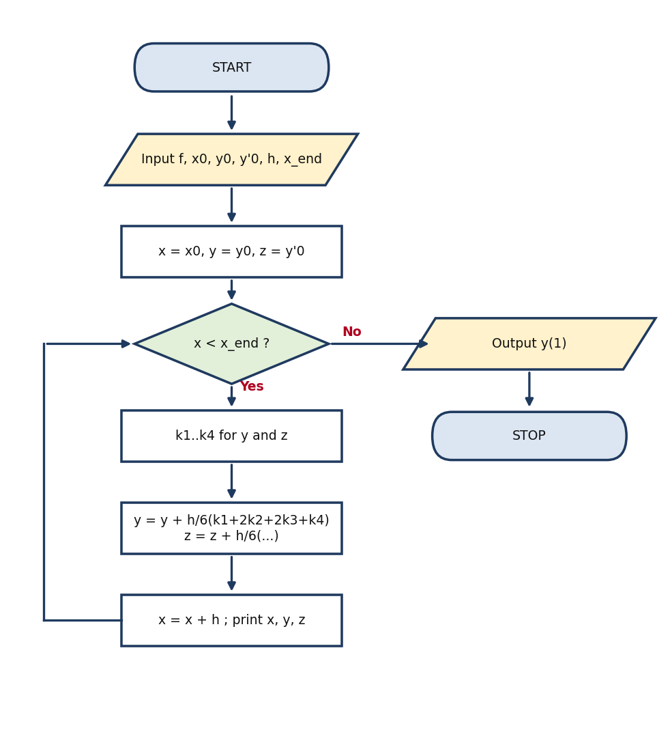
Q1: Flowcharts
FOR loop
WHILE loop
Group Ten | Numerical Methods Assignment

Slide 5
Q1: Program code (Python)
FOR loop
WHILE loop
def f(x, y, z):
# y' = z , z' = y'' = 2*x*z - 8*y
return z, 2*x*z - 8*y
def rk4_for(x0, y0, z0, h, n):
x, y, z = x0, y0, z0
rows = [(0, x, y, z)]
for i in range(1, n + 1):
k1y, k1z = f(x, y, z)
k2y, k2z = f(x + h/2, y + h/2*k1y, z + h/2*k1z)
k3y, k3z = f(x + h/2, y + h/2*k2y, z + h/2*k2z)
k4y, k4z = f(x + h, y + h*k3y, z + h*k3z)
y = y + h/6*(k1y + 2*k2y + 2*k3y + k4y)
z = z + h/6*(k1z + 2*k2z + 2*k3z + k4z)
x = x0 + i*h
rows.append((i, x, y, z))
return rows
rows = rk4_for(0, 12, 0, 0.1, 10)
for r in rows:
print("%2d x=%.1f y=%.6f y'=%.6f" % r)
def f(x, y, z):
return z, 2*x*z - 8*y
def rk4_while(x0, y0, z0, h, xend):
x, y, z = x0, y0, z0
i = 0
rows = [(i, x, y, z)]
while x < xend - 1e-9:
k1y, k1z = f(x, y, z)
k2y, k2z = f(x + h/2, y + h/2*k1y, z + h/2*k1z)
k3y, k3z = f(x + h/2, y + h/2*k2y, z + h/2*k2z)
k4y, k4z = f(x + h, y + h*k3y, z + h*k3z)
y = y + h/6*(k1y + 2*k2y + 2*k3y + k4y)
z = z + h/6*(k1z + 2*k2z + 2*k3z + k4z)
i = i + 1
x = x0 + i*h
rows.append((i, x, y, z))
return rows
rows = rk4_while(0, 12, 0, 0.1, 1.0)
for r in rows:
print("%2d x=%.1f y=%.6f y'=%.6f" % r)
Group Ten | Numerical Methods Assignment

Slide 6
Q1: Solution
i | x | y (RK4) | y' (RK4) | y exact | |error|
0 | 0.0 | 12.000000 | 0.000000 | 12.000000 | 0.00e+0
1 | 0.1 | 11.521596 | -9.535281 | 11.521600 | 4.00e-6
2 | 0.2 | 10.105672 | -18.686571 | 10.105600 | 7.23e-5
3 | 0.3 | 7.809827 | -27.069919 | 7.809600 | 2.27e-4
4 | 0.4 | 4.730055 | -34.301373 | 4.729600 | 4.55e-4
5 | 0.5 | 1.000747 | -39.996982 | 1.000000 | 7.47e-4
6 | 0.6 | -3.205311 | -43.772795 | -3.206400 | 1.09e-3
7 | 0.7 | -7.676938 | -45.244862 | -7.678400 | 1.46e-3
8 | 0.8 | -12.164555 | -44.029234 | -12.166400 | 1.85e-3
9 | 0.9 | -16.380188 | -39.741962 | -16.382400 | 2.21e-3
10 | 1.0 | -19.997470 | -31.999099 | -20.000000 | 2.53e-3
y(1) = -19.99747 (exact -20), y'(1) = -31.99910. FOR and WHILE loops give identical results.
Group Ten | Numerical Methods Assignment

Slide 7
Q2: Newton-Raphson method
x(n+1) = x(n) - f(x(n)) / f'(x(n))
(i) f(x) = 3x - e^(-x), f'(x) = 3 + e^(-x), x0 = 0
(ii) f(x) = tan x + 2 tanh x, f'(x) = sec^2 x + 2 sech^2 x, x0 = 2 (smallest non-zero positive root)
(iii) f(x) = x^4 - 4x^3 + x^2 + 1.2, f'(x) = 4x^3 - 12x^2 + 2x, x0 = 4 (largest root)
WHILE version stops when |x(n+1) - x(n)| <= 1e-6; FOR version uses N = 6 iterations.
Group Ten | Numerical Methods Assignment

Slide 8
Q2: Pseudocode
FOR loop
WHILE loop
START
INPUT f(x), f'(x), x0, N
x <- x0
FOR i = 1 TO N DO
x_new <- x - f(x)/f'(x)
PRINT i, x_new
x <- x_new
END FOR
OUTPUT root x
STOP
START
INPUT f(x), f'(x), x0, tol, max_iter
x <- x0 ; error <- 1 ; i <- 0
WHILE error > tol AND i < max_iter DO
x_new <- x - f(x)/f'(x)
error <- |x_new - x|
i <- i + 1
PRINT i, x_new
x <- x_new
END WHILE
OUTPUT root x, i
STOP
Group Ten | Numerical Methods Assignment

Slide 9

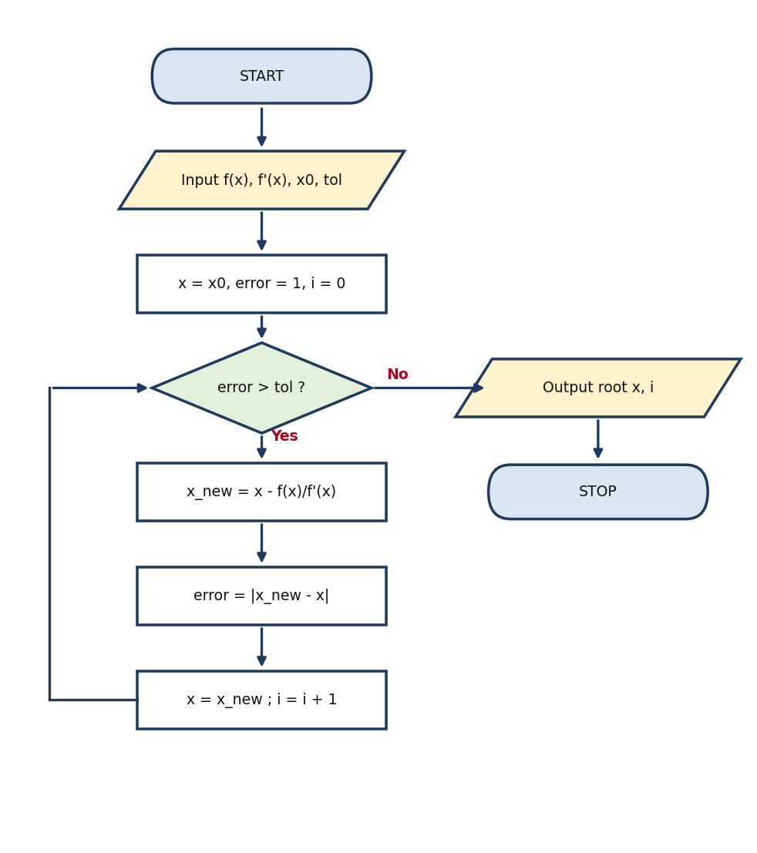
Q2: Flowcharts
FOR loop
WHILE loop
Group Ten | Numerical Methods Assignment

Slide 10
Q2: Program code (Python)
FOR loop
WHILE loop
from math import exp, tan, tanh, cosh, cos
def newton_for(f, df, x0, N=6):
x = x0
rows = []
for i in range(1, N + 1):
x_new = x - f(x) / df(x)
rows.append((i, x, f(x), x_new))
x = x_new
return x, rows
r1, t1 = newton_for(lambda x: 3*x - exp(-x), lambda x: 3 + exp(-x), 0.0)
r2, t2 = newton_for(lambda x: tan(x) + 2*tanh(x),
lambda x: 1/cos(x)**2 + 2/cosh(x)**2, 2.0)
r3, t3 = newton_for(lambda x: x**4 - 4*x**3 + x**2 + 1.2,
lambda x: 4*x**3 - 12*x**2 + 2*x, 4.0)
print(r1, r2, r3)
from math import exp, tan, tanh, cosh, cos
def newton_while(f, df, x0, tol=1e-6, max_iter=50):
x = x0
i = 0
error = 1.0
rows = []
while error > tol and i < max_iter:
x_new = x - f(x) / df(x)
error = abs(x_new - x)
i = i + 1
rows.append((i, x, f(x), x_new))
x = x_new
return x, rows
r1, t1 = newton_while(lambda x: 3*x - exp(-x), lambda x: 3 + exp(-x), 0.0)
r2, t2 = newton_while(lambda x: tan(x) + 2*tanh(x),
lambda x: 1/cos(x)**2 + 2/cosh(x)**2, 2.0)
r3, t3 = newton_while(lambda x: x**4 - 4*x**3 + x**2 + 1.2,
lambda x: 4*x**3 - 12*x**2 + 2*x, 4.0)
print(r1, r2, r3)
Group Ten | Numerical Methods Assignment

Slide 11
Q2: Solutions
(i) 3x - e^(-x) = 0
(ii) tan x + 2 tanh x = 0
(iii) x^4 - 4x^3 + x^2 + 1.2 = 0
n | x(n) | x(n+1)
1 | 0.000000 | 0.250000
2 | 0.250000 | 0.257622
3 | 0.257622 | 0.257628
4 | 0.257628 | 0.257628
n | x(n) | x(n+1)
1 | 2.000000 | 2.043441
2 | 2.043441 | 2.047854
3 | 2.047854 | 2.047892
4 | 2.047892 | 2.047892
n | x(n) | x(n+1)
1 | 4.000000 | 3.761111
2 | 3.761111 | 3.709005
3 | 3.709005 | 3.706656
4 | 3.706656 | 3.706651
5 | 3.706651 | 3.706651
Root = 0.257628
Root = 2.047892
Root = 3.706651
(ii): x = 0 is a trivial root, so the smallest non-zero positive root (between pi/2 and pi) is given.
Group Ten | Numerical Methods Assignment

Slide 12
Q3: Secant method
Problem: positive root of f(x) = x - 2 sin x = 0, x0 = 2, x1 = 1.9
x(n+1) = x(n) - f(x(n)) (x(n) - x(n-1)) / (f(x(n)) - f(x(n-1)))
f(2) = 0.181406, f(1.9) = 0.007400
x2 = 1.9 - 0.007400 (1.9 - 2) / (0.007400 - 0.181406) = 1.895747
WHILE version stops when |x(n+1) - x(n)| <= 1e-6; FOR version uses N = 5 iterations.
Group Ten | Numerical Methods Assignment

Slide 13
Q3: Pseudocode
FOR loop
WHILE loop
START
INPUT f(x), x0, x1, N
FOR i = 1 TO N DO
x2 <- x1 - f(x1)*(x1 - x0)/(f(x1) - f(x0))
PRINT i, x2
x0 <- x1 ; x1 <- x2
END FOR
OUTPUT root x1
STOP
START
INPUT f(x), x0, x1, tol, max_iter
error <- 1 ; i <- 0
WHILE error > tol AND i < max_iter DO
x2 <- x1 - f(x1)*(x1 - x0)/(f(x1) - f(x0))
error <- |x2 - x1|
i <- i + 1
PRINT i, x2
x0 <- x1 ; x1 <- x2
END WHILE
OUTPUT root x1, i
STOP
Group Ten | Numerical Methods Assignment

Slide 14


Q3: Flowcharts
FOR loop
WHILE loop
Group Ten | Numerical Methods Assignment

Slide 15
Q3: Program code (Python)
FOR loop
WHILE loop
from math import sin
def f(x):
return x - 2*sin(x)
def secant_for(x0, x1, N=5):
rows = []
for i in range(1, N + 1):
x2 = x1 - f(x1)*(x1 - x0)/(f(x1) - f(x0))
rows.append((i, x0, x1, f(x1), x2))
x0, x1 = x1, x2
return x1, rows
root, rows = secant_for(2.0, 1.9)
print(root)
from math import sin
def f(x):
return x - 2*sin(x)
def secant_while(x0, x1, tol=1e-6, max_iter=50):
i = 0
error = 1.0
rows = []
while error > tol and i < max_iter:
x2 = x1 - f(x1)*(x1 - x0)/(f(x1) - f(x0))
error = abs(x2 - x1)
i = i + 1
rows.append((i, x0, x1, f(x1), x2))
x0, x1 = x1, x2
return x1, rows
root, rows = secant_while(2.0, 1.9)
print(root)
Group Ten | Numerical Methods Assignment

Slide 16
Q3: Solution
Iteration | x(n-1) | x(n) | x(n+1)
1 | 2.000000 | 1.900000 | 1.895747
2 | 1.900000 | 1.895747 | 1.895495
3 | 1.895747 | 1.895495 | 1.895494
Positive root: x = 1.895494
Group Ten | Numerical Methods Assignment

Slide 17
Summary of answers
Question | Method | Answer
1 | Runge-Kutta 4 (h = 0.1) | y(1) = -19.99747 (exact -20)
2(i) | Newton-Raphson | x = 0.257628
2(ii) | Newton-Raphson | x = 2.047892
2(iii) | Newton-Raphson | x = 3.706651
3 | Secant | x = 1.895494
Group Ten: NABUKALU ANGEL, NABUKENYA LATIFAH MATOVU, ODONG HARON, MUSASIZI DAN, OLWENY EMMANUEL
Group Ten | Numerical Methods Assignment

