Slide 1

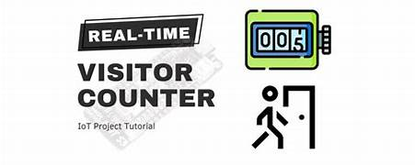
ADHIYAMAAN COLLEGE OF ENGINEERING
Human Detection Based AutomaticVisitor Counter
Using PIR+ULTRASONIC SENSOR
TEAM MEMBERS
ISHWARYA R (6176AC23UAD016)
NADHIYA S (6176AC23UAD036)
MADHUMITHA M (6176AC23UAD029)
ANANDHI D (6176AC23UAD006)

Slide 2
INTRODUCTION
An automatic visitor counter is a system used to count the number of people entering or exiting a particular area. In this project, PIR and Ultrasonic sensors are combined to improve accuracy. The PIR sensor detects human motion, while the ultrasonic sensor measures distance and movement direction. Arduino UNO processes the sensor data and displays the visitor count on an LCD display

Slide 3
COMPONENTS USED
Arduino UNO: Main controller that processes sensor data.
PIR Sensor: Detects human motion using body heat.
Ultrasonic Sensor: Measures distance to detect entry/exit.
LCD Display: Shows current visitor count.
Breadboard & Wires: For connecting components.
USB Cable: Powers Arduino and uploads code

Slide 4
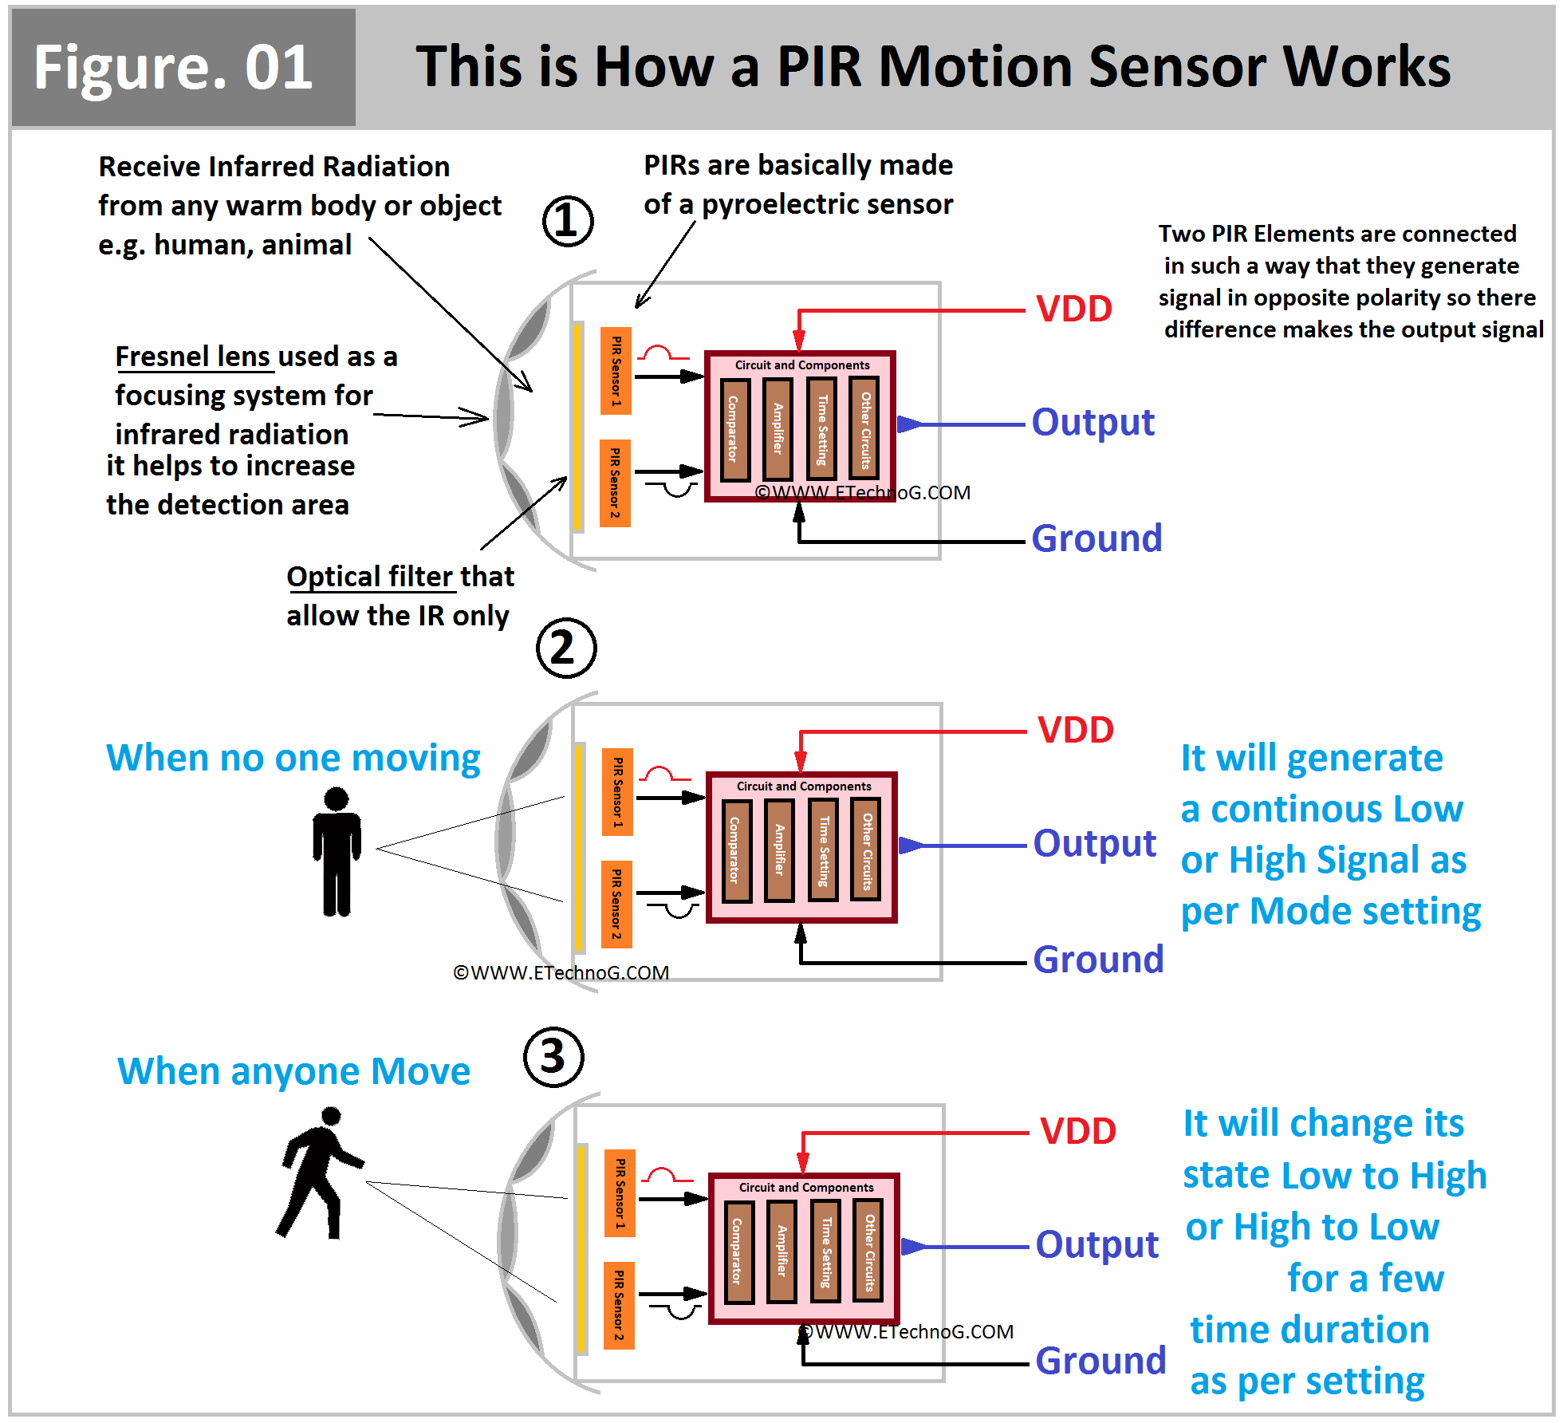
WORKING PRINCIPLE
The USB cable supplies power to the Arduino and initializes all connected components.
The PIR sensor continuously monitors the entrance and detects human motion using infrared radiation.
When a human is detected, the PIR sensor sends a signal to the Arduino.
After human confirmation, the ultrasonic sensor measures the distance to track movement through the entrance.
Arduino processes data from both sensors to determine whether the person is entering or exiting.
Based on the detected movement, the visitor count is increased or decreased.
The updated visitor count is displayed on the LCD in real time.

Slide 5
FUTURE SCOPE APPLICATION
Shopping malls and supermarkets
Libraries and educational institutions
Offices and conference halls
Public buildings and museums
Smart home and security systems
Integration with IoT for cloud-based data storage
Adding camera and AI for higher accuracy
Mobile app for real-time monitoring
Automatic occupancy limit alert system
Gender and age detection using advanced sensor

Slide 6
LIMITATION
CONCLUSION
PIR sensor cannot detect stationary humans
Ultrasonic sensor detects both humans and objects
Close or fast movement may cause counting errors
Limited accuracy in crowded environments
Environmental factors may affect sensor performance
The combination of PIR and ultrasonic sensors provides a cost-effective and reliable solution for automatic visitor counting. PIR sensor ensures human detection, while ultrasonic sensor helps in distance measurement and direction analysis. This combined approach improves accuracy compared to using a single sensor and is suitable for small to medium-scale applications

Slide 7
THANK YOU

