Slide 1

Computer Fundamentals and Office Applications
Project Title: Comprehensive Clinical Biochemistry Data Analysis Tool
Name: Md. Naeem
Batch:06

Slide 2
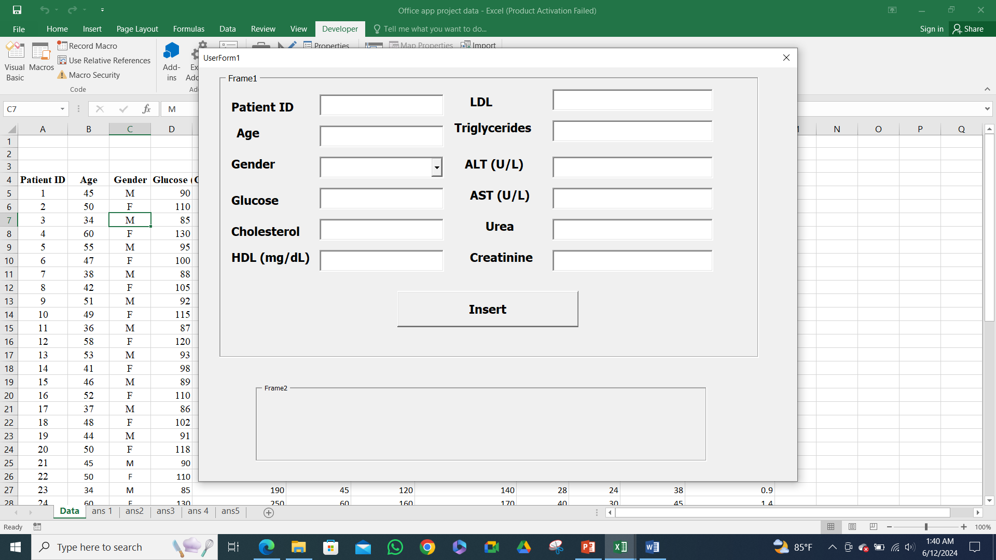

Slide 3
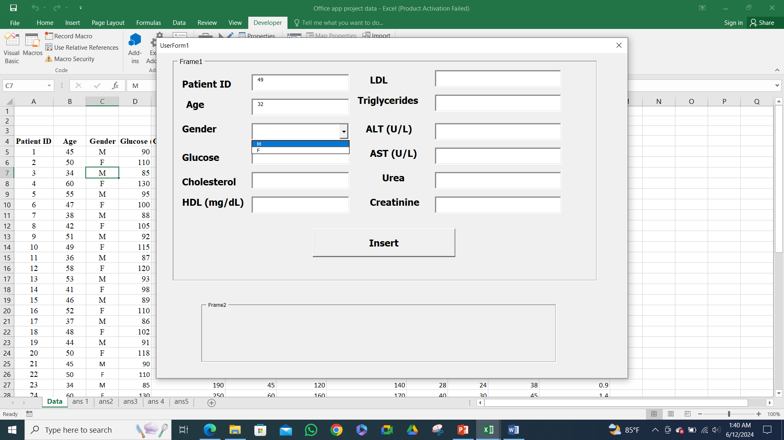

Slide 4
Analysis of Data: Using Pivot table
Count of Patient ID for each Age by Gender
Count of Patient Id for each age
What is the average glucose level across different age groups?
What is the distribution of cholesterol levels among male and female patients?
How do HDL levels correlate with LDL levels across different age groups?

Slide 5
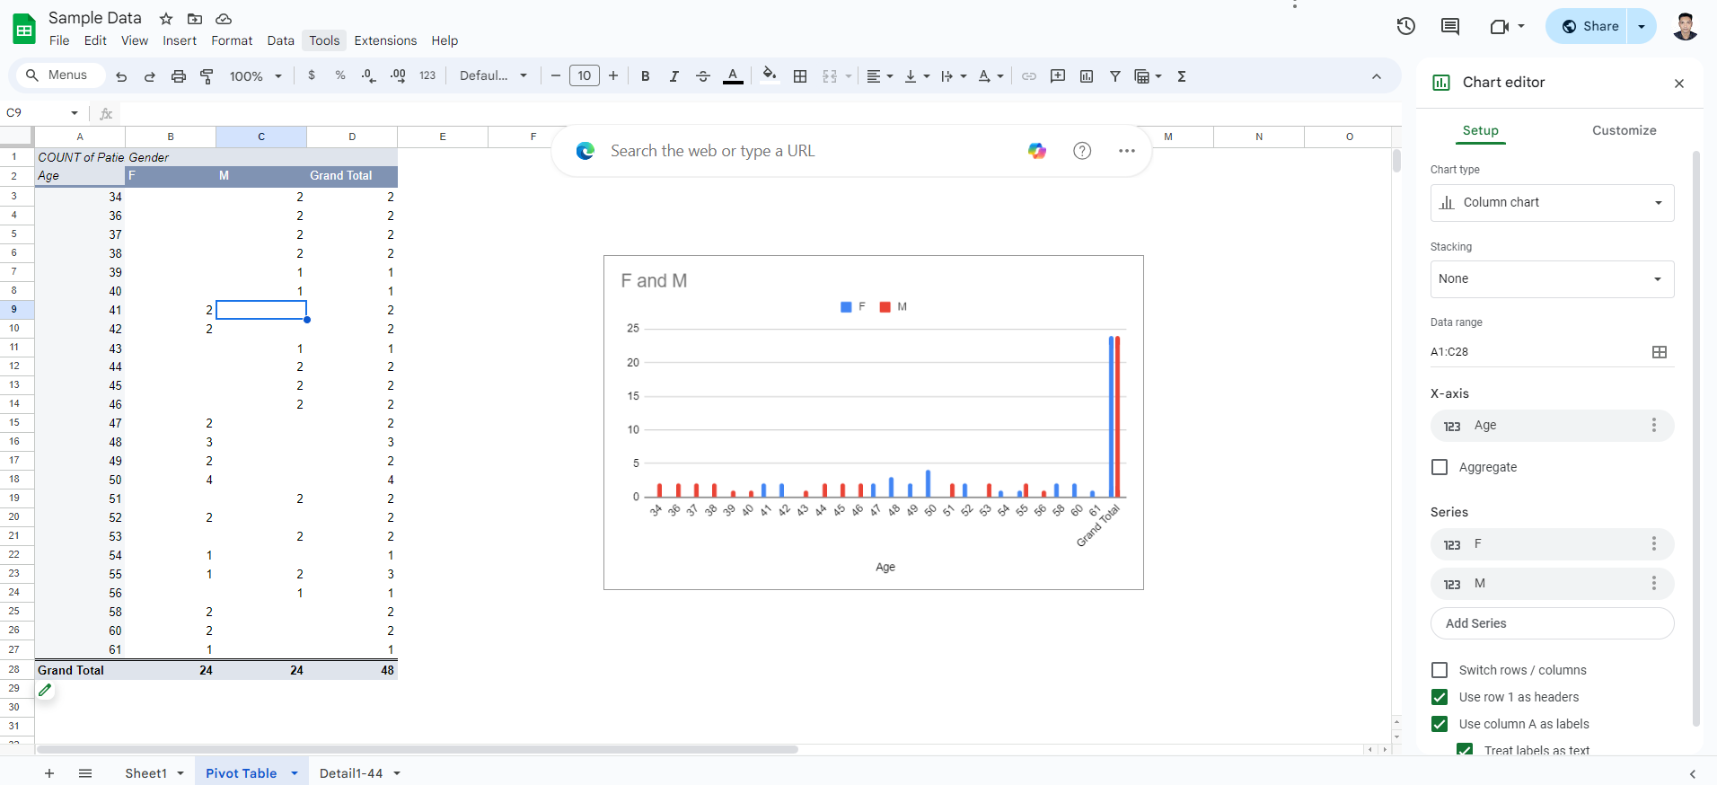
Analysis of Data: Pivot table
Count of Patient ID for each Age by Gender

Slide 6
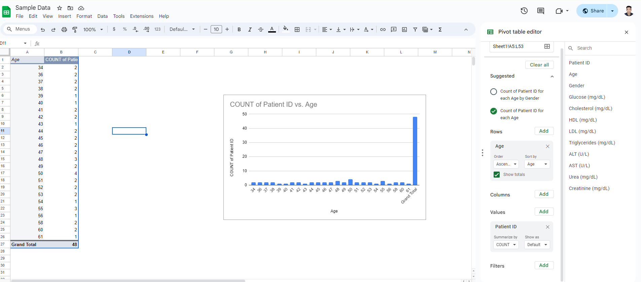
2. Count of Patient Id for each age

Slide 7
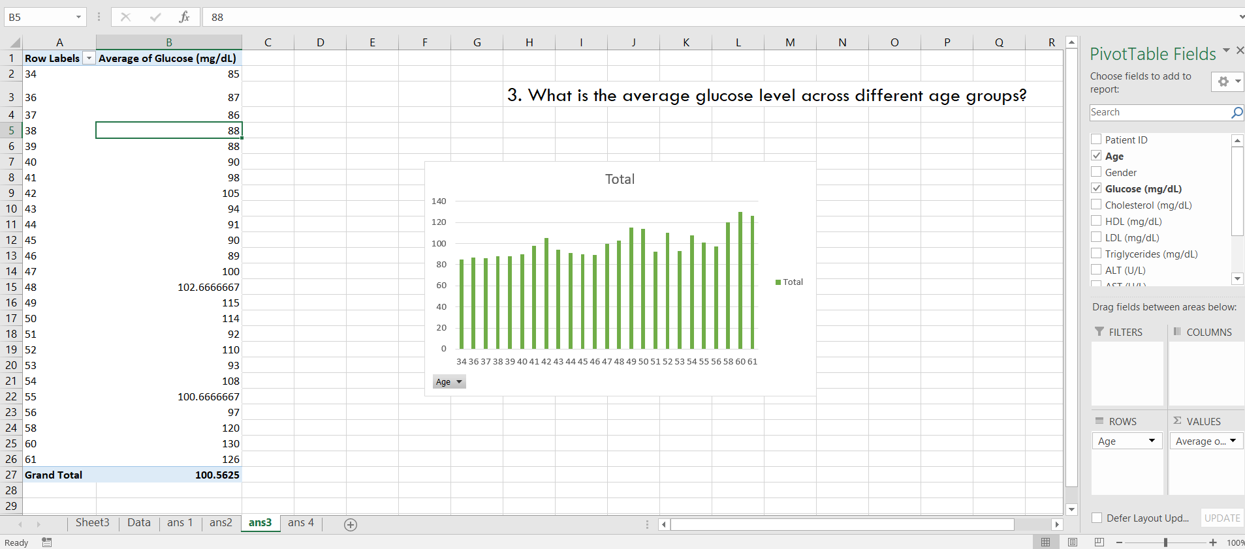
3. What is the average glucose level across different age groups?

Slide 8
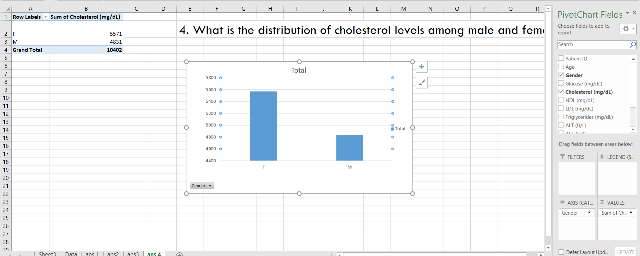
4. What is the distribution of cholesterol levels among male and female patients?

Slide 9
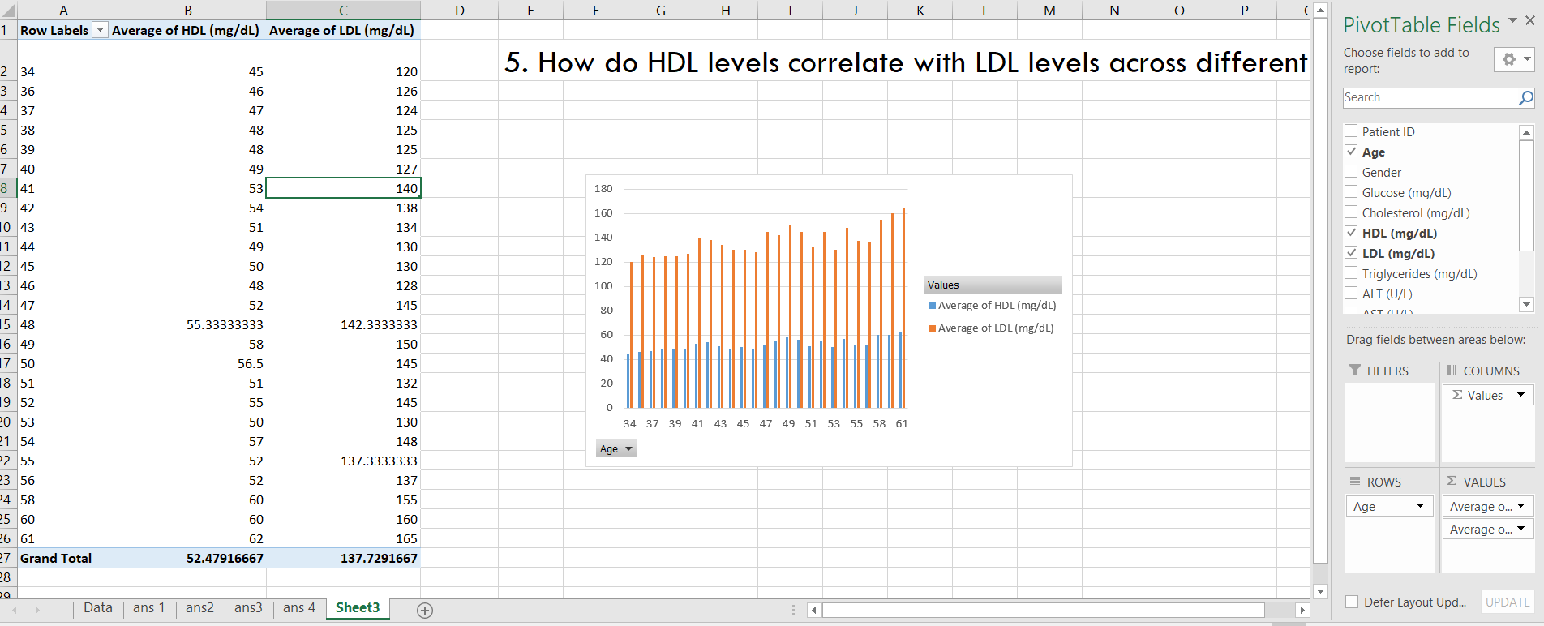
5. How do HDL levels correlate with LDL levels across different age groups?

Slide 10


