Slide 1


UNLOCKING THE POWER OF SOCIAL BUZZ: A DATA-DRIVEN ANALYSIS OF TRENDS AND INSIGHTS

Slide 2

Social Buzz, founded by two former engineers from a major social media conglomerate, prioritizes content by maintaining user anonymity and tracking reactions to content rather than individual users. With over 500 million monthly active users, Social Buzz has scaled rapidly and now requires external expertise to oversee their scaling process effectively. Their platform generates a massive amount of unstructured data, including over 100,000 daily pieces of content, necessitating sophisticated technology and a large technical staff to manage and maintain.
Analyzing content categories to identify the top 5 categories with the highest aggregate popularity.
Project Recap

Slide 3


Problem
Massive Amount Of Unstructured Data Generated By Over 100,000 Daily Pieces Of Content Is A Significant Challenge

Slide 4


Insights
People Loved Positive And Cheerful Loveable Contest Thean Rest Of Those
Animal Has The High Score Of Reaction
Month May Has The Highest Content Type
Picture Typed Content Are Most Widely Used

Slide 5
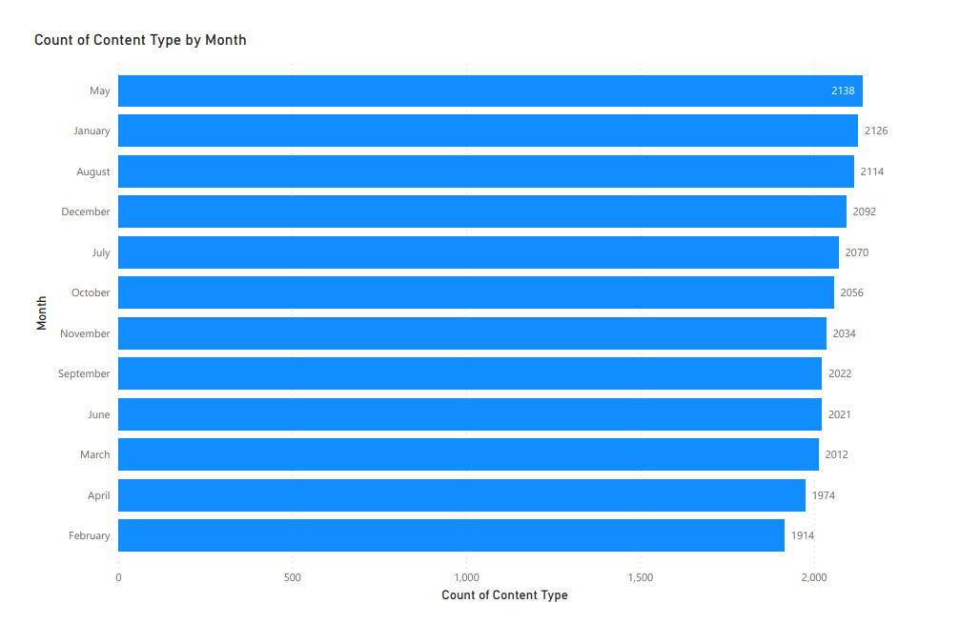

Slide 6
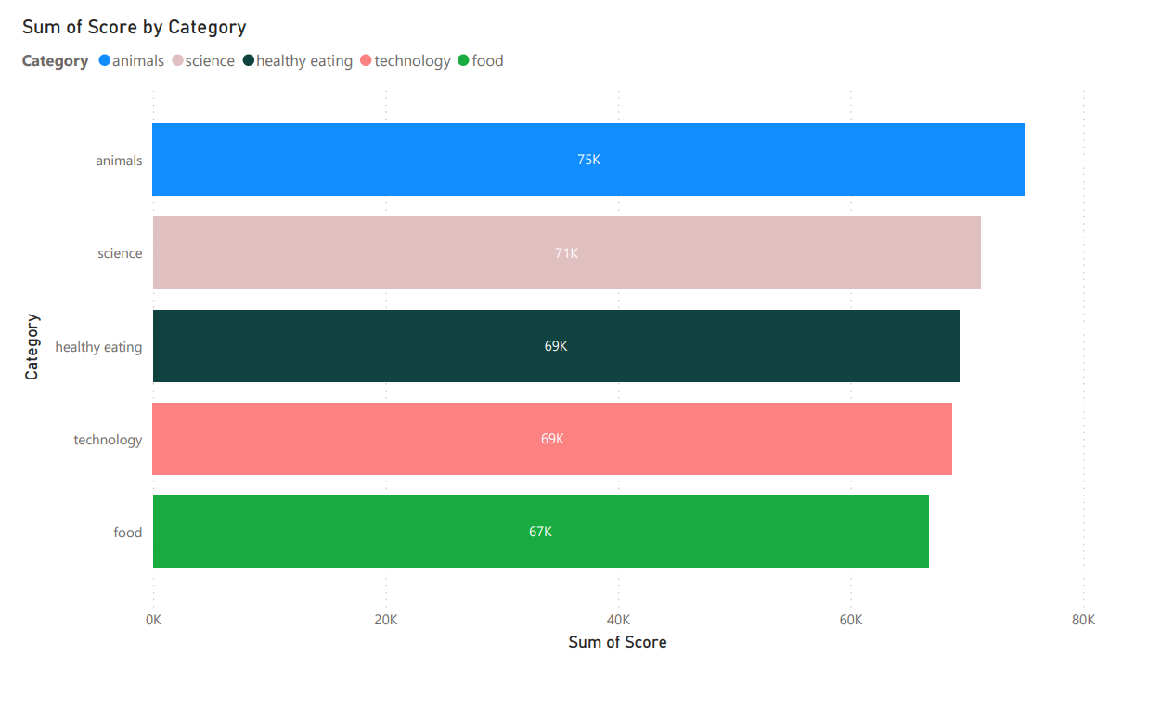

Slide 7
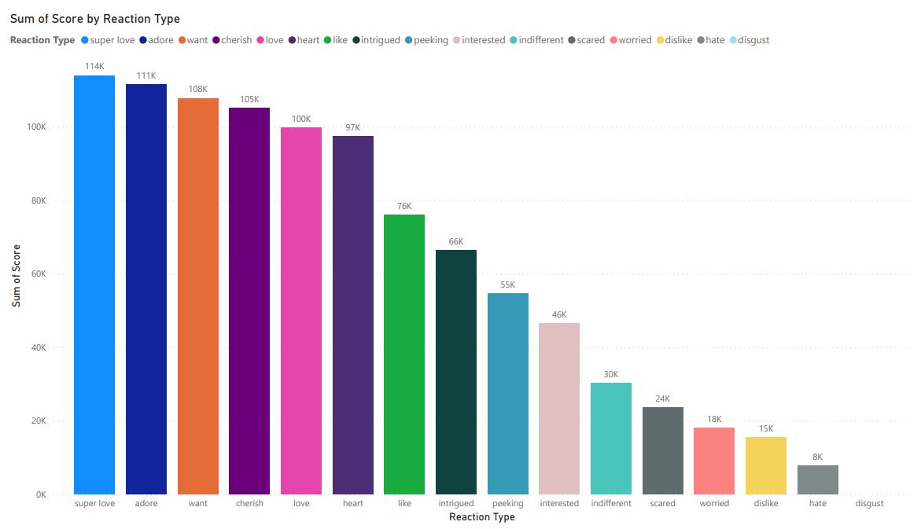

Slide 8
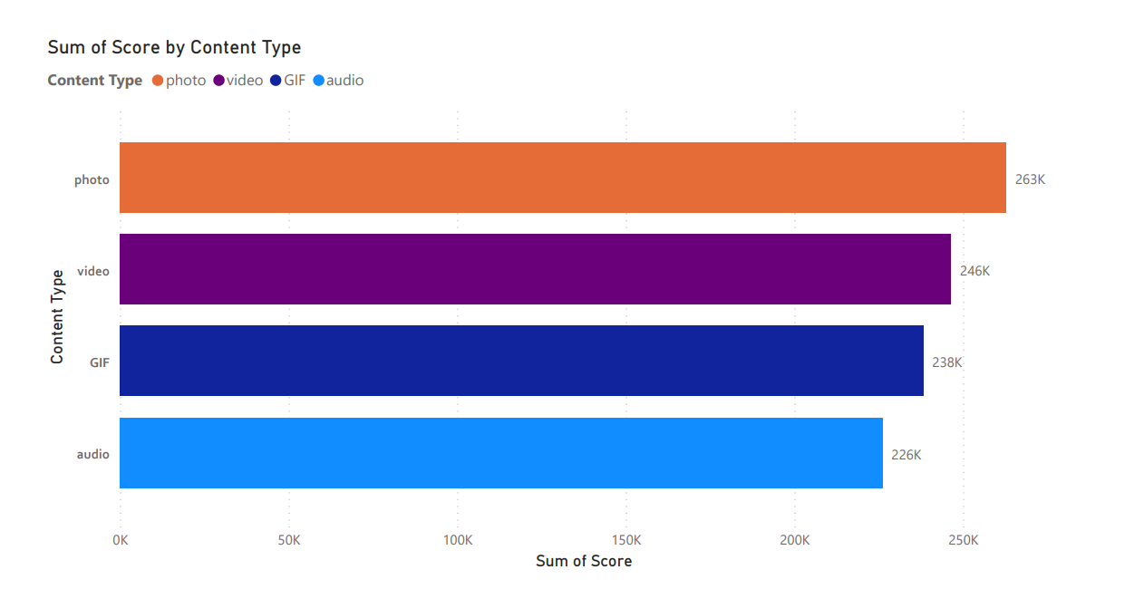

Slide 9
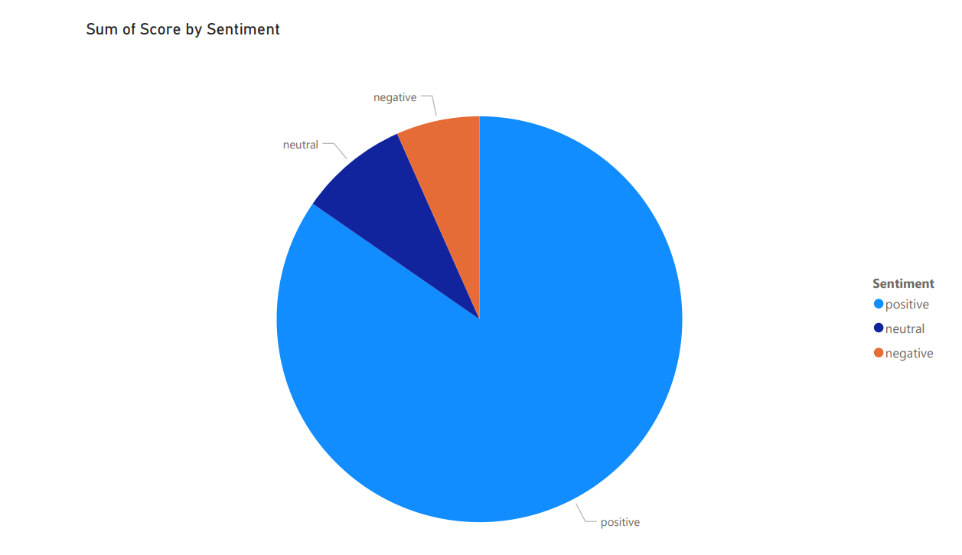

Slide 10

Users Show A Preference For Emotionally Positive Content, Particularly Those Evoking Love, Adoration, And Cheerfulness. Additionally, The Animal Category Garners Significant Views, Indicating Its Popularity Among Users. Leveraging These Insights, Social Buzz Can Enhance User Experience By Prioritizing Photo Content, Strategically Timing Content Releases, Curating Emotionally Positive Content, And Expanding Animal-related Offerings. These Improvements Can Lead To Increased User Engagement, Satisfaction, And Retention On The Platform.
Summary

Slide 11
Thank you!
ANY QUESTIONS?

