Slide 1
DevOps Tools – CI Using Jenkins

Slide 2
Continuous Integration: Improving Software Quality and Reducing Risk
Continuous Integration is a software development practice where members of a team integrate their work frequently, usually each person integrates at least daily - leading to multiple integrations per day.
Each integration is verified by an automated build (including test) to detect integration errors as quickly as possible.
This approach leads to significantly reduced integration problems and allows a team to develop cohesive software more rapidly.

Slide 3
Why Jenkins?
Open Source and Free
Incredibly Easy to Install and Use
70+% Market Share* – CI Build Server
600 Freely Available Plug-in and Integrations
DISTRIBUTED and SCALABLE!
*Sonatype Survey

Slide 4
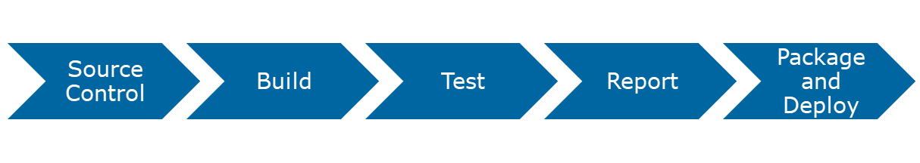
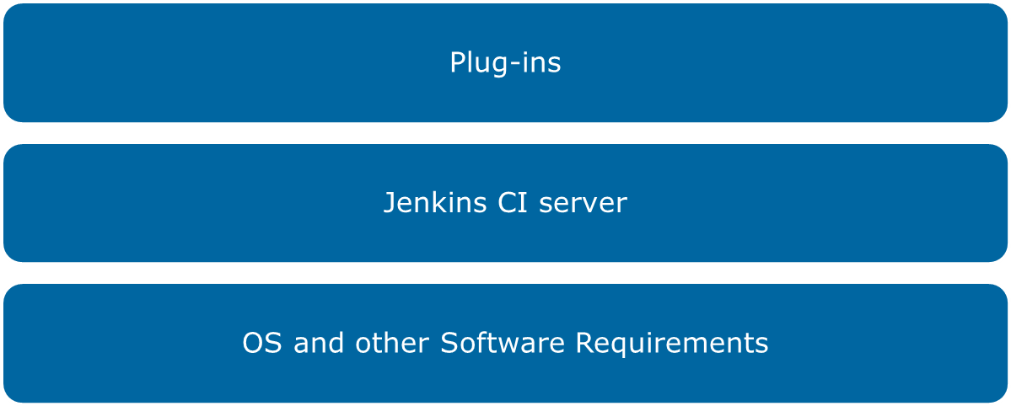
Continuous integration using Jenkins

Slide 5
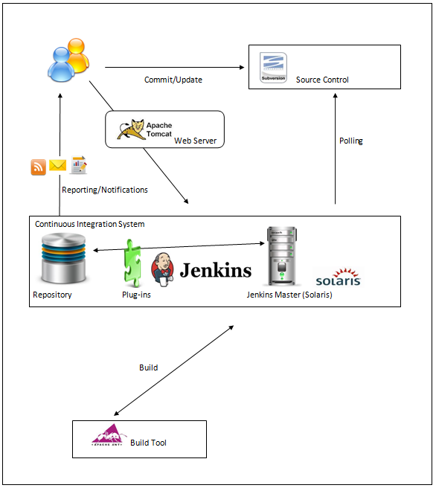
Environment setup in IMS CoE Lab

Slide 6
Jenkins features
Trigger a build
Get source code from repository
Automatically build and test
Generate report and notify
Deploy
Distributed builds

Slide 7
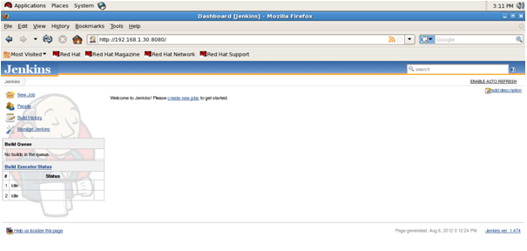
Jenkins welcome page

Slide 8
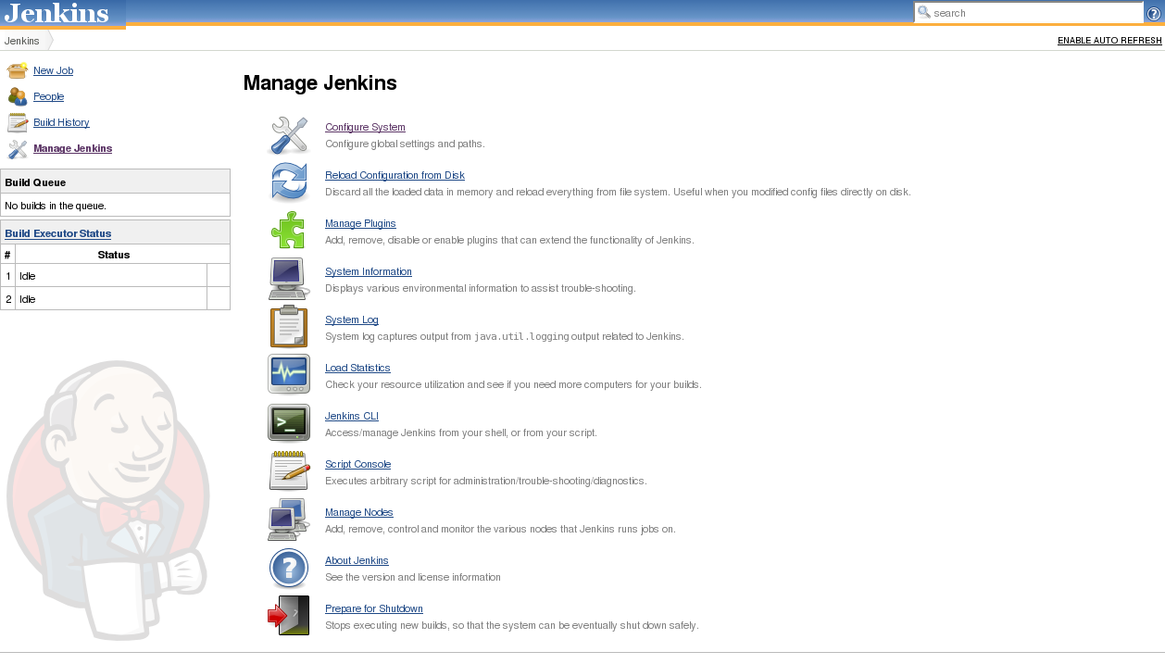
Manage Jenkins

Slide 9
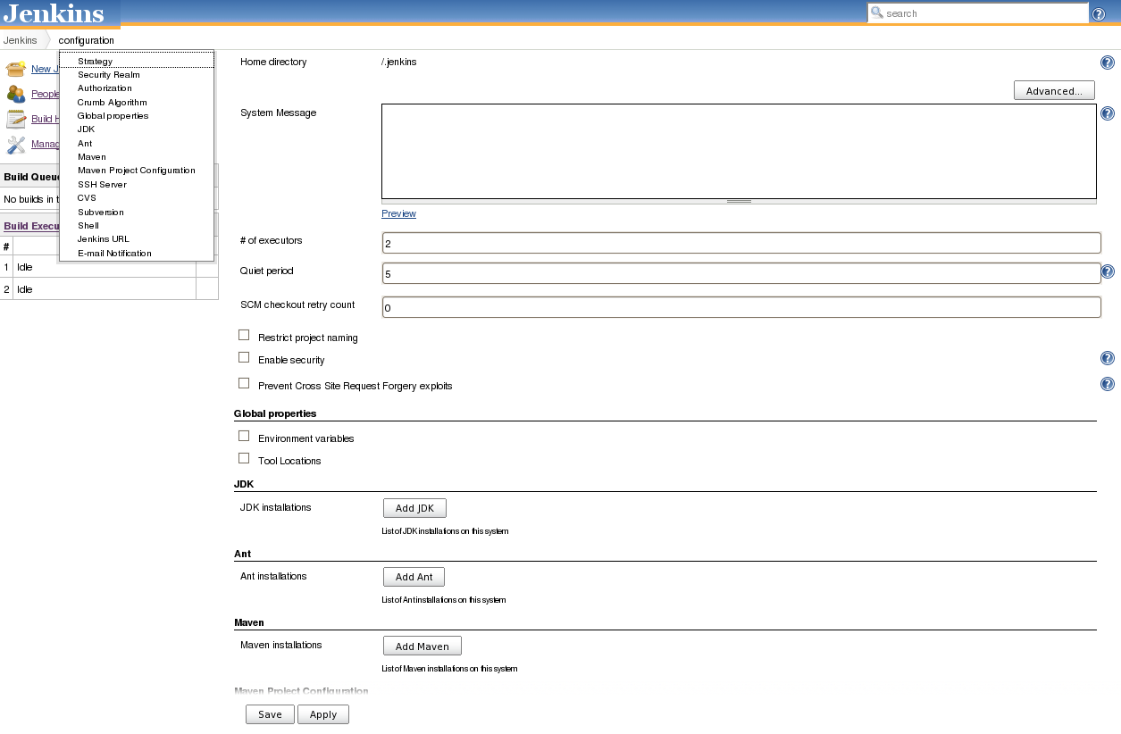
Manage Jenkins (contd.)

Slide 10
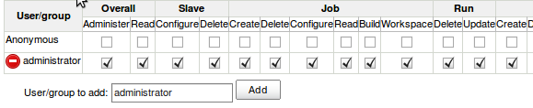
Manage Jenkins (contd.)
Security settings

Slide 11
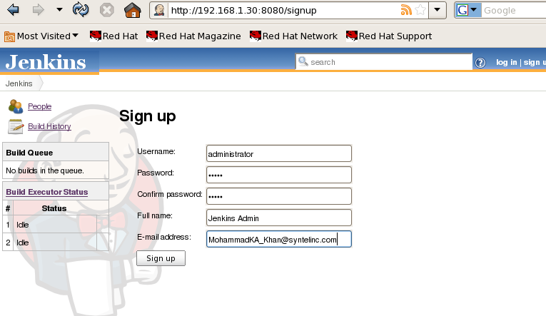
Manage Jenkins (contd.)
Signing up

Slide 12
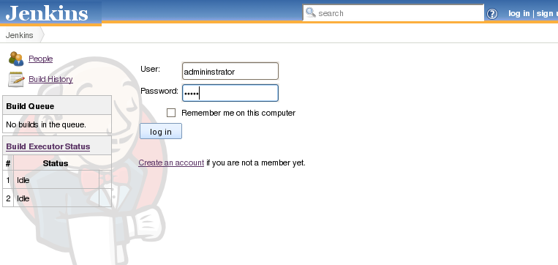
Manage Jenkins (contd.)
Login page

Slide 13
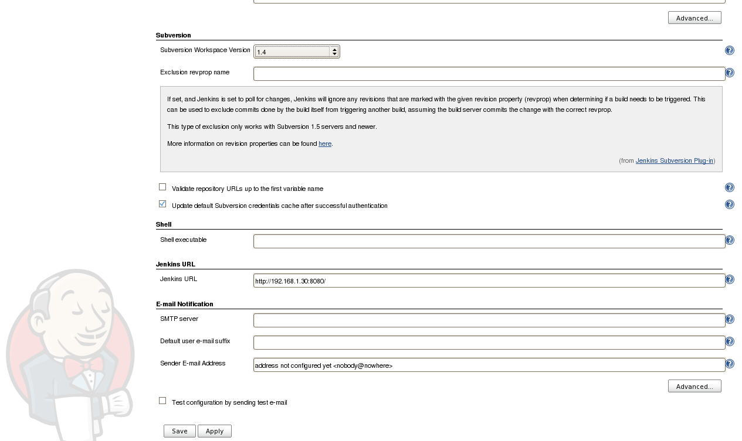
Manage Jenkins (contd.)
Configuring

Slide 14
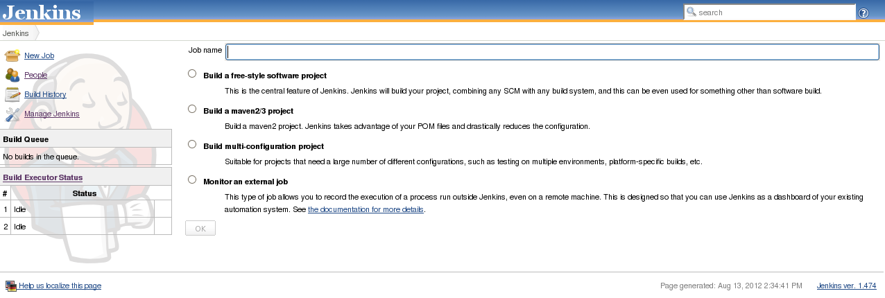
Create Job
Job name

Slide 15
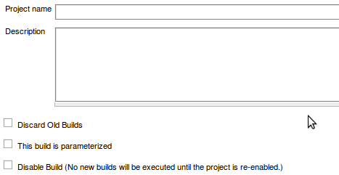
Create Job (Contd.)
Project details

Slide 16
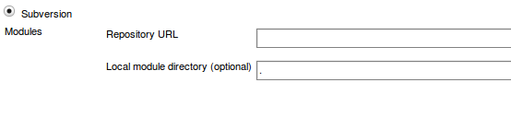
Create Job (Contd.)
Configuring Source Control

Slide 17
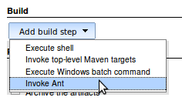
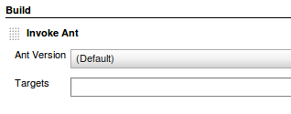
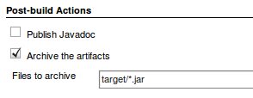
Create Job (Contd.)
Configuring Build Tool

Slide 18
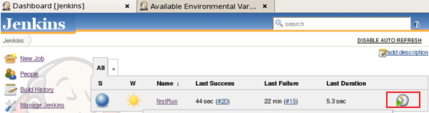
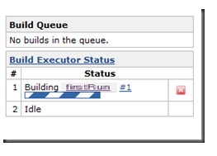
Configure Jenkins dashboard

Slide 19
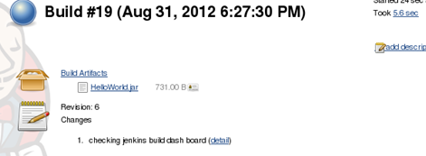
Build Artifacts

Slide 20
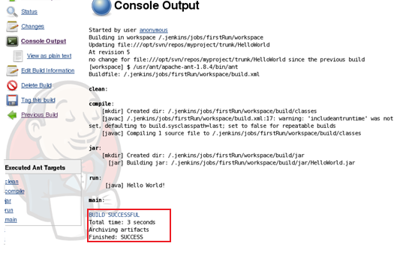
Console Output

Slide 21
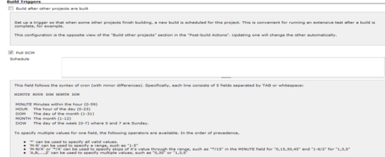
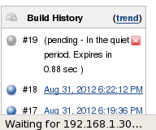
Polling

Slide 22
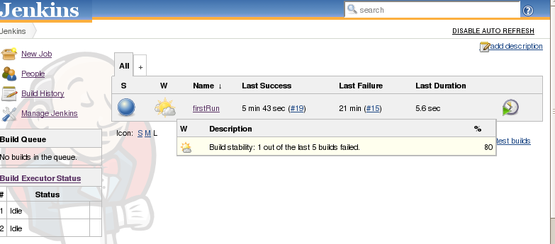
Dashboard [Jenkins]

Slide 23
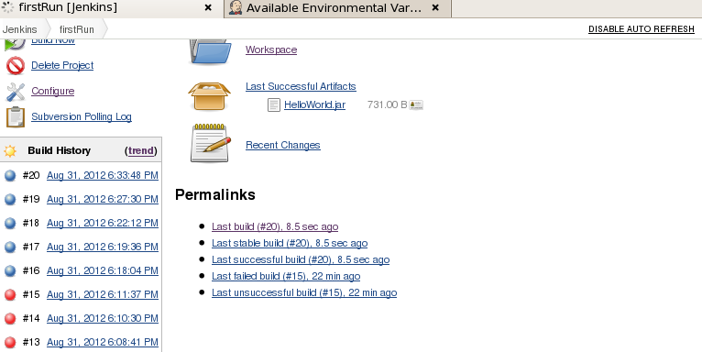
Closer look for build history

Slide 24
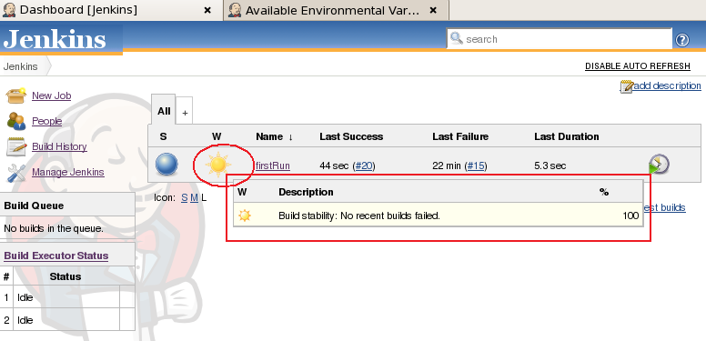
Dashboard [Jenkins]

Slide 25
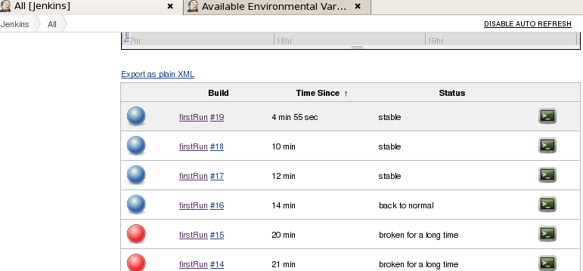
Build reports
Reports:

Slide 26
Questions?

