Slide 1
DevOps Tools - Version Control with Git

Slide 2
Agenda
What is Version Control? (and why use it?)
What is Git? (And why Git?)
How Git Works (in theory)
Setting up Git
The basics of Git (Just make it work!)
Working together (without killing each other)
Branching and merging and tagging
Repairing our screw-ups
Advanced features of Git

Slide 3
Getting Started with Version Control
What is version control?

Slide 4
Getting Started with Version Control
Version Control - A system for managing changes made to documents and other computer files
What kinds of files can we use it with?
Source code
Documentation
Short stories
Binary files (music and pictures)
What should we use it for?
Text files
Projects that have lots of revisions (changes)
Collaborating

Slide 5
VCS Systems and their Operation
Lots of different choices available:
CVS
SVN
Git
And more!
Most follow a repository model (though differ in how the repositories work)

Slide 6
So why Git (and still, why VCS)?
Our goals
Share code (or something else) easily
Keep track of any changes we make (and undo them with ease)
Maintain multiple versions of the same project/code base
Clearly communicate what changes have been made
Git is not like SVN
Git is distributed
Git is powerful (even more than SVN)

Slide 7
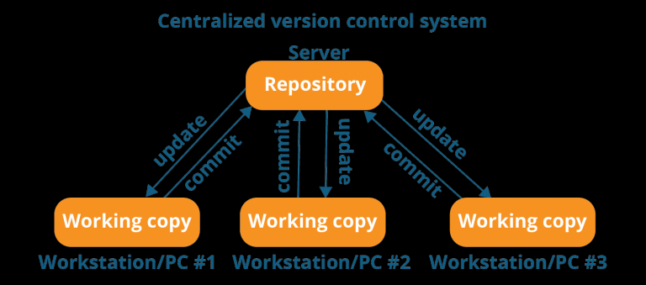
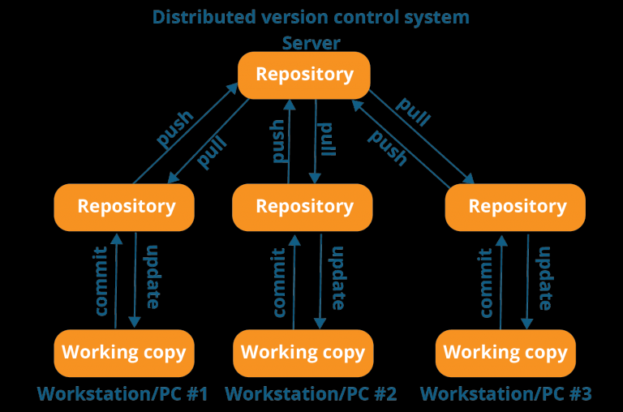
What is a DVCS?
Centralized VCS
One central repository
Must be capable of connecting to repo
Need to solve issues with group members making different changes on the same files
Distributed VCS
Everyone has a working repo
Faster
Connectionless
Still need to resolve issues, but it's not an argument against DVCS﻿

Slide 8
How Git stores data
Let's quickly talk about what goes into a repository (and what a repo is)
Commit - A snapshot of the trees and blobs at a point in time
It's easier to think of things in terms of changes in files
(but that's not really how Git does it--we'll ignore that for now)
Git (and other VCSes) get their power from working on files where changes can be easily seen (i.e. not binary files)

Slide 9
Let's Get Started (Setting up Git)
Install git for your platform of choice (git-scm.org)
Graphical installer for Windows
DMGs for Mac
Your favorite Linux package manager
Or compile from source!
And let's get set up: (green = command, blue = variable)
git config --global user.name “Meena Shanmuganathan"
git config --global user.email “Meena_S@Syntelinc.com"

Slide 10
Creating our first repository
Establish our first repository:
mkdir git-test
cd git-test
git init
What do we have here?
git status
Let's take a quick look around
.git directory
Add a file, make some changes, and run git status

Slide 11
Using our first repository
Let's commit a file into the repo:
git add test.py
git commit -m "My very first commit"
git status
Let's add a file we don't want to actually save
git add test.pyc
git commit -m "Something I didn't want to commit"
git rm test.pyc
git commit -m "Removing derivable data"
And stay out: .gitignore file

Slide 12
Looking deeper at the repository
What did we just do (at a glance)?
git hist
And what about in detail?
git log
git diff test.py
But why add and then commit
Staging area -- Where we set up a commit between file changes on the system and the commit to the repo
Quick thing about some fancy tools
Gitk -- The git GUI
tig -- The ncurses (in-terminal) frontend for git

Slide 13
Sharing -- Using a remote origin
Let's say our friend has set up a repository somewhere:
git clone “Git Path”
Make changes and commit like normal, then:
git push
If they make any changes, we can get them:
git pull
We can also tell an active repo where the remote origin is:
git remote add origin path

Slide 14
Best practices for code collaboration
When to commit?
Source of major arguments (big changes vs small change)
Never put broken code on the master branch (test first!)
Try not to break things (don't do two weeks worth of work in one commit)
Always use a clear, concise commit message
Put more details in lines below, but always make the first line short
Describe the why; the what is clear in the change log
When making giant changes, consider branches (we'll talk about these in a few slides)
Oh, and make sure your name and email are right

Slide 15
Resolving commit conflicts
My friend and I both made changes. What happens when I try to:
git push
Usually: automatic merging
Manual merging might be needed though--git will tell you to edit, and then commit.
Getting the original version of a file:
git checkout -- test.py # "--" means local repo head
A quick look at the stash
git stash # Put my staging area on the stack
git stash pop # Pop it back off (after resolving)

Slide 16
Advanced Versioning: Branches
So what is a branch?
Exactly what it sounds like!
By default, everything is on the ﻿master branch
We can make changes on another branch
Simple usage of branches:
git checkout -b testing # Make a new branch "testing"
make some changes and commit them
git checkout master # Switch to "master" branch
git merge testing # Merge the "testing" branch
Let's talk about use cases--versions, experimental branches, major change branches, etc

Slide 17
Advanced Versioning: Reverting changes
Revert ALL THE THINGS we changed:
git checkout -f
Ut oh, we already commited it:
git revert HEAD # Revert last commit (HEAD)
We can also use both of these commands to specify a revision (by it's SHA hash tag, visible in git log)
Revert is a very complex and nuanced command. Look stuff up as you need it

Slide 18
Tools for Organizing your Repository
Let's take a (very brief) look at a (very) powerful tool: rebase
git rebase -i HEAD~4 # Rebase last four commits
pick bdffc87 [some tag] Some commit
pick fed0f4c [game API] Another commit
pick 5df5842 [docs] [minor] Second! commit
pick 104c3c8 [data representation] First commit!
Basic operations:
pick -- Use this commit
reword -- Change the commit message
squash -- Make this commit part of the above commit
DON'T rebase on a repo which has been pushed remotely!

