Slide 1
DevOps Tools - Maven

Slide 2
Introduction
Apache Maven is an advanced build tool to support the developer at the whole process of a software project. It is implemented in Java which makes it platform-independent. Java is also the best work environment for Maven
Typical tasks of a build tools:-
compilation of source code,
running the tests and
packaging the result into JAR/WAR/EAR files

Slide 3
Running a Maven Build
To build a Maven project via the command line, run the mvn command from the command line. The command should be executed in the directory which contains the relevant pom file. You need to provide the mvn command with the life cycle phase or goal to execute
The Maven tool reads the pom file and resolves the dependencies of the project.
Maven validates if required components are available in a local repository. The local repository is found in the .m2/repository folder of the users home directory.
If the dependency is not available in the build reactor or the local repo, Maven downloads the depended artifacts from the central repository or the specified ones into the local repository.

Slide 4
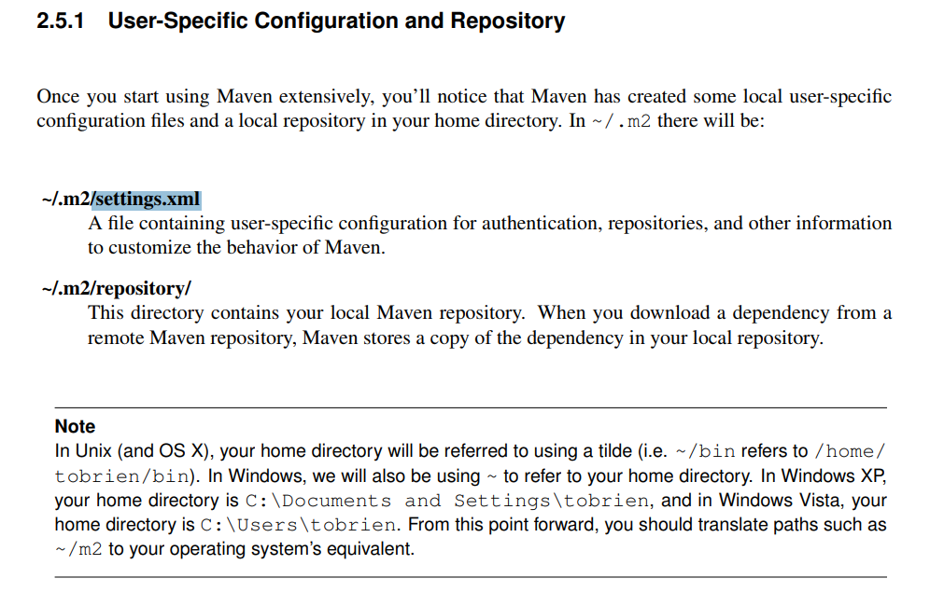
Maven User-Specific Configuration and Repository

Slide 5
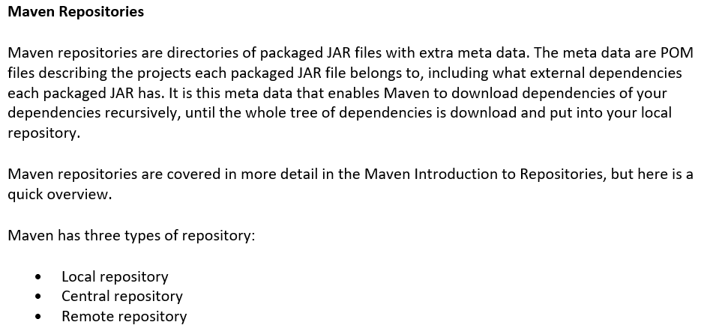
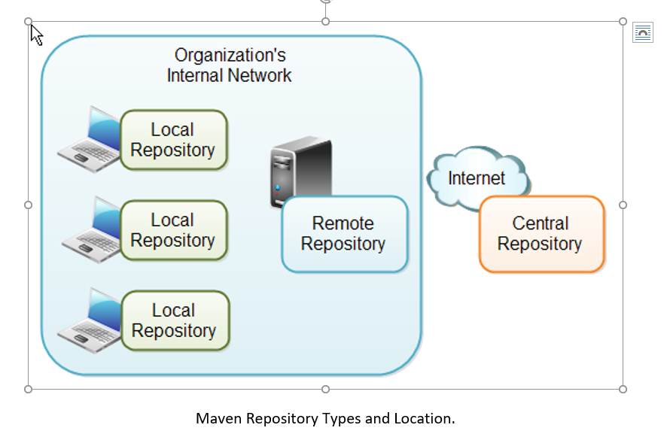
Maven Repositories

Slide 6
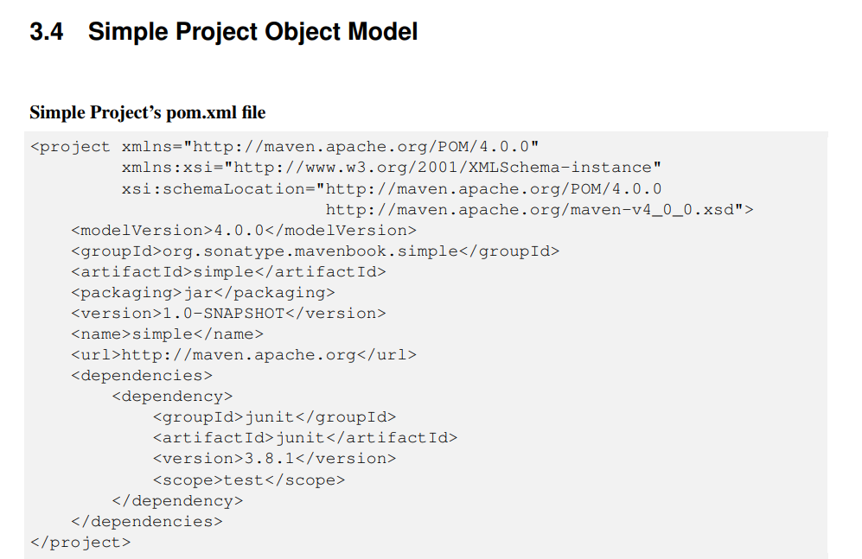
Sample POM

Slide 7
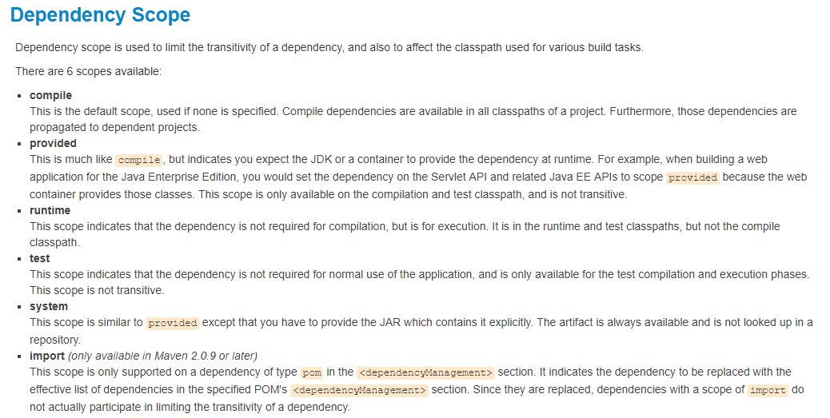
Maven Dependency Scope

Slide 8
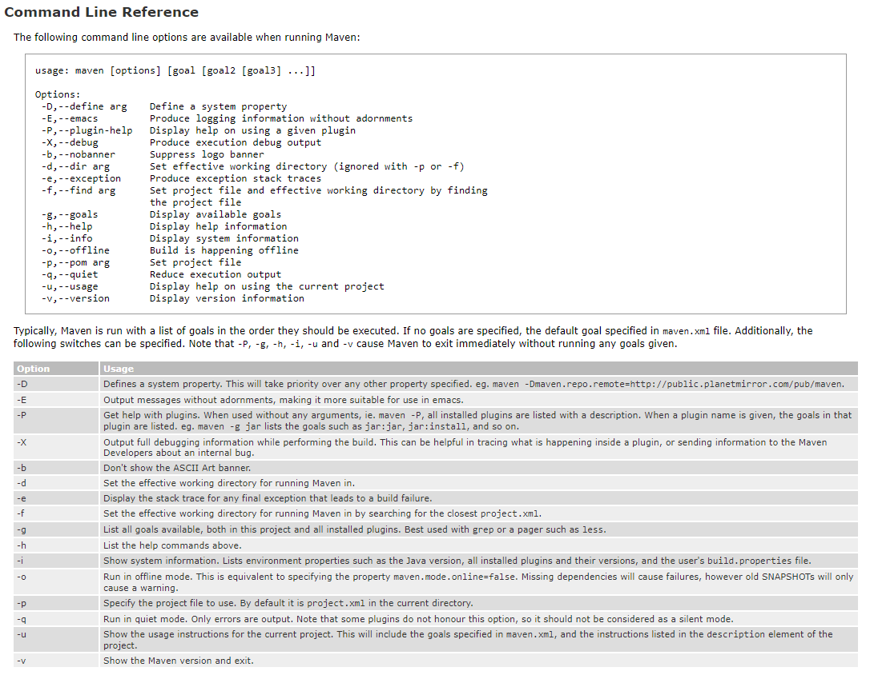
Maven Command Line Reference

Slide 9
Sample Maven Commands
mvn install -> compile, build and install the build result to a local Maven repository
mvn clean install -> To ensure that the build target is removed before a new build, add the clean target
mvn -o install -> By default, Maven checks online if the dependencies have been changed. If you want to use your local repository, you can use the -o to tell Maven to work offline. Copies an artifact to a local repository
mvn package -> Takes the compiled code and creates a deployable component (JAR, WAR, EAR file etc)
mvn deploy -> Deploys the package to a target, i.e. remote repository

Slide 10
Multi Module Projects (Aggregator)
Maven supports building multiple projects. A multi module project (aggregator) is defined by a parent POM referencing one or more projects. This aggregator can contain also the build configuration or include another parent POM to get this configuration.
<project>
<modelVersion>4.0.0</modelVersion>
<groupId>com.vogella.tychoexample</groupId>
<artifactId>com.vogella.tycho.aggregator</artifactId>
<version>1.0.0-SNAPSHOT</version>
<packaging>pom</packaging>
<parent>
<groupId>com.vogella.tychoexample</groupId>
<artifactId>com.vogella.tycho.parent</artifactId>
<version>1.0.0-SNAPSHOT</version>
<relativePath>../com.vogella.tycho.parent</relativePath>
</parent>
<modules>
<module>../com.vogella.build.targetdefinition</module>
<module>../com.vogella.tycho.plugin1</module>
<module>../com.vogella.tycho.plugin2</module>
<module>../com.vogella.tycho.rcp</module>
<module>../com.vogella.tycho.product</module>
<module>../com.vogella.tycho.feature</module>
<module>../com.vogella.tycho.update</module>
<module>../com.vogella.tycho.unittests</module>
</modules>
</project>
The packaging type of such a POM is pom, as such a project will not result in any build output.

Slide 11
Using profiles in Maven
Using Profiles
Maven supports the usage of profiles to define different configurations. If you start Maven, you can instruct it to use a certain profile. For this you specify the -P parameter followed directly (without whitespace) by the profile, e.g. -Pproduction.
<profiles>
<profile>
<id>dev</id>
<activation>
<activeByDefault>true</activeByDefault>
</activation>
<properties>
<db.location>URL_to_dev_system</db.location>
<logo.image>companylogo.png</logo.image>
</properties>
</profile>
<profile>
<id>production</id>
<properties>
<db.location>URL_to_prod_system</db.location>
<logo.image>companylogo2.png</logo.image>
</properties>
</profile>
</profiles>

Slide 12
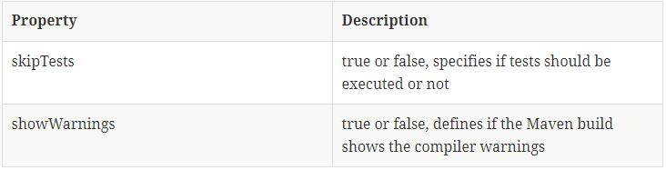
Using properties in Maven
Using Properties
You can specify properties in your build files. You can override them via the command line with the -D parameter followed directly (without whitespace) by its value.
<properties>
<skipTests>true</skipTests>
<maven.build.timestamp.format>yyyyMMdd-HHmm</maven.build.timestamp.format>
<buildTimestamp>${maven.build.timestamp}</buildTimestamp>
<buildId>${buildType}${buildTimestamp}</buildId>
</properties>
mvn clean install -DskipTests=false
Useful properties

Slide 13
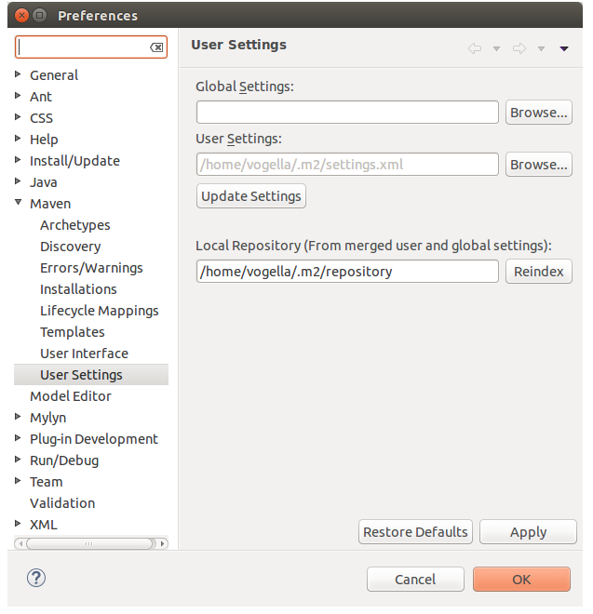
Maven Settings
You can view the file locations in the Eclipse IDE via Windows ▸ Preferences ▸ Maven ▸ User settings

Slide 14
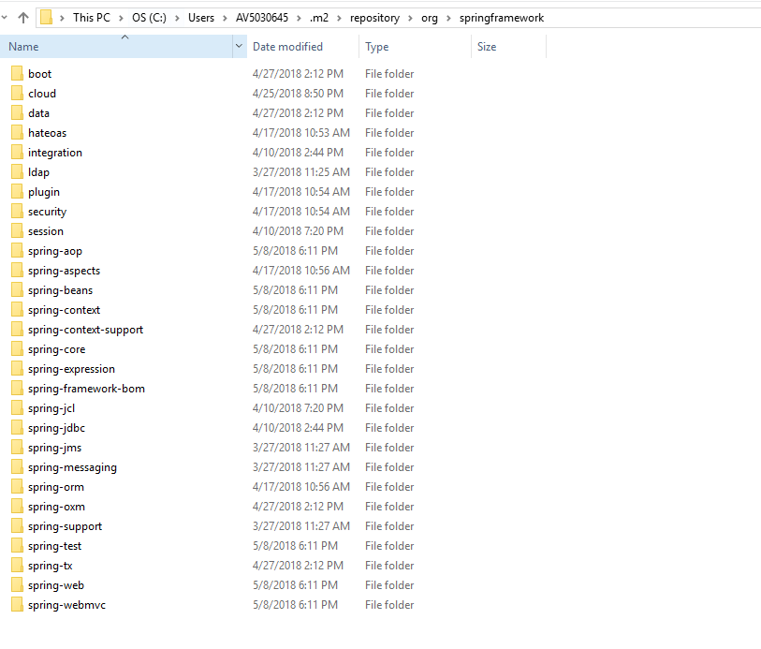
Maven – Local Repository Jar Details

Slide 15
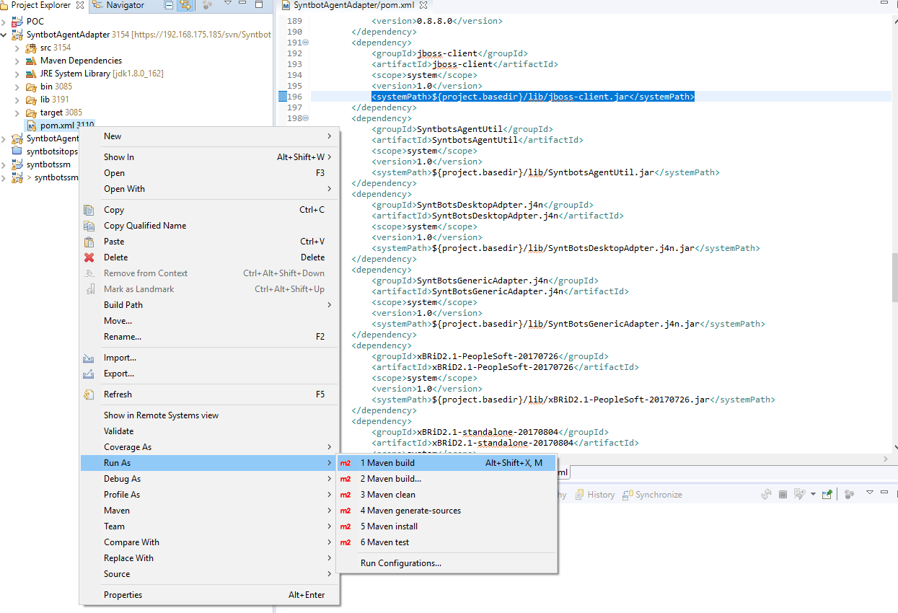
Maven Build Plugin

Slide 16
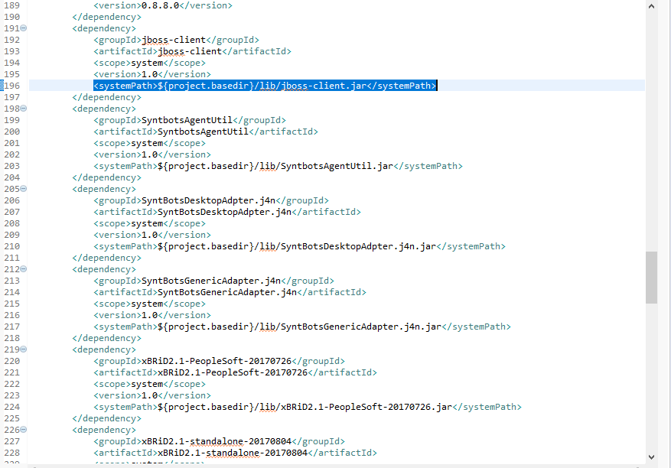
Maven – System Path

Slide 17
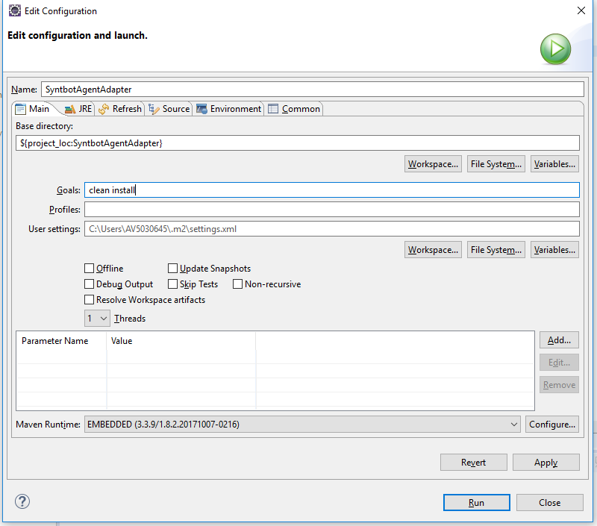
Maven Goals

Slide 18
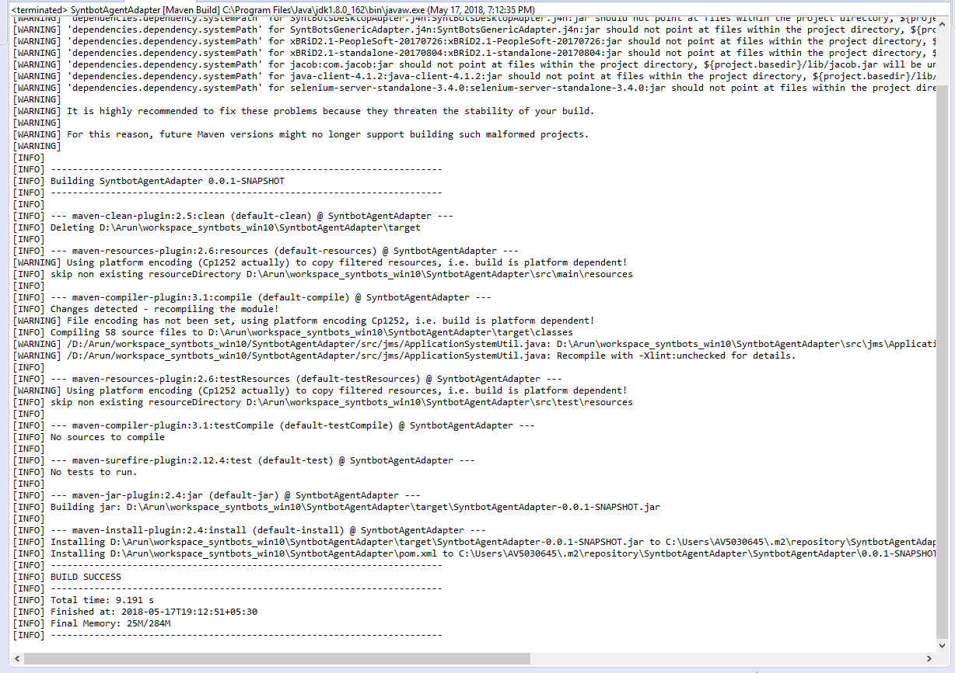
Maven Goals

Slide 19
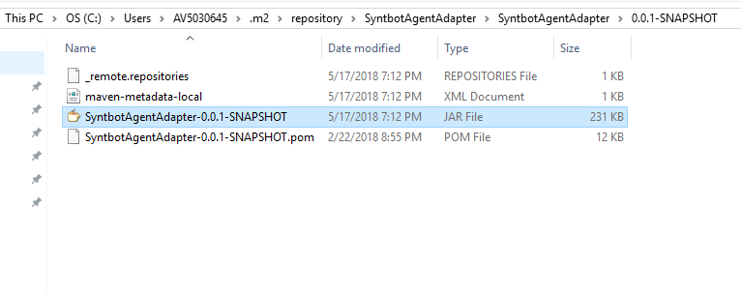
Maven Goals

Slide 20
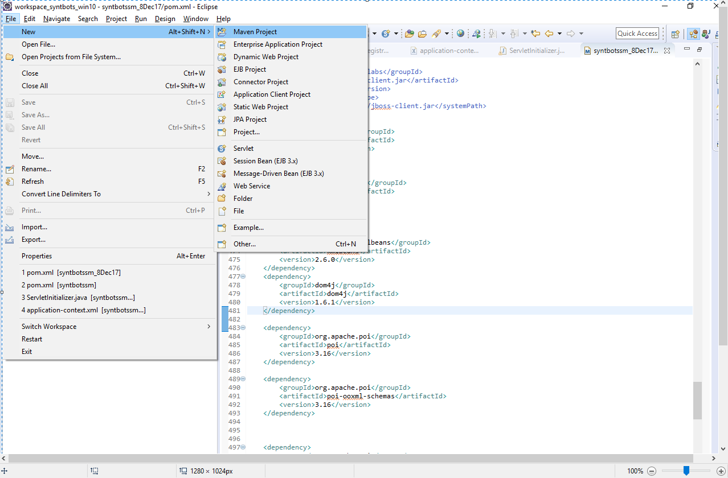
Maven Enabled Java Project Creation

Slide 21
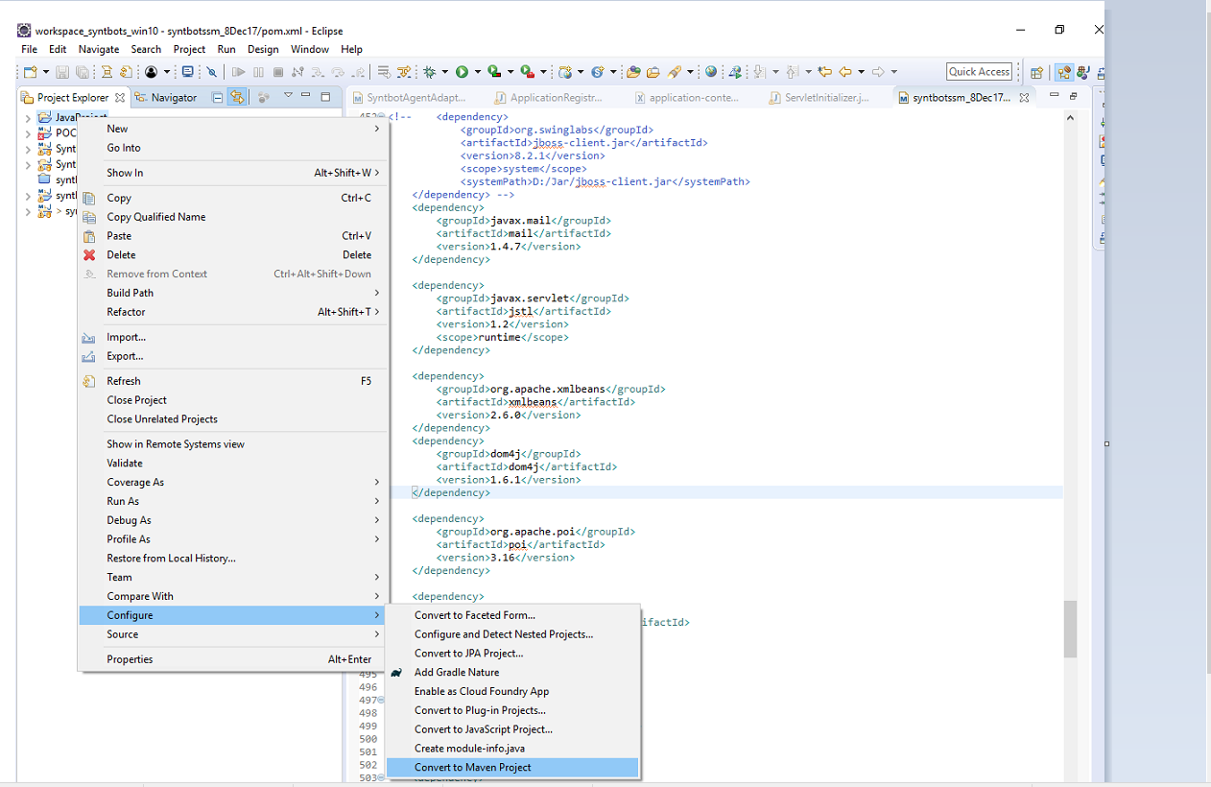
Maven Project Conversion

