Slide 1
Testing

Slide 2
Version Control and Revision History
 | Name | Date
Prepared By | Karthika | 02-12-2019
Reviewed By
Approved By
Version No. | Date | Affected Sections | Highlights
 |  | ALL | Updated Based on the course sheet coverage

Slide 3








Iconic Representations.......
Test your Memory
Objective
Coffee Break
Can you Solve?
Queries
Recap
Need more Info
Brainstorm

Slide 4
Testing
Manual Testing
Manual Testing is a process in which you compare the behavior of a developed of the code (software, module, API, feature, etc.) with the client expectation (requirement).
Automation Testing
Automation testing involves testing the behavior of an application with test scripts prepared using an automation tool

Slide 5
STLC

Slide 6
Software Testing Life Cycle
Requirement Gathering & Analysis
Test Plan
Test Development
Test Execution
Defect Tracking
Test Closure

Slide 7
TEST PLAN
A software project test plan is a document that describes the objectives, scope, approach, and focus of a software testing effort.
The process of preparing a test plan is a useful way to think through the efforts needed to validate the acceptability of a software product.
It identifies test items, the features to be tested, the testing tasks, who will do each task, and any risks requiring contingency Planning.

Slide 8
References for preparing Test Plan
The supporting documents for referring the test plan are:
Project Plan
System Requirements specifications.
High Level design document.
Detail design document.
Development and Test process standards.
Methodology

Slide 9
Scope
Types of testing in Scope
Scope of testing will includes the types of testing carried in the project.
Examples:
Functional Testing or System Testing
Automation Testing
Performance Testing
Security Testing
Usability Testing
Environment Testing
Compatibility Testing
Types of testing not in Scope
This section will have those types of testing which will not be performed in the Testing life Cycle of the project.

Slide 10
Entry & Exit Criteria
Here the test plan should explain as when the testing needs to be started (Entry Criteria) and when the test should be stopped (Exit Criteria)
The idea behind this section is that every process step be inspection, and functional test or Design has a precise entry & exit criteria

Slide 11
Suspension & Resumption Criteria
Suspension criteria specify the criteria to be used to suspend all or a portion of the testing activities
Resumption criteria specifies when testing can resume after it has been suspended.

Slide 12
Example
SUSPENSION CRITERIA | RESUMPTION CRITERIA
Urgent defects, which prevent further testing along any path. | Urgent defects are rectified
Non availability of Test data for scenarios | Test data uploaded in test environment as required to execute scenarios/cases

Slide 13
Test Deliverables
You have to define the list of deliverables which will be delivered from the testing engagement
For example
Test Plan
Traceability Matrix
Test Cases
Test Execution Log
QA Cycle Status Report

Slide 14
Environment Plan
Hardware configuration
For example as mentioned below, this should be the environment which the testers will be performing the test.
This is a very critical section which is an agreement and defining the environment where the testing will be performed
Laptops (Dell) Win XP & Win 2K IE 6.0- Novel Client
Cognizant Desktop compatible to Schering GX260 Win XP IE 6.0
Software configuration
Home Office Image
Research Image
Active X Control.
Notes:
Note:
The above mentioned lists are the builds or setup which needs to be deployed in the testers system prior to testing.
If this is not satisfied then the entire test performed by the testers will become invalid

Slide 15
Staffing and Training Needs
Training on the application/system.
Training for any test tools to be used.
The Test Items and Responsibilities sections affect this section. What is to be tested and who is
responsible for the testing and training.

Slide 16
Test Schedule
Specify test milestones
Specify all item transmittal events
Estimate time required to do each testing task
Schedule all testing tasks and test milestones
For each testing resource, specify its periods of use

Slide 17
Risks and Mitigation Plan
Risk detail should be given in the test plan based on the category of the risks the impact will be applied
What are the overall risks to the project with an emphasis on the testing process?
Notes:
Examples:
Lack of personnel resources when testing is to begin.
Lack of availability of required hardware, software, data or tools.
Late delivery of the software, hardware or tools.
Delays in training on the application and/or tools.
Changes to the original requirements or designs.
Complexities involved in testing the applications

Slide 18
Roles & Responsibility
Identify groups responsible for managing, designing, preparing, executing, witnessing, checking and resolving.
Identify groups responsible for providing the test items identified in the Test Items section.
Identify groups responsible for providing the environmental needs identified in the Environmental Needs section

Slide 19
Reference to Templates
This section should give reference to the templates for the following:-
Test cases
Review check list for Test cases
Test Incident Report
Test Summary Report

Slide 20
Test Development
It is a document which identifies the various tests required to ensure that the system covers all the requirements for the customer.
Test cases follow agreed standard format.(This will be based on the agreed upon format specified in the QAP or as specified in the Standards and Guidelines document)

Slide 21
Test Case Design & Execution
Test cases are designed to ensure complete coverage of the software components under different environmental conditions and data inputs
Test cases should exist for checking Performance of various operations e.g. data retrieval and updation, report printing
Test cases should exist for covering error conditions that can occur
Test data should be mentioned explicitly for each test condition

Slide 22
Types of Testing
Two approaches to achieve test objective
Static Testing
Software work products are examined manually or with a set of tools, but not executed
- Techniques - Reviews
Dynamic Testing
Software is executed using a set of input values and its output is then examined and compared to what is expected
Techniques
White box Testing techniques
-Statement Coverage
-Decision coverage
Black box Testing techniques
-Equivalence Partitioning
-Boundary Value Analysis

Slide 23
Defect Tracking/Closure
Defect Identified by the Tester
Entry made in the DTS Web by Tester
DTS Web can be accessed by Developers/Testers
Summary of the Defect and Description are entered
Severity is chosen among Fatal/Major/Minor/Suggestion
Priority could be High/Medium/Low
The initial State will be Open
Notes:
Defect Analyzer - Analyses the impact of the Defect
Assigns to the concerned team with person responsible
DA - Informs the concerned person
Further Comments can be given in the Description
DA enters the Phase introduced, detected and Root Cause Codes
Assigned team member fixes the defect
On resolution DA changes the defect to Under QC
QC reviews and tests the impacted items
If review ok the defect state is changed to Fixed
Changed files are checked-in to the VSS by CC
If review failed, its again assigned to the concerned team
DA informs the initiator to check for closure of the defect
Initiator confirms the Defect is actually fixed for Closure

Slide 24
Test Levels

Slide 25
TEST LEVELS
COMPONENT TESTING
INTEGRATION TESTING
SYSTEM TESTING
ACCEPTANCE TESTING

Slide 26
Component Testing
Test individual modules for its logic
White Box Testing is involved
Earlier Identification of defects reduces rework and cost

Slide 27
Integration testing
Integration testing is the phase of software testing in which individual software modules are combined and tested as a group.
Follows unit testing and precedes system testing.
Different types of integration testing.
Big Bang
Incremental Integration

Slide 28
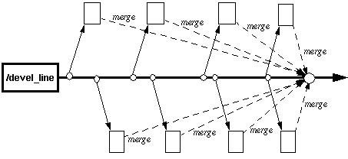
Big – Bang Integration
Big Bang Approach
After all of the modules are tested they are all integrated together at once and tested

Slide 29
Disadvantages
We need to wait until all the modules are developed and unit Tested
It is difficult to Trace the cause of Failures with the late integration

Slide 30
Incremental Testing
All programs are integrated one by one and a test is carried out after each step
Advantages:
Easy to track the source of Defect
Disadvantage:
Time consuming since stubs and drivers have to be developed and used in the test

Slide 31
Categories under Incremental
Top Down
Bottom Up

Slide 32
Top - Down Integration
Top-Down Integration
Modules tested in isolation are the modules which are at the highest level
Do this until all subsystems are incorporated into the test
Requires stub modules to simulate the functions of the missing modules that may be called
However, drivers are not needed since we are starting with the modules which is not used by any other module and use already tested modules when testing modules in the higher levels

Slide 33
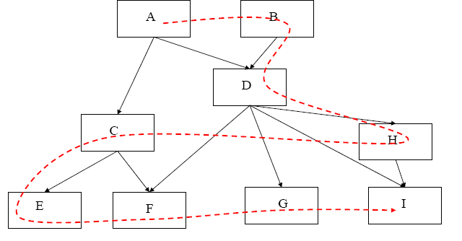
Top-Down Integration

Slide 34
Bottom-Up Integration
Only terminal modules are tested in isolation
Modules at lower levels are tested using the previously
tested higher level modules
This is done repeatedly until all subsystems are included in the testing
Requires a module driver for each module to feed the
test case input to the interface of the module being tested
However, stubs are not needed since we are starting with the terminal modules and use already tested modules when testing modules in the lower levels
Disadvantage: Tests the most important subsystem last

Slide 35
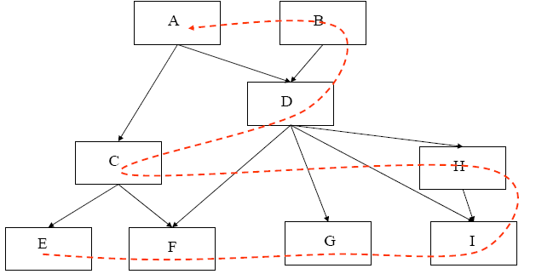
Bottom-Up Integration
Bottom-Up Integration

Slide 36
System Testing
System Testing helps to confirm that the product meets the requirements as per system specification.
System testing is performed when the entire system is assembled after integration and has to be tested as a whole.
This is a black box type of testing and involves both functional and non-functional testing.
After all components of a product are integrated and deployed into a single build on a controlled platform that is similar to the final production platform.

Slide 37
Acceptance Testing
Acceptance testing is black-box testing performed on a system prior to its delivery
Generally involves running a suite of tests on the completed system.
Each individual test, known as a case, exercises a particular operating condition of the user's environment or feature of the system, and will result in a pass or fail Boolean outcome.

Slide 38
For more information please contact: T+ 33 1 98765432 F+ 33 1 88888888 M+ 33 6 44445678 firstname.lastname@atos.net

