Slide 2

PROJECT ZOMATO (P968)
Ellis Turner

Slide 3

Team Members
MARUTHI D
NAGARATNA
DIKSHANT VARSALE
HARRY
SIDDESH
TEJAS NAMBIAR
KAVITA

Slide 4
ABOUT - ZOMATO
Founded in 2008 (India).
Online platform for restaurant discovery, food delivery, and dining services.
Operates in multiple countries with millions of users.
Provides services: restaurant listings, reviews, food delivery, and dining out offers.
Mission: “Better food for more people.”
Customers: Food lovers, restaurants, delivery partners.
Revenue Sources: Food delivery, restaurant ads, subscriptions (Zomato Gold / Pro).
Strengths: Wide reach, strong brand, real-time delivery tracking.

Slide 5
Project overview
Data Cleaning & Preparation
Data Modeling
Dashboard Development
Scope
Insights Generated
Outcome –
Delivered a professional dashboards.
Easy to explore trends and comparisons across cities and countries.
Supports better business insights & decision-making.
Tools Used -
SQL – Database design & queries
Excel – Data cleaning & quick dashboards
Power BI – Interactive dashboards & KPIs
Tableau – Advanced visualization & analysis

Slide 6

Challenges & solutions
Challenge 1: Currency Conversion
Issue: The dataset had restaurant costs in different local currencies, making comparisons difficult.
Solution: Created a Currency Table and converted all costs into USD using exchange rates for consistency.
Challenge 2: Calendar & Time-Based Analysis
Issue: Dataset lacked proper calendar fields (Year, Month, Quarter, Financial Month).
Solution: Built a Calendar Table with calculated columns (Year, Month Name, Quarter, Financial Year/Month) to enable time-series analysis.
Challenge 3: Dynamic Filtering in Dashboard
Issue: Users needed flexibility to filter by city, country, cuisines, and price buckets.
Solution: Implemented slicers & dynamic visuals in Power BI to allow drill-down analysis.
Challenge 4: KPI Calculation
Issue: Needed to calculate custom metrics (e.g., Avg Cost in USD, Restaurant Count by Year, Price Buckets).
Solution: Created DAX measures and calculated columns for KPIs & trends.

Slide 7
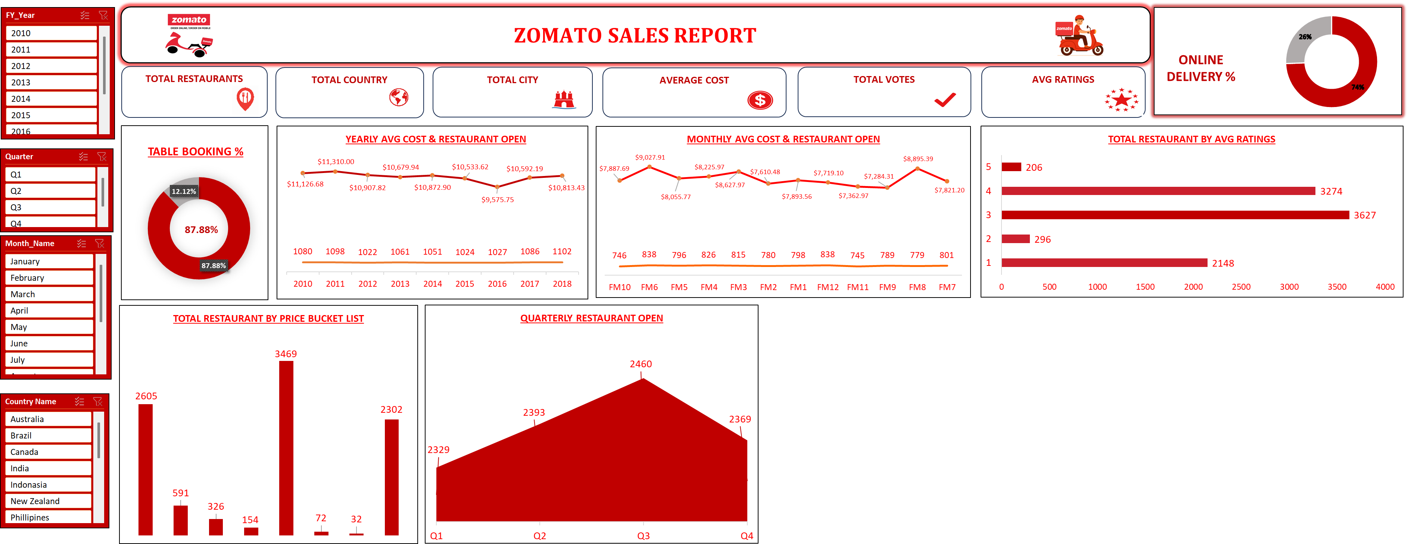
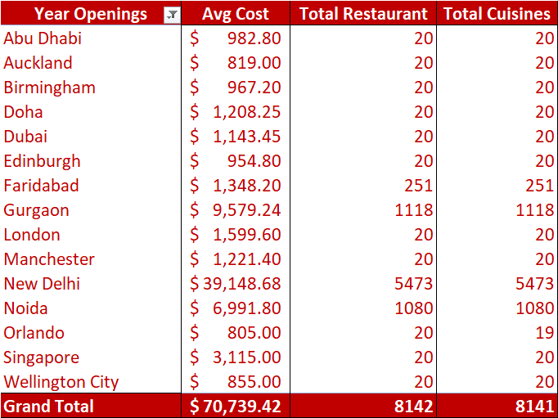
EXCEL DASHBOARD

Slide 8
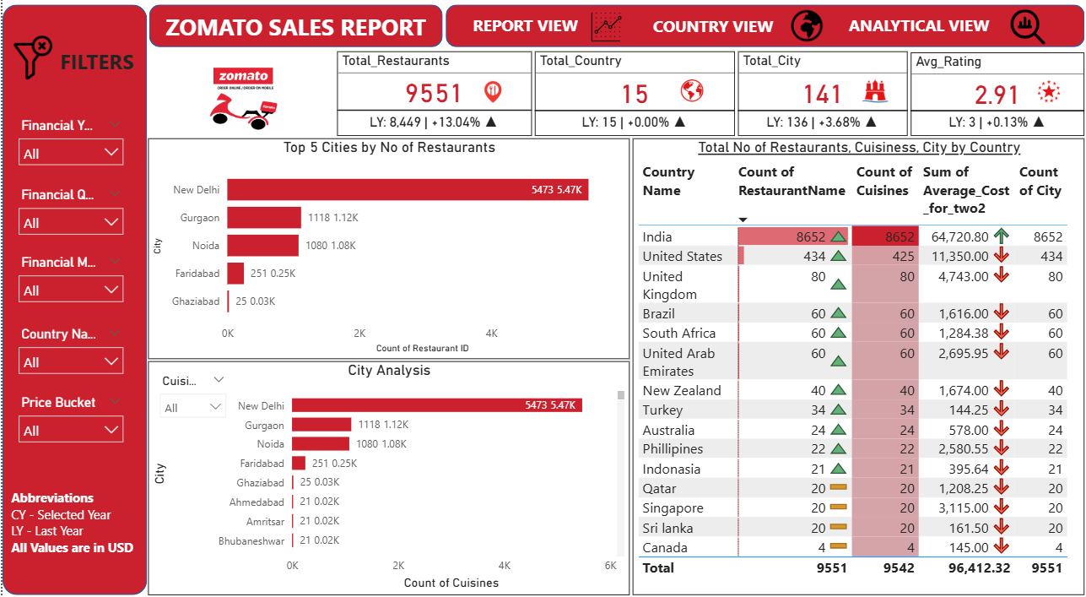
POWERBI DASHBOARD

Slide 9
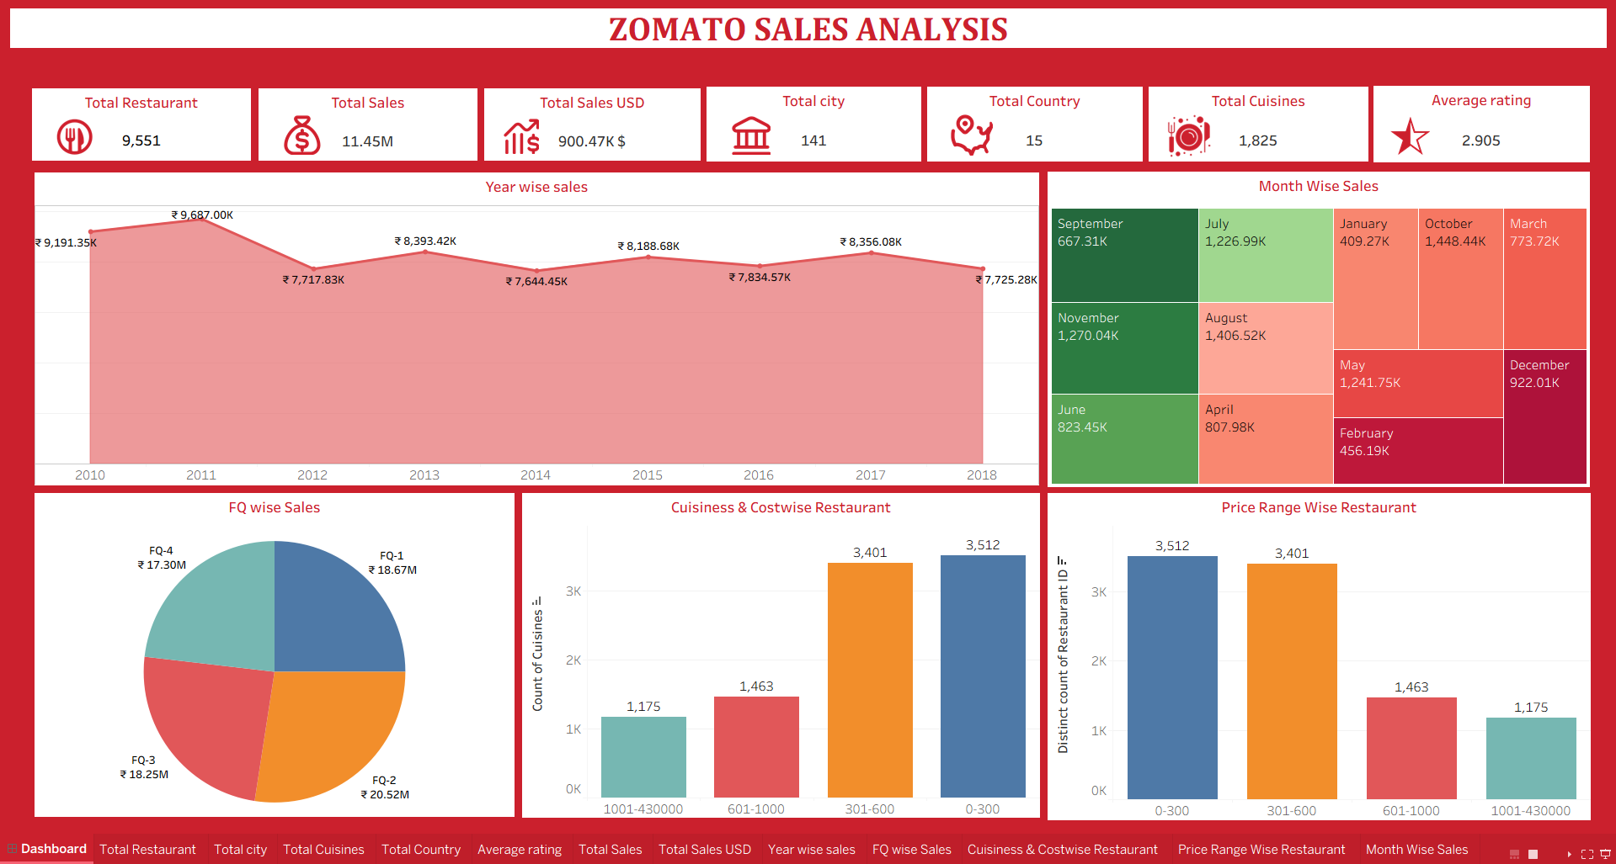
TABLEAU DASHBOARD

Slide 10

SQL
Objective
To design and query an Employee–Department database for analysis.
Scope
Created Dept, Employee, Job_Grades tables with constraints (PK, FK, checks, defaults).
Implemented queries for:
Salary analysis
Reporting structure
Department/job insights
Ranking & Top employees
Challenges & Solutions
Challenge: Enforcing data integrity (no negative salary, no duplicate Empno).
Solution: Applied constraints (PK, FK, CHECK, Default).
Challenge: Complex queries for hierarchy, ranking, and salary grouping.
Solution: Used Joins, Aggregate Functions, Window Functions.
Outcome
Built a robust relational database.
Delivered insights on salaries, departments, managers, and employee grades.
Strengthened SQL skills (DDL, DML, Joins, Aggregations, Ranking).

Slide 11
THANK YOU

