Slide 1
Machine Learning Project
Linear Regression : Predicting Student Scores Based on Hours Studied
Presented By –
Anirban Bhattacharjee
Rakesh Kumar Nag

Slide 2
Dataset Preview
Hours Studied
1.5
2.0
2.5
3.0
3.5
4.0
4.5
5.0
5.5
6.0
Scores
35.0
40.0
45.0
50.0
55.0
60.0
65.0
70.0
75.0
80.0

Slide 3
Model Code
X = df[['Hours Studied']]
y = df['Test Score']
X_train, X_test, y_train, y_test = train_test_split(X, y, test_size=0.2, random_state=42)
model = LinearRegression()
model.fit(X_train, y_train)
y_pred = model.predict(X_test)
mse = mean_squared_error(y_test, y_pred)

Slide 4
Model Code Contd...
print("Mean Squared Error:", mse)
plt.scatter(X, y, color='blue', label='Actual Data')
plt.plot(X, model.predict(X), color='red', linewidth=2, label='Regression Line')
plt.title("Hours Studied vs Scores")
plt.xlabel("Hours Studied")
plt.ylabel("Scores")
plt.legend()
plt.grid(True)
plt.show()

Slide 5
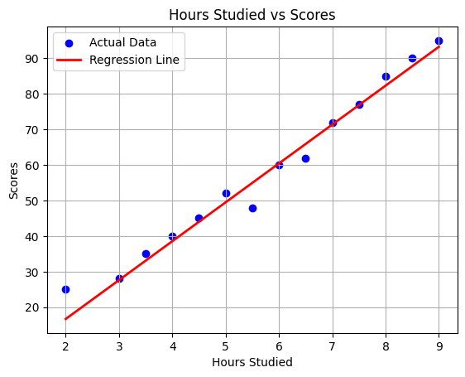
Regression Visualization

Slide 6
Model Performance
Mean Squared Error: 25.50
Prediction is quite accurate for this simple linear model.
Model Code

Slide 7
Conclusion
This simple ML project demonstrates how linear regression can be used to predict scores based on study hours.
The model fits the data well and provides interpretable results, useful for beginners in the ML domain.

