Slide 1
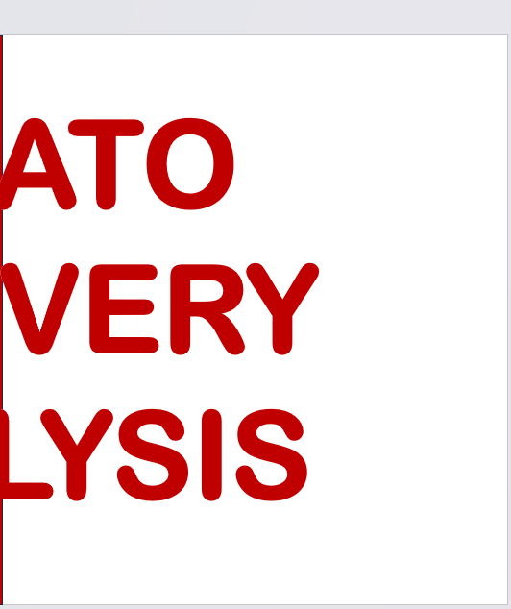

Slide 2
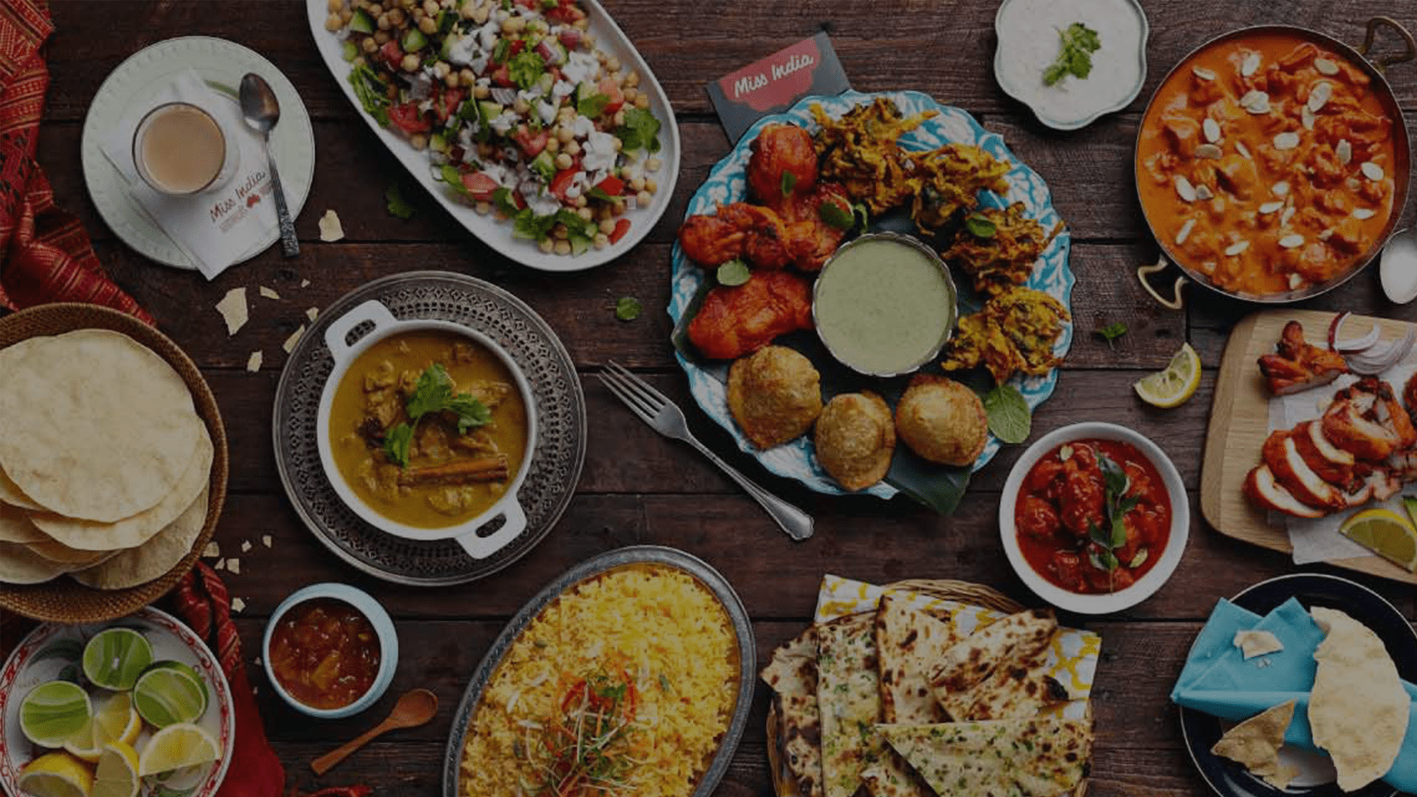




zomato
Bengaluru
FOOD DELIVERY ANALYSIS

Slide 3
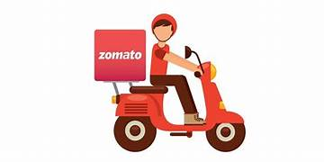
zomato
Bengaluru
FOOD DELIVERY ANALYSIS

Slide 4
zomato
Bengaluru
FOOD DELIVERY ANALYSIS

Slide 5
zomato
Bengaluru
FOOD DELIVERY ANALYSIS

Slide 6
zomato
Bengaluru
GROUP MEMBERS
NAHID
PARVEEN

Slide 7
zomato
Bengaluru
GROUP MEMBERS
NAHID
PARVEEN
AKSHAY
CHAUDHARI
VISHNU
ACHARYA

Slide 8
zomato
Bengaluru
GROUP MEMBERS
NAHID
PARVEEN
AKSHAY
CHAUDHARI
VISHNU
ACHARYA
SHUBHAM
SHRIVASTAV

Slide 9
zomato
Bengaluru
GROUP MEMBERS
NAHID
PARVEEN
AKSHAY
CHAUDHARI
VISHNU
ACHARYA
SHUBHAM
SHRIVASTAV

Slide 10
Welcome to the world of Zomato Delivery Analysis, where data unveils the story behind each delivery.
In this project, we delved into the intricacies of Zomato's delivery dataset to extract valuable insights.
Our mission was to understand the dynamics influencing delivery performance, customer satisfaction, and overall business impact.

Slide 11
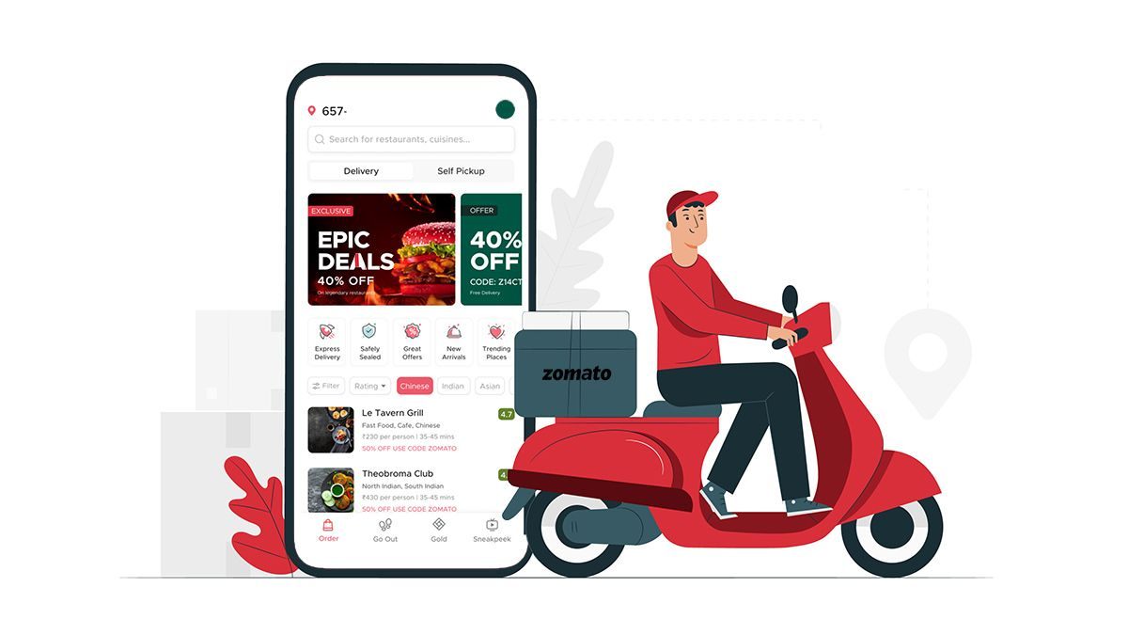
SIGNIFICANCE OF ANALYSIS:
The significance of this analysis lies in its potential to revolutionize Zomato's delivery operations.
By understanding the data-driven nuances, we aim to enhance delivery efficiency, elevate customer satisfaction, and provide valuable insights for strategic business decisions.
As we navigate through the project, we will get to shed light on the key patterns and trends within this vast pool of data.

Slide 12



Restaurant
name
Location
Delivery
Dataset Introduction:
The dataset encompasses a wealth of information, ranging from restaurant details and order specifics to customer feedback.
Ranging from columns like :
restaurants name
delivery review number
delivery rating
business hours that these restaurants operate in
average price for order in restaurant specific and similar data.

Slide 13
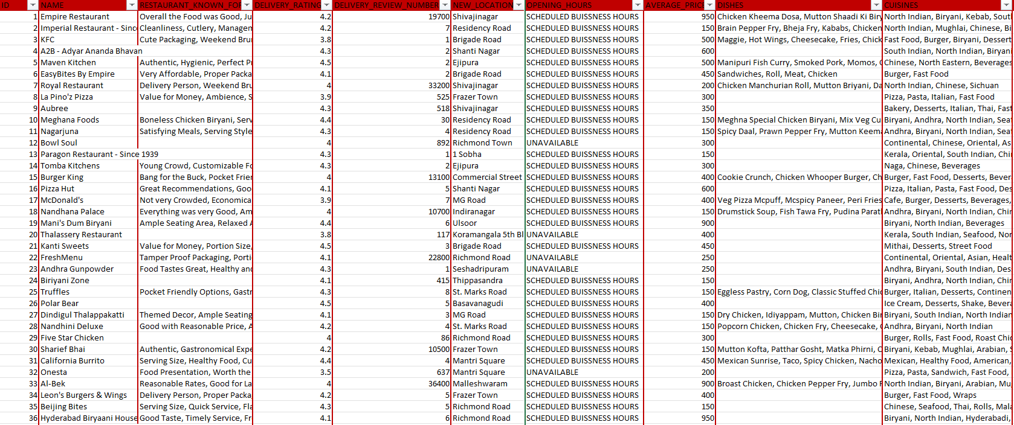

Slide 14
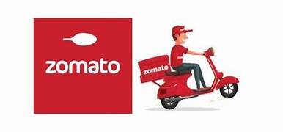
Methodology used:
PYTHON:
SCRAPPING
EDA:CLEANING,
VISUALIZATION,
ANALYSATION
MS EXCEL

Slide 15
SELENIUM
BEAUTIFULSOUP
PANDAS
FUNCTIONS
Data Scraping with Python:
Web Scraping Overview:
Utilized Python for web scraping to extract data from the Zomato website.
Python libraries such as Beautiful Soup and Requests were employed for seamless extraction.
Steps Involved:
1. URL Identification:
Identified relevant URLs containing delivery data.
2. HTML Parsing:
Used Beautiful Soup to parse HTML content and navigate the website's structure.
3. Data Extraction:
Extracted pertinent information such as restaurant details, menu items, delivery times, and customer feedback.

Slide 16
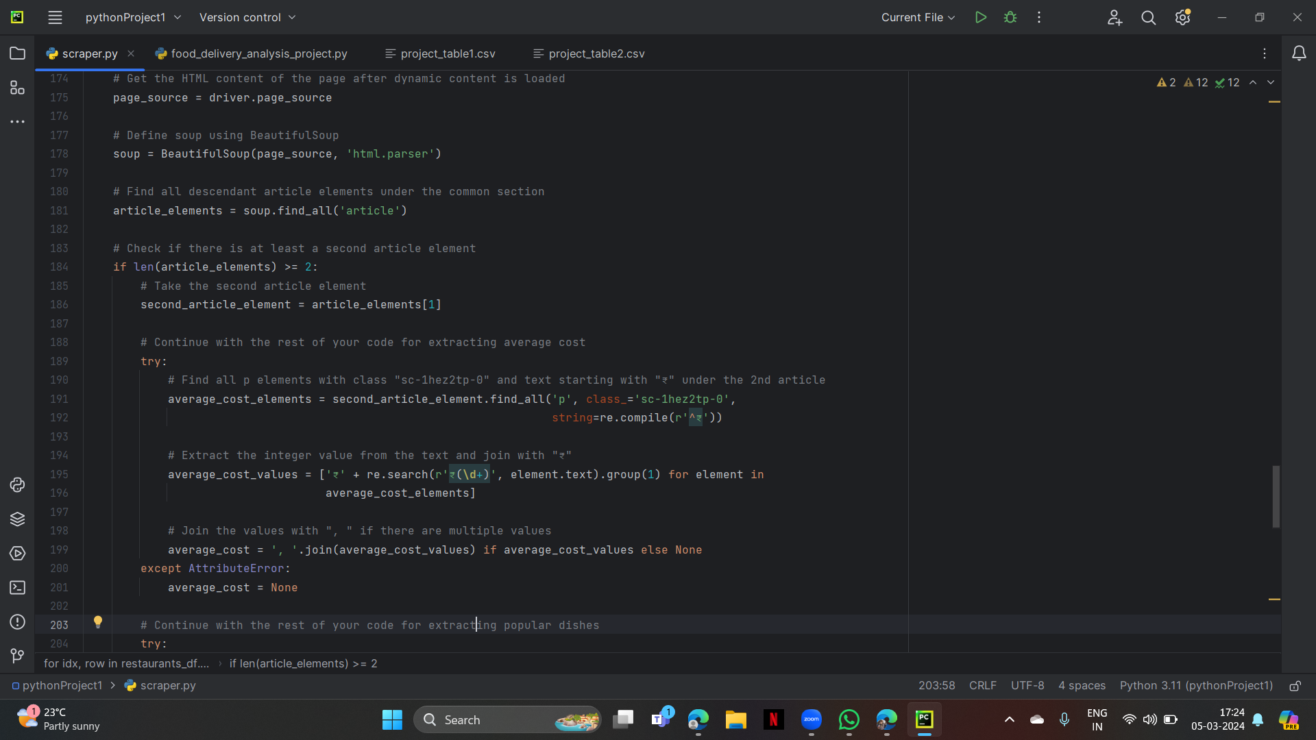
Our web scraping process involved the following steps:
1. Initializing WebDriver
2. Fetching Dynamic Content
3. Performing Scrolling
4. Extracting Restaurant Information
5. Extracting Additional Details
6. Data Storage
7. Saving Data to CSV

Slide 17
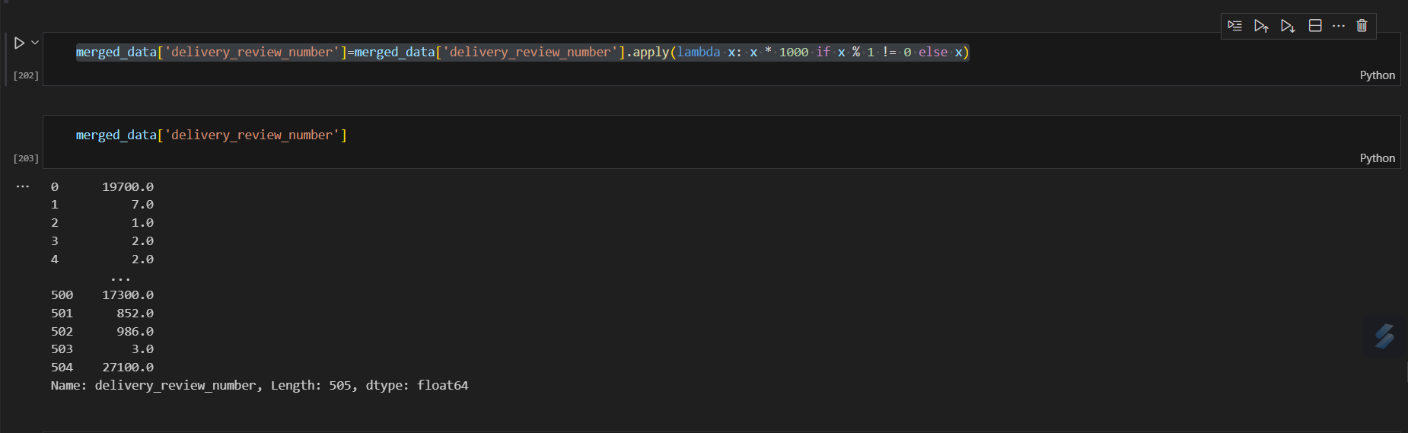
EDA: DATA CLEANING, DATA ANALYZATION AND VISUALIZATION
Data Cleaning:
Handling Missing Values
Duplicate Removal
Data Type Standardization
Addressing Inconsistencies
Data Visualization:
Univariate Analysis
Bivariate
Multivariate Analysis
CLEANED COLUMN OF DELIVERY_RATING:

Slide 18
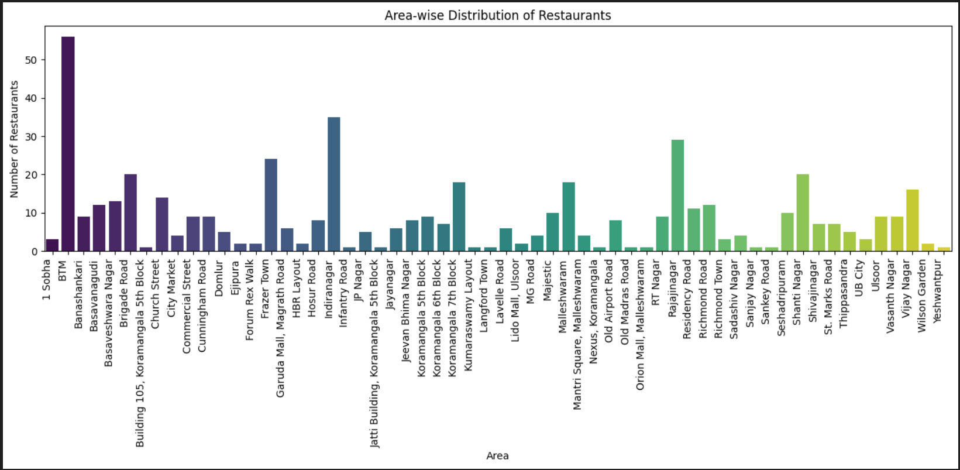
INSIGHT 1: Area-wise Distribution of Restaurants
The location with the maximum number of less-rated restaurants is BTM, Bangalore, with a count of 56 less-rated restaurants.

Slide 19
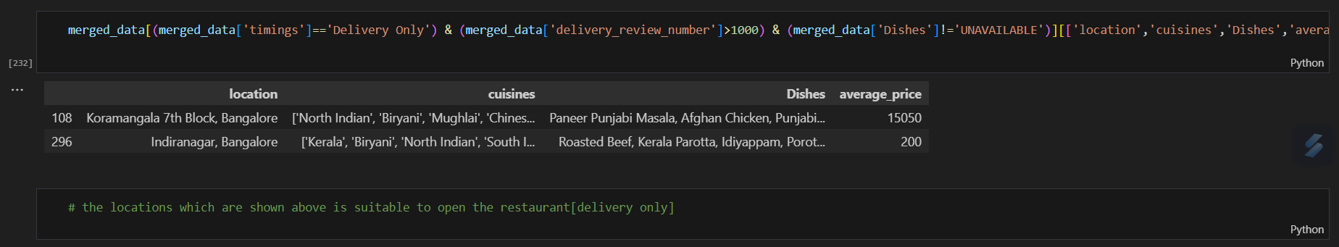
INSIGHT 2: Location with least competition in business

Slide 20
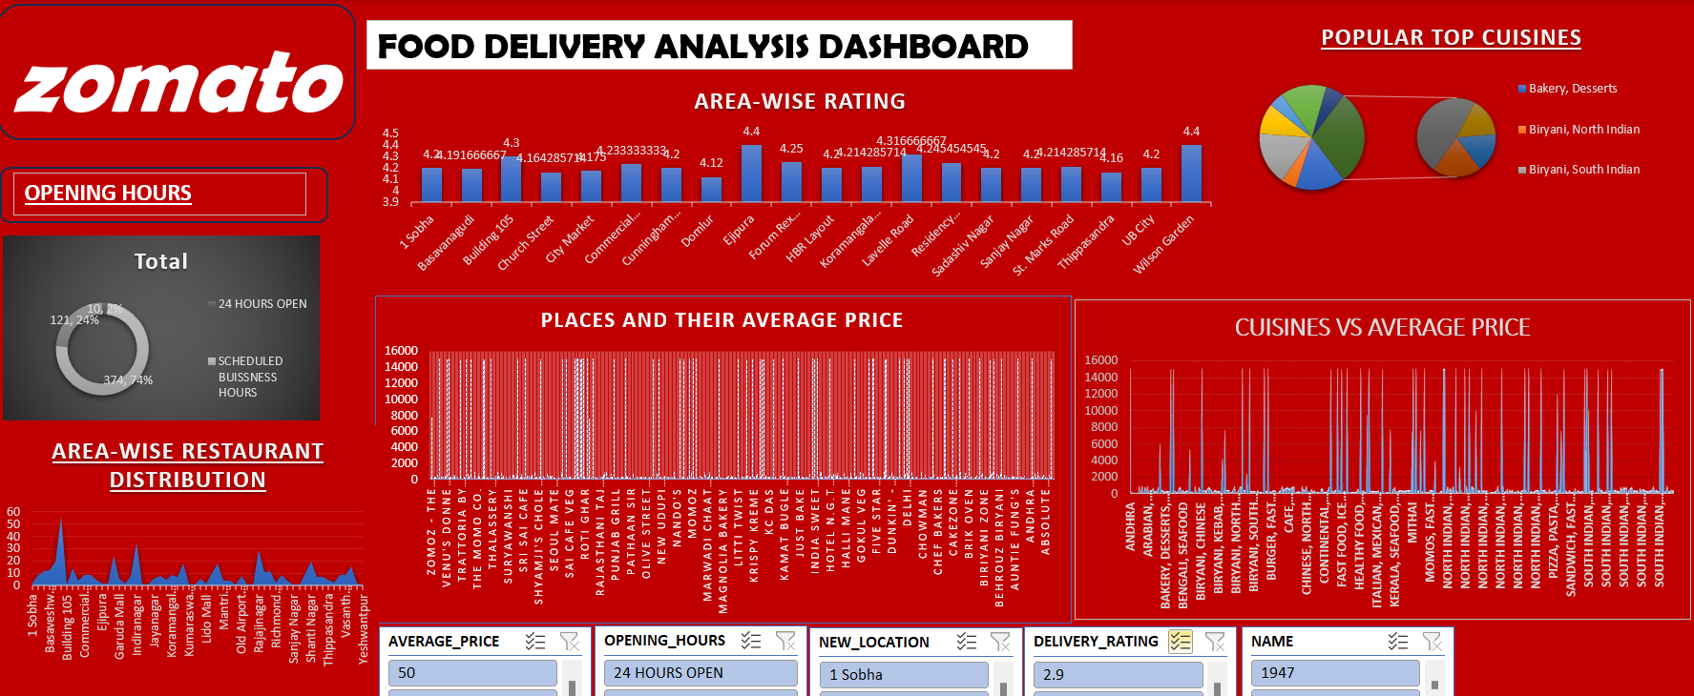
DASHBOARD ON ANALYSIS IN EXCEL:

Slide 21
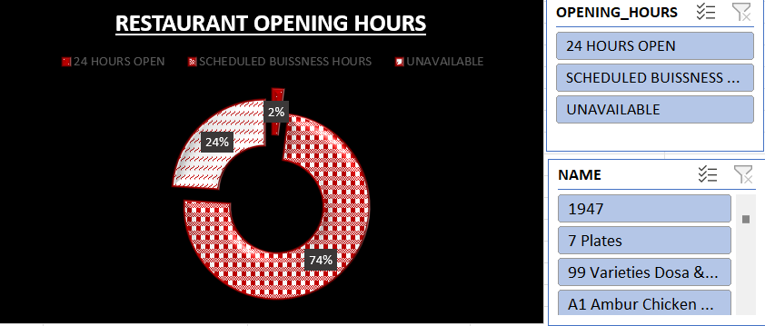
Accessible Business Hours: we can see major reataurants have specific timing for opening while 24% restaurants are open all the time meanwhile only 2% have no timings.

Slide 22
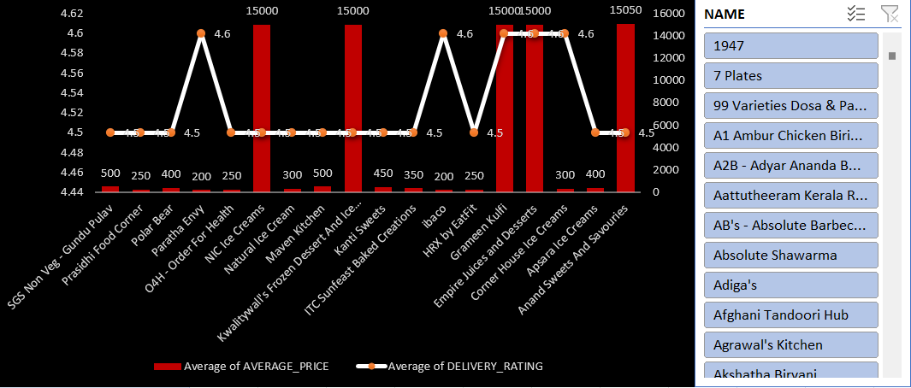
Delivery rating vs average price:
Delivery ratings don't necessarily align with restaurant prices. High prices don't guarantee better ratings, indicating other factors like service quality play a significant role.

Slide 23
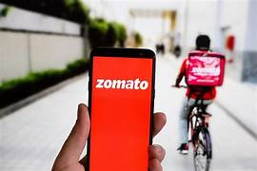
CONCLUSION:
Location Analysis: We observed that “BTM” have max number of restaurant and it is also a site for 56 less-rated restaurants, suggesting customers may need to be more selective.
Most idle location for opening new delivery only restaurant are koramangla and Indiranagar are more beneficial for opening remote restaurant(delivery only), because they offer most cuisines and have higher review number for restaurants

Slide 24
Top-Highest rated restaurant:
Kolkata Famous Kati Rolls,
Shanthi Sagar shine with Delivery ratings of 11.8 Known for quality food, efficient delivery.
Average price distribution:
Top cuisines like Biryani and Bakery/Desserts have higher average prices, with Biryani leading at 4500 closely followed by bakery and desserts at 3450.
Average of delivery rating:
Across different cuisines, average ratings tend to be consistently high, ranging from 4.4 to 4.6. Certain types like Ice Cream and Shake consistently stand out with higher average ratings.
In conclusion, these insights offer valuable guidance for relevant stakeholders or decision-makers.

Slide 25
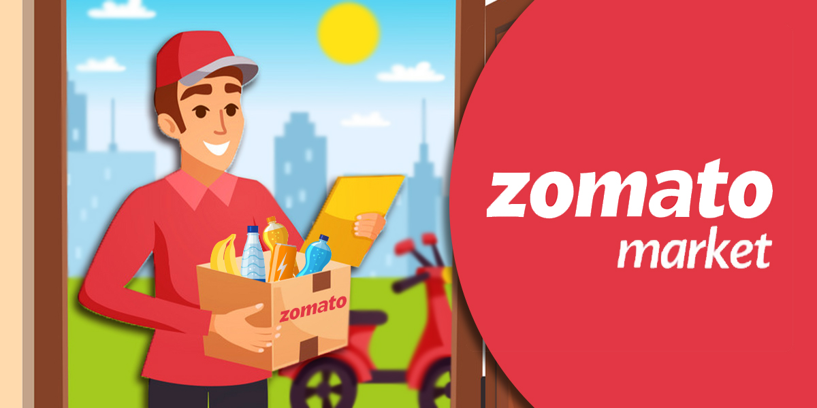
Challenges and Lessons Learned:
While the journey was enriching, it wasn't without challenges.
Like Navigating dynamic websites during scraping and addressing hurdles.
Data cleaning was challenging too.
However, these challenges provided valuable lessons in adaptability and the importance of robust data cleaning processes.

Slide 26
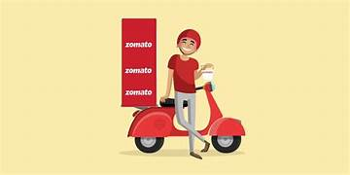
FUTURE WORK:
This project lays the foundation for future endeavors. As we reflect on the current insights, we envision a path forward that involves continuous analysis, incorporating additional datasets for a comprehensive view, and potential integration of machine learning models for predictive analytics.
In conclusion, our exploration of the Zomato delivery dataset has not only uncovered actionable insights but has also demonstrated the power of data-driven decision-making. As we wrap up this analysis, we recognize the potential for Zomato to leverage these findings for a more optimized and customer-centric delivery service.

