Slide 1
CSE 4128 Lab 2
Instructors:
Dr. Sk. Md. Masudul Ahsan Professor,
Dept. of Computer Science and Engineering, KUET
Mr. Sunanda Das
Assistant Professor,
Dept. of Computer Science and Engineering, KUET

Slide 2
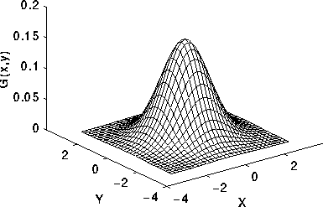
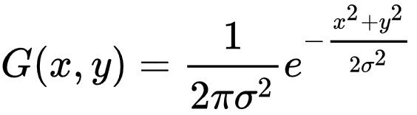
Gaussian Function
where x is the distance from the origin in the horizontal axis, y is the distance from the origin in the vertical axis, and σ is the standard deviation of the Gaussian distribution.
2-D Gaussian distribution with mean (0,0) and σ =1

Slide 3
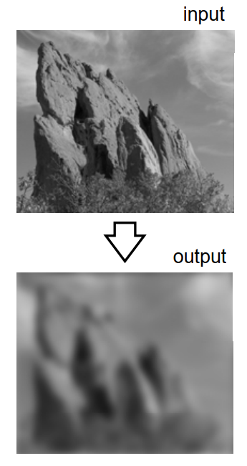
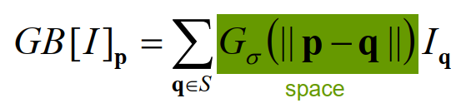
Properties of Gaussian Blur
Does smooth images
But smoothes too much
Edges are blurred
Only Spatial distance matters

Slide 4
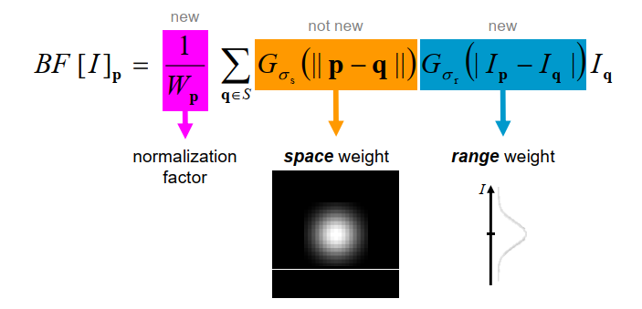
Bilateral Filter
A bilateral filter is a non-linear, edge-preserving, and noise-reducing smoothing filter for images.

Slide 5
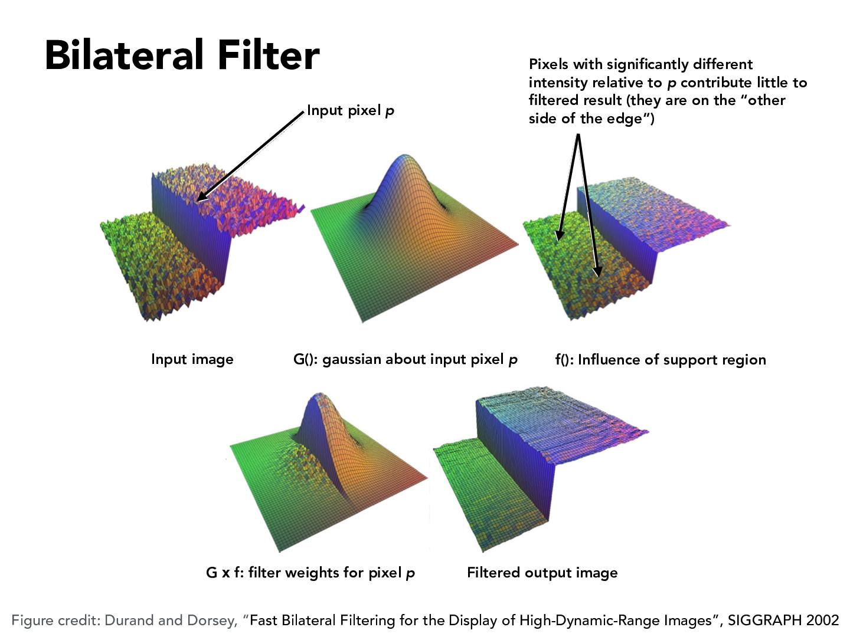
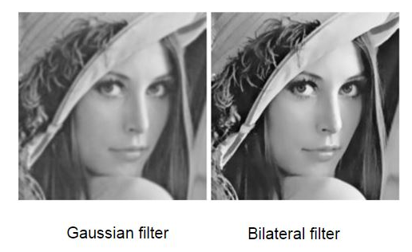

Slide 6
Homework
Mean
Median
Laplacian-3*3 korle hbe
Sobel- 2 ta ache
Gaussian
Bilateral filter

