Slide 1
CSE 4128 Lab 4
Instructors:
Dr. Sk. Md. Masudul Ahsan Professor,
Dept. of Computer Science and Engineering, KUET
Mr. Sunanda Das
Assistant Professor,
Dept. of Computer Science and Engineering, KUET

Slide 2
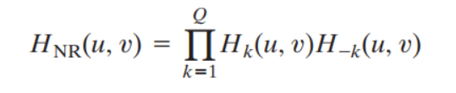
Notch Filter
A notch filter rejects (or passes) frequencies in a predefined neighborhood about the center of the frequency rectangle.
a notch with center at (u₀, v₀) must have a corresponding notch at location (-u₀, -v₀).

Slide 3
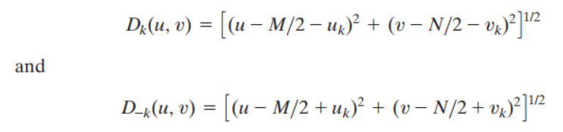
The distance computations for each filter are thus carried out using the expressions
Where, center of the frequency rectangle = (M/2, N/2)

Slide 4

Butterworth notch reject of order n

Slide 5
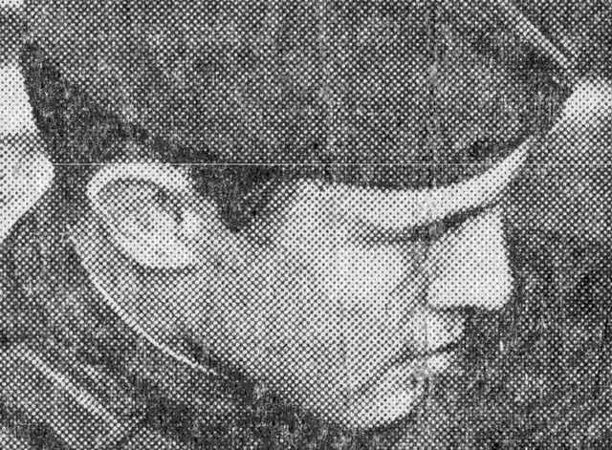
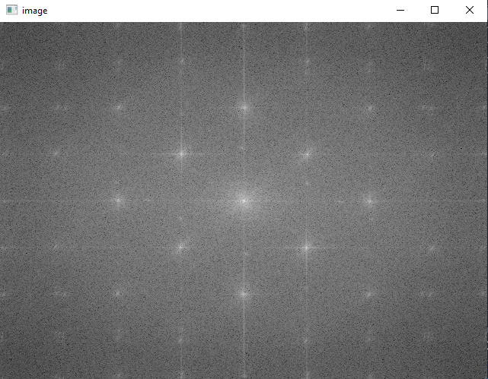
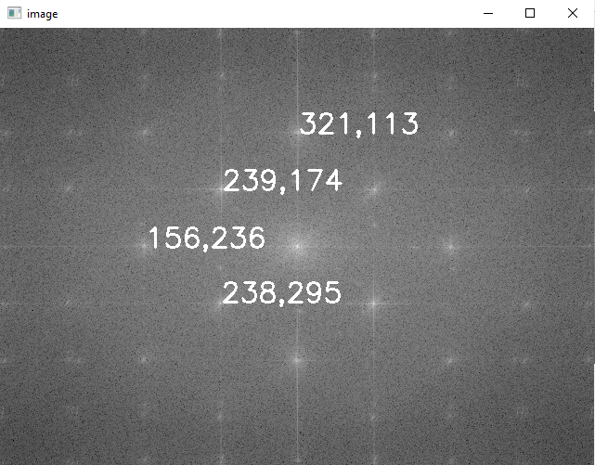
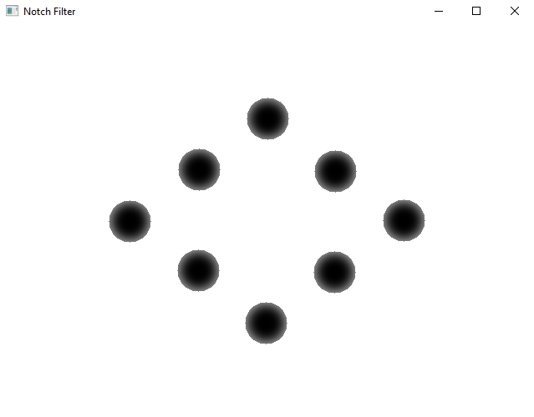
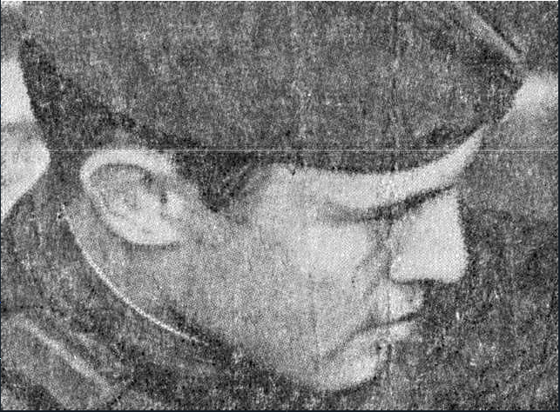
input
shifting the zero-frequency component to center
Notch location selection
Butterworth notch reject of order 2
output

Slide 6
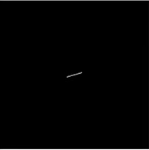
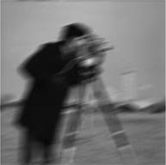
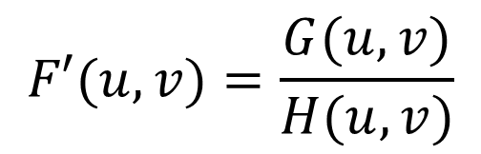






Assignment
Motion Deblur:
$$f\left(x,y\right)∗h\left(x,y\right)=g(x,y)$$
Camera Shake
Motion blurred image
(Point Spread Function)
$$h(x,y)$$
FT
$$H(u,v)$$
$$F′(u,v)=\frac{G(u,v)}{H(u,v)}$$
$$g(x,y)$$
FT
$$G(u,v)$$
IFT
$$f′(x,y)$$

Slide 7
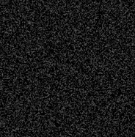

*
+
=
f(x,y)
h(x,y)
n(x,y)
g(x,y)

Slide 8
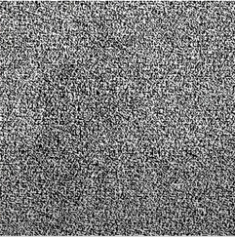
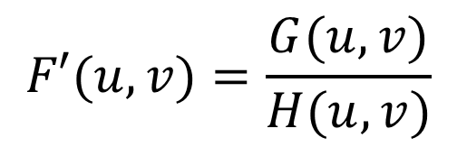

$$F′(u,v)=\frac{G(u,v)}{H(u,v)}$$
IFT
$$f′(x,y)$$

Slide 9


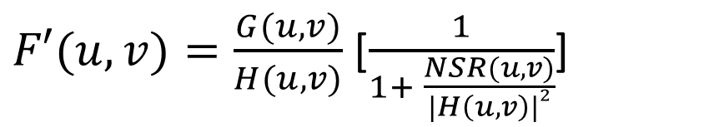
Noise Suppression: Wiener Filter
$F′(u,v)=\frac{G(u,v)}{H(u,v)}$ [$\frac{1}{1+ \frac{NSR(u,v)}{|H\left(u,v\right)|2}}$]
NSR(u,v) = Noise to signal Ratio
NSR$(u,v)=\frac{|N\left(u,v\right)|2}{|F\left(u,v\right)|2}$

