Slide 1
CSE 4128 Lab 4
Instructors:
Dr. Sk. Md. Masudul Ahsan Professor,
Dept. of Computer Science and Engineering, KUET
Mr. Sunanda Das
Assistant Professor,
Dept. of Computer Science and Engineering, KUET

Slide 2


Homographic Filtering
an image f(x,y) can be expressed as the product of its illumination, i(x,y) , and reflectance, r(x,y) , components:
This equation cannot be used directly to operate on the frequency components of illumination and reflectance because the Fourier transform of a product is not the product of the transforms:

Slide 3
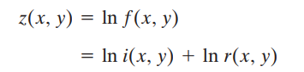
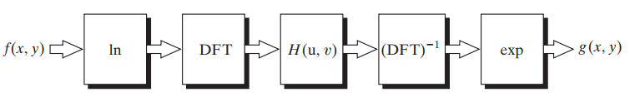


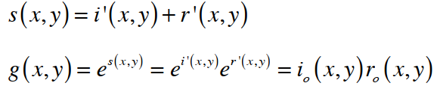
Separate frequency components
Fourier transform high and low frequency components
Filter out low frequency component
Inverse transform
Exponentiate to re-combine

Slide 4
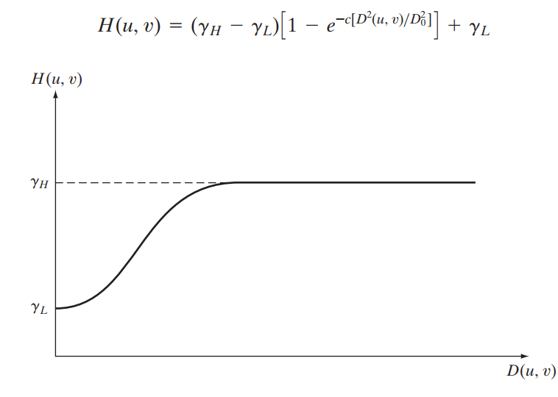


Modified form of the Gaussian highpass filter
$$γ_{H}>1$$
$$γ_{L}<1$$
c controls smoothness
Fig: Radial cross section of a circularly symmetric homomorphic filter function. The vertical axis is at the center of the frequency rectangle and D(u,v) is the distance from the center.

Slide 5
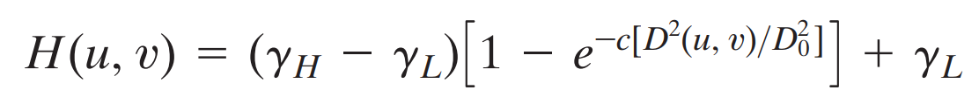
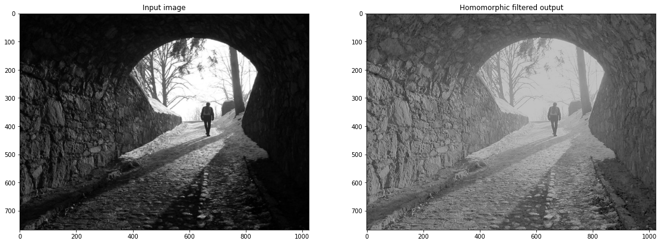

Slide 6
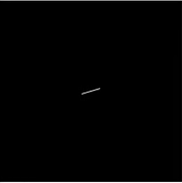
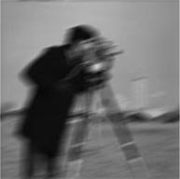
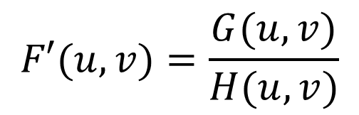






Assignment
Motion Deblur:
$$f\left(x,y\right)∗h\left(x,y\right)=g(x,y)$$
Camera Shake
Motion blurred image
$$h(x,y)$$
FT
$$H(u,v)$$
$$F′(u,v)=\frac{G(u,v)}{H(u,v)}$$
$$g(x,y)$$
FT
$$G(u,v)$$
IFT
$$f′(x,y)$$

