Slide 1
CSE 4128 Lab 5
Instructors:
Dr. Sk. Md. Masudul Ahsan Professor,
Dept. of Computer Science and Engineering, KUET
Mr. Sunanda Das
Assistant Professor,
Dept. of Computer Science and Engineering, KUET

Slide 2

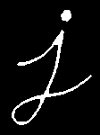
Erosion
import cv2 as cv
import numpy as np
img = cv.imread('j.png',0)
kernel = np.ones((5,5),np.uint8)
erosion = cv.erode(img, kernel, iterations = 1)
Erosion

Slide 3

Dilation
import cv2 as cv
import numpy as np
img = cv.imread('j.png',0)
kernel = np.ones((5,5),np.uint8)
dilation = cv.dilate(img, kernel, iterations = 1)
Dilation

Slide 4
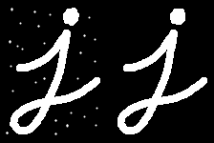
Opening
import cv2 as cv
import numpy as np
img = cv.imread('j.png',0)
kernel = np.ones((5,5),np.uint8)
opening = cv.morphologyEx(img, cv.MORPH_OPEN, kernel)
Opening

Slide 5
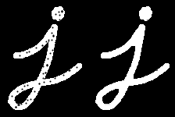
Closing
import cv2 as cv
import numpy as np
img = cv.imread('j.png',0)
kernel = np.ones((5,5),np.uint8)
closing = cv.morphologyEx(img, cv.MORPH_CLOSE, kernel)
Closing

Slide 6
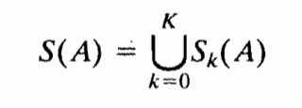


Skeletons

Slide 7

B
k=0

Slide 8
B
k=1

Slide 9
B
k=2

