Slide 1
CSE 4128 Lab 1
Instructors:
Dr. Sk. Md. Masudul Ahsan Professor,
Dept. of Computer Science and Engineering, KUET
Mr. Sunanda Das
Assistant Professor,
Dept. of Computer Science and Engineering, KUET

Slide 2
OpenCV Installation
Open Anaconda Prompt:
conda install -c conda-forge opencv
or
pip install opencv-python

Slide 3
Google Colab!
Sign In: https://colab.research.google.com/

Slide 4
Google Colab!
Colab, or "Colaboratory", allows you to write and execute Python in your browser, with
Zero configuration required
Access to GPUs free of charge
Easy sharing

Slide 5
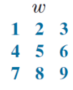
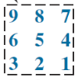
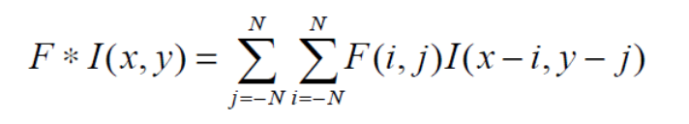
Convolution Operation
In Convolution operation, the kernel is first flipped by an angle of 180 degrees and is then applied to the image.
The convolution operation applied on Image I using a kernel F is given by

Slide 6
Filter
1 | 0 | 1
0 | 1 | 0
1 | 0 | 1

Slide 8
dst = cv.copyMakeBorder(src, top, bottom, left, right, borderType)
replicate = cv2.copyMakeBorder(img,1,1,1,1,cv2.BORDER_REPLICATE)
constant = cv2.copyMakeBorder(img,1,1,1,1, cv2.BORDER_CONSTANT, value = 0)

