Slide 1

Introduction to Large Language Models (LLM)
Presented by:
Abhay Kallur, Adityan CG, Naina Pandey, P Sneha Deepika

Slide 2

What is a Large Language Model?
A Large Language Model (LLM) is a sophisticated AI system designed to understand, process, and generate human language with remarkable fluency. These models are trained on vast amounts of text data, learning the intricate patterns, connections, and relationships between words, sentences, and ideas.
Think of an LLM as a highly intelligent reading and writing assistant that can comprehend context, generate coherent responses, and communicate naturally—much like a human would.

Slide 3

How LLMs are Created
Training
Fine-tuning
Learn language patterns with machine learning.
Improve accuracy, safety, and task alignment.
Data Collection
Deployment
Gather text from books, websites, and articles.
Integrate models into chatbots and AI tools.
Building an LLM is a sophisticated process that transforms raw text into intelligent conversational systems. Each stage is critical to developing a model that is accurate, helpful, and safe to use in real-world applications.

Slide 4
Powerful Capabilities of LLMs
Natural Language Understanding
Text Generation
Question Answering
Content Summarization
Creates human-like content across various formats and styles
Provides accurate, contextual responses to complex queries
Comprehends context and nuances in human communication
Distills long documents into concise, meaningful summaries
Language Translation
Text Completion
Converts text between languages while preserving meaning
Intelligently continues sentences and paragraphs based on context
LLMs adapt to different writing styles and respond intelligently based on the context of the conversation.

Slide 5
Popular LLM Examples
GPT
BERT
Claude
PaLM
Generative Pre-trained Transformer – known for versatile text generation and conversation
Bidirectional Encoder – excels at understanding context in search and language tasks
Focused on safety and helpful, harmless, and honest interactions
Pathways Language Model – Google's advanced reasoning and multi-task AI
LLaMA
Meta's open-access model designed for research and efficiency

Slide 6

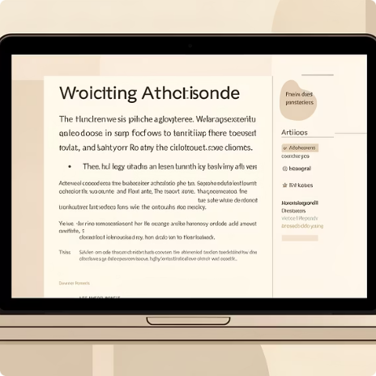
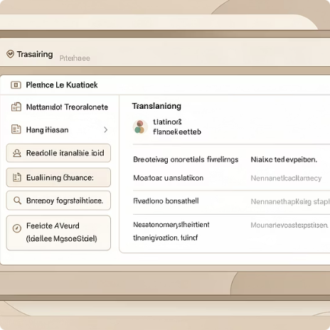

Real-World Applications
Conversational Assistants
Content Creation
Translation & Summarization
Coding Support
Generate high-quality articles, emails, reports, and creative writing
Assist with programming tasks, debugging, and technical problem-solving
Understand and respond to human language naturally in real-time interactions
Translate languages and condense lengthy content into digestible summaries

Slide 7
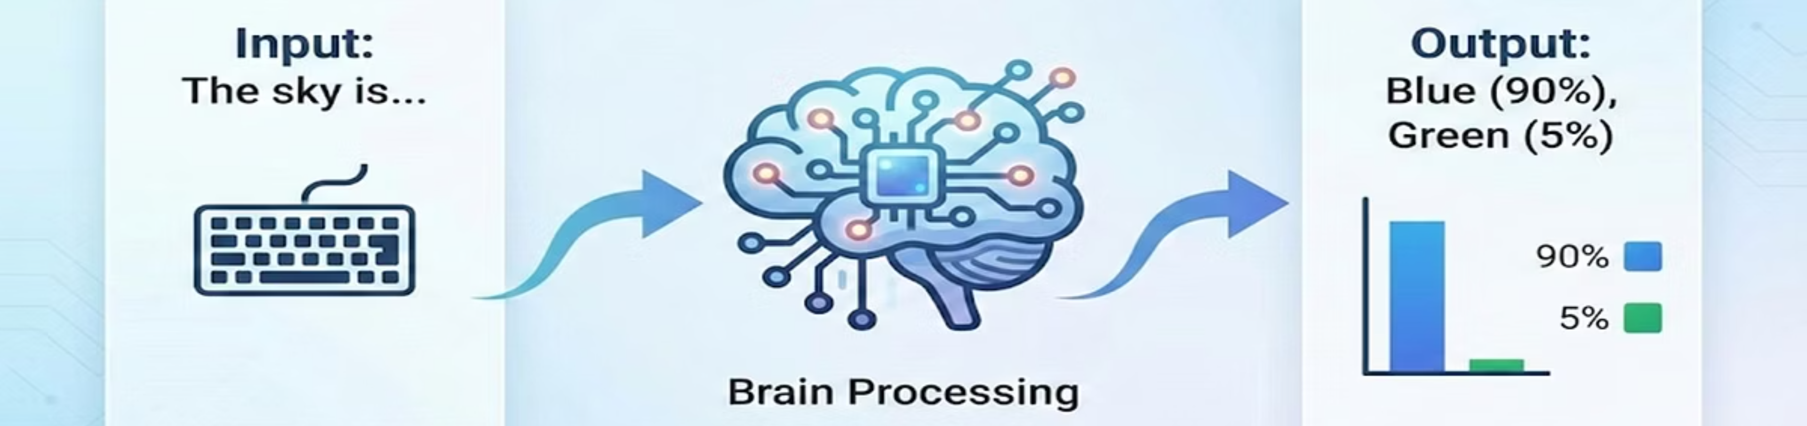
How LLMs Actually Work (The Engine)
The Core Mechanism: LLMs do not "know" facts; they predict probabilities. They are trained on massive datasets to guess the most likely next word (token) in a sequence.​
The Brain (Transformer Architecture): Uses "Attention Mechanisms" to understand context. Example: In "The bank of the river," it knows "bank” ≠​
"money" because it pays attention to the word "river."​
Key Takeaway: It's not a database search; it's a mathematical prediction engine.​

Slide 8

Basic Working of Large Language Models​
Step-by-Step Working
Input (Prompt): User gives instruction. ​
Example: “Create a motivational fitness caption for college students.”​
​2️⃣ Understanding Context: LLM identifies:​
Topic → Fitness​
Audience → College Students​
Tone → Motivational​
​3️⃣ Token Prediction: LLM predicts the next most meaningful word basedon patterns learned during training.​
4️⃣ Output Generation: Produces complete human-like text response.​
Key Point: LLM does not “search answers” — it predicts language patternsto generate responses.​
​

Slide 9
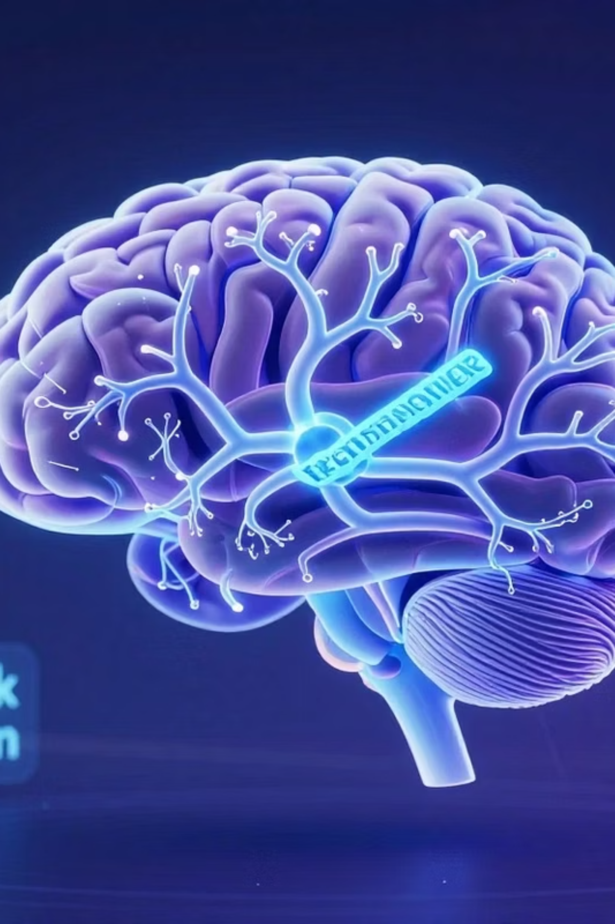
The "Generative" Power​
STATIC ​
Goal: Classify or Discriminate.​
Retrieve: Finds existing data.​
Example: "Is this email Spam or Not Spam?"​
Limitation: Can only show you what already exists. Ifa personalized summary doesn't exist, it can't show it.​
GENERATIVE​
Goal: Create and Generate.​
Create: Synthesizes new data from scratch.​
Example: "Write a reply to this email."​
Capability: Can combine concepts, rewrite tones, andgenerate unique content for every single user.​
Why It Matters: This allows for "Zero-Shot" creation—doing tasks it was never specifically programmed to do.​

Slide 10

Role of LLM in Our Project
LLM as the Core Engine of Personalized Media System​
In Our Project, LLM Will:​
Understand user preferences​
Generate personalized content​
Adjust tone and style​
Create platform-specific content​
Summarize or rewrite content​
​
Simple Flow: User Input → Prompt → LLM → Personalized Output.​

Slide 11
The Key Breakthrough: Meaning Over Words
Core Principle
What This Means
LLMs do not manipulate sentences directly—they operate on meaning.
Different sentences can express the same intent or idea
LLMs convert text into semantic (meaning-based) representations
The core meaning is preserved while format, tone, and style adapt
Context determines how meaning is expressed in output
This fundamental insight separates modern AI from simple text manipulation tools.

Slide 12





From One Idea to Many Expressions
Input Idea
"We conducted a technical workshop"
LinkedIn
"Excited to share insights from our recent technical workshop!"
Instagram
"Workshop vibes ✨ Teaching tech today!"
Blog Intro
"Last week, our team hosted a comprehensive technical workshop..."
Email
"Dear colleagues, I'm writing to update you on our recent workshop..."
Expression changes across platforms and contexts, but the intent stays exactly the same.

Slide 13


How Semantic Understanding Works
The Transformation Process
LLMs convert text into vector representations—mathematical structures that capture meaning in a multi-dimensional semantic space. Similar meanings cluster together in this space, regardless of the words used.
Input Text
Vector Representation
When generating output, the model reshapes this core meaning to fit the desired format, tone, or platform—all while preserving the original intent.
Multiple Outputs
One-Line Takeaway: LLMs are semantic transformation engines, not just sentence generators.

Slide 14

Why This Matters for Modern Applications
01
02
One Idea, Multiple Formats
Scalable Content Creation
Transform a single concept into platform-specific content automatically
Generate consistent, high-quality content at scale without manual rewriting
03
04
No Hard-Coded Rules
Intelligent Adaptation
Flexible, adaptive systems that understand context rather than following rigid templates
Content automatically adjusts tone, style, and structure based on intended platform and audience
This semantic understanding powers the next generation of intelligent web applications and content creation tools.

