Slide 1
FQsun: a wave function-based quantum emulator
Vu Tuan Hai
8/10/2024
Keywords: quantum emulator, wave-function, FPGA

Slide 2
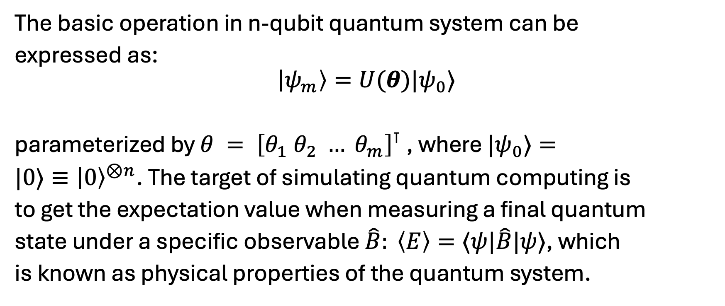
1. Introduction
The basic operation in n-qubit quantum system can be
expressed as:
$$\left|ψ_{m}\right\rangle =U(θ)|ψ_{0}⟩$$
parameterized by $θ = {\left[θ_{1} θ_{2} … θ_{m}\right]}^{⊺}$, where $|ψ_{0}⟩=$
$|0⟩≡{\left|0\right\rangle }^{⊗n}$. The target of simulating quantum computing is
to get the expectation value when measuring a final quantum
state under a specific observable $\hat{B}: \left\langle E\right\rangle =⟨ψ|\hat{B}|ψ⟩$, which
is known as physical properties of the quantum system.

Slide 3








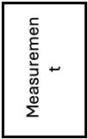

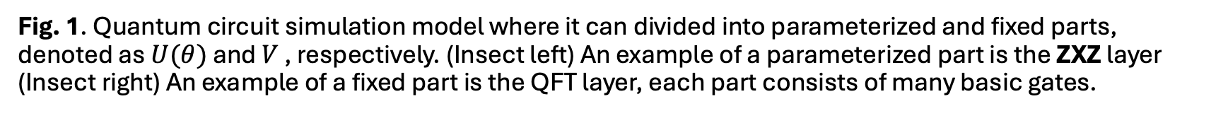







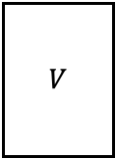






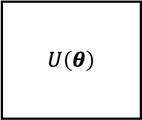


1. Introduction
$$H$$
$$QFT$$
$$⋮$$
$$P(\frac{π}{2^{n−2}})$$
=
$$R_{Z}(.)$$
$$R_{X}(.)$$
$$R_{Z}(.)$$
$$ZXZ$$
$$⋮$$
$$R_{Z}(.)$$
$$R_{X}(.)$$
$$R_{Z}(.)$$
$$H$$
$$R_{Z}(\frac{π}{2^{n−2}})$$
$$R_{Z}(\frac{−π}{2^{n−2}})$$
$$R_{Z}(\frac{π}{2^{n−2}})$$
=
$$⋮$$
$$R_{Z}(.)$$
$$R_{X}(.)$$
$$R_{Z}(.)$$
$$C−Phase(\frac{π}{2^{n−1}})$$
$SWAP$
$$× L$$
$$U\left(θ\right)$$
$$V$$
$$⋮$$
Measurement
$$|ψ_{0}⟩$$
$$⋮$$
$$⋮$$
$$\left\{p_{i}\right\}$$
Arbitrary parameterized quantum circuit
Fixed quantum circuit
Fig. 1. Quantum circuit simulation model where it can divided into parameterized and fixed parts, denoted as $U(θ)$ and $V$ , respectively. (Insect left) An example of a parameterized part is the ZXZ layer (Insect right) An example of a fixed part is the QFT layer, each part consists of many basic gates.

Slide 4
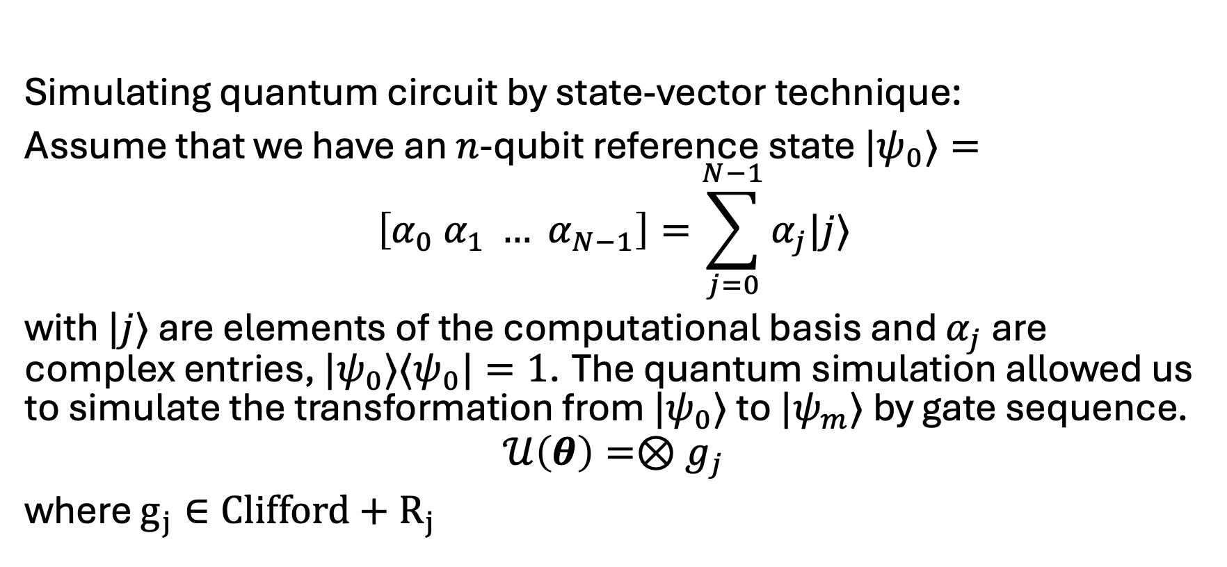
2. Background
Simulating quantum circuit by state-vector technique:
Assume that we have an $n$-qubit reference state $|ψ_{0}⟩=$
$$\left[α_{0} α_{1} … α_{N−1}\right]=\sum_{j=0}^{N−1}{α_{j}|j⟩}$$
with $|j⟩$ are elements of the computational basis and $α_{j}$ are complex entries, $|ψ_{0}⟩⟨ψ_{0}|=1$. The quantum simulation allowed us to simulate the transformation from $|ψ_{0}⟩$ to $|ψ_{m}⟩$ by gate sequence.
$$𝒰\left(θ\right)=⊗g_{j}$$
where $g_{j}∈Clifford+R_{j}$

Slide 5
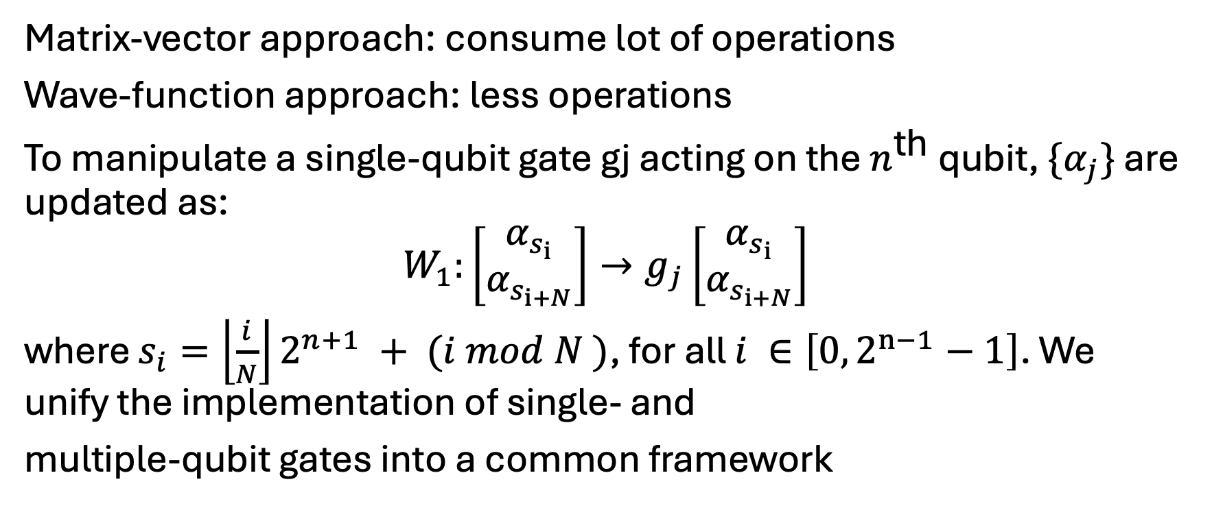
2. Background: wave-function approach
Matrix-vector approach: consume lot of operations
Wave-function approach: less operations
To manipulate a single-qubit gate gj acting on the $n^{\text{th}}$ qubit, $\{α_{j}\}$ are updated as:
$$W_{1}:\left[\begin{matrix}α_{s_{i}} \\ α_{s_{i+N}}\end{matrix}\right]→g_{j}\left[\begin{matrix}α_{s_{i}} \\ α_{s_{i+N}}\end{matrix}\right]$$
where $s_{i}=\left\lfloor \frac{i}{N}\right\rfloor 2^{n+1} + (i mod N )$, for all $i ∈\left[0, 2^{n−1}−1\right]$. We unify the implementation of single- and
multiple-qubit gates into a common framework

Slide 6
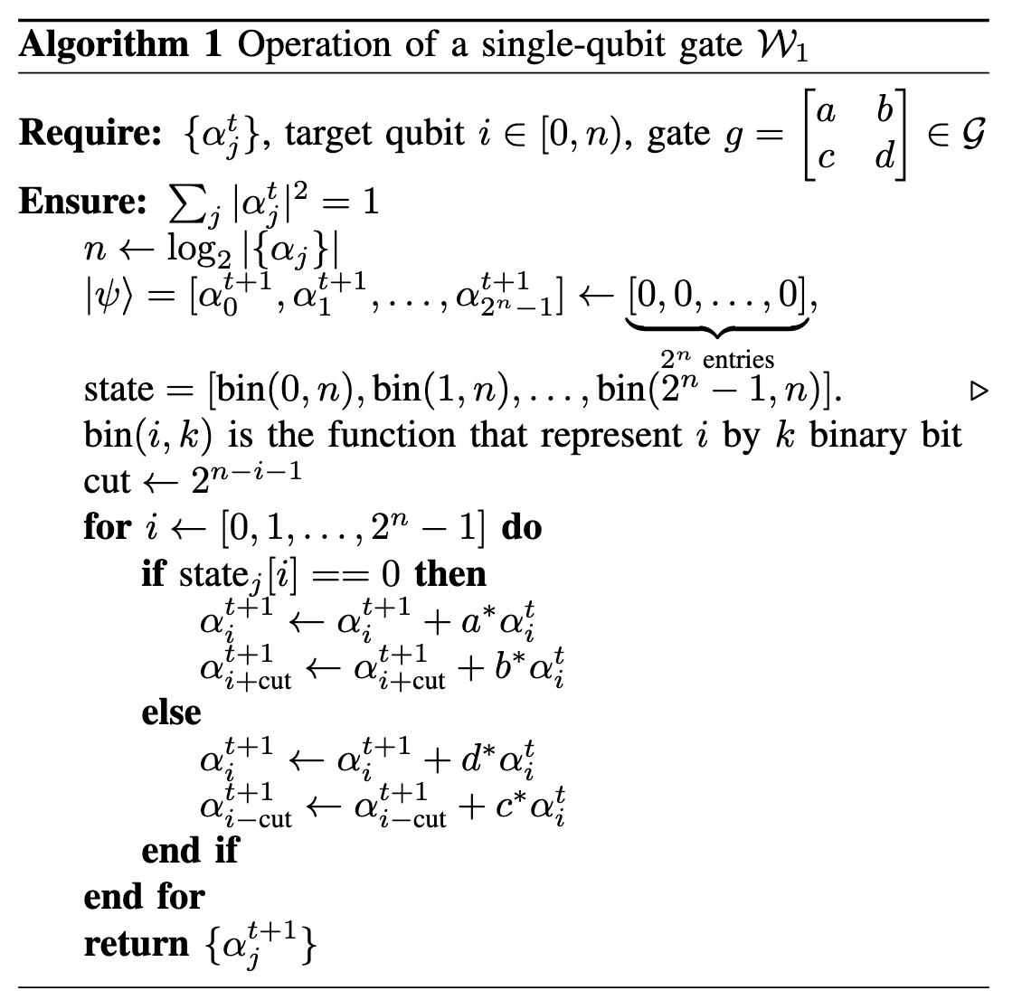
2. Background: wave-function approach
Idea: Update non-zeros elements in wave-function representation

Slide 7
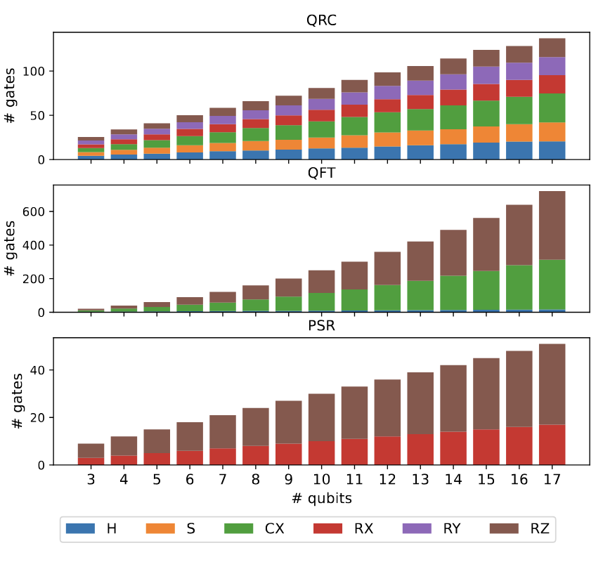
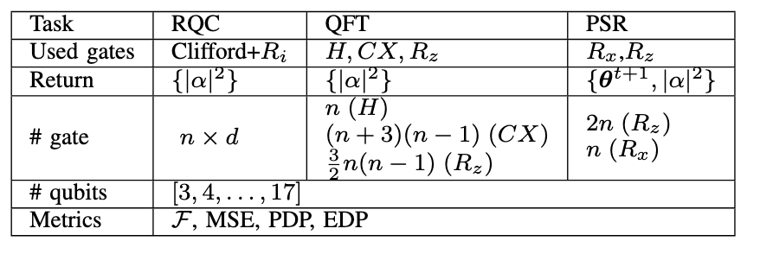
3. Software setup
Benchmarking set: andom quantum circuit (RQC), Quantum Fourier Transform (QFT), Quantum differentiable with Parameter-Shift Rule (PSR)
Table II: Properties of benchmarking tasks.

Slide 8
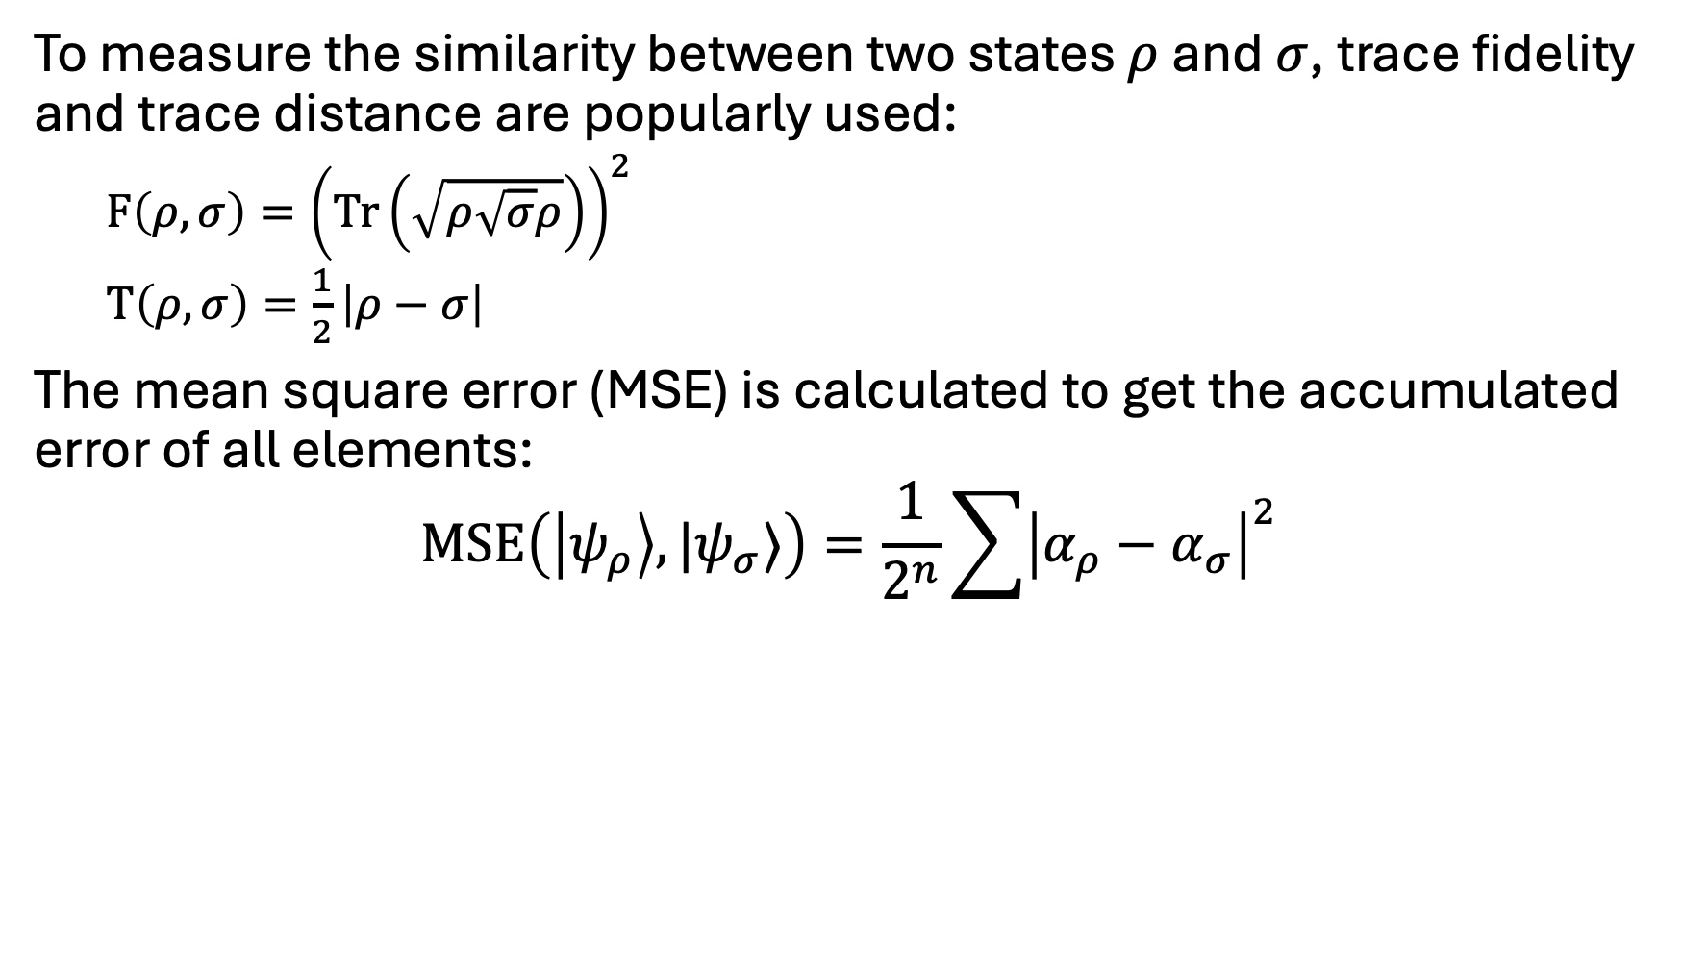
3. Software setup: evaluated metrics
To measure the similarity between two states $ρ$ and $σ$, trace fidelity and trace distance are popularly used:
$F\left(ρ,σ\right)={\left(Tr\left(\sqrt{ρ\sqrt{σ}ρ}\right)\right)}^{2}$
$T\left(ρ,σ\right)=\frac{1}{2}\left|ρ−σ\right|$
The mean square error (MSE) is calculated to get the accumulated error of all elements:
$$MSE\left(\left|ψ_{ρ}\right\rangle ,|ψ_{σ}⟩\right)=\frac{1}{2^{n}}\sum{{\left|α_{ρ}−α_{σ}\right|}^{2}}$$

Slide 9
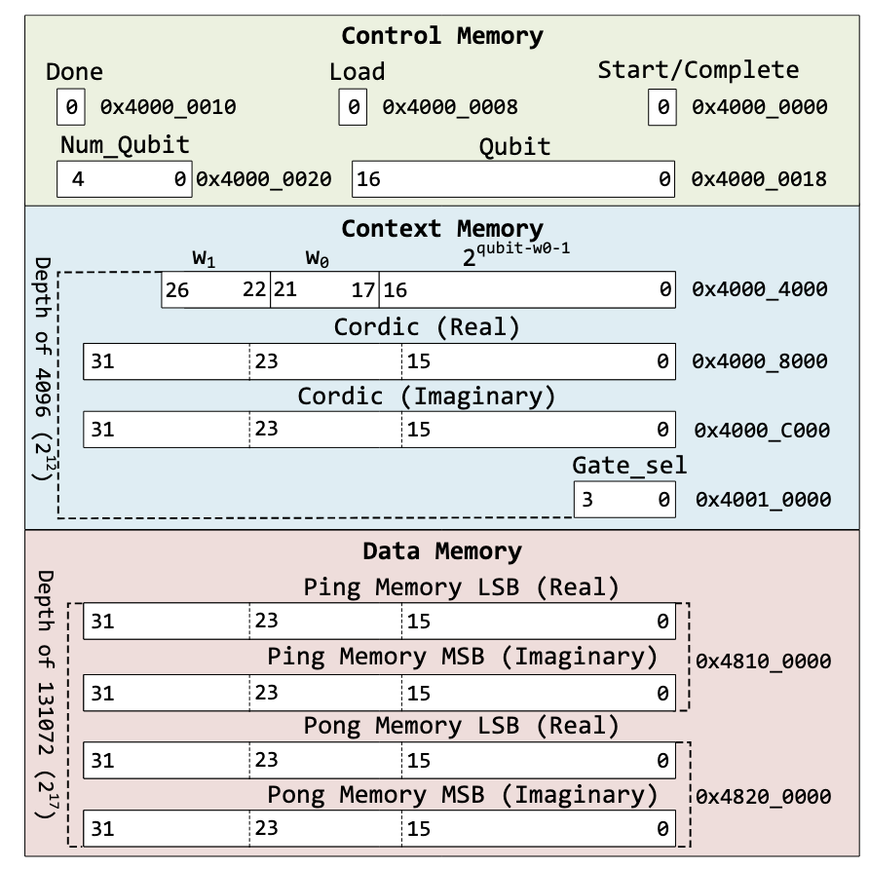
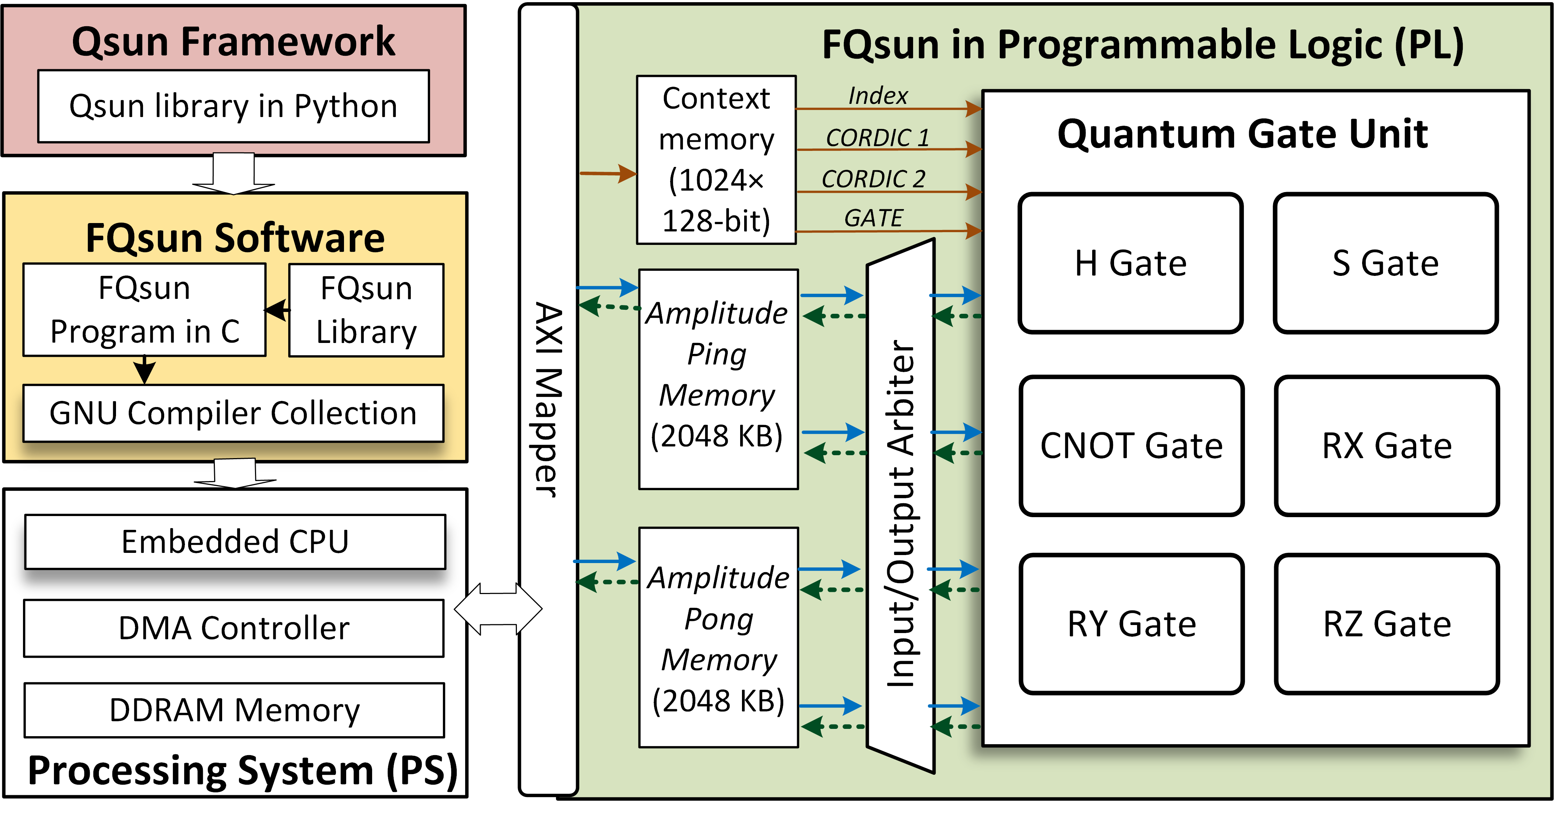
4. Hardware setup
Fig 3: Overall hardware architecture
Fig 2: Memory organization of the proposed FQsun

Slide 10
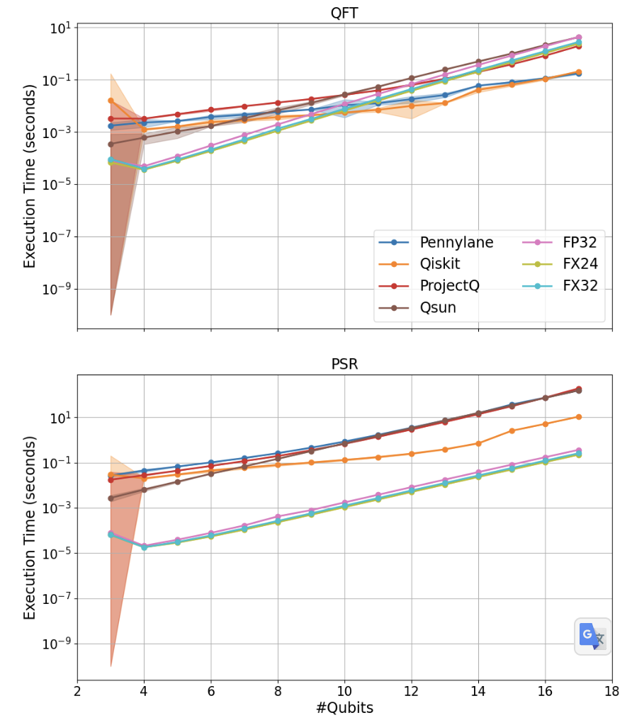
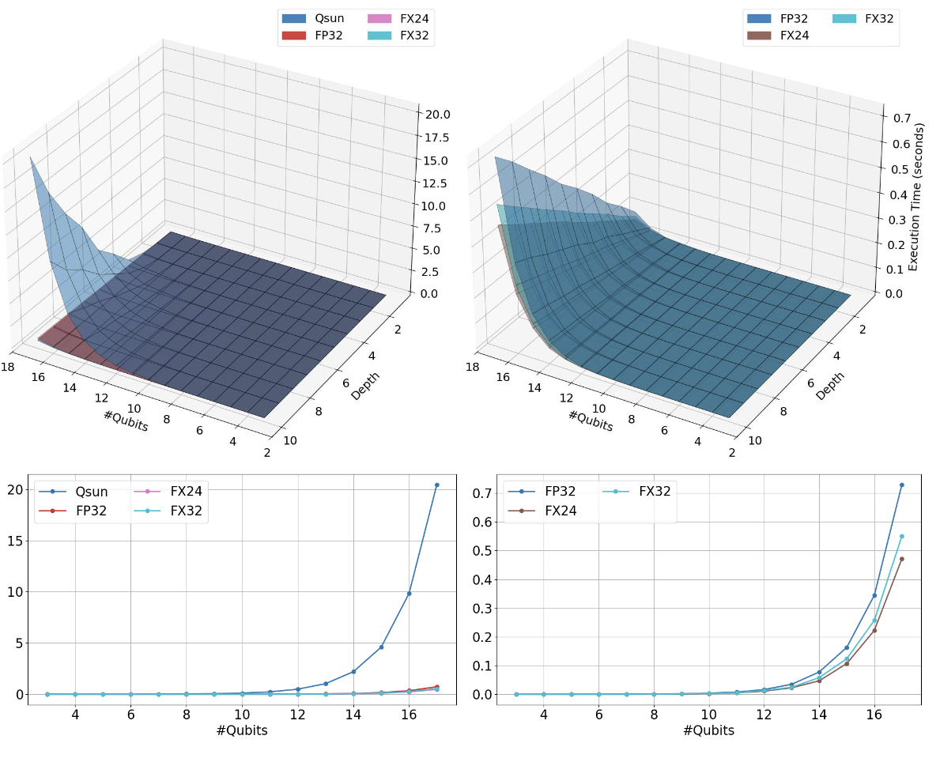
5. Results: execution time

Slide 11
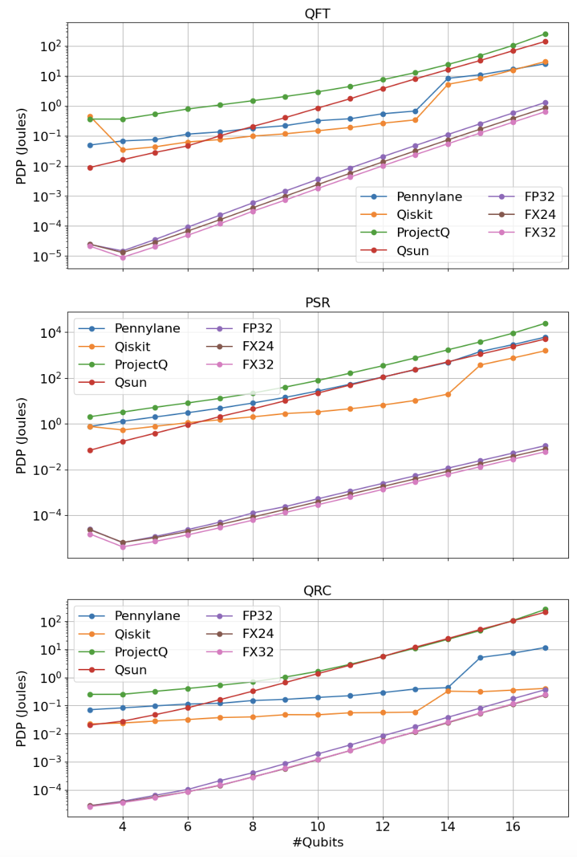
5. Result: PDP

Slide 12
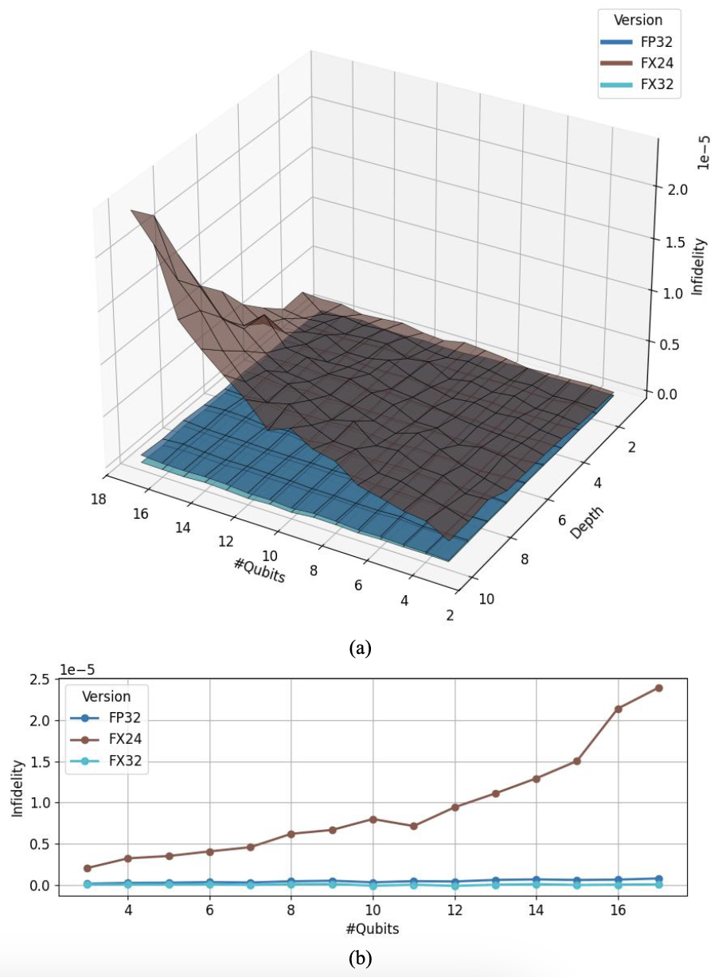
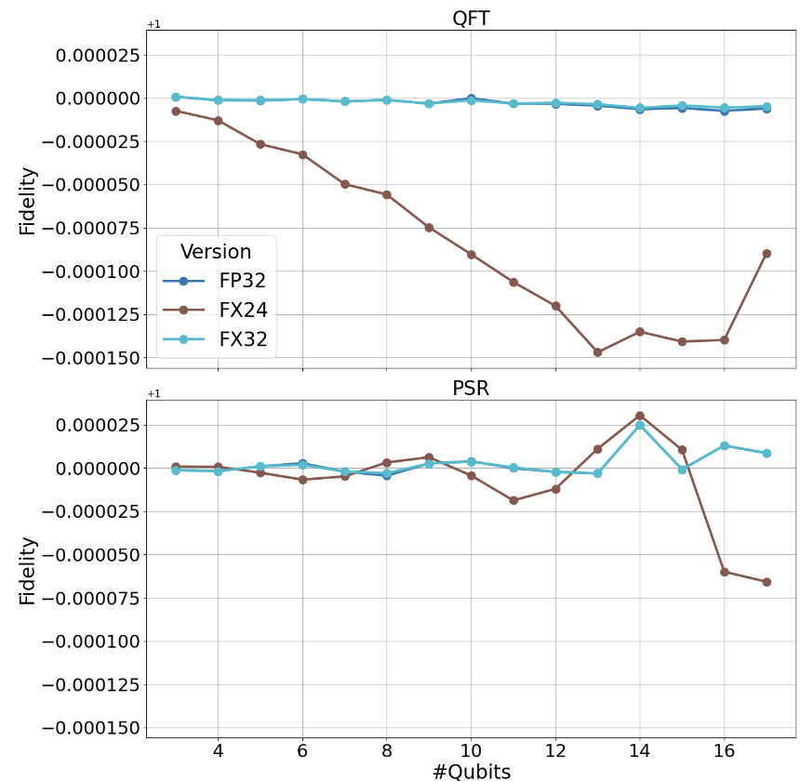
5. Result: Fidelity

