Slide 1



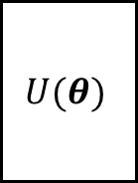




$θ^{t+1}←$QOptimizer $\left(θ^{t},{F^{−1}\left(θ^{t}\right),∇}_{θ}𝒞\left(θ^{t}\right)\right)$
QOptimizer
For evaluate cost $𝒞\left(θ\right)$
Y
$$U(θ)$$
$$𝒞\left(θ\right)<τ$$
$$n$$
$$|ψ_{0}⟩$$
Mode
Type
N
For evaluate gradient $\left\{𝒞\left(θ^{±ε_{k}}\right)\right\}$
Begin
COptimizer
End
$θ^{t+1}←$ COptimizer $\left(θ^{t},∇_{θ}𝒞\left(θ^{t}\right)\right)$

