Slide 1
Benchmarking Classical and Quantum Optimizers for Quantum Simulator
Vu Tuan Hai, Le Vu Trung Duong, Pham Hoai Luan, and Yasuhiko Nakashima
Nara Institute of Science and Technology, Nara, Japan.
Email: vu.tuan hai.vr7@naist.ac.jp

Slide 2
Outline
Introduction
Setting
Experiment results
Conclusion

Slide 3
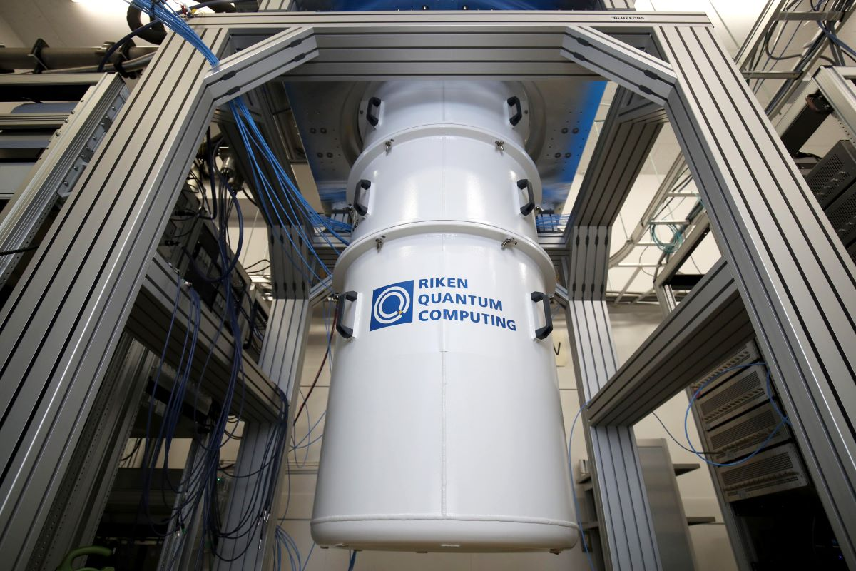
1. Introduction
Quantum computers are promising as a solver for hard problems in BQP class, lower complexity than classical
There are many exploitable aspect!
Fig. 1. Quantum computer from RIKEN

Slide 4








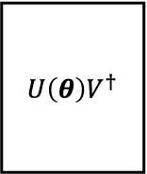


































1. Introduction: parameterized quantum circuit
(a)
$θ^{t+1}←$QOptimizer$\left(θ^{t},{F^{−1}\left(θ^{t}\right),∇}_{θ}𝒞\left(θ^{t}\right)\right)$
QOptimizer
For cost$:𝒞\left(θ\right)$
Yes
$$U\left(θ\right)V^{†}$$
$$𝒞\left(θ\right)<τ$$
For gradient$: \left\{𝒞\left(θ^{±ε_{k}}\right)\right\}$
$$|ψ_{0}⟩$$
Mode
Type
No
Begin
COptimizer
End
$θ^{t+1}←$ COptimizer$\left(θ^{t},∇_{θ}𝒞\left(θ^{t}\right)\right)$
$$R_{Y}(θ_{0})$$
$$R_{Y}(θ_{4})$$
$$R_{Y}(θ_{8})$$
$$R_{Y}(θ_{3})$$
Odd layer
Even layer
$$R_{Z}(θ_{0})$$
$$R_{X}(θ_{4})$$
$$R_{Z}(θ_{8})$$
$${ V}^{†}$$
$$ZXZ$$
$$ZXZ$$
$$ZXZ$$
$$R_{Y}(θ_{1})$$
$$R_{Y}(θ_{5})$$
$$R_{Y}(θ_{9})$$
$$R_{Y}(θ_{0})$$
$$R_{Z}(θ_{1})$$
$$R_{X}(θ_{5})$$
$$R_{Z}(θ_{9})$$
=
+
$$R_{Y}(θ_{2})$$
$$R_{Y}(θ_{6})$$
$$R_{Y}(θ_{10})$$
$$R_{Y}(θ_{1})$$
$$R_{Z}(θ_{2})$$
$$R_{X}(θ_{6})$$
$$R_{Z}(θ_{10})$$
$$R_{Y}(θ_{3})$$
$$R_{Y}(θ_{7})$$
$$R_{Y}(θ_{11})$$
$$R_{Y}(θ_{2})$$
$$R_{Z}(θ_{3})$$
$$R_{X}(θ_{7})$$
$$R_{Z}(θ_{11})$$
$$× L$$
(b) $|g_{2}g_{n}⟩$
(c) $|W_{chain}+ZXZ⟩$
(d) $|ZXZ+W_{alternating}⟩$
(e) $|ZXZ⟩$
Fig. 2. Detail structure of example 4-qubits $U\left(θ\right)V^{†}$ with $U(θ)$ is $L$ ansatz’s layers (b) $|g_{2}g_{n}(θ)⟩$, (c) $|W_{chain} + ZXZ(θ)⟩$, (d) $|ZXZ + W_{alternating} (θ)⟩$ or (e) $|ZXZ(θ)⟩$ [1]
[1] . S. Maria Schuld and F. Petruccione, “An introduction to quantummachine learning,” Contemporary Physics, vol. 56, no. 2, pp. 172–185, 2015

Slide 5
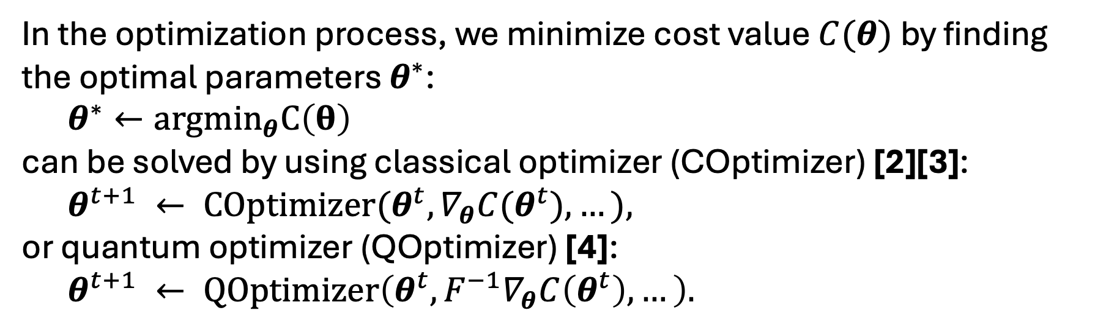
1. Introduction: optimizers
In the optimization process, we minimize cost value $C(θ)$ by finding the optimal parameters $θ^{∗}$:
$θ^{∗}←{argmin}_{θ}C\left(θ\right)$
can be solved by using classical optimizer (COptimizer) [2][3]:
$θ^{t+1} ← COptimizer(θ^{t}, ∇_{θ}C(θ^{t}), …),$
or quantum optimizer (QOptimizer) [4]:
$θ^{t+1} ← QOptimizer\left(θ^{t}, F^{−1}∇_{θ}C\left(θ^{t}\right), …\right).$
First-order gradient
Tensor metric
[2] S.-i. Amari, “Backpropagation and stochastic gradient descent method,” Neurocomputing, vol. 5, no. 4-5, pp. 185–196, 1993.
[3] D. P. Kingma and J. Ba, “Adam: A method for stochastic optimization,” arXiv preprint arXiv:1412.6980, 2014.
[4] J. Stokes, J. Izaac, N. Killoran, and G. Carleo, “Quantum natural gradient,” Quantum, vol. 4, p. 269, 2020
Which is the good optimizer for quantum models?

Slide 6
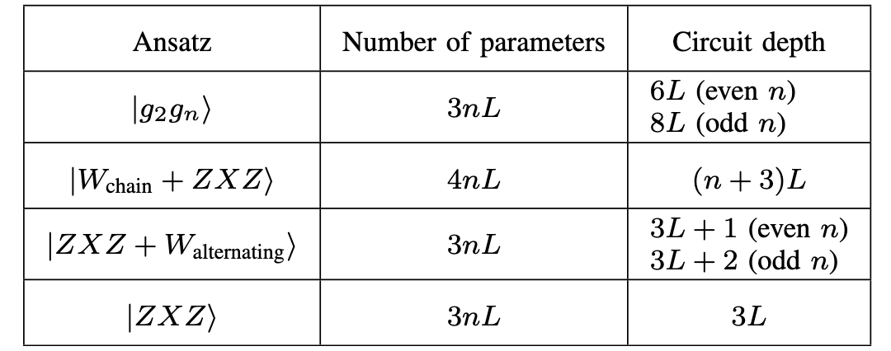
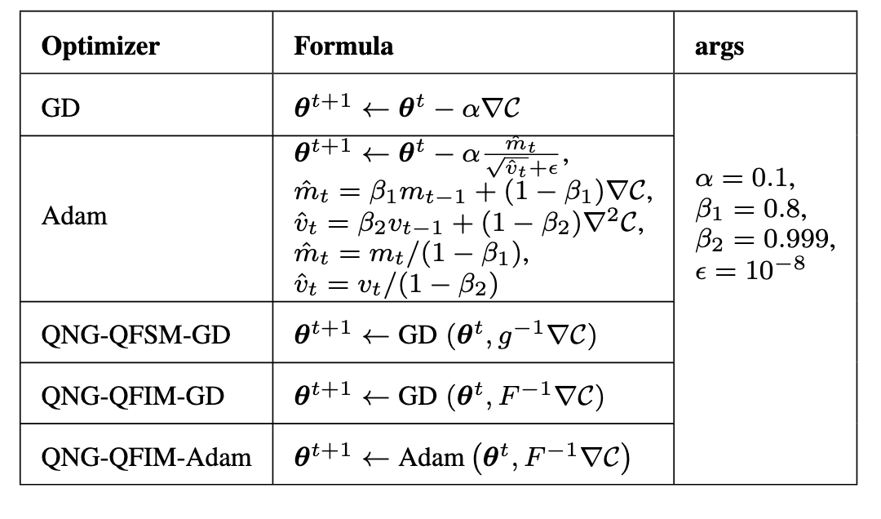
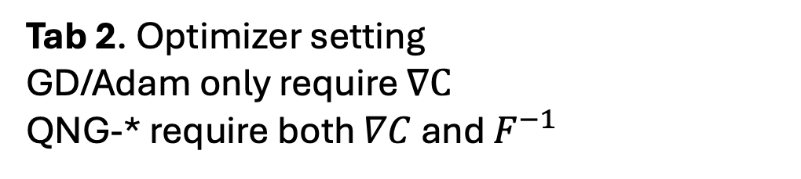
2. Setting
Tab 1. Ansatzes setting.
Both #parameters and circuit depth affect to the complexity computation linearly
Tab 2. Optimizer setting
GD/Adam only require $∇C$
QNG-* require both $∇C$ and $F^{−1}$

Slide 7
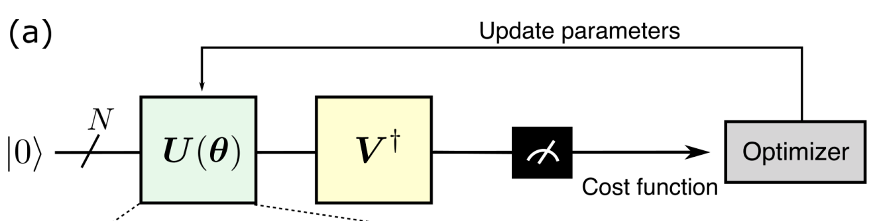
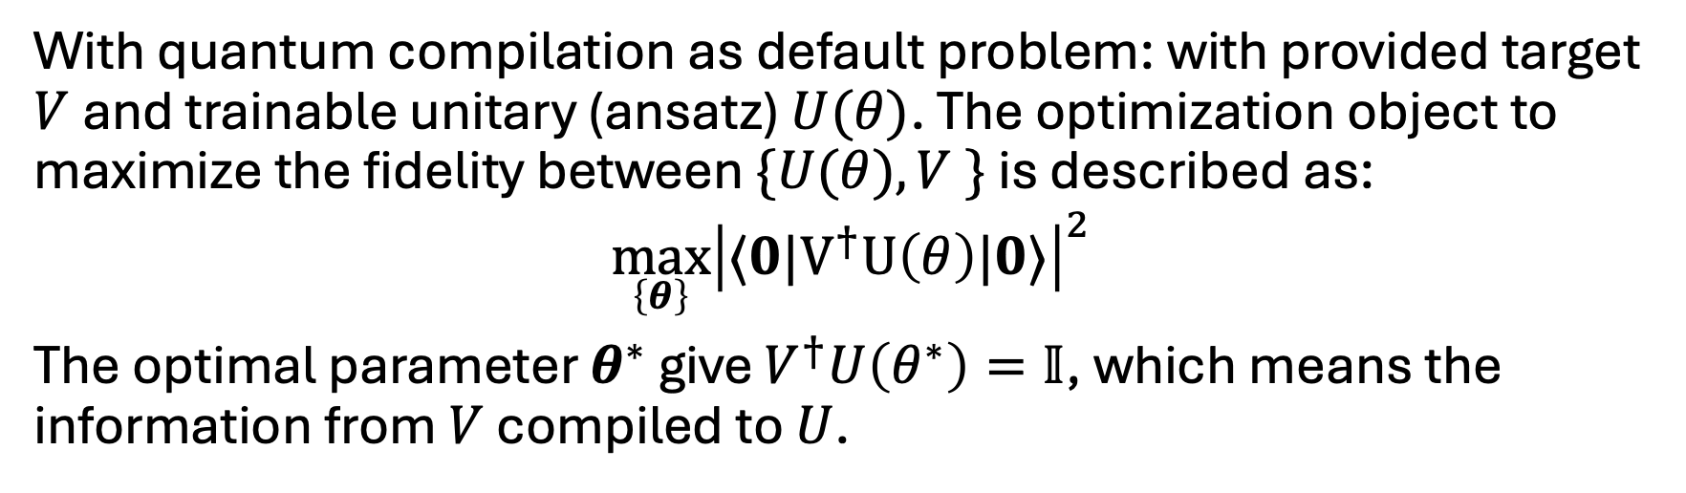
2. Setting
Fig. 3. Quantum compilation algorithm [5]
With quantum compilation as default problem: with provided target $V$ and trainable unitary (ansatz) $U(θ)$. The optimization object to maximize the fidelity between $\{U(θ), V \}$ is described as:
$${\max_{\left\{θ\right\}}\left|⟨0|V^{†}U\left(θ\right)|0⟩\right|}^{2}$$
The optimal parameter $θ^{∗}$ give $V^{†}U\left(θ^{∗}\right)=𝕀$, which means the information from $V$ compiled to $U$.
[5] Hai, V. T., Viet, N. T., & Ho, L. B. (2023). Variational preparation of entangled states on quantum computers. arXiv preprint arXiv:2306.17422.

Slide 8
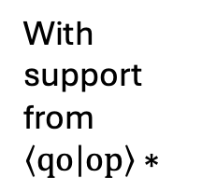

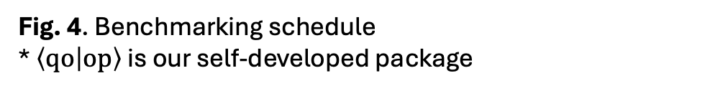
2. Setting: schedule
With support from Qiskit
Quantum model (PQC)
Classical optimizer
{GD, Adam}
Select optimizer (COptimizer/QOptimizer)
With support from $\left\langle qo | op\right\rangle ∗$
Quantum optimizer
{QNG-QFSM-GD,QNG-QFIM-GD, QNG-QFIM-Adam}
Select metrics
($C\left(θ\right),Δt,EDP,…$)
Metric values
Select device
Fig. 4. Benchmarking schedule
* $\left\langle qo | op\right\rangle$ is our self-developed package

Slide 9
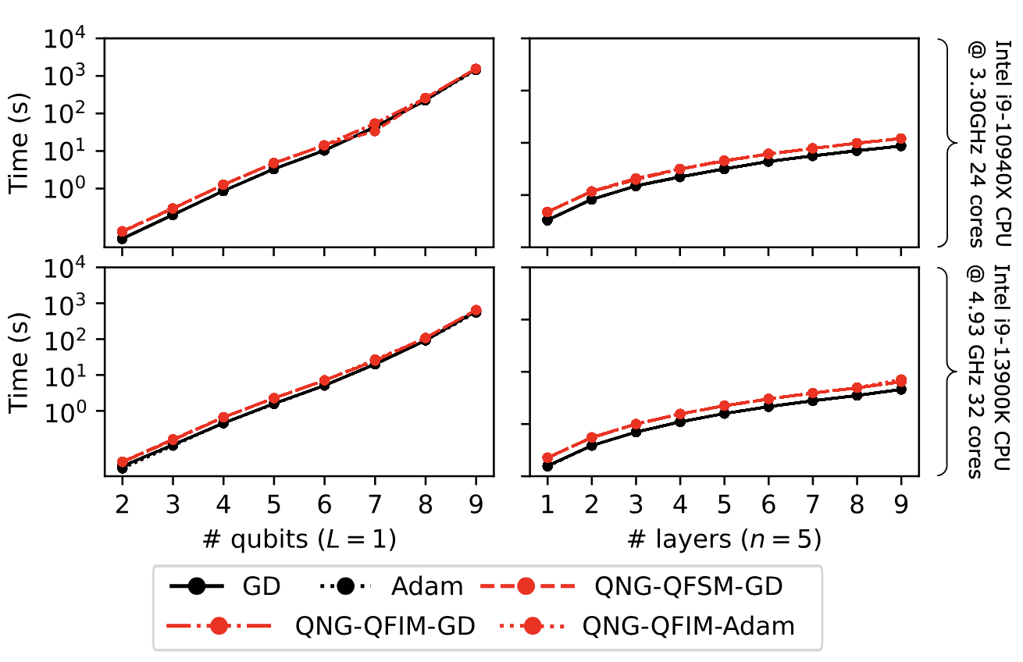
3. Experiment results
Fig. 5. The wall time per iteration (s) in log scale with a fixed number of layers (Top-Left and Bottom-Left) and fixed number of qubits (Top-Right and Bottom-Right).

Slide 10
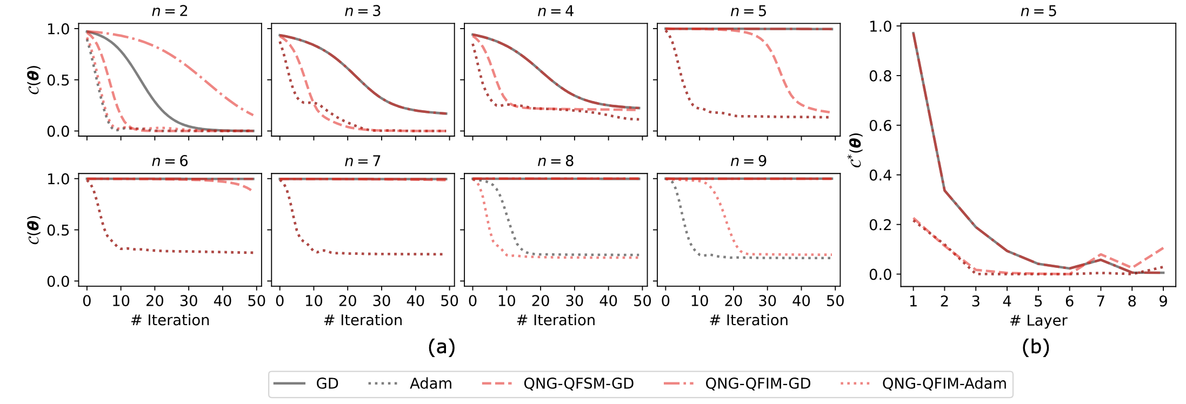
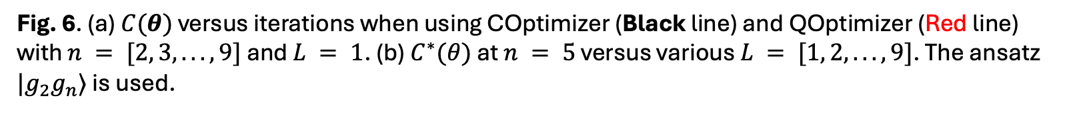
3. Experiment results
Fig. 6. (a) $C(θ)$ versus iterations when using COptimizer (Black line) and QOptimizer (Red line) with $n = [2, 3, . . . , 9]$ and $L = 1$. (b) $C^{∗}(θ)$ at $n = 5$ versus various $L = [1, 2, . . . , 9]$. The ansatz $|g_{2}g_{n}⟩$ is used.

Slide 11
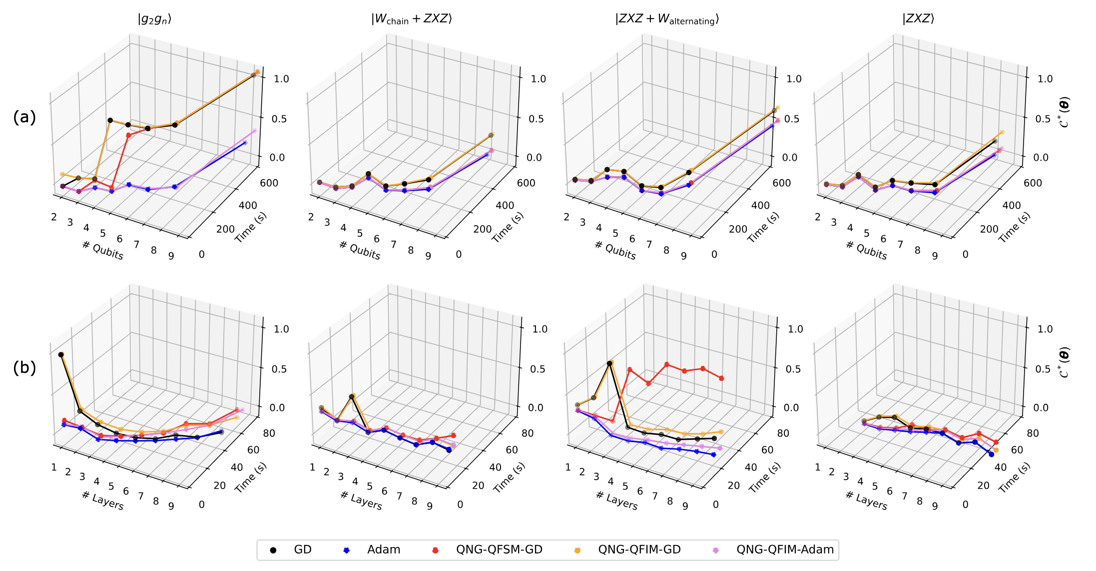
3. Experiment results
Fig. 7. $C^{∗}(θ)$ versus wall time (s) on different kinds of ansatz with (a) various number of qubits $n = [2, 3, . . . , 9]$, fixed $L = 1$ and (b) various number of layers $L = [1, 2, . . . , 9]$, fixed $n = 5$.

Slide 12
4. Conclusion
We proved that classical optimizers such as Adam still outperform quantum optimizers in both wall time and cost value to solve a quantum optimization problem on a simulator.
Adam not only does not depend on whatever type of ansatz but also proves to have the best performance in scalable scenarios.
QFIM and QFSM require more quantum evaluations, which makes it slower than classical ones. It’s more suitable for measuring information

Slide 13
Thanks for your attention!

Slide 14
References
[1] S. Maria Schuld and F. Petruccione, “An introduction to quantummachine learning,” Contemporary Physics, vol. 56, no. 2, pp. 172–185, 2015
[2] S.-i. Amari, “Backpropagation and stochastic gradient descent method,” Neurocomputing, vol. 5, no. 4-5, pp. 185–196, 1993.
[3] D. P. Kingma and J. Ba, “Adam: A method for stochastic optimization,” arXiv preprint arXiv:1412.6980, 2014.
[4] J. Stokes, J. Izaac, N. Killoran, and G. Carleo, “Quantum natural gradient,” Quantum, vol. 4, p. 269, 2020
[5] Hai, V. T., Viet, N. T., & Ho, L. B. (2023). Variational preparation of entangled states on quantum computers. arXiv preprint arXiv:2306.17422.

