Slide 1


Efficient Random Quantum Circuit Generator: A Benchmarking Approach for Quantum Simulators Vu Tuan Hai, Le Vu Trung Duong, Pham Hoai Luan, and Yasuhiko Nakashima Nara Institute of Science and Technology, 8916–5 Takayama-cho, Ikoma, Nara 630-0192, Japan. Email: vu.tuan hai.vr7@naist.ac.jp
RIVF’2024

Slide 2
Outline
Introduction
Randomize benchmarking
Method: Random Quantum Circuit generator
Results
Conclusion

Slide 3
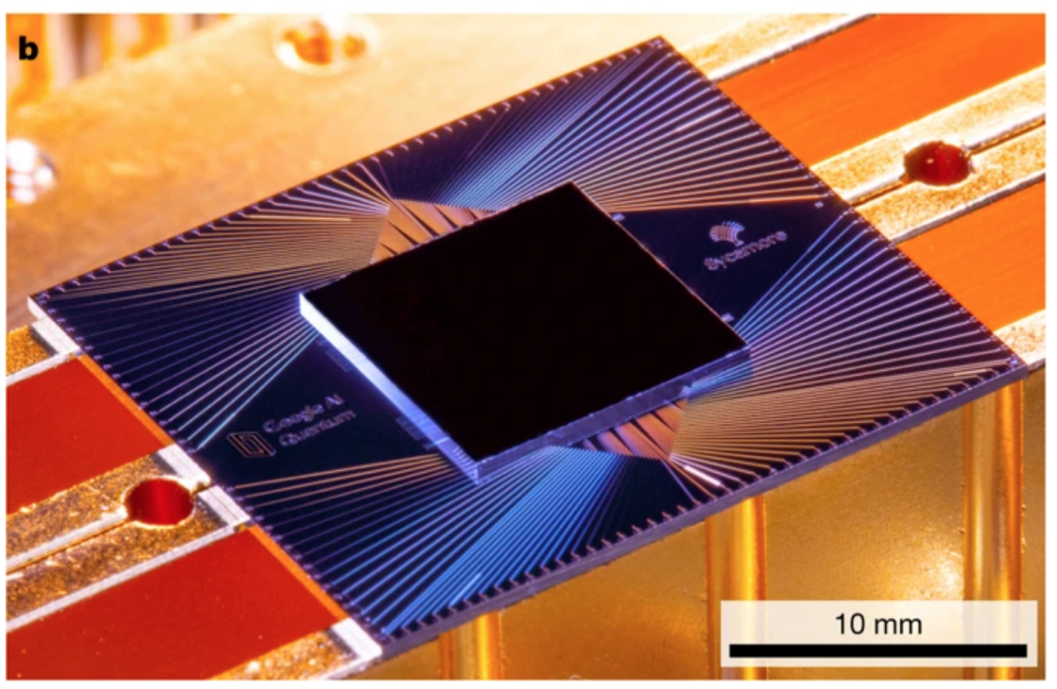
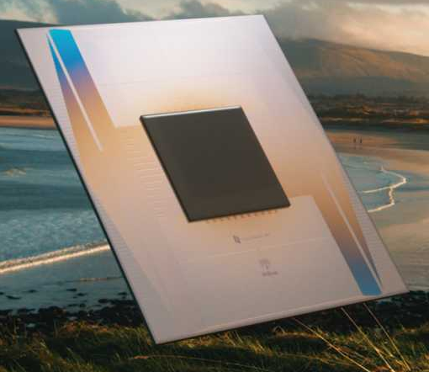
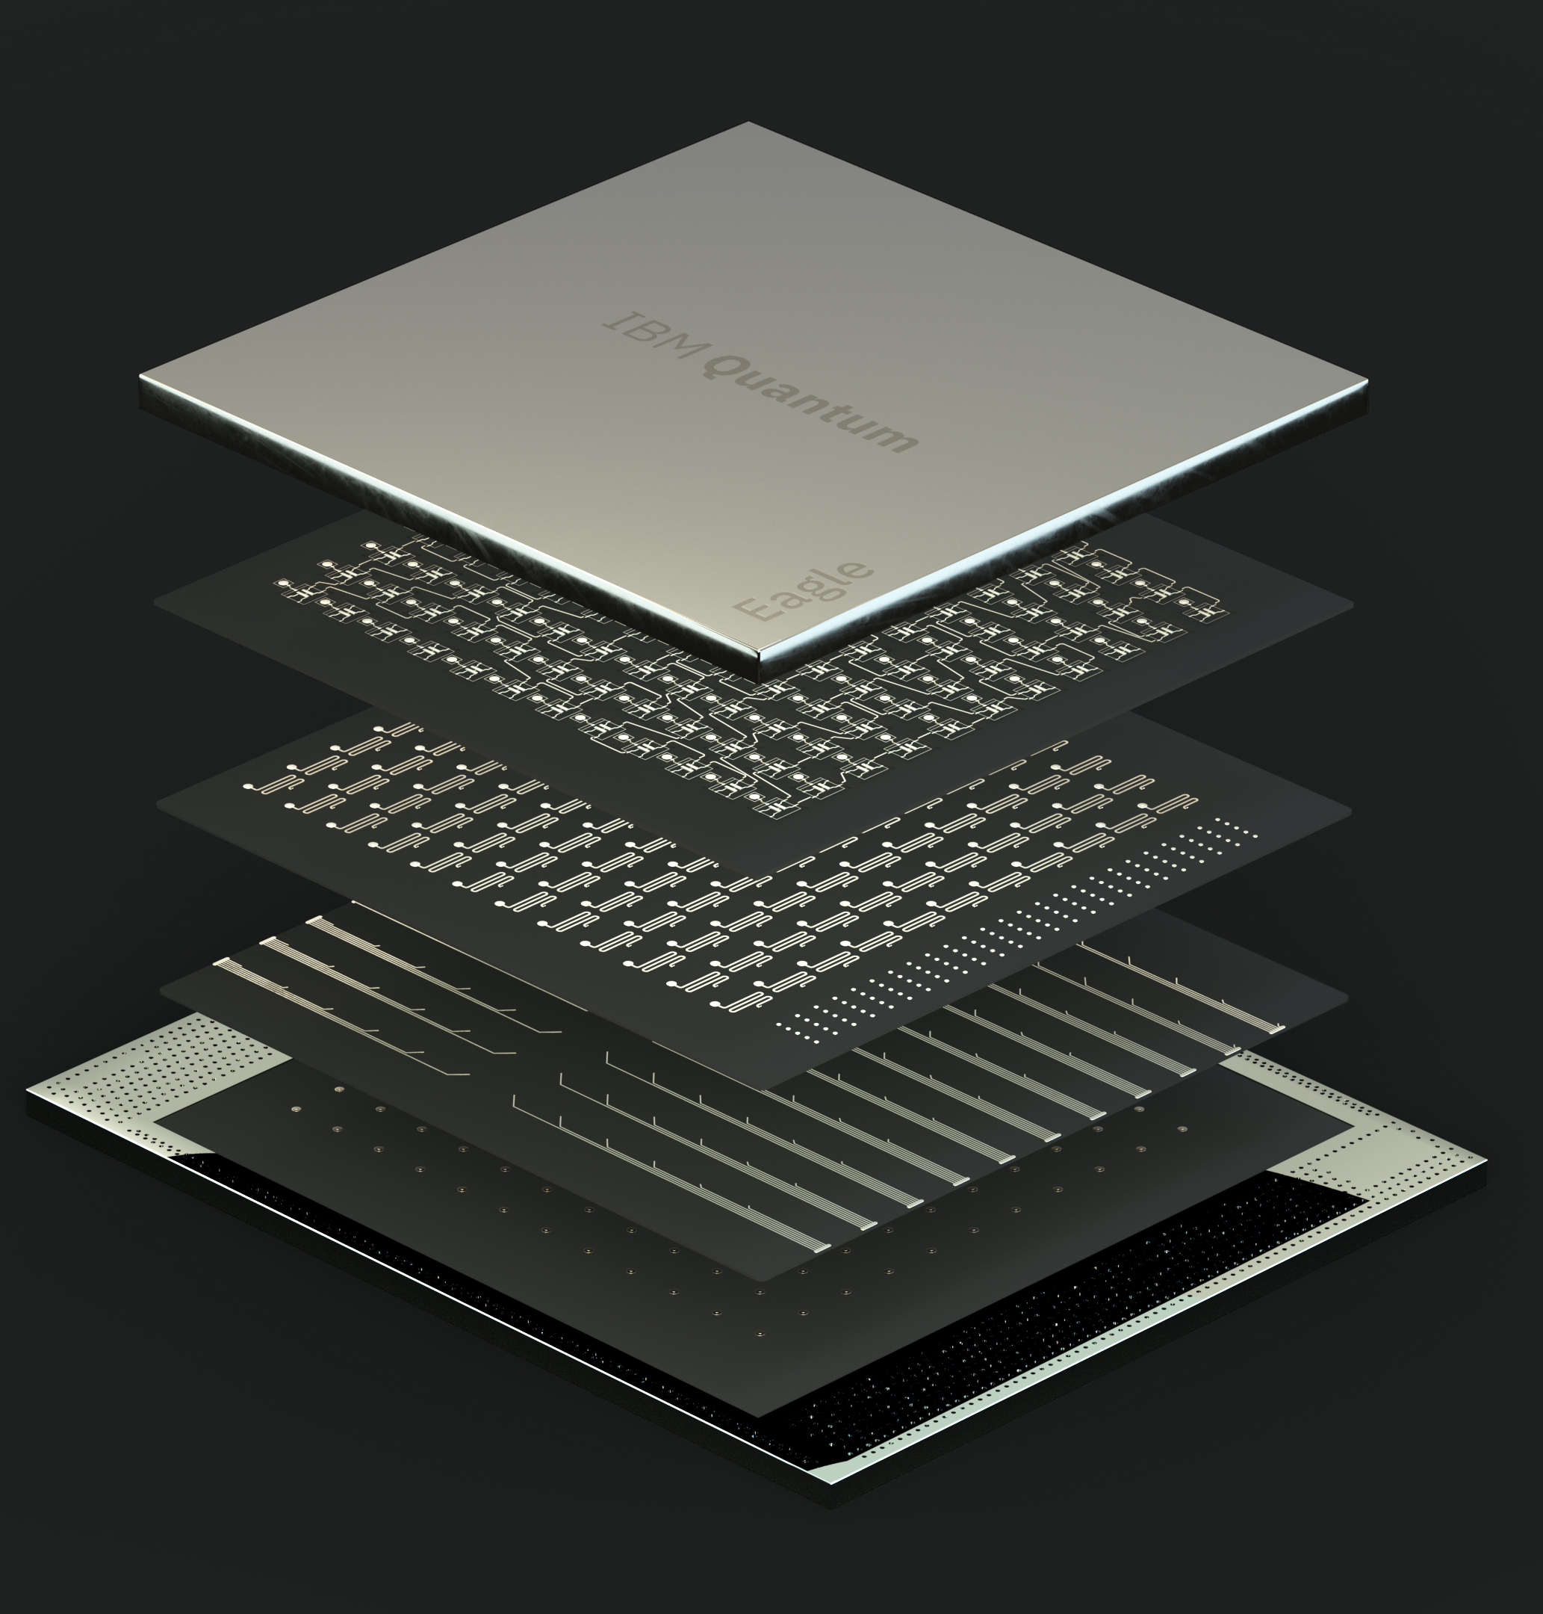
1. Introduction
Google Sycamore
2019 – 70 qubits
Google Willow
2024 – 105 qubits
IBM Flamingo
2024 – 1000 qubits+
Quantum computer is rising as a new type of computer, promising to execute quantum algorithms, which can solve hard problems!

Slide 4
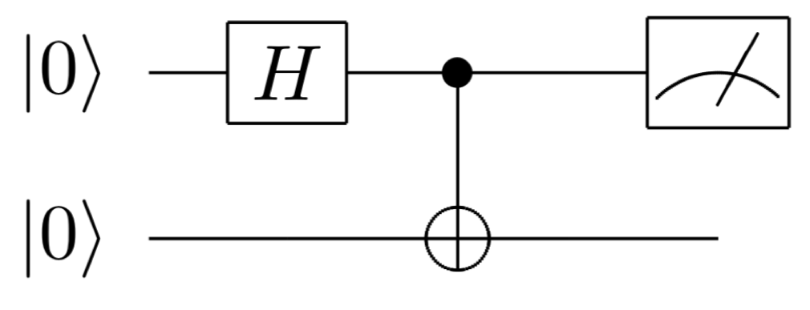








1. Introduction: challenge
$$(\%)$$
Noise
$$⇒$$
$$|0⟩$$
$$|1⟩$$
2-qubit system
Measurement causes noise, decoherent, …
Need to design low-depth circuits for bechmarking!
Quantum circuit
But it only live in 0.4 $μs$ !
Time
Example: A qubit need 0.5 $μs$ to go to measurement gate

Slide 5
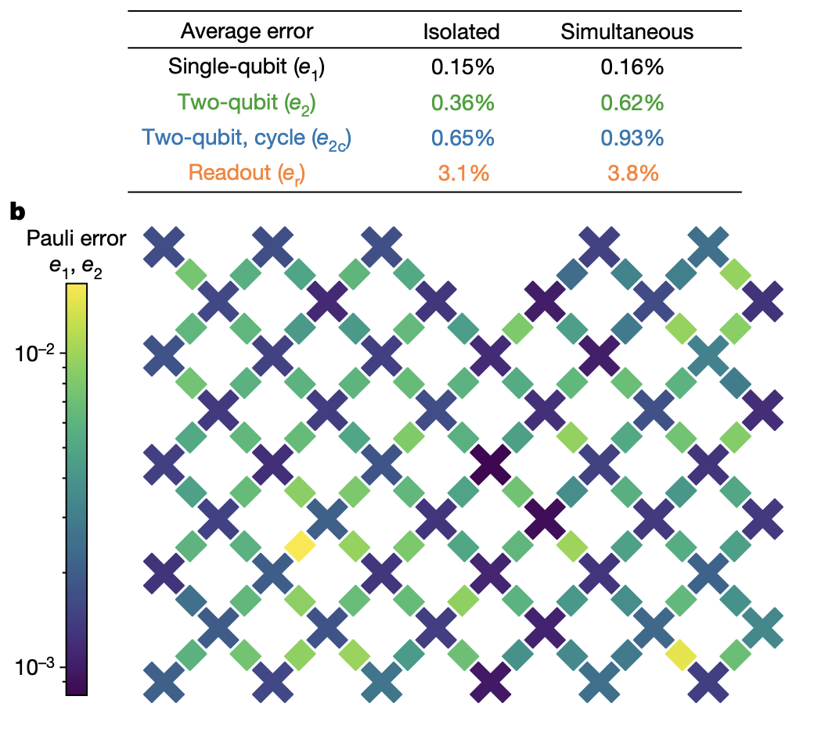
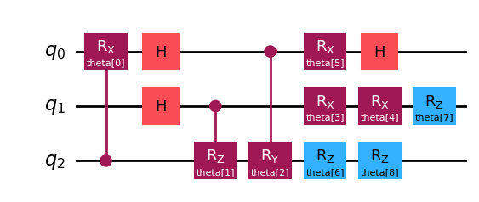
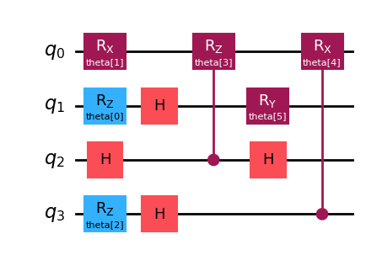
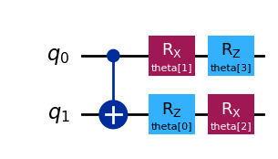
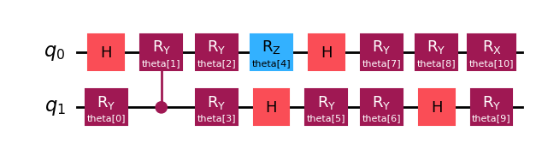


2. Randomize benchmarking
Error from environment noise!!!
Mapping and executing on
a real quantum processor or simulator
Fig. 1. System-wide Pauli and measurement errors [1].
Fig. 3. Random Quantum Circuits (RQC).
Fig. 2. Quantum simulators/emulators.
RQC for benchmarking is needed, but we lack an auto generator!
[1] Arute, F et al (2019). Nature, 574(7779), 505-510.

Slide 6
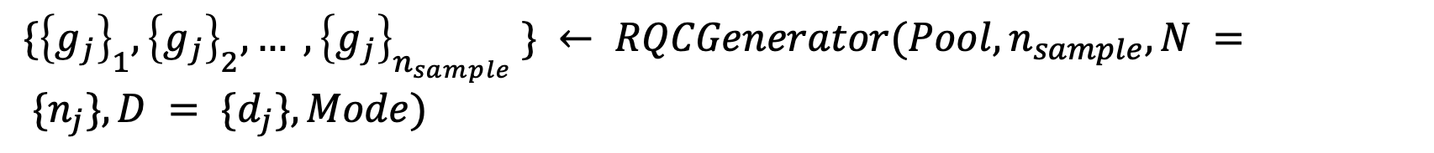
3. Method: RQC generator
I proposed a collection of metrics here
Fig 4. RQC generator and its application in simple quantum simulator/emulator evaluation.
$\{{\left\{g_{j}\right\}}_{1}, {\left\{g_{j}\right\}}_{2}, … , {\left\{g_{j}\right\}}_{n_{sample}} \} ← RQCGenerator(Pool, n_{sample}, N = \{n_{j}\}, D = \{d_{j}\}, Mode)$
There are many modes! My contribution ‘s here

Slide 7
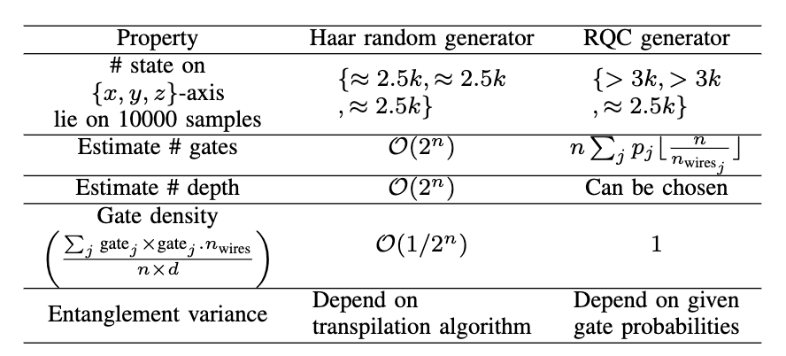
3. Method: RQC generator
Tab 1. Resources comparison between haar random generator and RQC generator (mode smallest-#depth)

Slide 8
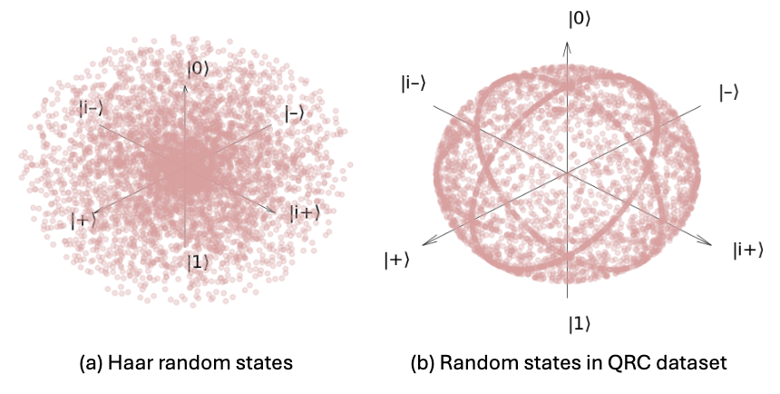
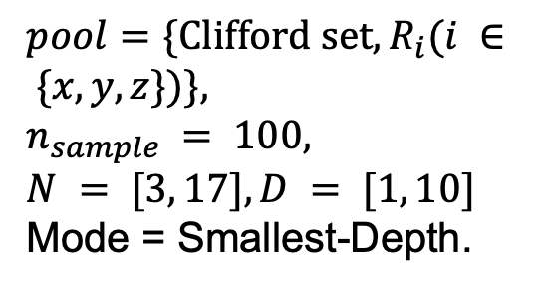
4. Results
$pool=\{Clifford set, R_{i}(i ∈ \{x, y, z\})\},$
$n_{sample} = 100,$
$N = [3, 17], D = [1, 10]$
Mode = Smallest-Depth.
14 GB of 15,000 random quantum circuit
Fig 5. Quantum state distribution on the Bloch sphere. Each point in the Bloch sphere corresponds to a pure quantum state.

Slide 9
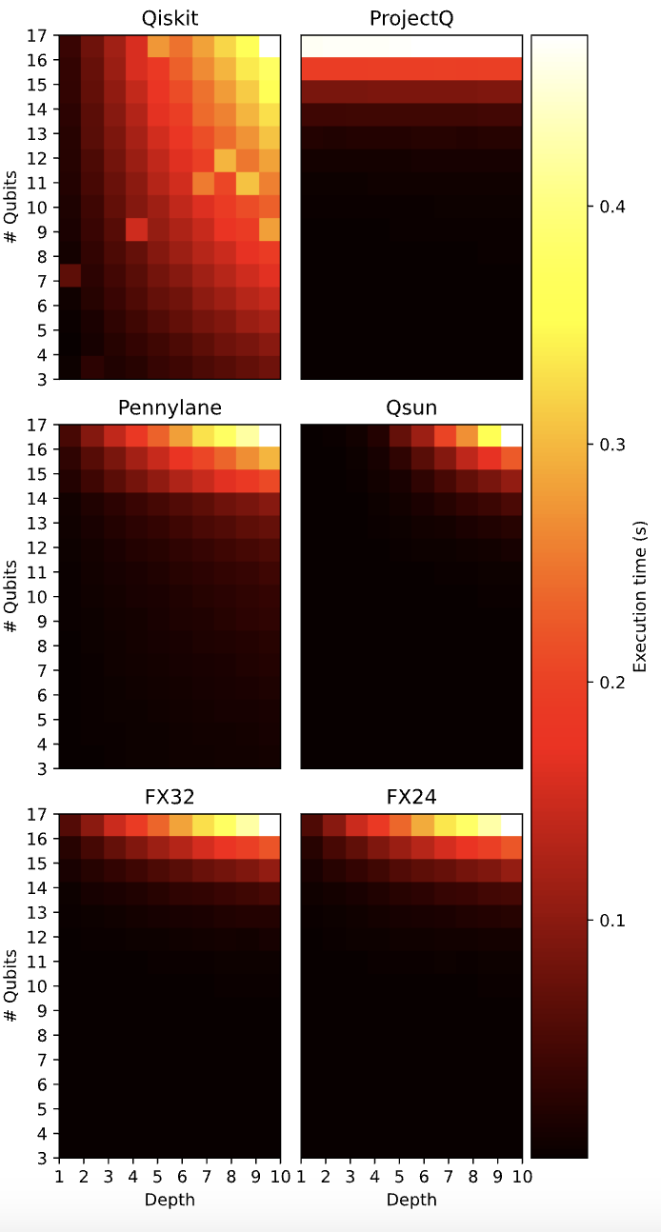
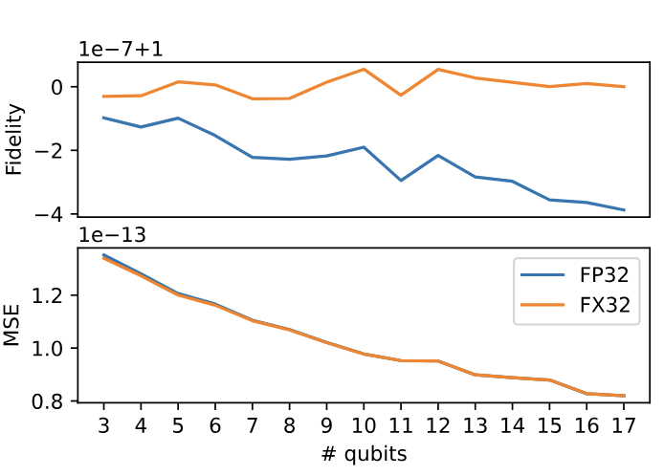
4. Results: using on simulator/emulator
Fig. 6. Average fidelity and MSE of FQsun (32-bit floating point and 32-bit fixed point) on RQC dataset.
Fig. 7. Execution time (second) on both simulators and emulators.

Slide 10
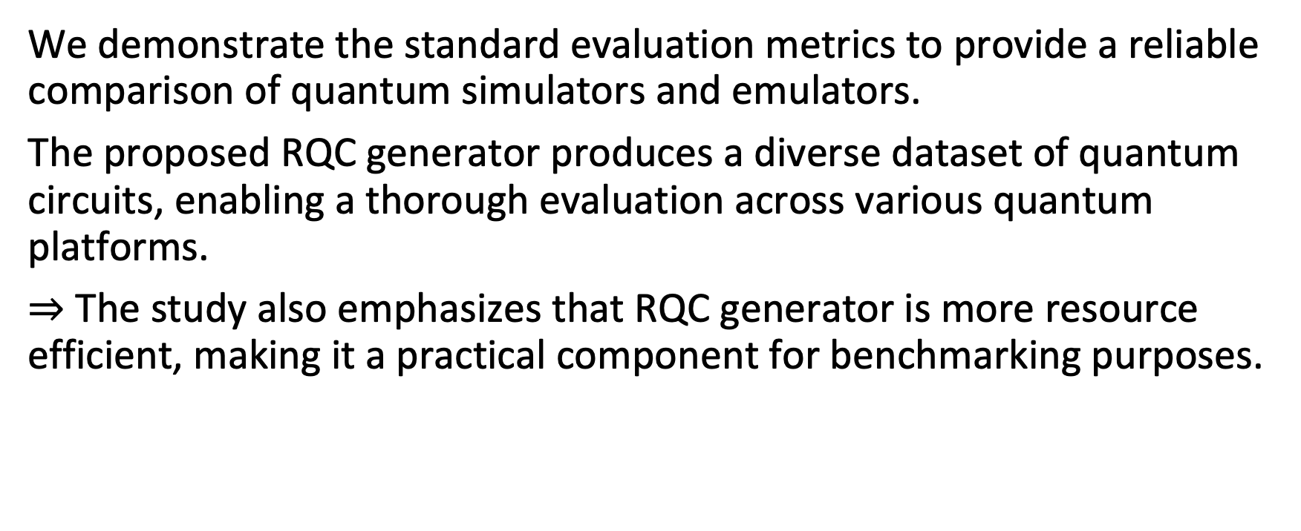
5. Conclusion
We demonstrate the standard evaluation metrics to provide a reliable comparison of quantum simulators and emulators.
The proposed RQC generator produces a diverse dataset of quantum circuits, enabling a thorough evaluation across various quantum platforms.
$⇒$ The study also emphasizes that RQC generator is more resource efficient, making it a practical component for benchmarking purposes.
Code avaiability: https://github.com/NAIST-Archlab/RQC

Slide 11
Thank you!

