Slide 1








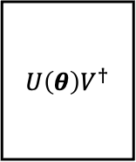


































(a)
$θ^{t+1}←$QOptimizer$\left(θ^{t},{F^{−1}\left(θ^{t}\right),∇}_{θ}𝒞\left(θ^{t}\right)\right)$
QOptimizer
For cost$:𝒞\left(θ\right)$
Yes
$$U\left(θ\right)V^{†}$$
$$𝒞\left(θ\right)<τ$$
For gradient$: \left\{𝒞\left(θ^{±ε_{k}}\right)\right\}$
$$|ψ_{0}⟩$$
Mode
Type
No
Begin
COptimizer
End
$θ^{t+1}←$ COptimizer$\left(θ^{t},∇_{θ}𝒞\left(θ^{t}\right)\right)$
$$R_{Y}(θ_{0})$$
$$R_{Y}(θ_{4})$$
$$R_{Y}(θ_{8})$$
$$R_{Y}(θ_{3})$$
Odd layer
Even layer
$$R_{Z}(θ_{0})$$
$$R_{X}(θ_{4})$$
$$R_{Z}(θ_{8})$$
$${ V}^{†}$$
$$ZXZ$$
$$ZXZ$$
$$ZXZ$$
$$R_{Y}(θ_{1})$$
$$R_{Y}(θ_{5})$$
$$R_{Y}(θ_{9})$$
$$R_{Y}(θ_{0})$$
$$R_{Z}(θ_{1})$$
$$R_{X}(θ_{5})$$
$$R_{Z}(θ_{9})$$
=
+
$$R_{Y}(θ_{2})$$
$$R_{Y}(θ_{6})$$
$$R_{Y}(θ_{10})$$
$$R_{Y}(θ_{1})$$
$$R_{Z}(θ_{2})$$
$$R_{X}(θ_{6})$$
$$R_{Z}(θ_{10})$$
$$R_{Y}(θ_{3})$$
$$R_{Y}(θ_{7})$$
$$R_{Y}(θ_{11})$$
$$R_{Y}(θ_{2})$$
$$R_{Z}(θ_{3})$$
$$R_{X}(θ_{7})$$
$$R_{Z}(θ_{11})$$
$$× L$$
(b) $|g_{2}g_{n}⟩$
(c) $|W_{chain}+ZXZ⟩$
(d) $|ZXZ+W_{alternating}⟩$
(e) $|ZXZ⟩$

Slide 2











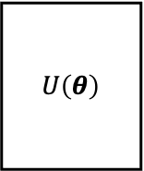

















$$H$$
$$QFT$$
$$⋮$$
$$P(\frac{π}{2^{n−2}})$$
$$⋮$$
=
$$R_{Z}(.)$$
$$R_{X}(.)$$
$$R_{Z}(.)$$
$$ZXZ$$
$$R_{Z}(\frac{π}{2^{n−2}})$$
$$R_{Z}(\frac{−π}{2^{n−2}})$$
$$R_{Z}(\frac{π}{2^{n−2}})$$
$$R_{Z}(.)$$
$$R_{X}(.)$$
$$R_{Z}(.)$$
=
$$H$$
$$⋮$$
$$C−Phase(\frac{π}{2^{n−1}})$$
$$R_{Z}(.)$$
$$R_{X}(.)$$
$$R_{Z}(.)$$
$SWAP$
$$× L$$
$$U\left(θ\right)$$
$$V$$
Measurement
$$|ψ_{0}⟩$$
$$⋮$$
$$\left\{p_{i}\right\}$$
$$⋮$$
Arbitrary parameterized quantum circuit
Fixed quantum circuit

Slide 3
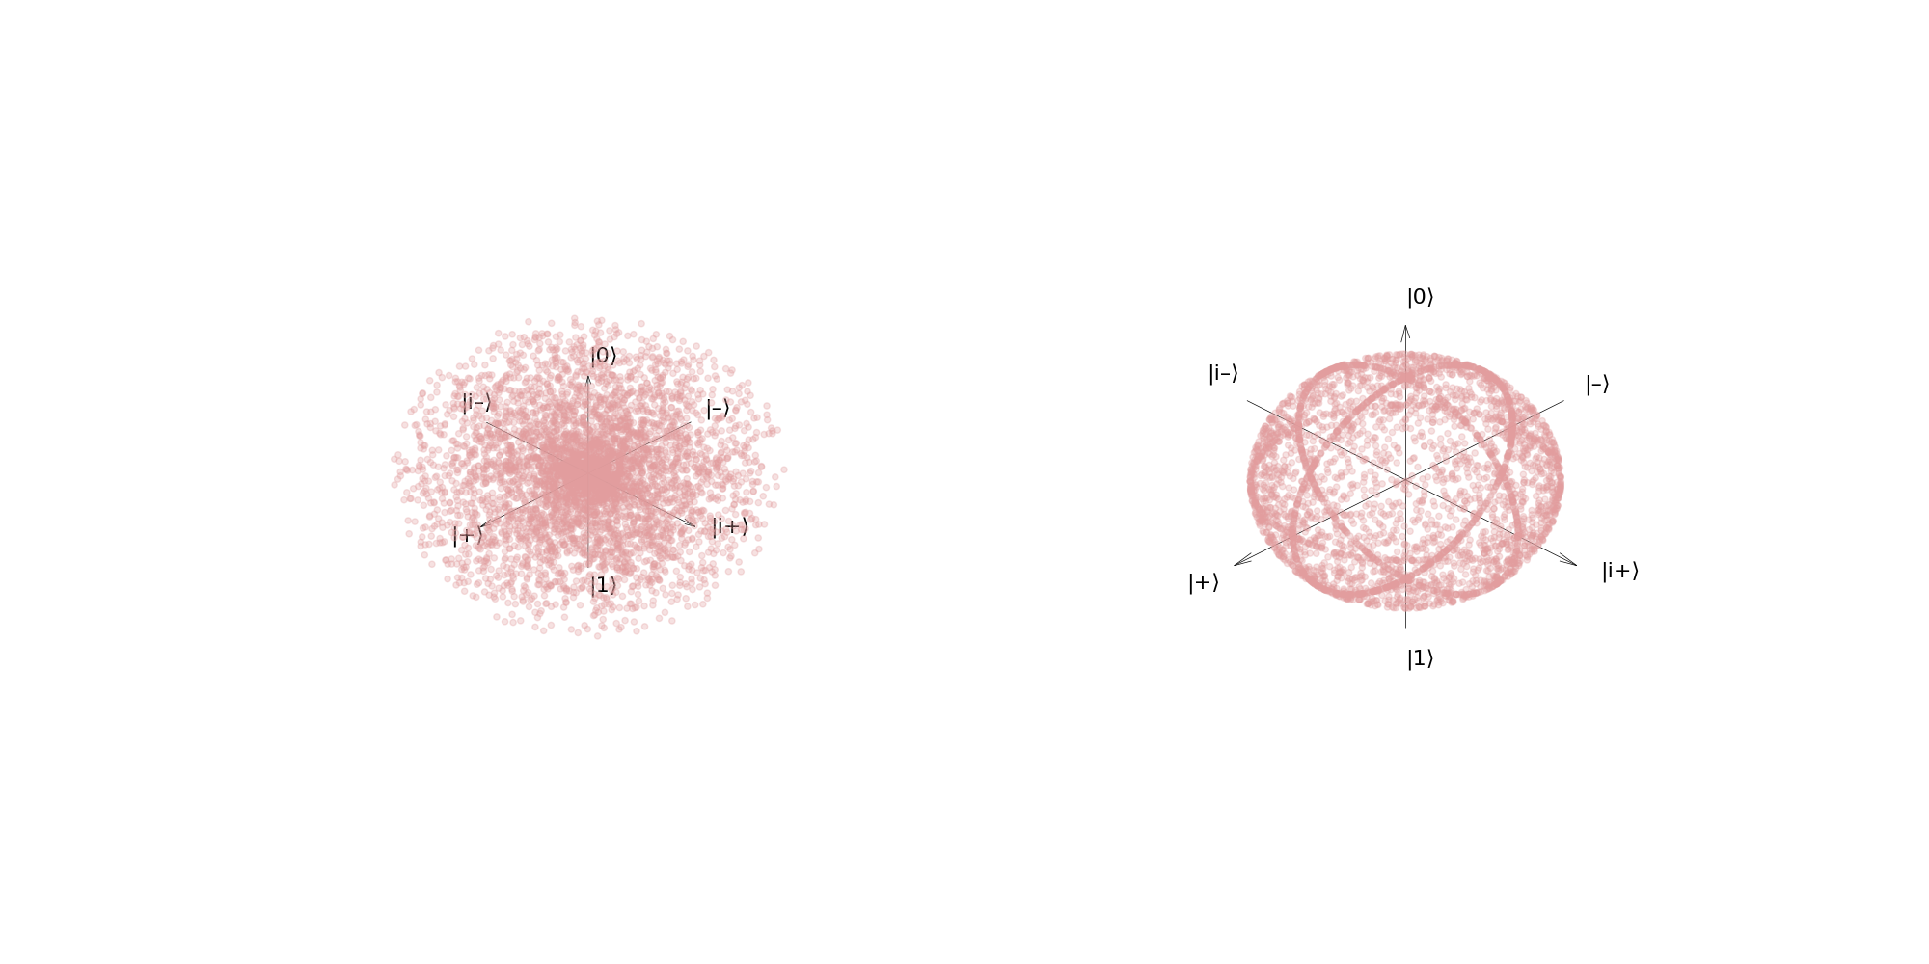
(a) Haar random states
(b) Random states in QRC dataset

Slide 4




















Choose from pool
Metrics
Pass
Transpiled circuit
Transpile
Haar random matrix
$$H$$
$$S$$
$$CX$$
$$⋯$$
$$R_{X}(.)$$
$$R_{Y}(.)$$
$$R_{Z}(.)$$
Evaluate
Quantum task
Pass
QASM2+ or
{Gate} format
Choose from pool
$$R_{Y}(θ_{0})$$
$$R_{Y}(θ_{2})$$
$$R_{Y}(θ_{0})$$
$$R_{Y}(θ_{2})$$
$$R_{X}(θ_{4})$$
Yes
$$R_{Z}(θ_{1})$$
$$R_{Y}(θ_{3})$$
Fill
$$R_{Z}(θ_{1})$$
$$R_{Y}(θ_{3})$$
Check
$$H$$
$$H$$
Satisfy?
$$⋮$$
$$⋮$$
$$⋮$$
$$⋮$$
No

