Slide 1
Efficient Parameter-Shift Rule Implementation for Computing Gradient on Quantum Simulators
Hai Vu Tuan; Le Vu Trung Duong; Hoai Luan Pham; Yasuhiko Nakashima
Nara Institute of Science and Technology, Japan

Slide 2





















1. Parameterized quantum circuit (PQC) as learning model [1]
$$|0⟩$$
$$H$$
$$R_{Z}\left(.\right)$$
$C\left(θ\right)=⟨0\left|U^{†}\left(θ\right)\hat{B}U\left(θ\right)\right|0⟩$
$$|0⟩$$
$$H$$
$$S$$
$$H$$
$$H$$
$$S$$
Measurement
$$R_{Z}\left(.\right)$$
$$∇_{θ}C\left(θ\right)$$
$$|0⟩$$
$$R_{X}\left(.\right)$$
$$θ^{t+1 }←Optimizer\left(θ^{t},∇_{θ}C\left(θ\right)\right)$$
$U_{0}\left(θ_{0}\right)$
$U_{1}\left(θ_{1}\right)$
$U_{2}\left(θ_{2}\right)$
Update new $θ$
$U\left(θ\right)$
Fig. 1. Left) An example 3-qubits PQC is propose to split into sub-circuits. Each sub-circuit has only one parameter. (Right) The output is used for computing gradient, then back to update PQC’s parameters by the classical optimizer.
A PQC$U\left(θ\right)=U_{m−1}U_{m−2}…U_{0}$ can be splitted into $m$ sub-circuit (sub-operator) with $\left|θ\right|=m.$
[1] M. Schuld and F. Petruccione, Machine learning with quantum computers. Springer, 2021, vol. 676

Slide 3
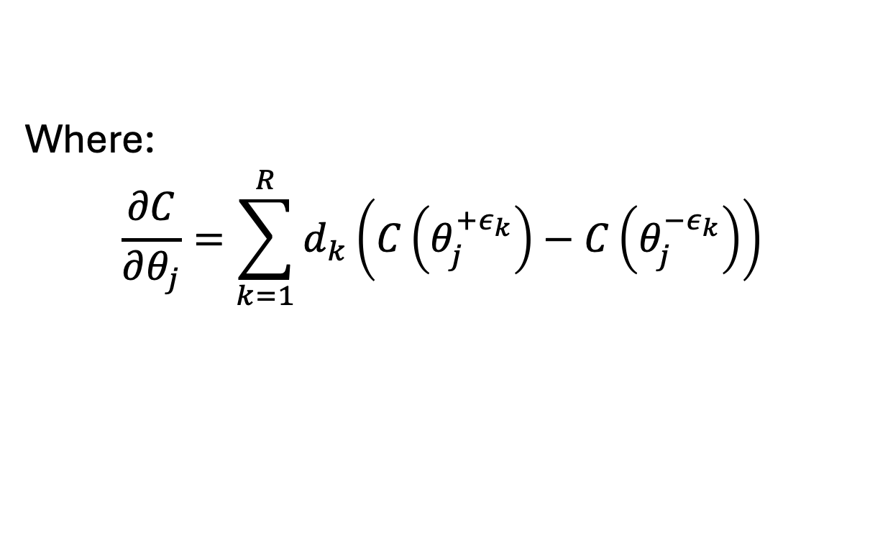
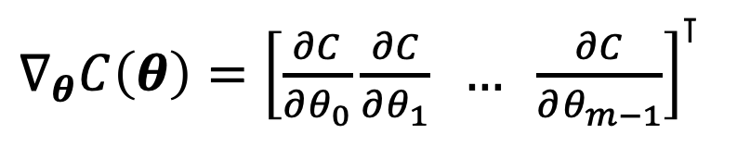
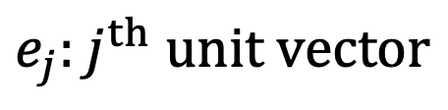
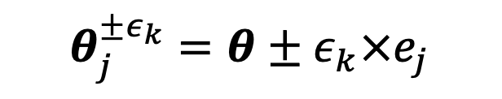
2. Quantum gradient
Computing quantum gradient is the key in various quantum machine learning models:
$∇_{θ}C\left(θ\right)={\left[\frac{∂C}{∂θ_{0}}\frac{∂C}{∂θ_{1}} … \frac{∂C}{∂θ_{m−1}}\right]}^{⊺}$
$$θ_{j}^{±ε_{k}}=θ±ε_{k}×e_{j}$$
$e_{j}:j^{th} unit vector$
Where:
$$\frac{∂C}{∂θ_{j}}=\sum_{k=1}^{R}{d_{k}\left(C\left(θ_{j}^{+ε_{k}}\right)−C\left(θ_{j}^{−ε_{k}}\right)\right)}$$
Based on general parameter-shift rule technique [2]
[2] D. Wierichs, J. Izaac, C. Wang, and C. Y.-Y. Lin, “General parameter- shift rules for quantum gradients,” Quantum, vol. 6, p. 677, Mar. 2022

Slide 4



























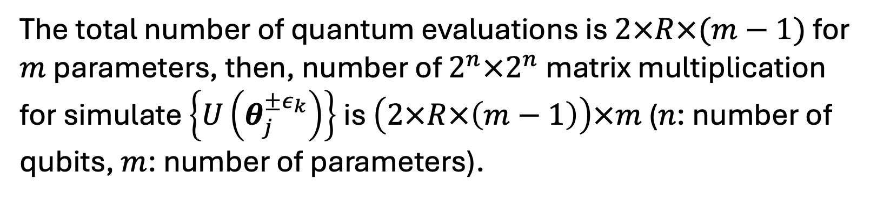
3. Computing $∇_{θ}C\left(θ\right)$ consume too much resources!
$$|0⟩$$
$$U_{0}(θ_{0})$$
$$U_{1}(θ_{1})$$
$$…$$
$$U_{m−1}(θ_{m−1}−ε_{μ})$$
$$U(θ_{m−1}^{−ε_{μ}})$$
$$…$$
$$…$$
$$|0⟩$$
$$U_{0}(θ_{0}−ε_{μ})$$
$$U_{1}(θ_{1})$$
$$…$$
$$U_{m−1}(θ_{m−1})$$
$$U(θ_{0}^{−ε_{μ}})$$
Order
$$…$$
$$…$$
$$|0⟩$$
$$U_{0}(θ_{0}+ε_{0})$$
$$U_{1}(θ_{1})$$
$$…$$
$$U_{m−1}(θ_{m−1})$$
$$U(θ_{0}^{+ε_{0}})$$
$$|0⟩$$
$$U_{0}(θ_{0})$$
$$U_{1}(θ_{1})$$
$$…$$
$$U_{m−1}(θ_{m−1})$$
$$U(θ)$$
$$d$$
The total number of quantum evaluations is $2×R×(m−1)$ for $m$ parameters, then, number of $2^{n}×2^{n}$ matrix multiplication for simulate $\left\{U\left(θ_{j}^{±ε_{k}}\right)\right\}$ is $\left(2×R×\left(m−1\right)\right)×m$ ($n$: number of qubits, $m$: number of parameters).

Slide 5
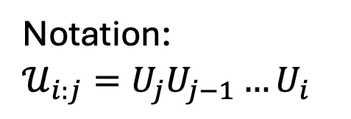
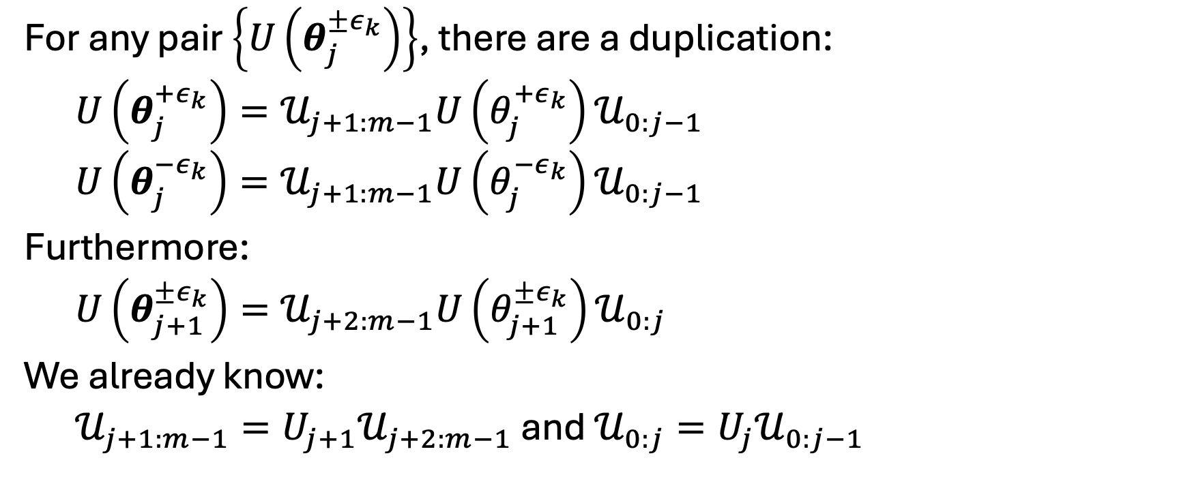
4. New scheme
For any pair $\left\{U\left(θ_{j}^{±ε_{k}}\right)\right\}$, there are a duplication:
$U\left(θ_{j}^{+ε_{k}}\right)=𝒰_{j+1:m−1}U\left(θ_{j}^{+ε_{k}}\right)𝒰_{0:j−1}$
$U\left(θ_{j}^{−ε_{k}}\right)=𝒰_{j+1:m−1}U\left(θ_{j}^{−ε_{k}}\right)𝒰_{0:j−1}$
Furthermore:
$U\left(θ_{j+1}^{±ε_{k}}\right)=𝒰_{j+2:m−1}U\left(θ_{j+1}^{±ε_{k}}\right)𝒰_{0:j}$
We already know:
$𝒰_{j+1:m−1}=U_{j+1}𝒰_{j+2:m−1}$ and $𝒰_{0:j}=U_{j}𝒰_{0:j−1}$
Notation:
$𝒰_{i:j}=U_{j}U_{j−1}…U_{i}$

Slide 6































4. Compact scheme
$$U_{m−1}(θ_{m−1})$$
$$U(θ)$$
$$U_{1}(θ_{1})$$
$$…$$
$$U_{m−1}(θ_{m−1}−ε_{μ})$$
$$…$$
$$U_{0}(θ_{0})$$
$$U_{1}(θ_{1}−ε_{μ})$$
$$U_{m−1}(θ_{m−1}+ε_{0})$$
(a)
$$…$$
$$𝒰_{2:m−1}(θ_{2:m−1})$$
Order
For matrix multiplication-based
$$U_{1}(θ_{1}+ε_{0})$$
$$\{U\left(θ_{i}^{±ε_{k}}\right)\}$$
$$|0⟩$$
$$U_{0}(θ_{0}−ε_{μ})$$
$$…$$
$$𝒰_{1:m−1}(θ_{1:m−1})$$
$$U_{0}(θ_{0}+ε_{0})$$
$$U_{0}\left(θ_{0}\right)|0⟩$$
$${|ψ}_{m−1}⟩$$
$$U_{m−2}(θ_{m−2})$$
$$…$$
$$U_{0} \left(θ_{0}−ε_{k}\right)|0⟩$$
$$…$$
$$U_{m−1}(θ_{m−1})$$
$$U_{m−2}(θ_{m−2}−ε_{k})$$
$$U_{0} \left(θ_{0}+ε_{0}\right)|0⟩$$
$$…$$
$$|ψ_{m−3}⟩$$
For state vector-based
Order
(b)
$$U_{m−2}(θ_{m−2}+ε_{0})$$
$$\{|ψ_{m−1}\left(θ_{i}^{±ε_{k}}\right)⟩\}$$
$$U_{m−1}(θ_{m−1}−ε_{k})$$
$$…$$
$$|ψ_{m−2}⟩$$
$$U_{m−1}(θ_{m−1}+ε_{0})$$
Fig. 2: Computation order from begin to end (y-axis) for (a) Baseline PSR, (b) Proposed PSR for MM-based simulator,

Slide 7
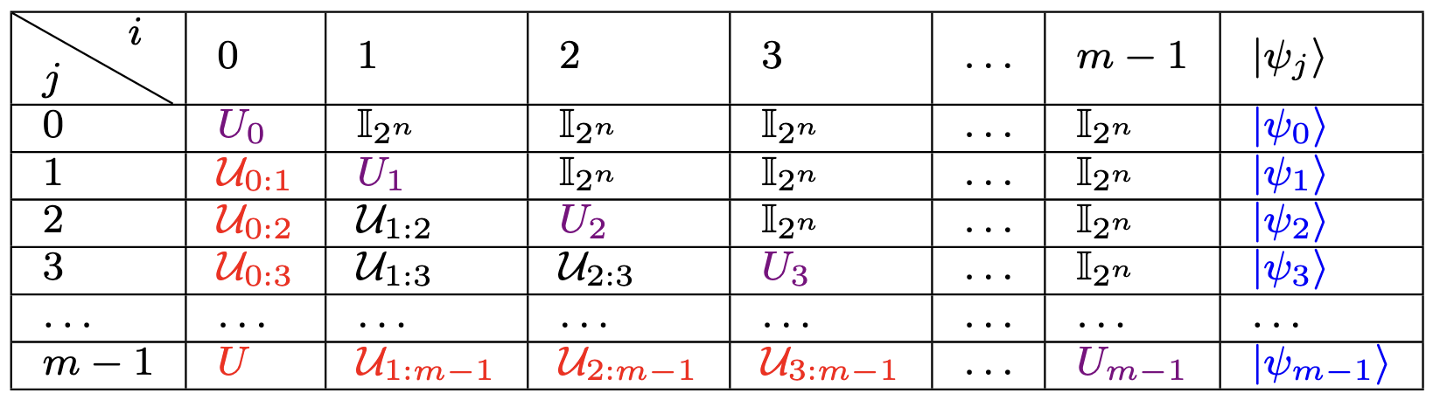
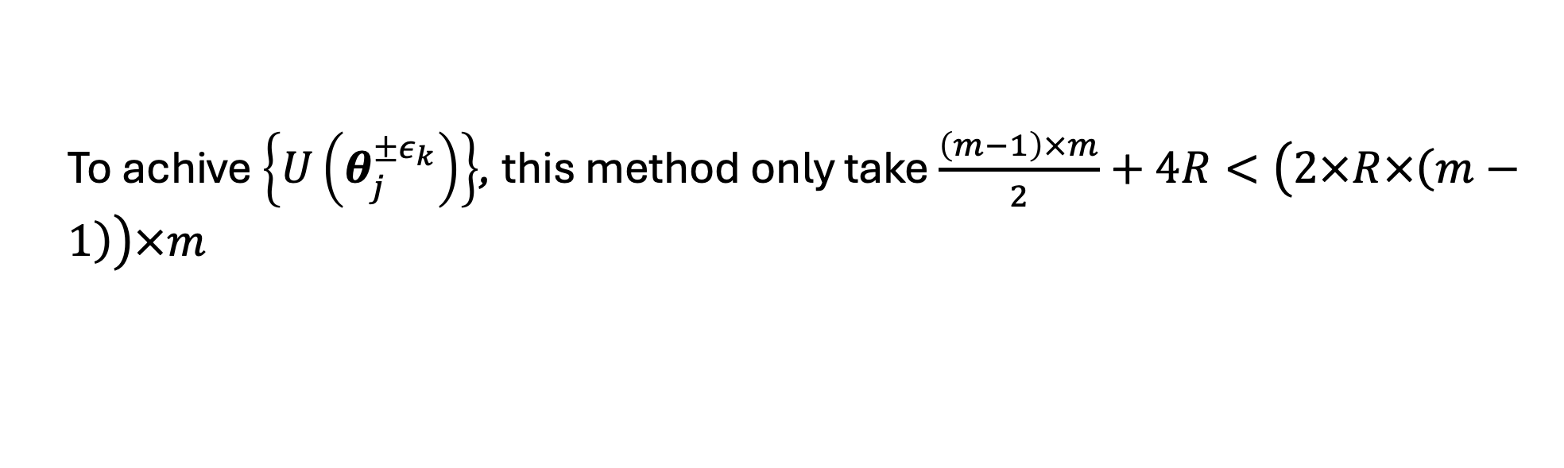

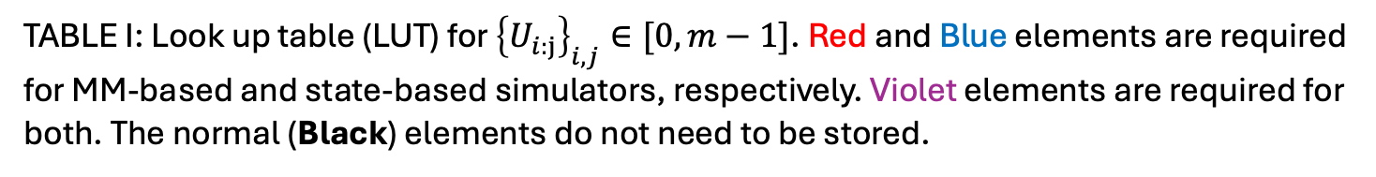
4. Using Look up table (LUT)
TABLE I: Look up table (LUT) for ${\left\{U_{i:j}\right\}}_{i,j}∈[0,m−1]$. Red and Blue elements are required for MM-based and state-based simulators, respectively. Violet elements are required for both. The normal (Black) elements do not need to be stored.
To fill this LUT, only take $\sum_{j=0}^{m−1}{j}=\frac{\left(m−1\right)×m}{2}$ matrix multiplication
To achive $\left\{U\left(θ_{j}^{±ε_{k}}\right)\right\}$, this method only take $\frac{\left(m−1\right)×m}{2}+4R<\left(2×R×\left(m−1\right)\right)×m$

Slide 8
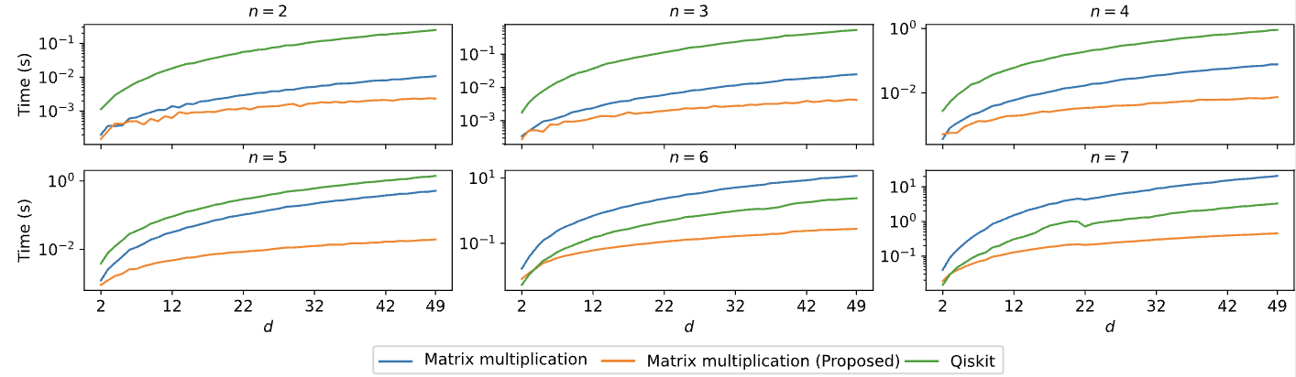
5. Experiments and results
Fig. 3: Execution time (y-axis) from 2 to 7-qubit quantum circuit in log scale, with (x-axis) is depth value from 2 to 49.

Slide 9
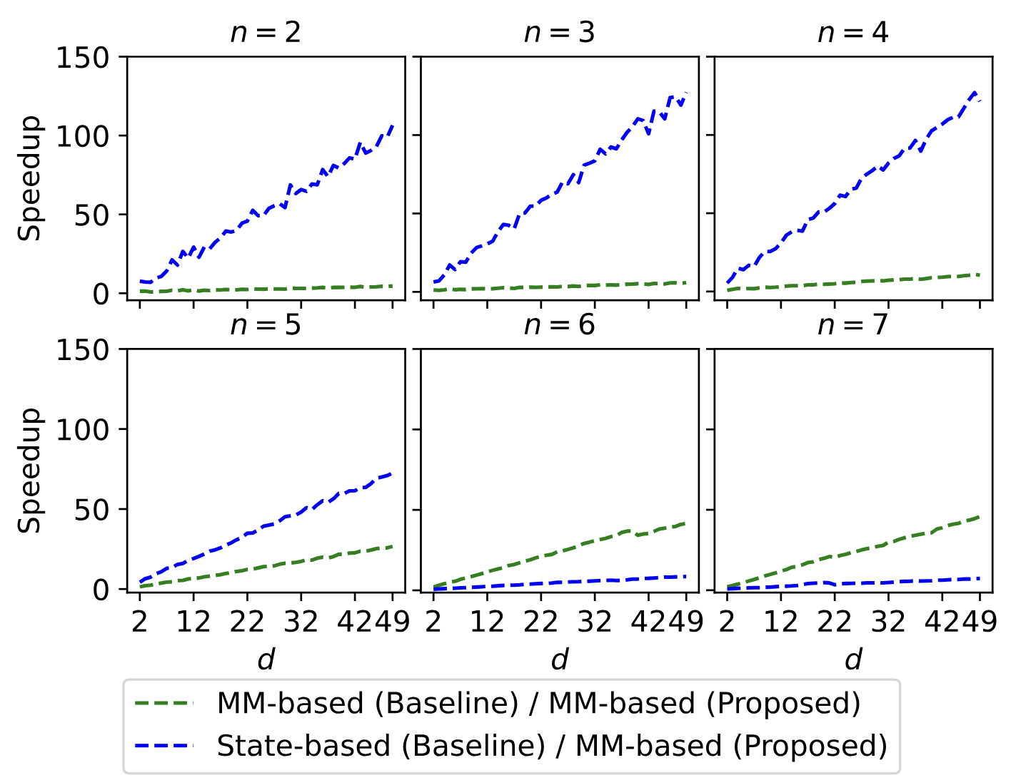
5. Experiments and results
Fig. 4: Speedup (y-axis) compare between proposed method
and baselines, from 2 to 7-qubit quantum circuit, with (x-axis)
is depth value from 2 to 49.

Slide 10
References
[1] M. Schuld and F. Petruccione, Machine learning with quantum computers. Springer, 2021, vol. 676
[2] D. Wierichs, J. Izaac, C. Wang, and C. Y.-Y. Lin, “General parameter-shift rules for quantum gradients,” Quantum, vol. 6, p. 677, Mar. 2022.
[3] J. Stokes, J. Izaac, N. Killoran, and G. Carleo, “Quantum Natural Gradient,” Quantum, vol. 4, p. 269, May 2020.

