Slide 1



17th IEEE International Symposium on Embedded Multicore/Many-core Systems-on-chip (MCSoC 2024)
Theoretical Analysis of the Memory-Efficient Matrix Storage Method for Quantum Emulation Accelerators with Gate Fusion on FPGAs
Le Tran Xuan Hieu^{1,2}, Pham Hoai Luan³, Vu Tuan Hai³, Le Vu Trung Duong³ and Yasuhiko Nakashima³.
¹University of Information Technology, Ho Chi Minh City, 700000, Vietnam.
²Vietnam National University, Ho Chi Minh City, 700000, Vietnam.
³Nara Institute of Science and Technology, 8916–5 Takayama-cho, Ikoma, Nara, 630-0192 Japan.
Email: le.duong@naist.ac.jp
Notes:
Hi everyone,
I’m Hai, I’m from Nara Institute of Science and Technology, Japan.
Today I will present our research which is relevant to the theoretical analysis of the hardware resources.
This project was raised when we began to design an FPGA for quantum emulation applications.

Slide 2
Outline
Introduction
Proposed methods
Results and discussion
Conclusion
Future work
Q&A
Notes:
The outline’s presentation is divided into five sections.
First, I will introduce the problem, why we do the quantum emulator on FPGA, and what is difficult while we conduct such an application.
Next are some proposed methods for solving the hardware limitation
We also estimate resource capacity in some aspects in the results and discussion section.
Finally, we come to a conclusion and propose related future work,

Slide 3
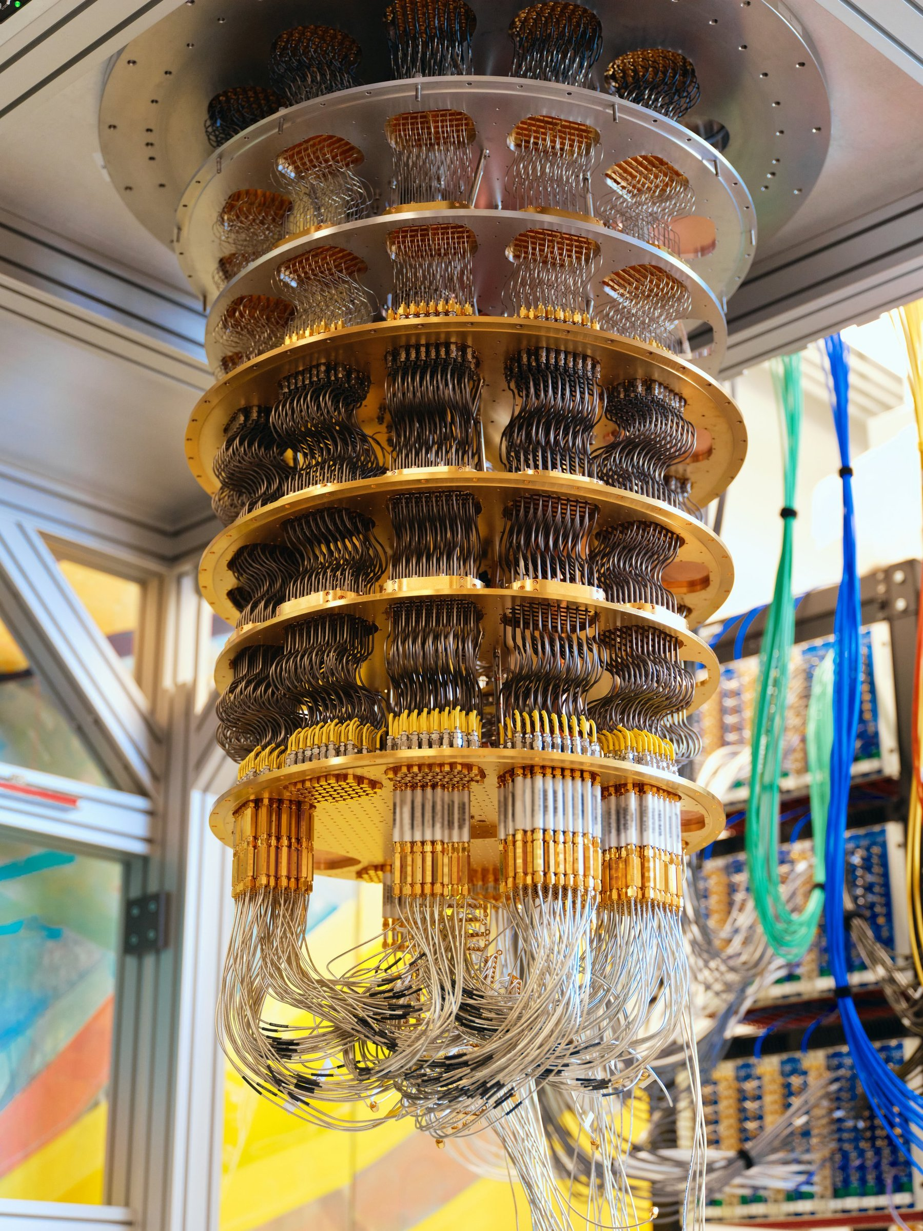


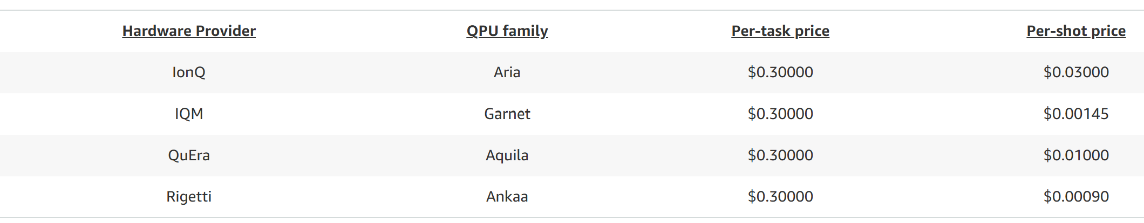
Introduction (1/2)
The pricing for experiments on real quantum computers is still very high!
The only way is using existing software package on your laptop
Simulation
time
Hardware
resources
Fig. 1. Fault-tolerant Quantum Computing
Large #Qubit
Exponential scaling!!!
Challenges
Memory-Efficient Matrix Storage
Gate Fusion
Minimize storage requirements.
Maximize parallel processing speed.
Source: https://aws.amazon.com/braket/pricing/
Notes:
Nowadays, quantum computers are a new type of computer that is promising to solve high-complexity problems by quantum algorithm.
Many companies such as IBM, Google, and QuEra are developing the real quantum computer, as Figure 1.
Unfortunately, there are still a lot of limited for the current generation of quantum computers, especially regarding fidelity, decoherent time, and accessibility.
For people who want to execute algorithms on quantum computers, it will take much money per task or per shot.
Therefore, since 2017, simulation packages like Qiskit have been developed, allowing us to simulate quantum algorithms on classical computers.
This also leads to another problem, on a large scale, or large number of qubits, the computation resources will scale exponentially.

Slide 4
Introduction (2/2): Related works
 | Cori II super-computer [1] | Gate Fusion [2] | FPGA-based emulators [3] | Grover’s algorithm Modification [4]
Purpose | Simulate large #Qubits. | Reduce simulation time. | Improved scalability, accuracy, and throughput | Simulation with high accuracy and resource optimization.
Char** | 0.5 PBs of memory for 45 qubits. | Large memory usage (up to 68.72 GBs for 32 qubits). | Large memory usage (up to 32 GBs for 32 qubits). Simulation time (7.92E10 s) | Large memory usage (up to 40 GBs for 32 qubits). Simulation time (7.92E10 s)
Char**: Characteristics of works.
[1] T. H¨aner and D. S. Steiger, “0.5 petabyte simulation of a 45-qubit quantum circuit,” in Proceedings of the International Conference for High Performance Computing, Networking, Storage and Analysis, ser. SC ’17. ACM, Nov. 2017.
[2] H. Hiroshi and D. Jun, “Optimization of Quantum Computing Simulation with Gate Fusion,” IBM Quantum, IBM Research Tokyo, IBM Quantum, IBM Research Tokyo, Tech. Rep. 23, mar 2021.
[3] N. Mahmud, B. Haase-Divine, A. Kuhnke, A. Rai, A. MacGillivray, and E. El-Araby, “Efficient computation techniques and hardware architectures for unitary transformations in support of quantum algorithm
emulation,” Journal of Signal Processing Systems, vol. 92, pp. 57–74, 2020.
[4] N. Mahmud, B. Haase-Divine, A. MacGillivray, B. Srimoungchanh, A. Kuhnke, N. Blankenau, A. Rai, and E. El-Araby, “Modifying quantum grover’s algorithm for dynamic multi-pattern search on reconfigurable hardware,” Journal of Computational Electronics, vol. 19, no. 3, pp. 1215–1231, Sep 2020.
Too much memory usage.
Processing time is still long.
Notes:
This is the summary table for the kinds of state-vector quantum simulators or emulators.
The 2-left column works for simulation and the 2-right columns is work for emulation on FPGA.
As shown in slides, it requires at least 32 GBs for a 32-qubit full-state vector and 0.5 PBs for 45 qubits.
The simulation time and memory usage seem to double for increasing one qubit.
Normally, applying the optimization technique such as gate fusion will reduce the needed resources. However, we realize that if we apply it on FPGA instead of classical computer,
We can achieved lower resources.

Slide 5
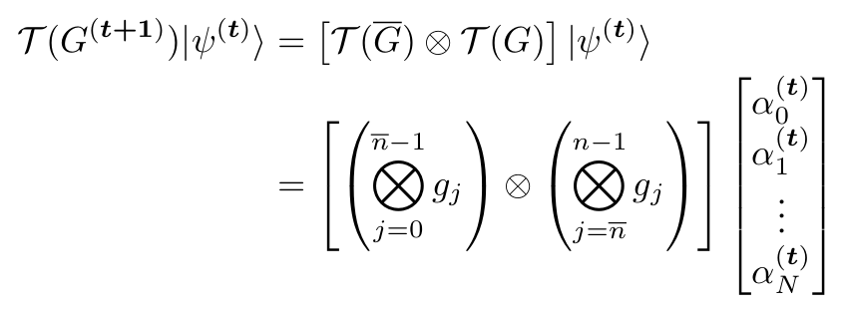
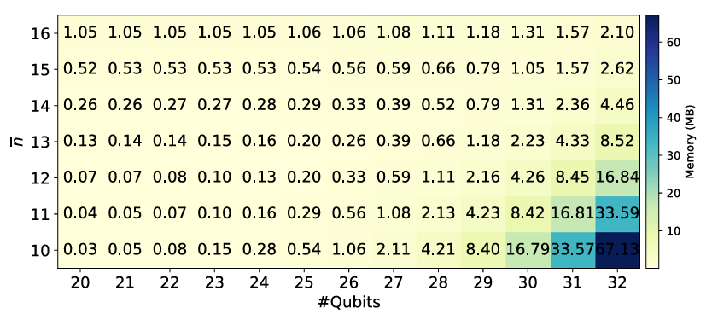
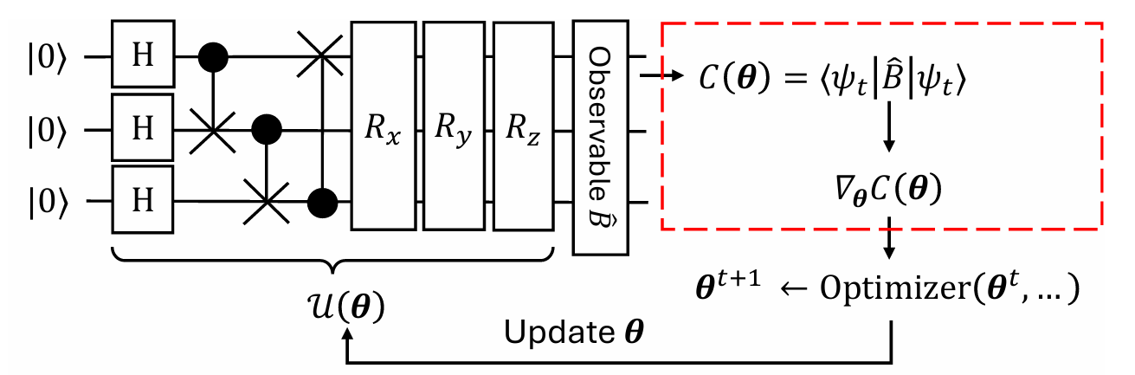
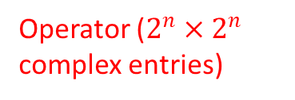
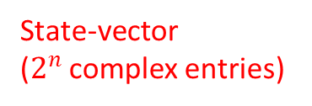
Proposed methods (1/2)
Memory-Efficient Matrix Storage (MEMS) Method
Gate fusion function
Operator ($2^{n}×2^{n}$ complex entries)
State-vector
($2^{n}$ complex entries)
Coordinate Format (COO)
Memory Storage Minimization
Tensor Product
Gate Fusion in COO
Tensor Product
Decompose by hardware resources and gate types
Fig. 2. Computational path in quantum computation model.
Fig. 3. Proposed MEMS for gate fusion’s storage.
Notes:
The key idea is to use the coordinate format and gate fusion technique for processing the quantum operator (which is an exponential-square matrix).
First, in a quantum operator, we divided it into sparse gates and non-sparse gates, when the sparse gates are tensors to each other, the non-sparse gates will only be tensors with identity gates.
By saving the final operator in coordinate format, we can reduce the temporary memory effectively, as Figure 3. The memory at the optimal divided point increases slower than exponentially.

Slide 6
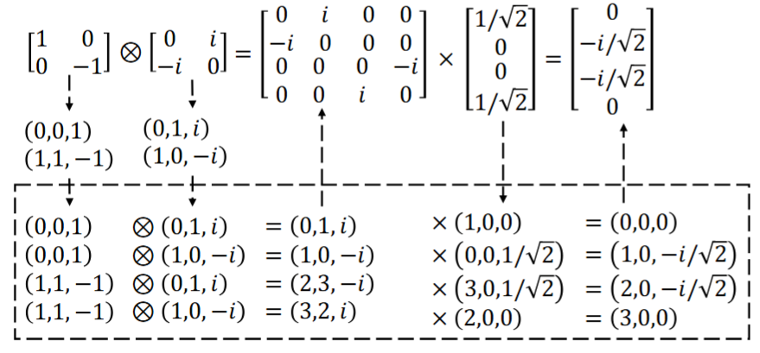
Proposed methods (1/2)
Example: Conducting both TP and MM in COO format ($𝒯\left(\left\{Z,Y\right\}\right)|ψ_{GHZ}⟩$)
How can we conduct these computation in most compact way?
Notes:
This is an example of how the operator acts on a state vector in the normal way, without optimization.
The gate Z and Y which is the sparse gate will be converted to two tuples, and then multiple with another tuple from the state vector.
The question is how to control these tuple-multiplications in the most compact way.

Slide 7
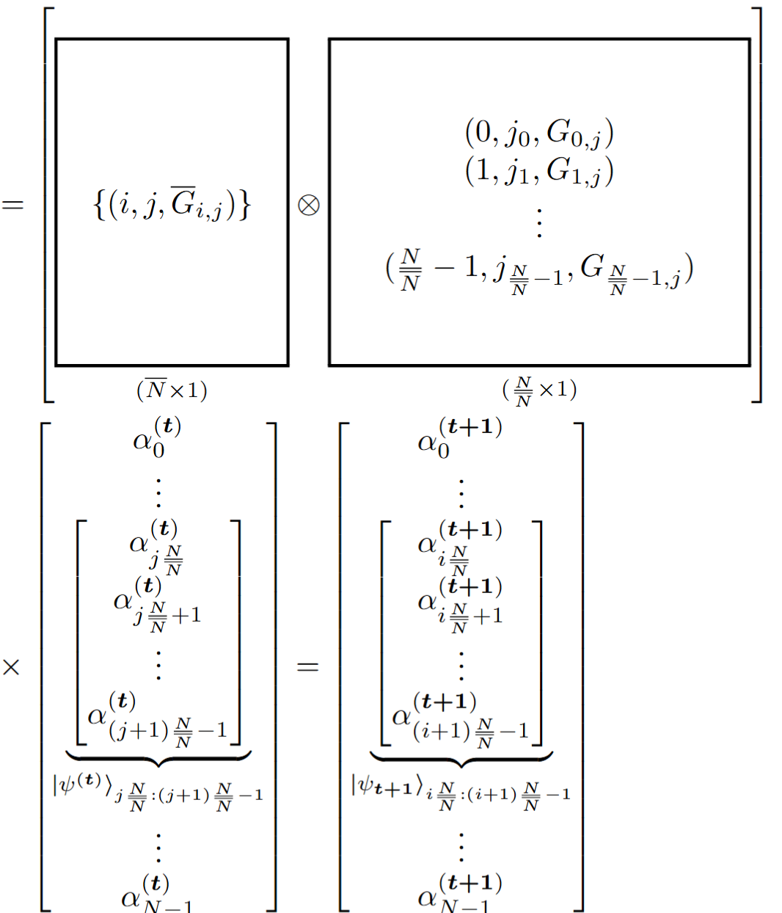
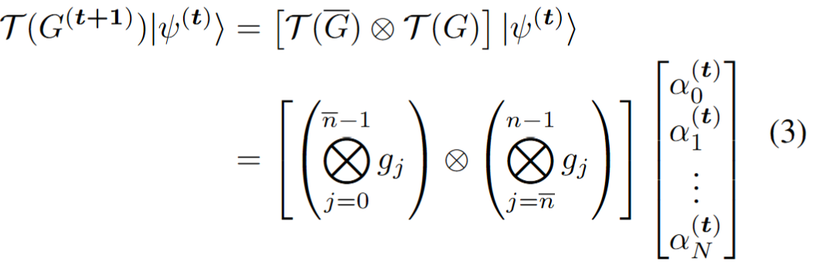
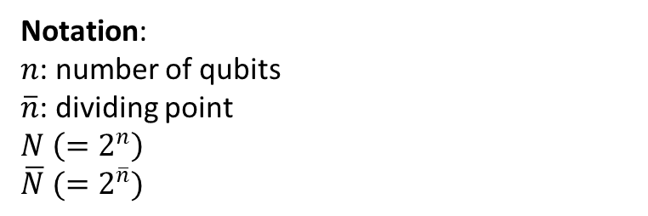

Proposed methods (1/2): Important idea
Tensor product between sparse gates, where each row/column has only one element
$k$ entries inside the state vector ($k≪N$)
Output from one core/PE
(Processing Element)
Notation:
$n$: number of qubits
$\overline{n}$: dividing point
$N \left(=2^{n}\right)$
$\overline{N} (=2^{\overline{n}})$
Parallelly on multi-core/PE
Notes:
After finding the optimal points, the left operator is initialized from gates which is also a sparse matrix, note that we only save n hat non-zero entries.
For each entry in the left operator, we multiply we k entries inside the state vector, these k entries are pre-defined, in one core or processing element.
Then multi-core or multi PE can process the equation 3 very fast.

Slide 8
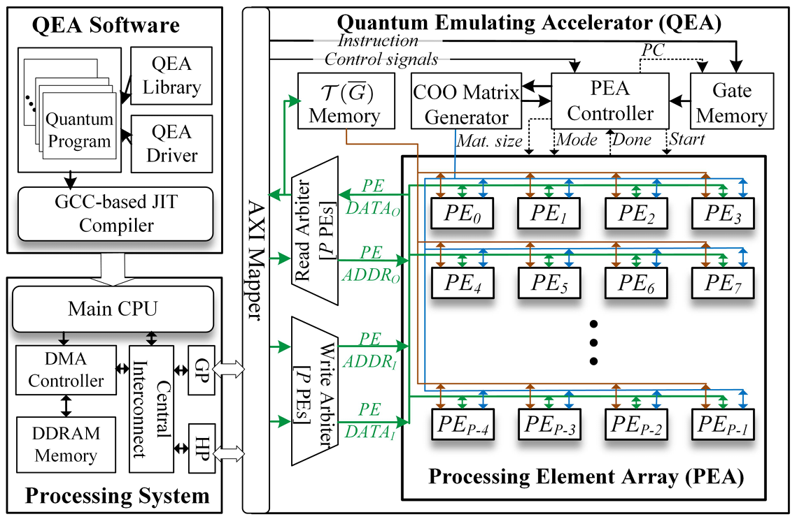
Proposed methods (2/2)
MEMS based-Quantum Emulation Accelerators (1/2).
Multi-Processing Elements: Enhanced simulation processing speed.
QEA with p RCCs: Parallelism for high throughput.
Optimal PE Count: Prevents bus congestion, ⬇️ power use.
Dual AXI Buses: Config data separation maximizes transfer.
DMA-Enhanced Transfer: High-volume without stalling QEA.
Unified Memory: Streamlined storage for p PE efficiency.
4-Stage Parallelism: Simultaneous computation across PEs.
Fig. 4. Hardware architecture of the quantum emulating accelerator at the system-on-chip level.
Notes:
This is the hardware architecture designed for the previous idea, the QEA will control p PE for processing the equation 3. The result will be written to the external memory through AXI mapper.

Slide 9
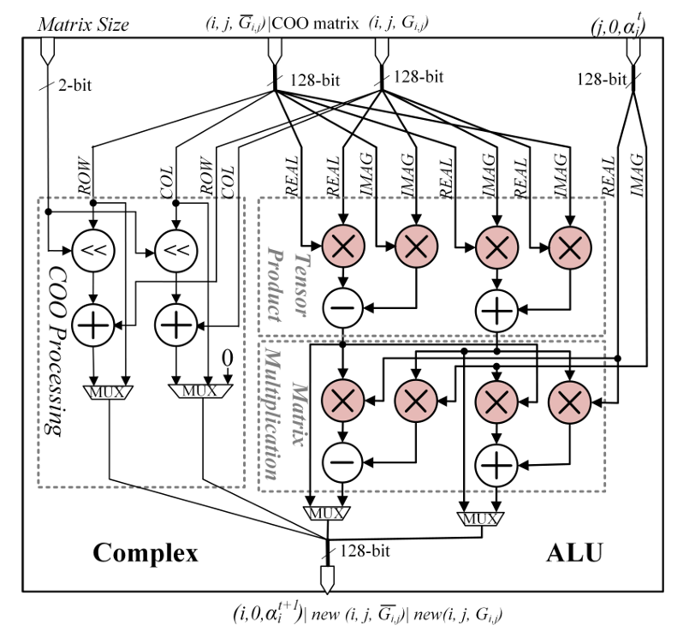
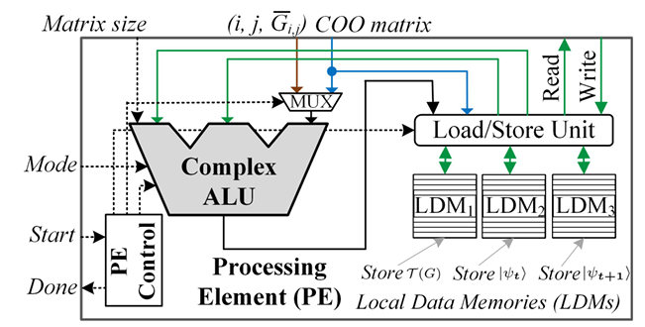
Proposed methods (2/2)
MEMS based-Quantum Emulation Accelerators (QEA) (2/2).
Fig. 5. Hardware architecture of the processing element.
Local Data Memory: Flexible storage for parallel computing.
4-Stage Parallelism: Reduces critical path, ⬆️ max frequency.
Multiplexer Logic: Selects between shifting & static registers, for adaptability.
Complex ALU: Computation in COO, prevents ✖️ multiplication with zero-elements.
Fig. 6. Microarchitecture of the complex ALU.
Notes:
The PE receives tuples from the operator and state vector, the results are written or read through Local Data Memory 1 to 3, and the different LDM will offer different capacities and speeds.
Take example, for large number of qubits, LDM 3 will be chosen.
Inside an ALU, it is designed for conducting only tensor product and matrix multiplication effectively. Note that it only conduct will non-zero elements.

Slide 10
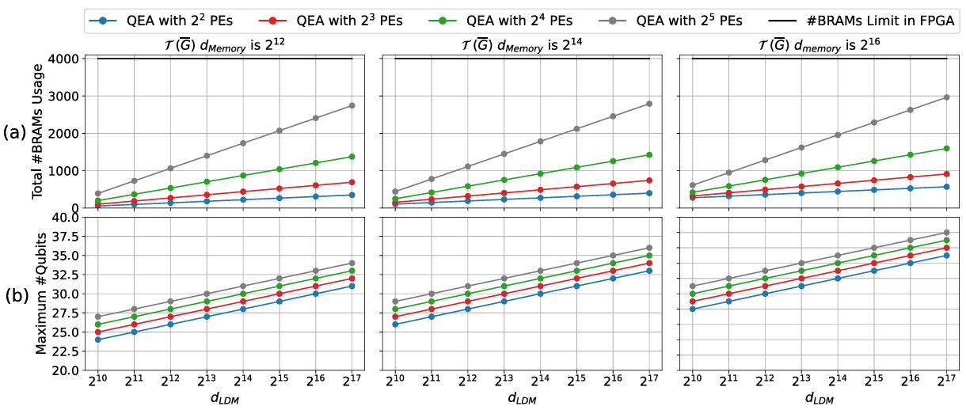
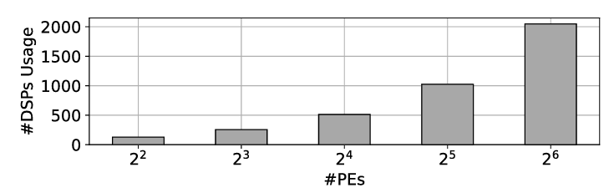
Results and discussion (1/2)
Fig. 7. Total estimated #BRAM usage (a) and maximum #Qubits support (b) for QEA configurations.
BRAM usage increases linearly with the #PEs and LDM memory depth (a).
The maximum #Qubits supported increases linearly with the #PEs, reflecting the doubling of LDM depth as the #Qubits grows (b).
Fig. 8. Estimated #DSPs usage for QEA as #PEs increases.
The MEMS method enables QEA to support up to 32 qubits while maintaining BRAM and DSP resource requirements
Notes:
The resources is estimated as Figure 7 and 8.
BRAM usage increases linearly with the #PEs and LDM memory depth.
The maximum #Qubits supported increases linearly with the #PEs, reflecting the doubling of LDM depth as the #Qubits grows.
Finally, The MEMS method enables QEA to support up to 32 qubits while maintaining BRAM and DSP resource requirements

Slide 11
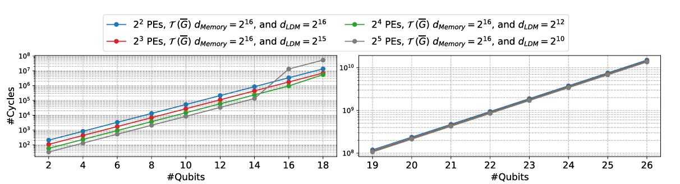
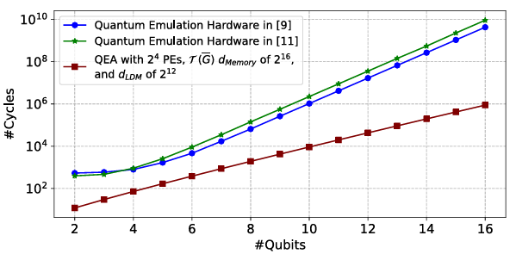
Results and discussion (2/2)
Fig. 9. Estimated cycle count of four different versions of QEA on the Xilinx ZCU102 FPGA
Fig. 10. #Cycles between QEA and other FPGA-based quantum emulation from [9], [11] on QFT algorithm
The Xilinx ZCU102 FPGA has only 4GB of DDR4 memory.
Maximum number of effectively supported #Qubits is limited to 26.
#Cycles for 4 QEA versions become insignificant and depend primarily on the transmission bandwidth between DDR4 and the QEA.
Increasing the #PEs to 16
a 16× acceleration in computations.
Notes:
On the Xilinx ZCU102 FPGA has only 4GB of DDR4 memory, and the maximum number of effectively supported #Qubits is limited to 26.
The number of Cycles for 4 QEA versions becomes insignificant and depends primarily on the transmission bandwidth between DDR4 and the QEA.
Increasing the #PEs to 16 will achieve 16 times acceleration in computations.

Slide 12
Conclusion
This study introduced the MEMS method and QEA architecture to address memory and computational challenges in quantum emulation.
However, for circuits exceeding 19 qubits → bottlenecked by the data transfer bandwidth between DDR4 memory and the QEA, which consumes 66% of the total execution time.
Design QEA in Verilog and implement it practically on the Xilinx ZCU102 FPGA.
Additionally, we will implement QEA on the Alveo U280 FPGA, which features high-bandwidth memory of up to 460GB/s.
Notes:
In the conclusion,
This study introduced the MEMS method and QEA architecture to address memory and computational challenges in quantum emulation.
However, for circuits exceeding 19 qubits → bottlenecked by the data transfer bandwidth between DDR4 memory and the QEA, which consumes 66% of the total execution time.
Design QEA in Verilog and implement it practically on the Xilinx ZCU102 FPGA.
Additionally, we will implement QEA on the Alveo U280 FPGA, which features high-bandwidth memory of up to 460GB/s.

Slide 13

Q&A
Notes:
Thank you for listening.

