Slide 1

An efficient scheme for computing quantum gradient $∇_{θ}C\left(θ\right)$
Vu Tuan Hai, NAIST, Japan
06/06/2024

Slide 2






















1. Parameterized quantum circuit (PQC) as learning model
$$|0⟩$$
$$H$$
$$R_{Z}\left(.\right)$$
$C\left(θ\right)=⟨0\left|U^{†}\left(θ\right)\hat{B}U\left(θ\right)\right|0⟩$
$$|0⟩$$
$$H$$
$$S$$
$$H$$
$$H$$
$$S$$
Measurement
$$R_{Z}\left(.\right)$$
$$∇_{θ}C\left(θ\right)$$
$$|0⟩$$
$$R_{X}\left(.\right)$$
$$θ^{t+1 }←Optimizer\left(θ^{t},∇_{θ}C\left(θ\right)\right)$$
$U_{0}\left(θ_{0}\right)$
$U_{1}\left(θ_{1}\right)$
$U_{2}\left(θ_{2}\right)$
Update new $θ$
$U\left(θ\right)$
$PQC: U\left(θ\right)=U_{m−1}U_{m−2}…U_{0}$ can be splitted into $m$ sub-circuit with $\left|θ\right|=m$
Cost function $C\left(θ\right)=⟨0\left|U^{†}\left(θ\right)\hat{B}U\left(θ\right)\right|0⟩$

Slide 3
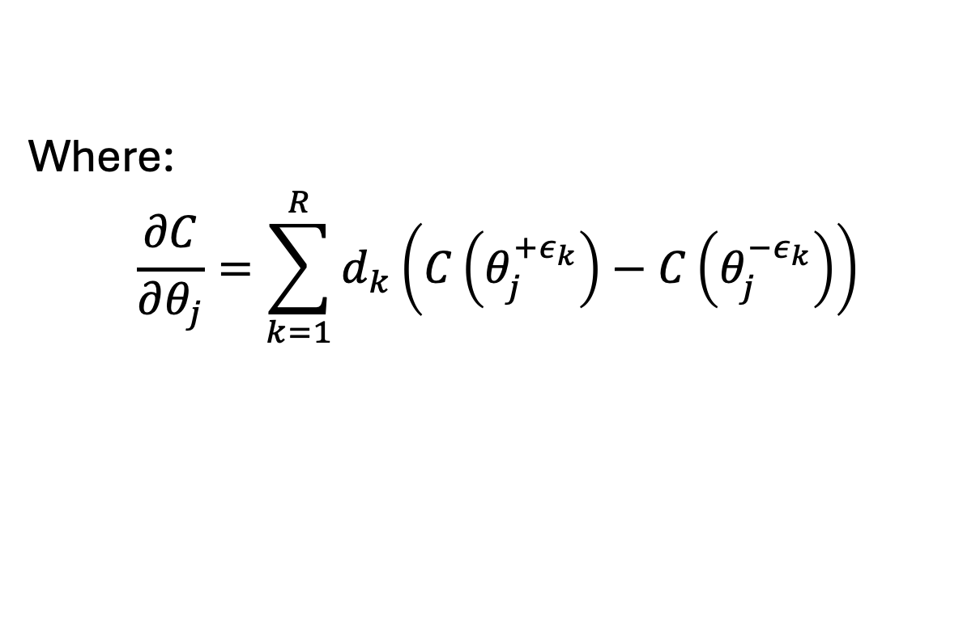
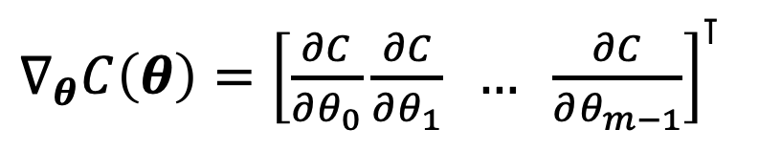
2. Quantum gradient
Computing quantum gradient is the key in various quantum machine learinng models:
$∇_{θ}C\left(θ\right)={\left[\frac{∂C}{∂θ_{0}}\frac{∂C}{∂θ_{1}} … \frac{∂C}{∂θ_{m−1}}\right]}^{⊺}$
Where:
$$\frac{∂C}{∂θ_{j}}=\sum_{k=1}^{R}{d_{k}\left(C\left(θ_{j}^{+ε_{k}}\right)−C\left(θ_{j}^{−ε_{k}}\right)\right)}$$
*Based on general parameter-shift rule technique
[ ] D. Wierichs, J. Izaac, C. Wang, and C. Y.-Y. Lin, “General parameter- shift rules for quantum gradients,” Quantum, vol. 6, p. 677, Mar. 2022

Slide 4


























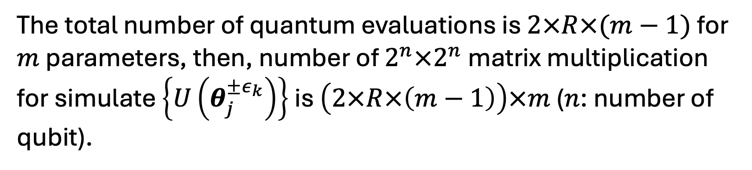
3. Computing $∇_{θ}C\left(θ\right)$ consume too much resources!
$$|0⟩$$
$$U_{0}(θ_{0})$$
$$U_{1}(θ_{1})$$
$$…$$
$$U_{m−1}(θ_{m−1}−ε_{μ})$$
$$U(θ_{m−1}^{−ε_{μ}})$$
$$…$$
$$…$$
$$|0⟩$$
$$U_{0}(θ_{0}−ε_{μ})$$
$$U_{1}(θ_{1})$$
$$…$$
$$U_{m−1}(θ_{m−1})$$
$$U(θ_{0}^{−ε_{μ}})$$
Order
$$…$$
$$…$$
$$|0⟩$$
$$U_{0}(θ_{0}+ε_{0})$$
$$U_{1}(θ_{1})$$
$$…$$
$$U_{m−1}(θ_{m−1})$$
$$U(θ_{0}^{+ε_{0}})$$
$$|0⟩$$
$$U_{0}(θ_{0})$$
$$U_{1}(θ_{1})$$
$$…$$
$$U_{m−1}(θ_{m−1})$$
$$U(θ)$$
$$d$$
The total number of quantum evaluations is $2×R×(m−1)$ for $m$ parameters, then, number of $2^{n}×2^{n}$ matrix multiplication for simulate $\left\{U\left(θ_{j}^{±ε_{k}}\right)\right\}$ is $\left(2×R×\left(m−1\right)\right)×m$ ($n$: number of qubit).

Slide 5
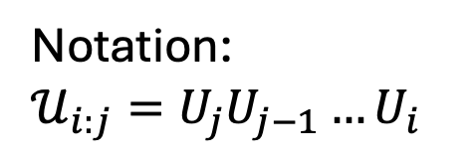
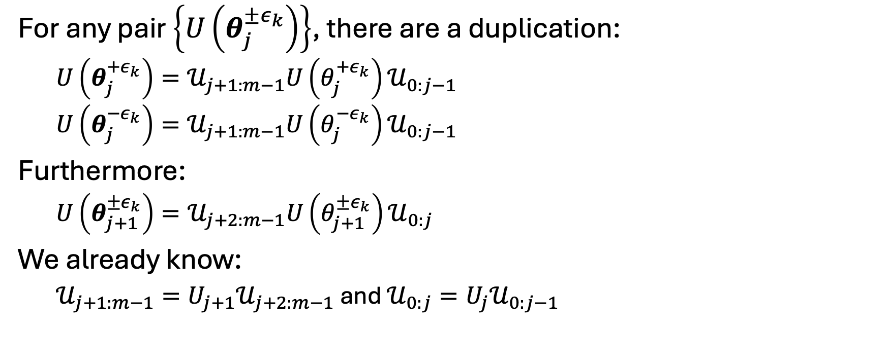
4. New scheme
Notation:
$𝒰_{i:j}=U_{j}U_{j−1}…U_{i}$
For any pair $\left\{U\left(θ_{j}^{±ε_{k}}\right)\right\}$, there are a duplication:
$U\left(θ_{j}^{+ε_{k}}\right)=𝒰_{j+1:m−1}U\left(θ_{j}^{+ε_{k}}\right)𝒰_{0:j−1}$
$U\left(θ_{j}^{−ε_{k}}\right)=𝒰_{j+1:m−1}U\left(θ_{j}^{−ε_{k}}\right)𝒰_{0:j−1}$
Furthermore:
$U\left(θ_{j+1}^{±ε_{k}}\right)=𝒰_{j+2:m−1}U\left(θ_{j+1}^{±ε_{k}}\right)𝒰_{0:j}$
We already know:
$𝒰_{j+1:m−1}=U_{j+1}𝒰_{j+2:m−1}$ and $𝒰_{0:j}=U_{j}𝒰_{0:j−1}$

Slide 6

































4. New scheme
$$U_{m−1}(θ_{m−1})$$
$$U(θ)$$
$$U_{1}(θ_{1})$$
$$…$$
$$U_{m−1}(θ_{m−1}−ε_{μ})$$
$$…$$
$$U_{0}(θ_{0})$$
$$U_{1}(θ_{1}−ε_{μ})$$
$$U_{m−1}(θ_{m−1}+ε_{0})$$
For matrix multiplication-based
(a)
$$…$$
$$𝒰_{2:m−1}(θ_{2:m−1})$$
Order
$$U_{1}(θ_{1}+ε_{0})$$
$$\{U\left(θ_{i}^{±ε_{k}}\right)\}$$
$$|0⟩$$
$$U_{0}(θ_{0}−ε_{μ})$$
$$…$$
$$𝒰_{1:m−1}(θ_{1:m−1})$$
$$U_{0}(θ_{0}+ε_{0})$$
$$U_{0}\left(θ_{0}\right)|0⟩$$
$${|ψ}_{m−1}⟩$$
$$U_{m−2}(θ_{m−2})$$
$$…$$
$$U_{0} \left(θ_{0}−ε_{k}\right)|0⟩$$
$$…$$
$$U_{m−2}(θ_{m−2}−ε_{k})$$
$$U_{0} \left(θ_{0}+ε_{0}\right)|0⟩$$
For state evolution-based
$$U_{m−1}(θ_{m−1})$$
$$…$$
$$|ψ_{m−3}⟩$$
Order
(b)
$$U_{m−2}(θ_{m−2}+ε_{0})$$
$$\{|ψ_{m−1}\left(θ_{i}^{±ε_{k}}\right)⟩\}$$
$$U_{m−1}(θ_{m−1}−ε_{k})$$
$$…$$
$$|ψ_{m−2}⟩$$
$$U_{m−1}(θ_{m−1}+ε_{0})$$

Slide 7
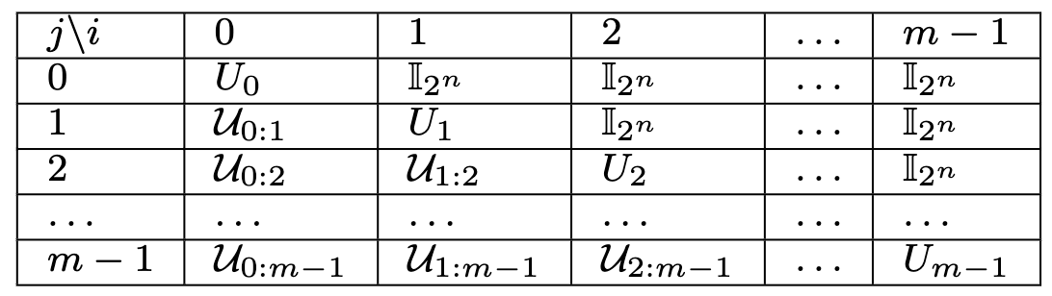


4. New scheme: Look up table (LUT)
To fill this LUT, only take $\sum_{j=0}^{m−1}{j}=\frac{\left(m−1\right)×m}{2}$ matrix multiplication
To achive $\left\{U\left(θ_{j}^{±ε_{k}}\right)\right\}$,
this method take $\frac{\left(m−1\right)×m}{2}+4R<\left(2×R×\left(m−1\right)\right)×m$

Slide 8
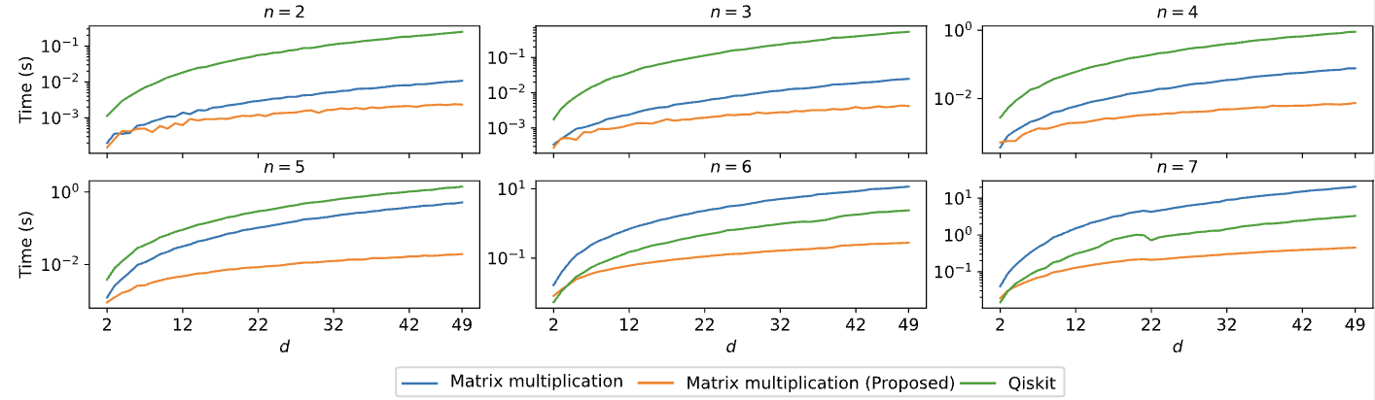
Experiments and results

Slide 9



















$$\hat{B}$$
$$|0⟩$$
$$H$$
$$R_{Y}\left(θ_{1}\right)$$
$$|0⟩$$
$$H$$
$$S$$
$$H$$
$$⋮$$
$$H$$
$$S$$
$C\left(θ\right)=⟨ψ\left|U^{†}\left(θ\right)\hat{B}U\left(θ\right)\right|ψ⟩$
Measurement
$$|0⟩$$
$$R_{X}\left(θ_{0}\right)$$
$$R_{Z}\left(θ_{m−1}\right)$$
$$∇_{θ}C\left(θ\right)$$
$U_{0}\left(θ_{0}\right)$
$U_{1}\left(θ_{1}\right)$
$U_{m−1}\left(θ_{m−1}\right)$
$$θ^{t+1 }←Optimizer\left(θ^{t},∇_{θ}C\left(θ\right)\right)$$
$U\left(θ\right)$
Update new $θ$

Slide 10


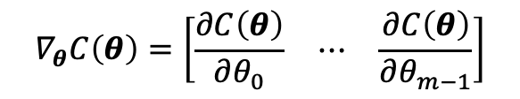
$$|0⟩$$
$$H$$
$$R_{Y}\left(θ_{1}\right)$$
$$|0⟩$$
$$H$$
$$S$$
$$H$$
$$⋮$$
$$H$$
$$S$$
$C\left(θ\right)=⟨ψ\left|U^{†}\left(θ\right)\hat{B}U\left(θ\right)\right|ψ⟩$
Measurement
$$|0⟩$$
$$R_{X}\left(θ_{0}\right)$$
$$R_{Z}\left(θ_{m−1}\right)$$
$$∇_{θ}C\left(θ\right)=\left[\begin{matrix}\frac{∂C\left(θ\right)}{∂θ_{0}} & ⋯ & \frac{∂C\left(θ\right)}{∂θ_{m−1}}\end{matrix}\right]$$
$U_{0}\left(θ_{0}\right)$
$U_{1}\left(θ_{1}\right)$
$U_{m−1}\left(θ_{m−1}\right)$
$$θ^{t+1 }←Optimizer\left(θ^{t},∇_{θ}C\left(θ\right)\right)$$
$U\left(θ\right)$
Update new $θ$

Slide 11












$$|0⟩$$
$$H$$
$${ R}_{x}$$
$${ R}_{y}$$
$${ R}_{z}$$
$C\left(θ\right)=⟨ψ_{t}\left|\hat{B}\right|ψ_{t}⟩$
$$|0⟩$$
$$H$$
Observable $\hat{B}$
$$∇_{θ}C\left(θ\right)$$
$$|0⟩$$
$$H$$
$$θ^{t+1 }←Optimizer\left(θ^{t},…\right)$$
$$𝒰\left(θ\right)$$
Update $θ$

Slide 12

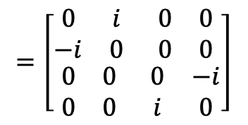



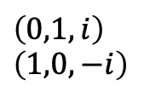

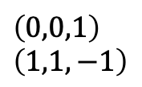
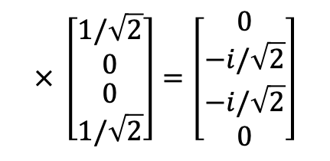
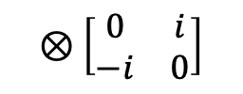

$$=\left[\begin{matrix}\begin{matrix}0 & i \\ −i & 0\end{matrix} & \begin{matrix}0 & 0 \\ 0 & 0\end{matrix} \\ \begin{matrix}0 & 0 \\ 0 & 0\end{matrix} & \begin{matrix}0 & −i \\ i & 0\end{matrix}\end{matrix}\right]$$
$$× \left[\begin{matrix}\begin{matrix}1/\sqrt{2} \\ 0\end{matrix} \\ \begin{matrix}0 \\ 1/\sqrt{2}\end{matrix}\end{matrix}\right]=\left[\begin{matrix}\begin{matrix}0 \\ −i/\sqrt{2}\end{matrix} \\ \begin{matrix}−i/\sqrt{2} \\ 0\end{matrix}\end{matrix}\right]$$
$$\left[\begin{matrix}1 & 0 \\ 0 & −1\end{matrix}\right]$$
$$⊗\left[\begin{matrix}0 & i \\ −i & 0\end{matrix}\right]$$
$\left(0,0,1\right)$
$\left(1,1,−1\right)$
$\left(0,1,i\right)$
$\left(1,0,−i\right)$
$\left(0,0,1\right)$
$\left(0,0,1\right)$
$\left(1,1,−1\right)$
$$\left(1,1,−1\right)$$
$⊗\left(0,1,i\right)$
$⊗\left(1,0,−i\right)$
$⊗\left(0,1,i\right)$
$⊗\left(1,0,−i\right)$
$=\left(0,1,i\right)$
$=\left(1,0,−i\right)$
$=\left(2,3,−i\right)$
$=\left(3,2,i\right)$
$× \left(1,0,0\right)$
$× \left(0,0,1/\sqrt{2}\right)$
$× \left(3,0,1/\sqrt{2}\right)$
$× \left(2,0,0\right)$
$=\left(0,0,0\right)$
$=\left(1,0,−i/\sqrt{2}\right)$
$=\left(2,0,−i/\sqrt{2}\right)$
$=\left(3,0,0\right)$

Slide 13


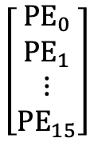
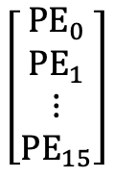

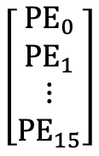










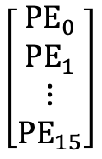

Store unit
Store
$$\left[\begin{matrix}\begin{matrix}{PE}_{0} \\ {PE}_{1}\end{matrix} \\ \begin{matrix}⋮ \\ {PE}_{15}\end{matrix}\end{matrix}\right]$$
$$\left[\begin{matrix}\begin{matrix}{PE}_{0} \\ {PE}_{1}\end{matrix} \\ \begin{matrix}⋮ \\ {PE}_{15}\end{matrix}\end{matrix}\right]$$
Store unit
Store
Store
$$\left[\begin{matrix}\begin{matrix}{PE}_{0} & {PE}_{1}\end{matrix} & \begin{matrix}⋯ & {PE}_{15}\end{matrix}\end{matrix}\right] ×$$
$$\left[\begin{matrix}\begin{matrix}{PE}_{0} \\ {PE}_{1}\end{matrix} \\ \begin{matrix}⋮ \\ {PE}_{15}\end{matrix}\end{matrix}\right]$$
$$\left[\begin{matrix}\begin{matrix}{PE}_{0} \\ {PE}_{1}\end{matrix} \\ \begin{matrix}⋮ \\ {PE}_{15}\end{matrix}\end{matrix}\right]$$
Store
$$LDM_{1}$$
$$LDM_{2}$$
$$LDM_{3}$$
$$\left[\begin{matrix}\begin{matrix}{PE}_{0} & {PE}_{1}\end{matrix} & \begin{matrix}⋯ & {PE}_{15}\end{matrix}\end{matrix}\right] ×$$
Load $j^{th}$ row into $LDM_{1}$
$$j++$$
T
$$j<{n_{\tilde{o}}}_{ }$$
F
$$LDM_{1}$$
$$LDM_{2}$$
$$LDM_{3}$$
Load $j^{th}$ row into $LDM_{1}$
$$j++$$
T
$$j<{n_{\tilde{o}}}_{ }$$
F

Slide 14





















































$$|0⟩$$
$$U_{0}$$
$$U_{1}$$
$$…$$
$$U_{m−1}(θ_{m−1}^{−ε_{R}})$$
$$…$$
$$|0⟩$$
$$U_{0}(θ_{0}^{−ε_{R}})$$
$$U_{1}$$
$$…$$
$$U_{m−1}$$
$$\{U\left(θ_{j}^{±ε_{k}}\right)\}$$
Order
$$…$$
(a)
$$|0⟩$$
$$U_{0}(θ_{0}^{+ε_{1}})$$
$$U_{1}$$
$$…$$
$$U_{m−1}$$
$$|0⟩$$
$$U_{0}$$
$$U_{1}$$
$$…$$
$$U_{m−1}$$
$$U_{m−1}$$
$$U_{1}$$
$$…$$
$$U_{m−1}(θ_{m−1}^{−ε_{R}})$$
$$…$$
$$U_{0}$$
$$U_{1}(θ_{1}^{−ε_{R}})$$
$$U_{m−1}(θ_{m−1}^{+ε_{1}})$$
(b)
$$…$$
$$𝒰_{2:m−1}$$
Order
$$\{U\left(θ_{j}^{±ε_{k}}\right)\}$$
$$U_{0}(θ_{0}^{−ε_{R}})$$
$$U_{1}(θ_{1}^{+ε_{1}})$$
$$|0⟩$$
$$…$$
$$𝒰_{1:m−1}$$
$$U_{0}(θ_{0}^{+ε_{1}})$$
$$U_{0}\left(θ_{0}\right)$$
$$|0⟩$$
$$U_{0}\left(θ_{0}^{−ε_{R}}\right)$$
$$…$$
$$U_{m−2}$$
$$…$$
$$U_{0}\left(θ_{0}^{+ε_{1}}\right)$$
$$U_{m−2}(θ_{m−2}^{−ε_{R}})$$
$$U_{m−1}$$
$$|ψ_{m−3}⟩$$
$$…$$
$$\{|ψ_{m−1}\left(θ_{j}^{±ε_{k}}\right)⟩\}$$
Order
(c)
$$U_{m−2}(θ_{m−2}^{+ε_{1}})$$
$U_{m−1}(θ_{m−1}^{−ε_{R}})$
$$|ψ_{m−2}⟩$$
$$…$$
$$U_{m−1}\left(θ_{m−1}^{+ε_{1}}\right)$$
$$0$$
$$d$$
$$m−1$$

Slide 15












$U_{0}\left(θ_{0}\right)$
$$U_{1:m−1}(θ_{1:m−1})$$
$U_{0:1}\left(θ_{0:1}\right)$
$$U_{2:m−1}(θ_{2:m−1})$$
$$…$$
$$…$$
$U_{0:m−2}\left(θ_{0:m−2}\right)$
$$U_{m−1}(θ_{m−1})$$
$U_{0:m−1}\left(θ_{0:m−1}\right)≡U\left(θ\right)$
$𝕀_{2^{n}}$
$$U_{head}$$
$$U_{tail}$$

Slide 16

















$$m−1$$
$${|ψ}_{m−1}⟩$$
$$U_{0}\left(θ_{0}\right)|0⟩$$
$$U_{m−2}(θ_{m−2})$$
$$…$$
$$U_{0} \left(θ_{0}−ε_{k}\right)|0⟩$$
$$…$$
$$U_{m−1}(θ_{m−1})$$
$$U_{m−2}(θ_{m−2}−ε_{k})$$
$$U_{0} \left(θ_{0}+ε_{0}\right)|0⟩$$
$$…$$
$$|ψ_{m−3}⟩$$
Order
$$U_{m−2}(θ_{m−2}+ε_{0})$$
$$\{|ψ_{m−1}\left(θ_{i}^{±ε_{k}}\right)⟩\}$$
$$|0⟩$$
$$U_{m−1}(θ_{m−1}−ε_{k})$$
$$…$$
$$|ψ_{m−2}⟩$$
$$U_{m−1}(θ_{m−1}+ε_{0})$$
0
$$d$$

