Slide 1
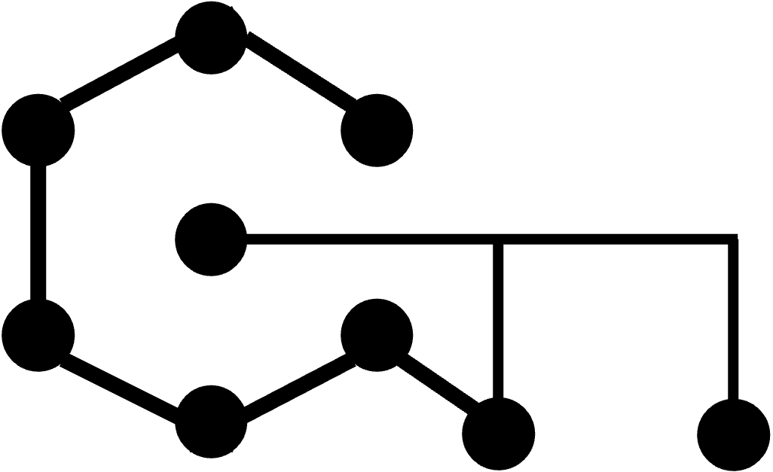










Quantum part
Classical part
$$N$$
$$U$$
$$V^{†}\left(θ\right)$$
$$𝒞(θ)$$
$$|0⟩$$
Optimizer
Update $θ$
Quantum state tomography
Quantum part
Classical part
$$N$$
$$U(θ)$$
$$V^{†}$$
$$𝒞(θ)$$
$$|0⟩$$
Optimizer
Update $θ$
Quantum state preparation
Notes:
Quantum compilation has drawn strong interest as a solution for both quantum state tomography and preparation. Its core idea relies on a training process to transform a trainable unitary into a target unitary. If the first unitary is parameterized, quantum compilation can be used to solve the preparation problem, otherwise, it solves the tomography problem.

Slide 2



plugin module
evolution
High level
plugin module
compilation
environment
utilities
core module
qcomilation
crossover
mutate
selection
optimizer
metric
visualize
qsp
qst
gradient
loss
measure
ansatz
state
(save/load)
backend module
utilities
constant
logger
parallel
json files
(developing)
(developing)
Database
dependencies
 | Dependency
 | Association
 | Generalization
Low level
Development timeline

Slide 3
PauliComposor
StabilizerGenerator
to_csr(word)
PauliTerm
PauliWord
scalar:
complex
to_matrix()
to_matrix()
to_matrix()
list[PauliWord]
list[PauliTerm]
word:str

Slide 4

















$$0$$
Other gates
$$1$$
$$×$$
$$×$$
$$×$$
$$2$$
$$⋮$$
$$×$$
$$×$$
CX gate
$$3$$
$$×$$
$$×$$
$$U_{0}$$
$$V_{0}$$
$$U_{1}$$
$$V_{1}$$
$$V_{k−1}$$

Slide 5
qcompilation
+ u + vdagger + thetas
+ init (attributes) + set_attribute (attribute) + fit (num_steps) + save (path) + load (path)
qsp
+ u + vdagger + thetas
+ init (attributes) + save (path) + load (path) + find_ansatz(conditions)
qst
+ u + vdagger + thetas
+ init (attributes) + save (path) + load (path) + find_ansatz(conditions)

