Slide 1
PauliComposor
StabilizerGenerator
to_csr(word)
PauliTerm
PauliWord
scalar:
complex
to_matrix()
to_matrix()
to_matrix()
list[PauliWord]
list[PauliTerm]
word:str

Slide 2















































$$4^{n}−1$$
$$0$$
$w_{0}$
$w_{1}$
$w_{0}$
$w_{1}$
$w_{0}$
$w_{1}$
$$j=0$$
(a)
(b)
$w_{2}$
$w_{3}$
$w_{2}$
$w_{3}$
$w_{2}$
$w_{3}$
$$×$$
$${ R}_{x}$$
$${ R}_{y}$$
$${ R}_{z}$$
(a)
$$×$$
$$×$$
$${ R}_{x}$$
$${ R}_{y}$$
$${ R}_{z}$$
$$X$$
$$Y$$
$$Z$$
$$⋮$$
$$×$$
$${ R}_{x}$$
$${ R}_{y}$$
$${ R}_{z}$$
$$×$$
$$×$$
$$×$$
$${ R}_{x}$$
$${ R}_{y}$$
$${ R}_{z}$$
$$k=0$$
$$U_{0}$$
$$V_{0}$$
$$U_{1}$$
$$V_{1}$$
$× \#R$epeats
$× \#L$ayers
$$n−1$$
$$n−1$$
$$⋯$$
$$j=n−1$$
Other gates
$$×$$
CX gate
$$0$$
$$n−1$$
$$In$$
$$1$$
$$2$$
$$3$$
$$4$$
$$⋮$$
$$15$$
$$Out$$
$$1$$
$$14$$
$$15$$
$$5$$
$$⋮$$
$$3$$
(b)
$$4^{n}−1$$
$$i=0$$

Slide 3

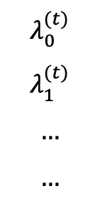









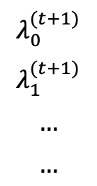







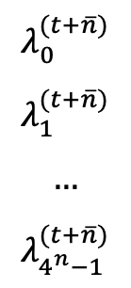







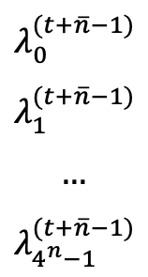

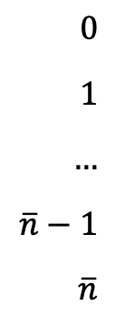

Instructor: $\left\{g,w,θ\right\}$
$ℙ_{n,j}^{(0)}$: $λ^{\left(0\right)},𝓘^{(0)}$
Begin
divide()
${map}_{non−CX}$()
$G:\{ℙ_{n,j}^{\left(0\right)}\}$
$0$
$1$
$…$
$\overline{n}−1$
$\overline{n}$
$$λ_{0}^{(t)}$$
$$λ_{1}^{(t)}$$
$$…$$
$$…$$
Operator: $\left\{U_{k},V_{k′}\right\}$
Weight: $W$
map()
$${CX}_{(1)}$$
$$λ_{0}^{(t+1)}$$
$$λ_{1}^{(t+1)}$$
$$…$$
$$…$$
Encoding
createLUT()
flatten()
$${CX}_{(1)}$$
$\{ℙ_{n,j}^{\left(K\right)}\}$
for operator in $U_{0},V_{0},…U_{K−1}/V_{K−1}^{′}$
$$LUT_{non−CX}$$
$$λ^{\left(k\right)},𝓘^{\left(k\right)}$$
$$LUT_{CX}$$
toDM()
$$λ_{0}^{(t+\overline{n}−1)}$$
$$λ_{1}^{(t+\overline{n}−1)}$$
$$…$$
$$λ_{4^{n}−1}^{(t+\overline{n}−1)}$$
${map}_{CX}$()
Decoding
$$…$$
$$⋮$$
$$ρ$$
$$λ^{\left(k^{′}\right)},𝓘^{\left(k^{′}\right)}$$
$${CX}_{(\overline{n})}$$
$$λ_{0}^{(t+\overline{n})}$$
$$λ_{1}^{(t+\overline{n})}$$
$$…$$
$$λ_{4^{n}−1}^{(t+\overline{n})}$$
$$× n$$
End
$${CX}_{(\overline{n})}$$
$…$
$…$
$$…$$
$$4^{n}+\overline{n}$$
$${CX}_{(\overline{n})}$$
Step

Slide 4

























































$ℙ_{n,0}^{\left(T\right)}$
$ℙ_{n,n−1}^{\left(T\right)}$
$$λ_{0},P_{n,0}$$
$$λ_{1},P_{n,1}$$
$$…$$
$$λ_{4^{n}−1},P_{n,4^{n}−1}$$
$$…$$
$$λ_{0},P_{n,0}$$
$$λ_{1},P_{n,1}$$
$$…$$
$$λ_{4^{n}−1},P_{n,4^{n}−1}$$
toMatrix()
$$\{$$
$$M_{0}$$
$$M_{1}$$
$$…$$
$$M_{4^{n}−1}$$
$$\}$$
$$\{$$
$$M_{0}$$
$$M_{1}$$
$$…$$
$$M_{4^{n}−1}$$
$$\}$$
$$⨁$$
$$⨁$$
$$⨁$$
$$⨁$$
$$=$$
$$=$$
add()
$$=$$
$$=$$
$\left\lceil \log_{2}\left(n′\right)\right\rceil$ times
$$M_{0,1}$$
$$…$$
$$…$$
$$M_{4^{n}−{2,4}^{n}−1}$$
$$…$$
$$M_{0,1}$$
$$…$$
$$…$$
$$M_{4^{n}−{2,4}^{n}−1}$$
$$…$$
$$…$$
$$…$$
$$…$$
$$ℳ_{0}$$
$$…$$
$$…$$
$$…$$
$$ℳ_{n−1}$$
$$×$$
multiply()
$$×$$
$\left\lceil \log_{2}\left(n\right)\right\rceil$times
$$=$$
$$=$$
$$ℳ_{0,1}$$
$$…$$
$$…$$
$$ℳ_{n−2,n−1}$$
$$…$$
$$…$$
$$ρ$$

