Slide 1
SDEV2150
Lesson 21: Rendering Strategies

Slide 2
Lesson Objectives
In this lesson, students will:
Explain what a rendering strategy is
Describe how client-side rendering (CSR) works
Trace the flow from URL to UI in a React app
Compare CSR with traditional server rendering
Identify advantages and tradeoffs of CSR

Slide 3
Agenda
What is rendering?
Traditional vs client-side rendering
How React renders in the browser
Routing and data loading in CSR
Observing CSR in DevTools
Advantages and tradeoffs
Preview of SSR

Slide 4
Connecting

Slide 5
Where does the UI come from?
When you visit a website:
Where does the HTML come from?
When is it created?
What role does JavaScript play?

Slide 6
Traditional web applications
Typical flow:
Browser requests a URL
Server generates HTML
Browser renders the page
Navigation causes full page reloads
The server is responsible for rendering.

Slide 7
React applications (CSR)
Typical flow:
Browser requests a URL
Server returns minimal HTML + JavaScript
JavaScript loads
React renders the UI
Navigation happens without full reloads
The browser is responsible for rendering.

Slide 8
How CSR Works

Slide 9
Initial HTML
React apps often start with a minimal HTML shell:
<div id="root"></div>
<script type="module" src="/src/main.jsx"></script>
There is no visible UI yet.

Slide 10
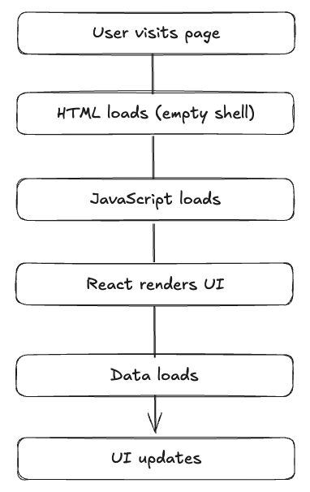
Rendering flow

Slide 11
Key idea
Client-Side Rendering means:
The browser builds the UI
JavaScript is required before the app appears

Slide 12
React + Routing Flow

Slide 13
What happens after JavaScript loads?
React initializes
The router determines the route
Route loaders fetch data (if used)
Components render
UI becomes visible

Slide 14
Navigation in CSR
After the first load:
navigation is handled by the client
no full page reload
only data may be fetched
This creates a smoother user experience.

Slide 15
Important distinction
Even with route loaders:
rendering still happens in the browser
data loading is still initiated from the client
This is still CSR.

Slide 16
Observing CSR

Slide 17
DevTools: Network tab
Reload the application and observe:
HTML document
JavaScript files
CSS files
API requests

Slide 18
What loads first?
Typical pattern:
HTML shell
JavaScript bundles
React starts
API requests
UI updates

Slide 19
Navigation behavior
When clicking links:
URL changes
UI updates
no full document reload

Slide 20
Disable JavaScript
What happens if JavaScript is disabled?
HTML still loads
UI does not render properly
CSR depends heavily on JavaScript.

Slide 21
Advantages of CSR

Slide 22
Strengths
Smooth in-app navigation
Rich interactivity
Strong component model
Can be deployed as static assets
Excellent for dynamic applications

Slide 23
Tradeoffs of CSR

Slide 24
Limitations
Slower initial load
Requires JavaScript to render
Can delay meaningful content
More work on the client device

Slide 25
Important perspective
CSR is not better or worse.
It is one rendering strategy with specific tradeoffs.

Slide 26
Comparing Rendering Strategies

Slide 27
Client-Side Rendering (CSR)
Browser renders UI
Minimal initial HTML
Requires JavaScript to display content

Slide 28
Server-Side Rendering (SSR)
Server renders HTML
Browser receives ready-to-display content
JavaScript enhances interactivity after load

Slide 29
Key difference
CSR:
UI built in browser
SSR:
UI built on server first

Slide 30
Quick Poll

Slide 31
What happens first in a CSR React app?
Full HTML page is rendered by the server
JavaScript runs and builds the UI
Data is fetched before HTML loads
React components render on the server

Slide 32
Lesson Summary
In this lesson, we covered the following:
Explain what a rendering strategy is
Describe how client-side rendering (CSR) works
Trace the flow from URL to UI in a React app
Compare CSR with traditional server rendering
Identify advantages and tradeoffs of CSR

Slide 33
Exit Ticket
Explain:
What client-side rendering is
What the browser receives on initial load
One advantage of CSR
One tradeoff of CSR

