Slide 1
SDEV2150
Lesson 22: Server-Side Rendering

Slide 2
Lesson Objectives
In this lesson, students will:
Explain what server-side rendering (SSR) is
Compare CSR and SSR rendering flows
Describe how hydration works
Identify advantages and tradeoffs of SSR
Recognize when SSR is appropriate

Slide 3
Agenda
CSR recap and limitations
What is SSR?
SSR rendering flow
Hydration
Observing SSR in the browser
Hybrid rendering
Frameworks and SSR

Slide 4
Connecting

Slide 5
Recap: Client-Side Rendering
In CSR:
HTML is minimal
JavaScript loads
React builds the UI

Slide 6
The problem
CSR can result in:
delayed first content
blank screens during load
reliance on JavaScript

Slide 7
Key question
What if the server sent a fully rendered page first?

Slide 8
What is SSR?

Slide 9
Server-Side Rendering
SSR means:
server generates HTML for the route
browser receives ready-to-display content
JavaScript enables interactivity after load

Slide 10
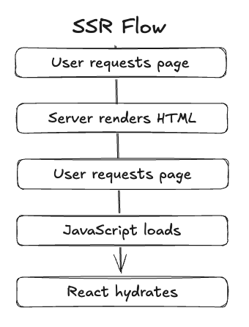
SSR detailed flow

Slide 11
Key idea
SSR improves time to first content.

Slide 12
CSR vs SSR

Slide 13
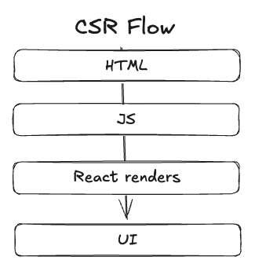
CSR flow

Slide 14
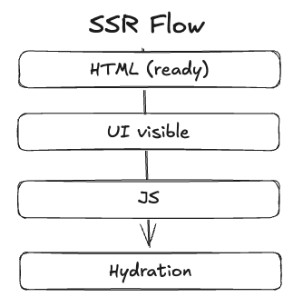
SSR flow

Slide 15
Key difference
CSR:
UI built in browser
SSR:
UI built on server first

Slide 16
Hydration

Slide 17
What is hydration?
Hydration is:
React attaching behaviour to server-rendered HTML

Slide 18
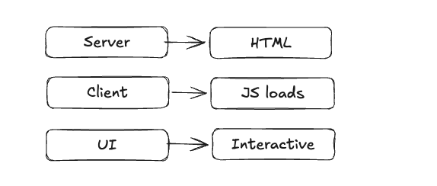
Hydration flow

Slide 19
Important distinction
SSR provides content early
hydration enables interactivity

Slide 20
Observing SSR

Slide 21
DevTools: Network tab
Reload the page and inspect:
HTML response
JavaScript files

Slide 22
What you should see
HTML contains actual content
content appears immediately
JavaScript loads afterward

Slide 23
Compare with CSR
CSR:
empty HTML shell
SSR:
pre-rendered content

Slide 24
Hybrid Rendering

Slide 25
Modern approach
Applications often mix strategies:
SSR for initial load
CSR for navigation
Pre-rendering for static content

Slide 26
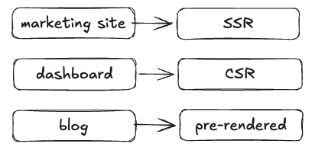
Example

Slide 27
Key idea
Rendering strategy is a design decision.

Slide 28
Frameworks and SSR

Slide 29
Modern frameworks
Examples:
React Router (framework mode)
Next.js
Remix (Now React Router)

Slide 30
What frameworks do
render on server
manage routing and data
hydrate on client

Slide 31
Important point
Frameworks handle SSR complexity.

Slide 32
Advantages of SSR

Slide 33
Strengths
faster initial content
better perceived performance
improved SEO
better on slower devices

Slide 34
Tradeoffs of SSR

Slide 35
Limitations
more complex architecture
requires server environment
harder to debug
hydration still required

Slide 36
Important perspective
SSR is one tool, not a replacement for CSR.

Slide 37
Hands-on Practice
Exercise: Review and compare CSR vs SSR using the existing project and a contrived SSR example.
Objective: Explain the differences between CSR and SSR.
Obtain the exercise starter files
Run each project separately.
Inspect how each project renders a UI and when interactivity is enabled.
Ask questions if you are unsure of what to do or how the code works.

Slide 38
Quick Poll

Slide 39
What is the main benefit of SSR?
Faster interactivity
Faster initial content display
Less JavaScript required overall
No need for hydration

Slide 40
Lesson Summary
In this lesson, we covered the following:
Explain what server-side rendering (SSR) is
Compare CSR and SSR rendering flows
Describe how hydration works
Identify advantages and tradeoffs of SSR
Recognize when SSR is appropriate
Complete lesson 22 checklist

Slide 41
Exit Ticket
Explain:
What server-side rendering is
What hydration is
One advantage of SSR
One tradeoff of SSR

