Slide 1
SDEV2150
Lesson 18: Dynamic Routing with React Router 7

Slide 2
Lesson Objectives
In this lesson, students will:
Define dynamic routes using URL parameters
Use the useParams() hook to read route values
Navigate programmatically using useNavigate()
Build route‑driven interfaces where the URL represents application state

Slide 3
Agenda
Review static routing
Understanding dynamic routes
URL parameters and route matching
Reading parameters with useParams()
Navigating programmatically
Designing route‑driven UIs

Slide 4
Connecting

Slide 5
Real‑world examples of dynamic routes
Many real websites use URLs with parameters.
Examples:
/products/42
/users/135
/courses/SDEV1150
The structure of the page stays the same, but the content changes based on the parameter.

Slide 6
Why dynamic routes matter

Slide 7
Dynamic routes allow applications to:
Reuse a single page component
Load different data based on the URL
Support bookmarking and sharing
Represent application state in the address bar
The URL becomes part of the application logic.

Slide 8
Static vs Dynamic Routing

Slide 9
Conceptual difference
Static routing maps a fixed path to a component.
Dynamic routing maps a pattern to a component and extracts values from the URL.

Slide 10
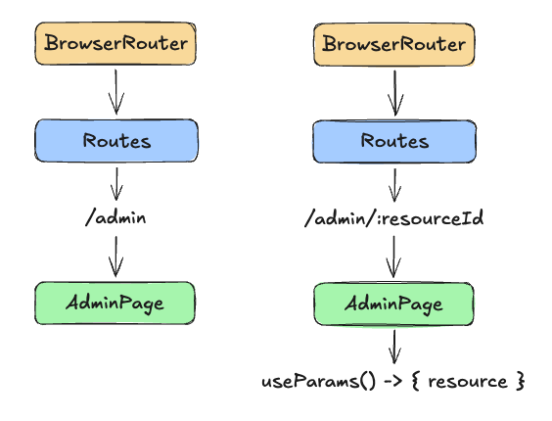
Visual comparison
The diagram to the right illustrates how static and dynamic routes differ in how they interpret the URL.
The same component can render different data depending on the route parameter.

Slide 11
Defining Dynamic Routes

Slide 12
Parameter syntax
Dynamic segments are defined using “:”.
Example:
<Route path="admin/:resourceId" element={<AdminPage />} />
Here:
admin is the static portion
:resourceId is the dynamic parameter

Slide 13
What React Router does
When a URL matches the route:
/admin/abc123
React Router extracts the parameter value:
resourceId = "abc123"
This value becomes available inside the component.

Slide 14
Reading Route Parameters

Slide 15
The useParams() hook
React Router provides a hook for accessing parameters.
import { useParams } from "react-router";
const { resourceId } = useParams();
useParams() returns an object containing the parameter values.

Slide 16
Example
If the URL is:
/admin/abc123
Then:
resourceId === "abc123"
This value can be used to:
load data
display details
control application state

Slide 17
Route‑Driven UI State

Slide 18
Using the URL as application state
Instead of storing state locally:
selectedResource = "abc123"
we can encode it directly in the URL:
/admin/abc123
This approach improves:
navigation
bookmarking
debugging

Slide 19
Benefits of route‑driven state
URLs represent the current view
State survives page refreshes
Links can be shared
Navigation becomes predictable
This pattern is very common in production applications.

Slide 20
Programmatic Navigation

Slide 21
The useNavigate() hook
React Router provides a way to change routes from code.
import { useNavigate } from "react-router";
const navigate = useNavigate();

Slide 22
Navigating to a dynamic route
Example:
function handleEdit(resource) {
navigate(`/admin/${resource.id}`);
}
This updates the browser URL and triggers a route change.

Slide 23
Dynamic Route Flow

Slide 24
Example flow
User clicks a resource
Application navigates to /admin/:resourceId
React Router extracts the parameter
Component reads it using useParams()
The UI renders the appropriate data
The URL drives the interface.

Slide 25
Nested Routing Review

Slide 26
Dynamic routes inside layouts
Dynamic routes often appear inside layout routes.
Example structure:
<Route path="/" element={<App />}>
<Route index element={<Home />} />
<Route path="admin" element={<AdminPage />} />
<Route path="admin/:resourceId" element={<AdminPage />} />
</Route>
The layout remains the same while the content changes.

Slide 27
Hands-on Practice
Exercise: Update the existing walkthrough project to make use of a route parameter to display the currently selected resource.
Objective: Implement dynamic client-side routing in an SPA
Obtain the exercise starter files
Add the necessary application route.
Access the route parameter on the page.
Display the correct resource based in the route parameter id.
Ask questions if you are unsure of what to do or how the code works.

Slide 28
Quick Poll

Slide 29
If a route is defined as:
<Route path="users/:userId" element={<UserPage />} />
What will useParams() return for the URL /users/42?
{ id: 42 }
{ userId: "42" }
{ user: "42"}
{ params: "42" }

Slide 30
Lesson Summary
In this lesson, we covered the following:
Define dynamic routes using URL parameters
Use the useParams() hook to read route values
Navigate programmatically using useNavigate()
Build route‑driven interfaces where the URL represents application state
Complete lesson 18 checklist

Slide 31
Exit Ticket
Explain:
What a dynamic route is
How useParams() retrieves route data
Why using the URL as application state can improve an application

