Slide 1
SDEV2150
Lesson 16: Component Lifecycle in React

Slide 2
Lesson Objectives
In this lesson, students will:
Explain the lifecycle of a functional component
Use useEffect to manage side effects
Control effect execution using dependency arrays
Implement cleanup logic correctly

Slide 3
Agenda
Review: State-driven rendering
Lifecycle mental model
What is a side effect?
useEffect syntax and patterns
Cleanup functions
Common mistakes
Exit ticket

Slide 4
Connecting

Slide 5
Review
Components re-render when state changes
Rendering should be pure
Custom hooks encapsulate logic
Question:
What kinds of tasks happen outside of rendering?

Slide 6
Lifecycle Mental Model

Slide 7
React function components follow a simple loop:
1. Render - React calls your function
2. Commit - React updates the DOM
3. Effect - React runs useEffect
Rendering computes UI.
Effects synchronize with the outside world.

Slide 8
Mount, Update, Unmount

Slide 9
Mount - Component appears in the DOM
Update - State or props change
Unmount - Component is removed
Effects allow us to respond to each phase.

Slide 10
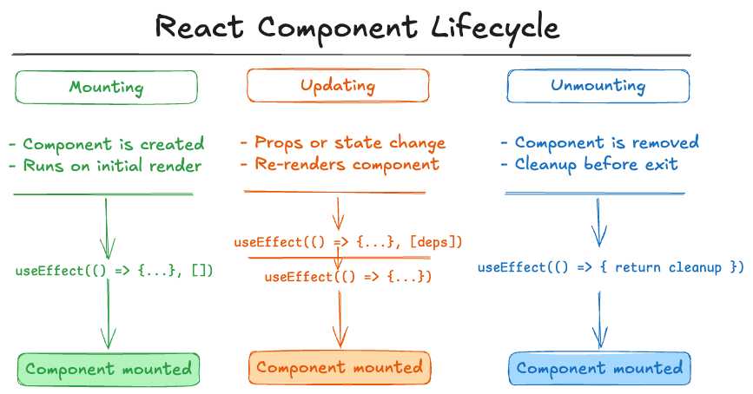
Mount, Update, Unmount

Slide 11
What Is a Side Effect?

Slide 12
A side effect is any code that:
Reaches outside the component
Performs asynchronous work
Mutates something external
Examples:
Fetching data
Setting timers
Subscribing to events
Writing to storage

Slide 13
INTRODUCING useEffect

Slide 14
Basic structure:
useEffect(() => {
// side effect logic
}, [dependencies]);
Runs after rendering
Dependency array controls when it re-runs

Slide 15
Dependency Array Patterns

Slide 16
Run once (on mount):
useEffect(() => {
// run once
}, []);
Run when value changes:
useEffect(() => {
// run when count changes
}, [count]);
Run every render:
useEffect(() => {
// no dependency array
});

Slide 17
Example: Timer Component

Slide 18
useEffect(() => {
const id = setInterval(() => {
setSeconds(prev => prev + 1);
}, 1000);
return () => {
clearInterval(id);
};
}, []);
Setup on mount.
Cleanup on unmount.

Slide 19
Cleanup Functions

Slide 20
If your effect:
Creates a subscription
Starts a timer
Registers an event listener
You must clean it up.
return () => {
// cleanup logic
};

Slide 21
Fetching Data with useEffect

Slide 22
Fetching is a side effect because:
It happens over time
It updates state when complete
Pattern:
useEffect(() => {
async function fetchData() {
const res = await fetch('/api');
const data = await res.json();
setData(data);
}
fetchData();
}, []);

Slide 23
Why Effects Must Be Predictable

Slide 24
Common mistakes:
Missing dependencies
Adding unnecessary dependencies
Causing infinite loops
Example infinite loop:
useEffect(() => {
setCount(count + 1);
}, [count]);

Slide 25
Stale Data Problem

Slide 26
If dependencies are incorrect:
Effects may use outdated values
UI can become inconsistent
Always include every external value used inside the effect.

Slide 27
Strict Mode Note

Slide 28
In development, React may run effects twice.
This is intentional.
It helps detect unsafe side effects.
Do not remove Strict Mode to “fix” it.

Slide 29
QUICK POLL

Slide 30
When does useEffect run if the dependency array is empty?
On every render
Only on mount
Only on unmount
Never

Slide 31
Hands-on Practice
Exercise: Refactor your existing exercise project to use the “useEffect” hook for any side effects
Objective: Implement the “useEffect” hook to manage side effects.
Obtain the exercise starter files
Create and use a custom hook function for fetching data.
Refactor any existing code that includes side effects.
Ask questions if you are unsure of what to do or how the code works.

Slide 32
Lesson Summary
In this lesson, we covered the following:
Explain the lifecycle of a functional component
Use useEffect to manage side effects
Control effect execution using dependency arrays
Implement cleanup logic correctly
Complete lesson 15 checklist

Slide 33
Exit Ticket
Write a short code snippet that:
Fetches data on mount
Cleans up a timer on unmount
Explain why cleanup is necessary.

