Slide 1

AI Today
The Artificial Intelligence Ecosystem

Slide 2
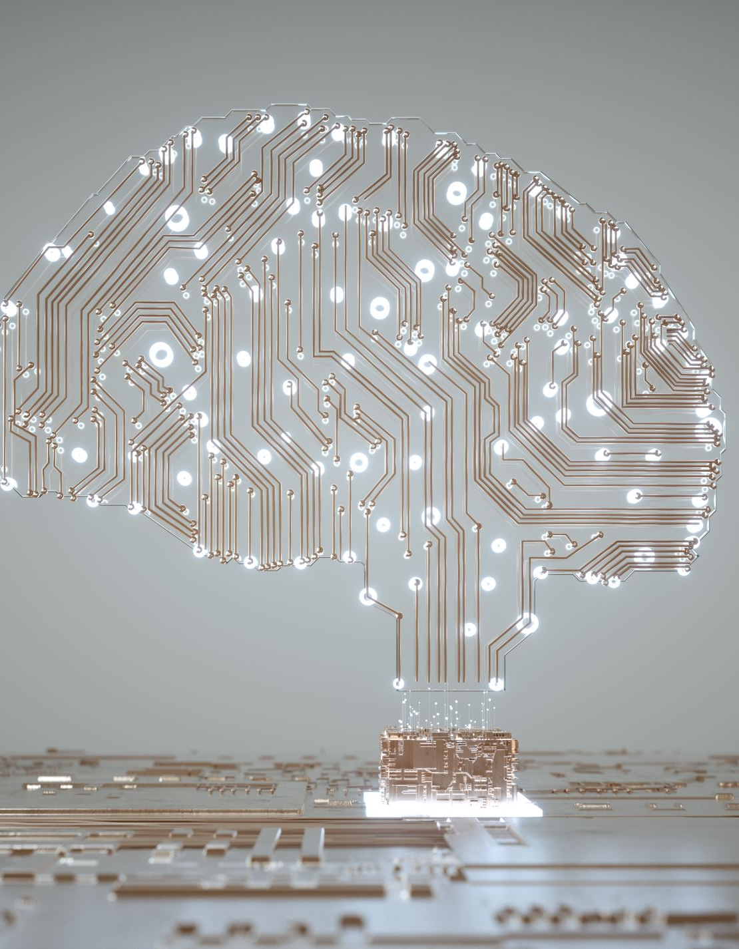
Overview of AI
Narrow AI vs. General AI
Key Fields of AI Application
Future of AI
Notes:
Introduce the distinction between Narrow AI and General AI.
Outline the significance of different AI applications in various fields.
Provide a roadmap of the presentation, highlighting the key AI technologies and their applications.

Slide 3

Narrow AI (Weak AI)
Designed and trained for a specific task
Virtual Assistants (e.g., Siri, Alexa)
Image Recognition (e.g., facial recognition)
Recommendation Systems (e.g., Netflix, Amazon)
Notes:
Define Narrow AI as AI systems designed and trained for specific tasks. They cannot perform tasks outside their predefined capabilities.
Examples:
- Virtual Assistants (e.g., Siri, Alexa): Utilize Natural Language Processing (NLP) and Machine Learning (ML) algorithms for voice recognition and response generation.
- Image Recognition (e.g., facial recognition): Powered by Convolutional Neural Networks (CNNs) for image analysis and pattern recognition.
- Recommendation Systems (e.g., Netflix, Amazon): Leverage collaborative filtering, content-based filtering, and hybrid methods using ML algorithms to predict user preferences.

Slide 4
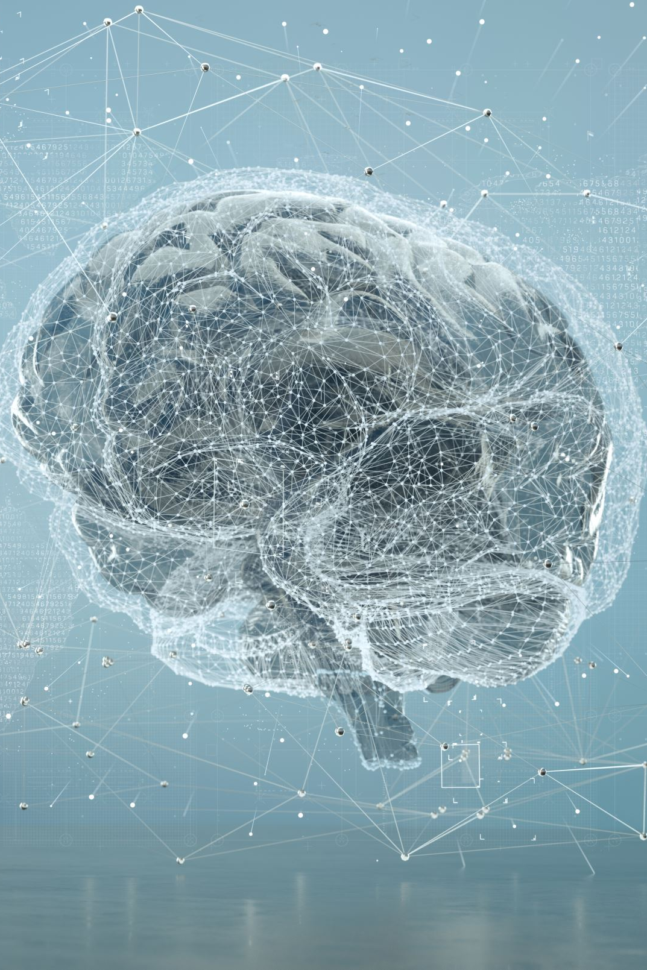
General AI (Strong AI)
AI systems with the ability to understand, learn and apply knowledge in a way that is comparable to human intelligence
Theoretical concept
Notes:
Define General AI as systems with the ability to understand, learn, and apply knowledge across various tasks at a human intelligence level.
Characteristics:
- Flexibility and adaptability.
- Ability to transfer knowledge between domains.
Currently theoretical, requiring advancements in algorithms, computational power, and understanding of human cognition.

Slide 5

Challenges in Achieving General AI
Technical and Computational Hurdles
Ethical and Societal Concerns
Research and Development Status
Notes:
Technical and Computational Hurdles: Need for advanced algorithms, massive computational resources, and extensive data.
Ethical and Societal Concerns: Aligning AI goals with human values, addressing job displacement, managing risks of autonomous systems.
Research and Development Status: Progress in areas like neural networks, reinforcement learning, and cognitive architectures, but true General AI remains distant.

Slide 6

Natural Language Processing (NLP)
Focuses on the interaction between humans and computers through natural language
Virtual Assistants (e.g., Siri, Alexa)
Chatbots (e.g., customer service bots)
Language Translation (e.g., Google Translate)
Notes:
Define NLP as AI focused on the interaction between computers and humans through natural language.
Examples:
- Virtual Assistants (e.g., Siri, Alexa): Use NLP for speech recognition and language understanding.
- Chatbots (e.g., customer service bots): Employ NLP for conversation simulation and customer interaction.
- Language Translation (e.g., Google Translate): Use sequence-to-sequence models and Transformer architectures for accurate translation.

Slide 7
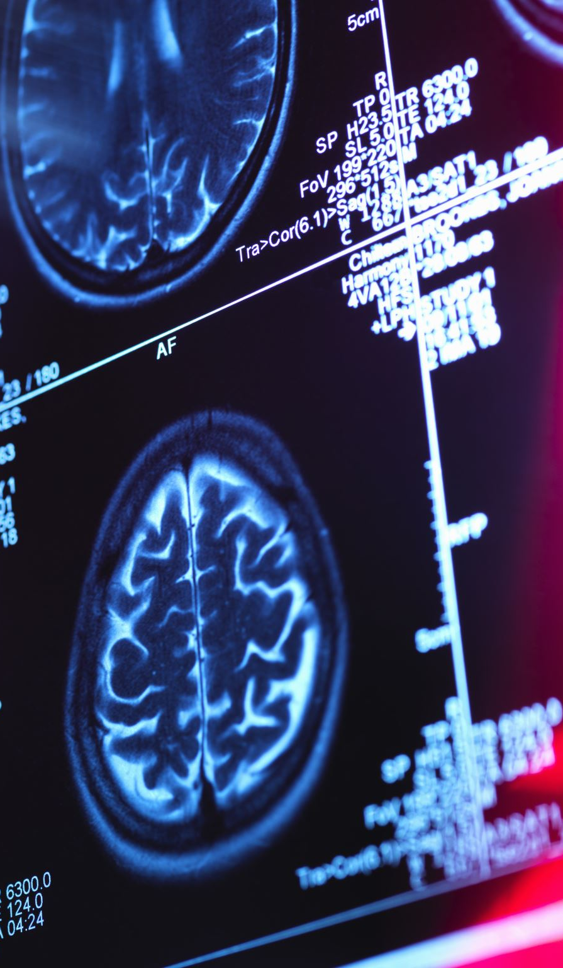
Image Detection and Processing
Focuses on interpreting and understanding visual information
Facial Recognition (e.g., security systems)
Medical Imaging (e.g., tumor detection)
Autonomous Vehicles (e.g., object detection)
Notes:
Define image detection and processing as AI that interprets and understands visual information.
Examples:
- Facial Recognition (e.g., security systems): Utilize CNNs for detecting and recognizing faces.
- Medical Imaging (e.g., tumor detection): Employ deep learning techniques for identifying anomalies in medical scans.
- Autonomous Vehicles (e.g., object detection): Rely on computer vision and sensor fusion, combining data from cameras, LiDAR, and radar for navigation and obstacle detection.

Slide 8
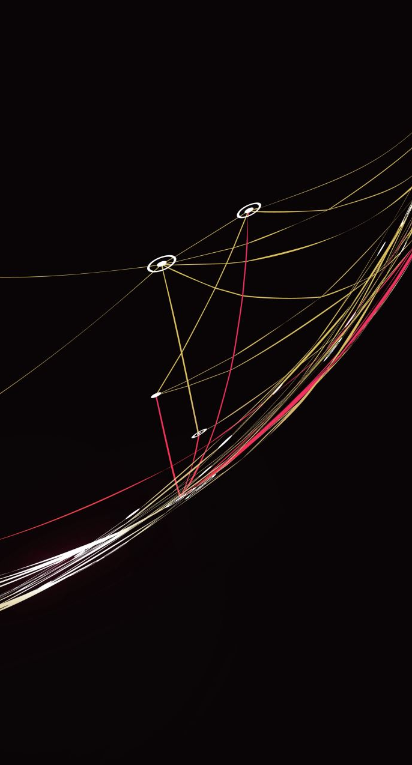
Generative AI
Focuses on creating new content from existing data using AI models
Art and Music Generation (e.g., AI-generated paintings, compositions)
Content Creation (e.g., GPT, Claude for writing text or code)
Synthetic Data Generation
Notes:
Define generative AI as AI that creates new content from existing data using models.
Examples:
- Art and Music Generation (e.g., AI-generated paintings, compositions): Use Generative Adversarial Networks (GANs) and Variational Autoencoders (VAEs) to create new artwork.
- Content Creation (e.g., GPT, Claude for writing text or code): Utilize Transformer-based models like GPT-3 for generating human-like text.
- Synthetic Data Generation: Use GANs to create realistic data for training other AI models.

Slide 9
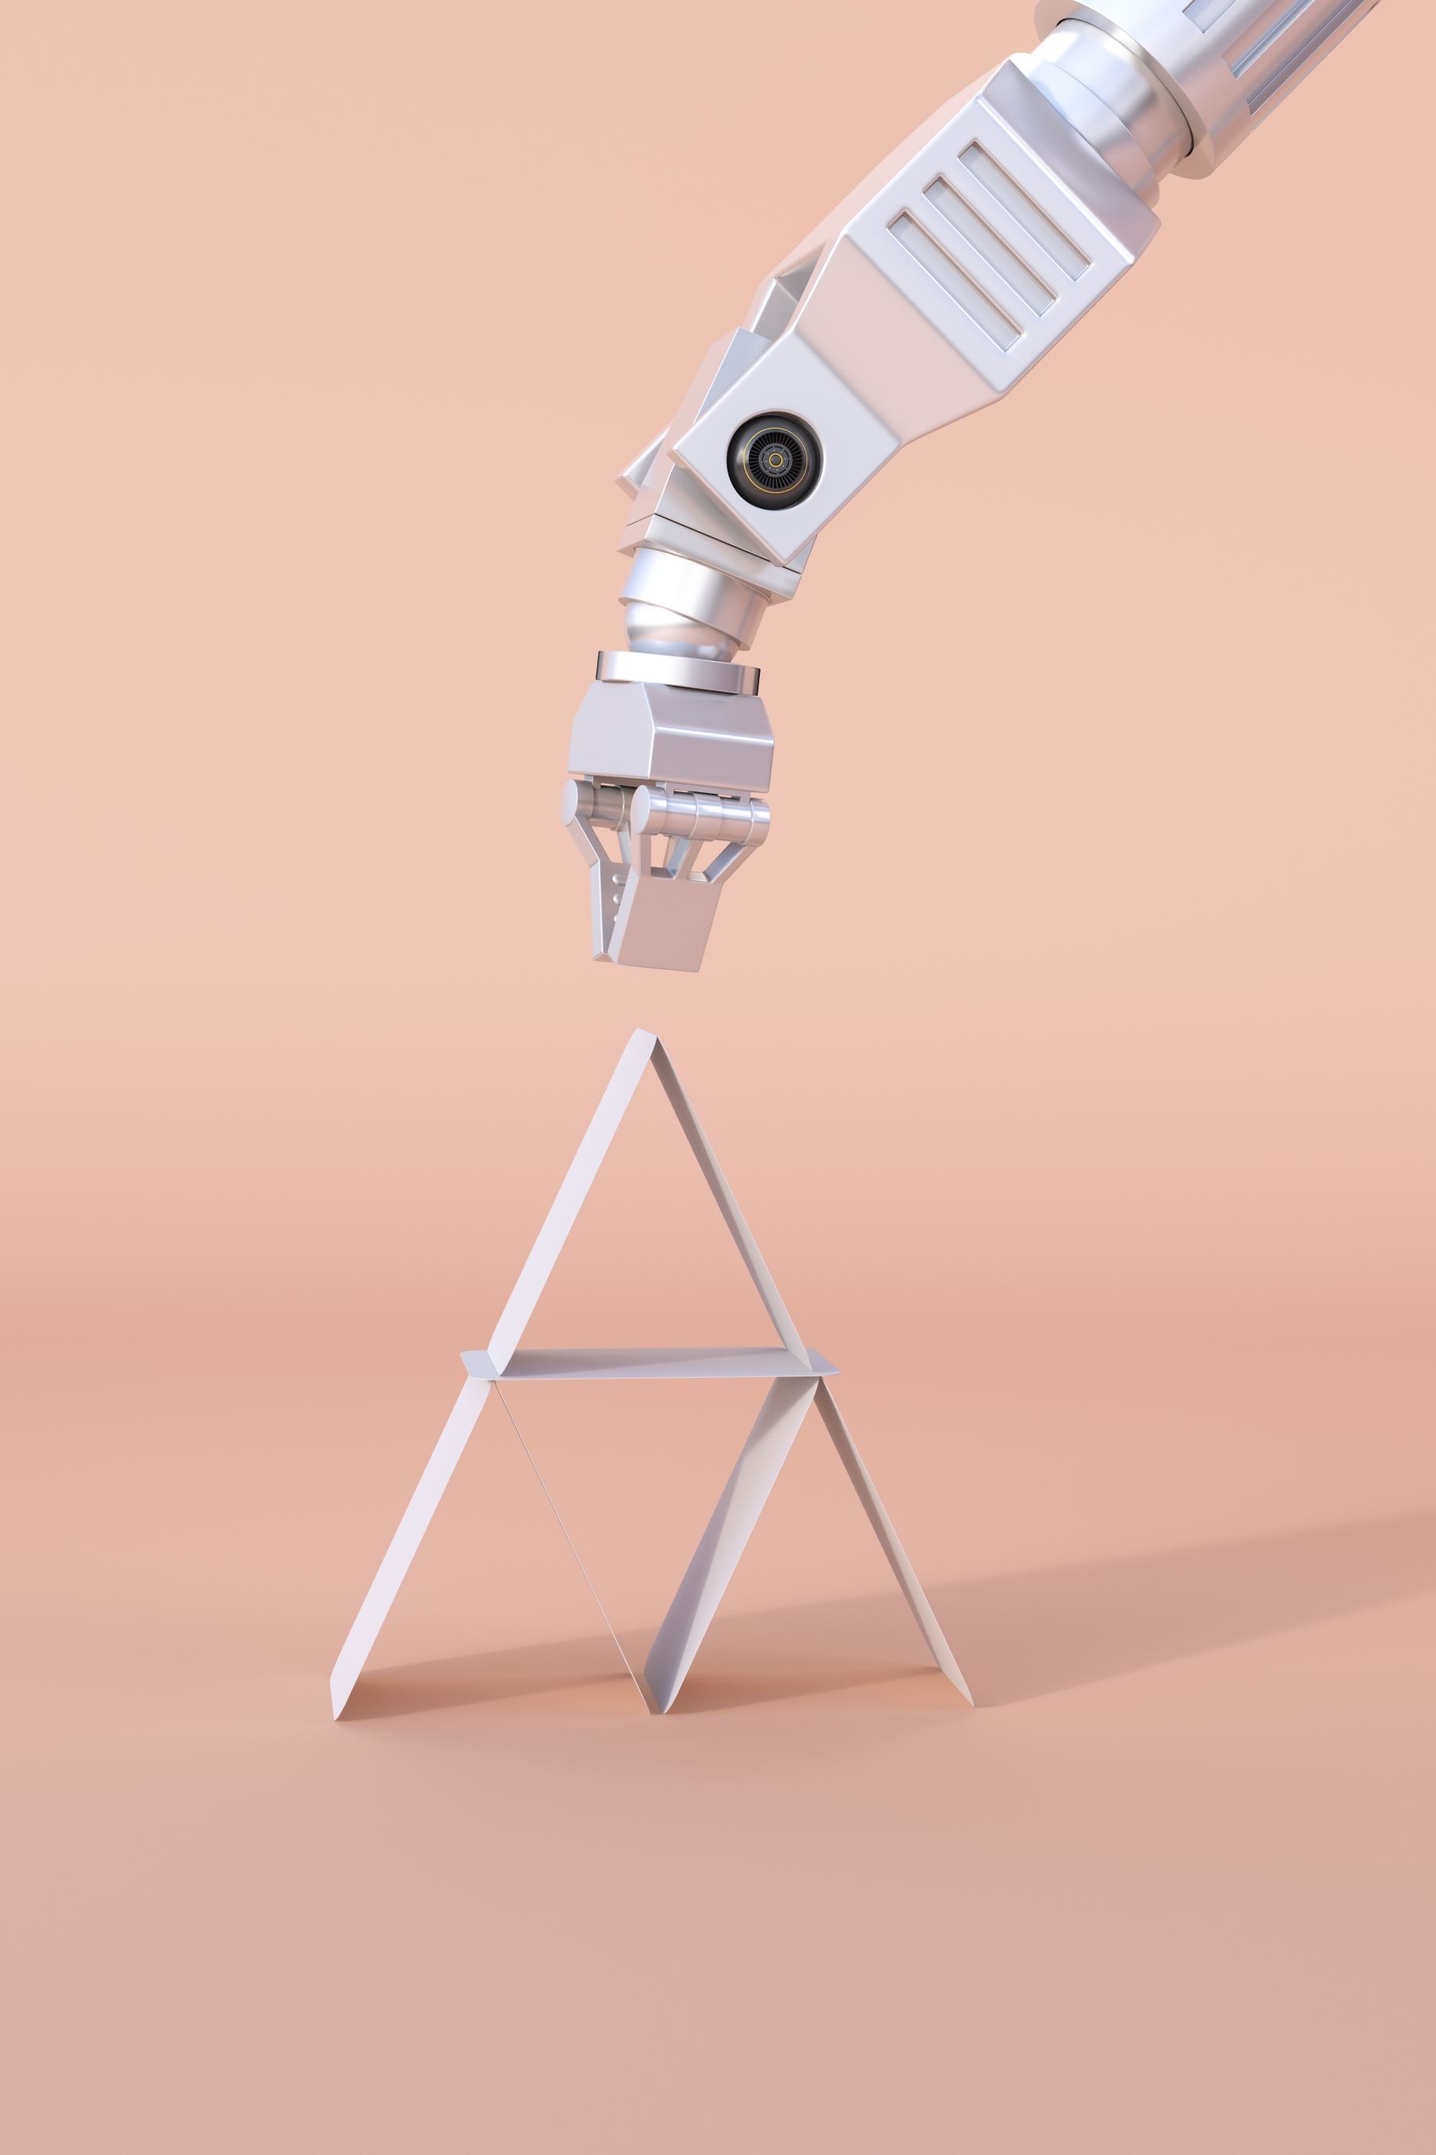
Autonomous Vehicles and Robots
Focuses on creating machines that can function without human interaction
Autonomous Vehicles (e.g. self-driving cars, delivery robots)
Industrial Robots (e.g. for dangerous tasks like welding or painting)
Drones (e.g. for surveillance or military functions)
Notes:
Autonomous Vehicles: Self-driving cars like those developed by Tesla and Waymo.Delivery Robots: Robots used by companies like Starship Technologies for delivering goods.Industrial Robots: Robots used in manufacturing for tasks like welding, assembly, and painting.Drones: Unmanned aerial vehicles used for surveillance, delivery, and agricultural monitoring.

Slide 10

AI in Healthcare
Predictive Analytics
disease outbreak prediction
Personalized Medicine
tailored treatment plans
Robotic Surgery
precision in surgical procedures
Notes:
Predictive Analytics: Utilize ML algorithms for predicting disease outbreaks and managing public health.
Personalized Medicine: Apply AI to patient data for creating tailored treatment plans using decision trees and clustering algorithms.
Robotic Surgery: Enhance precision in surgical procedures with AI-driven robotic systems, using real-time data and ML for improved outcomes.

Slide 11

AI in Finance
Fraud Detection
monitoring transactions
Algorithmic Trading
automated trading strategies
Customer Service
AI-driven chatbots
Notes:
Fraud Detection: Use anomaly detection algorithms and neural networks to monitor transactions and identify suspicious activities.
Algorithmic Trading: Employ ML and deep learning for automated trading strategies that maximize profits.
Customer Service: Implement AI-driven chatbots using NLP to handle routine inquiries and transactions efficiently.

Slide 12

AI in Entertainment
Recommendation Systems
Netflix, Spotify
Game AI
non-player characters in video games
Content Personalization
personalized news feeds
Notes:
Recommendation Systems: Use collaborative filtering, content-based filtering, and hybrid methods for suggesting movies, shows, and music based on user preferences.
Game AI: Develop more realistic and challenging non-player characters (NPCs) using reinforcement learning and procedural content generation.
Content Personalization: Tailor news feeds and social media content using ML algorithms to match individual interests.

Slide 13
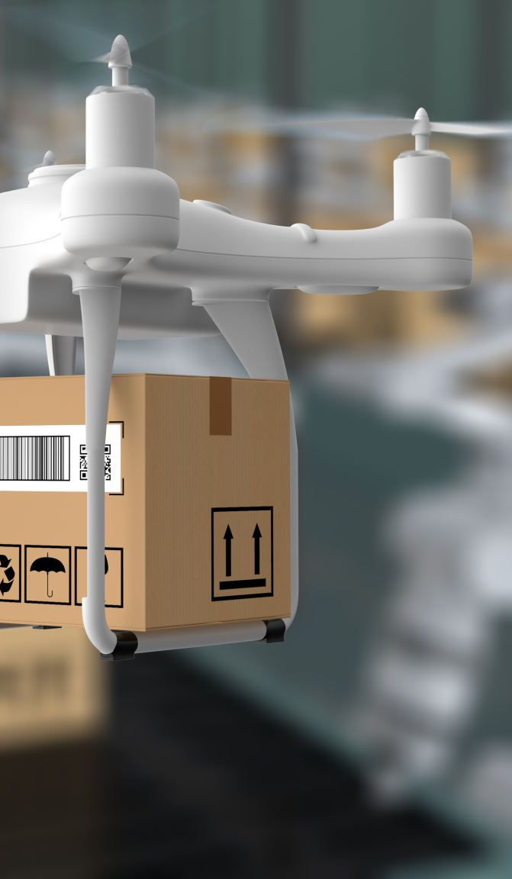
AI in Retail
Inventory Management
demand forecasting
Personalized Shopping Experiences
recommendation engines
Visual Search
finding products through images
Notes:
Inventory Management: Apply demand forecasting using time series analysis and ML to optimize stock levels.
Personalized Shopping Experiences: Use recommendation engines powered by collaborative filtering and ML to suggest products based on customer behavior.
Visual Search: Implement image recognition and computer vision to allow customers to find products by uploading images.

Slide 14

Future of AI
Upcoming Trends:
AI in Space Exploration
Advances in General AI Research
Integration into Daily Life
Explainable AI (XAI)
Quantum Computing
Potential Impacts:
Shaping the Economy
Transforming Society
Notes:
AI in Space Exploration: Autonomous rovers and satellites powered by AI for deep-space missions.
Advances in General AI Research: Progress towards creating AI systems with human-like intelligence.
Integration into Daily Life: Smarter personal assistants, more intuitive interfaces, and AI-driven automation in homes and cities.
Explainable AI (XAI):
Focus on making AI decision-making processes more transparent and understandable.
Increasing trust and usability for critical applications like healthcare and finance.
Potential Impacts
Shaping the Economy: New industries, job opportunities, and efficiencies.
Transforming Society: Ethical questions, improved quality of life, and changing human interactions with technology.
What is Quantum Computing?
A computing paradigm based on principles of quantum mechanics (e.g., superposition and entanglement).
Capable of processing complex computations exponentially faster than classical computers.
Quantum Computing’s Impact on AI
Faster Training of AI Models: Accelerates machine learning and deep learning processes.
Solving Complex Optimization Problems: Tackles tasks like logistics, resource allocation, and neural network optimization.
Improved Simulations: Enables realistic simulations for fields like climate modeling or molecular biology.
Real-World Example
Drug Discovery: Quantum AI accelerates molecular simulations to identify potential drug candidates faster. Companies like IBM and D-Wave are leading research in quantum-enhanced AI applications for healthcare and other industries.

Slide 15

And More
Every day new technologies are being developed!
Notes:
Emphasize that AI is an evolving field with new technologies being developed continuously.
Encourage staying updated with the latest advancements and their applications.

