Slide 1

Notes:
Hello.
Now, Map application, Navigation and National defence etc., Navigation Satelite System is indispensable item.
So, I talk about Japanses NSS, Michibiki.

Slide 2

Notes:
Do you know Mitibiki?

Slide 3
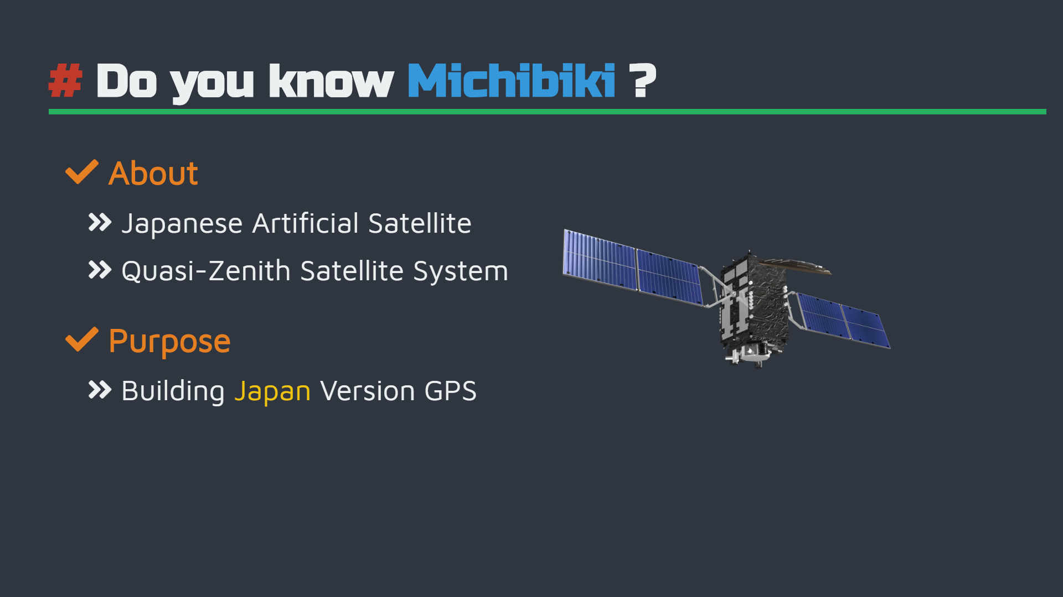
Notes:
Michibiki is Japanses Artifical Satelite. The Cabinet Office government of Japan launched to construct a system of Quasi-Zenith Satelite System(QZSS).
Purpose of GPS is Complements GPS for satelite positioning, navigation and timing service that is more precise and statble.

Slide 4
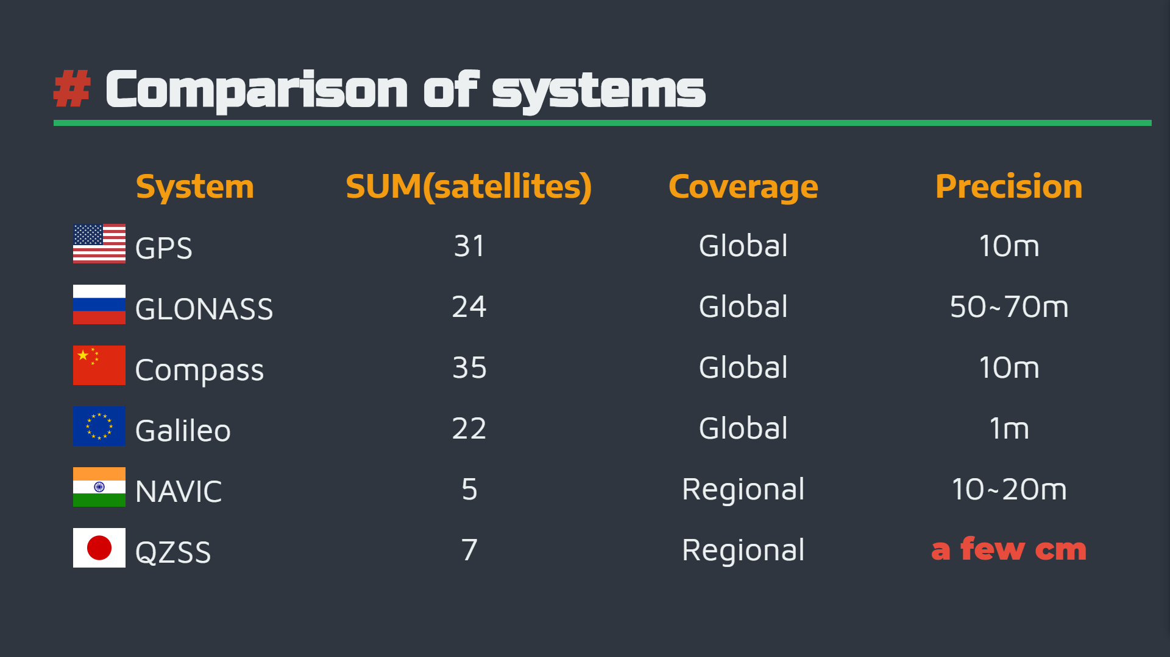
Notes:
Please have a look at this chart.
This is Navigation Satelite System of World.
In 2011 the Government of Japan has decided to accelerate the QZSS deployment in order to reach a 4-satelites constellation by the late 2010s, while aiming at a final 7-satelites constellation in the future.
GPS Precision is about 10m. But Michibiki is a few cm.
Government of Japan aims improve of QZSS accuracy.

Slide 5

Notes:
The system has merit and demerit.
About merit.
Services have always been offered in a statble way. and Increasing the nunber of QZSS to improve positioning errors!
But that has Demerit.
After all, very Expensive!

Slide 6

Notes:
This system costs 3 hundred billion!
But this system will givce you a good life.

Slide 7

Notes:
Thank you

